Slide 1


INTELLECTUAL PROPERTY: negative responses
Resolved: The United States federal government should significantly strengthen its protection of domestic intellectual property rights in copyrights, patents, and/or trademarks.
A look at negative responses, provided by Rich Edwards, Baylor University

Slide 2
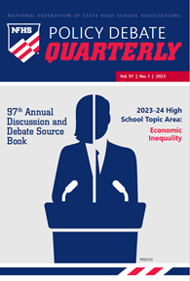

Negative toolbox
Topicality
Disadvantages
Case
Counterplans
Kritiks
A brief look at Disadvantages and Case Arguments will be provided here; see other NFHS slide series for Topicality and Counterplans. Kritiks are not acceptable in all parts of the country and will not be discussed here. Consult the NFHS publication, Policy Debate Quarterly #4 for a full discussion of negative options on the intellectual property topic.
https://www.nfhs.org/nfhs-for-you/speechdebate-theatredirectors-judges/policy-debate-quarterly

Slide 3
What are the elements of a disadvantage?
Uniqueness: Explain (with evidence) why the disadvantage is not happening in the present system.
Link: Explain (with evidence and/or by citing claims made in the Affirmative case) why the adoption of the plan will cause the disadvantage.
Impact: Establish (with evidence) why the disadvantage would cause great harm.

Slide 4
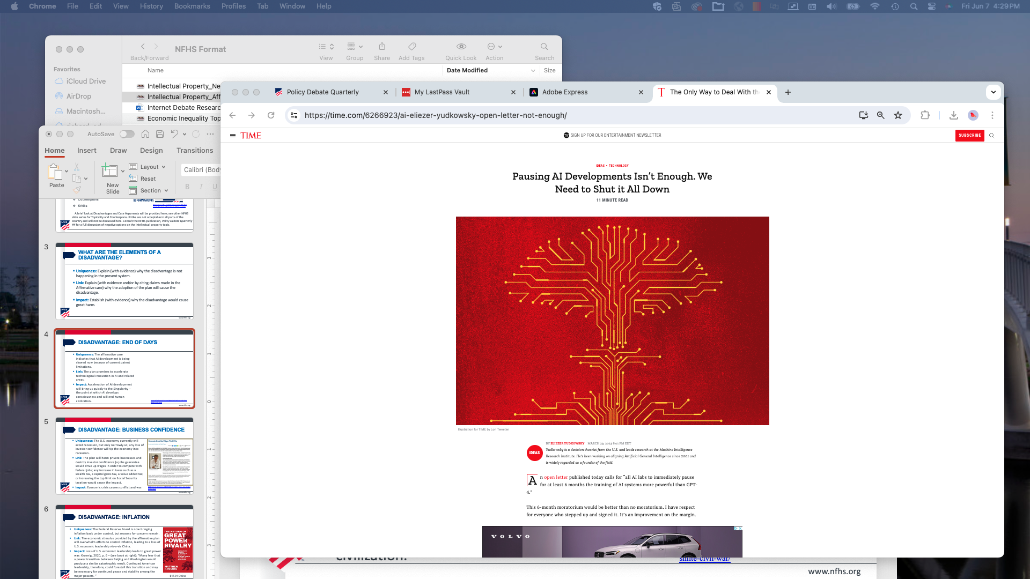
Disadvantage: End of Days
Uniqueness: The affirmative case indicates that AI development is being slowed now because of current patent limitations.
Link: The plan promises to accelerate technological innovation in AI and related areas.
Impact: Acceleration of AI development will bring us quickly to the Singularity – the point at which AI develops consciousness and will end human civilization.
Eliezer Yudkowsky, (Research Scientist, Machine Intelligence Research Institute)
Many researchers steeped in these issues, including myself, expect that the most likely result of building a superhumanly smart AI, under anything remotely like the current circumstances, is that literally everyone on Earth will die. Not as in “maybe possibly some remote chance,” but as in “that is the obvious thing that would happen.”
https://time.com/6266923/ai-eliezer-yudkowsky-open-letter-not-enough/

Slide 5
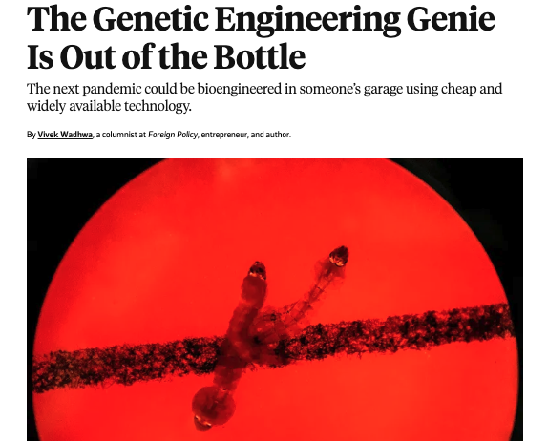
Disadvantage: GENETIC MODIFICATION RUNAMUCK
Uniqueness: The affirmative case claims that current patent law holds back genetic research.
Link: The plan will unleash genetic research from current limitations, leading to advances, possibly including germline genetic modification.
Impact: Genetic research and modification will lead to genetic selection, euthanasia, and perhaps to a pandemic that cannot be contained.
https://foreignpolicy.com/2020/09/11/crispr-pandemic-gene-editing-virus/

Slide 6
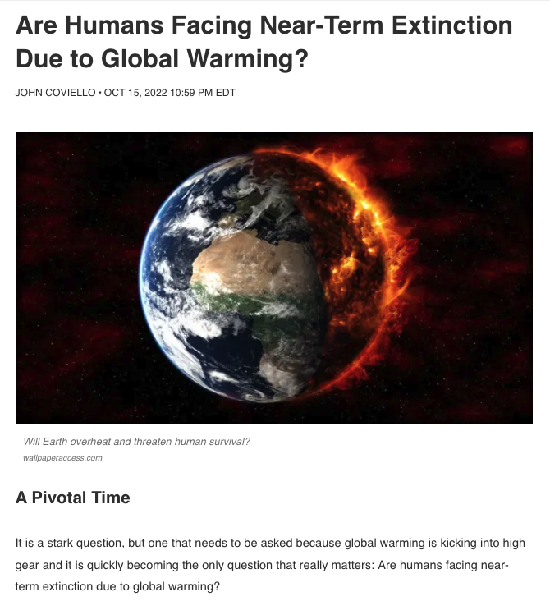
Disadvantage: GROWTH BAD
Uniqueness: The affirmative case establishes that technological innovation is currently lagging, hurting U.S. economic growth.
Link: The affirmative solvency argument claims that the plan will jump-start U.S. economic growth.
Impact: Increased economic growth will push the world past the brink for climate change, risking human extinction.
https://soapboxie.com/social-issues/Are-Humans-Facing-Near-Term-Human-Extinction-Due-to-Global-Warming

Slide 7
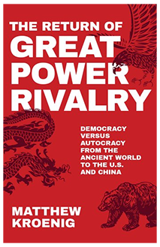
Disadvantage: INFLATION
Uniqueness: The Federal Reserve Board is now bringing inflation back under control, but reasons for concern remain.
Link: The economic stimulus provided by the affirmative plan will overwhelm efforts to control inflation, leading to a loss of U.S. economic leadership vis-a-vis China.
Impact: Loss of U.S. economic leadership leads to great power war: Kroenig, 2020, p. 6 – (see book at right): “Many fear that a power transition between Beijing and Washington would produce a similar catastrophic result. Continued American leadership, therefore, could forestall this transition and may be necessary for continued peace and stability among the major powers. “
$17.31 Online

Slide 8
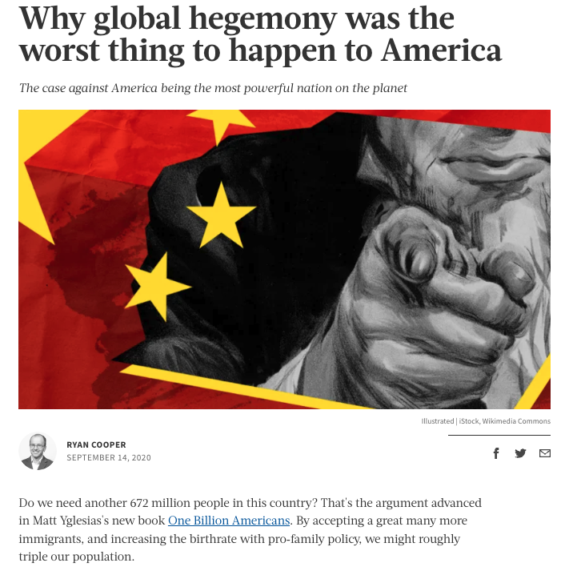
Disadvantage: U.S. Hegemony Bad
Uniqueness: The case claims that the U.S. is currently losing its leadership position on the world stage.
Link: The plan claims to restore and build U.S. soft power and leadership.
Impact: A U.S. return to world leadership and dominance results in unending wars.
https://theweek.com/articles/937094/why-global-hegemony-worst-thing-happen-america

Slide 9
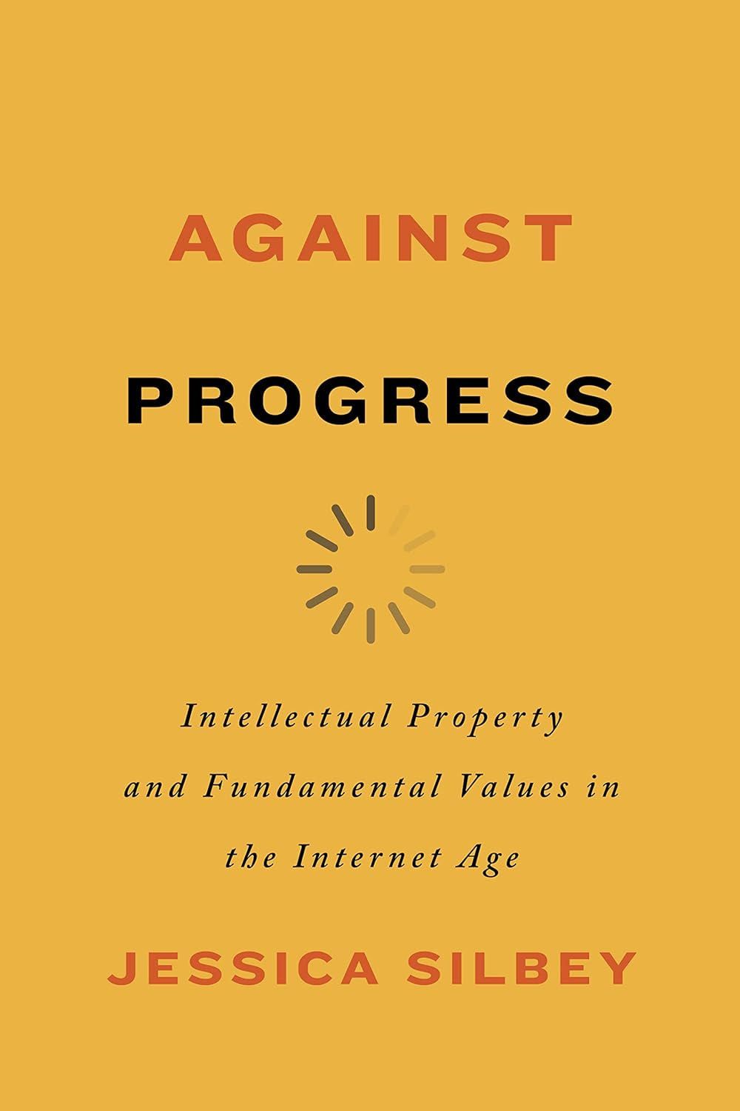
patent eligibility restoration act
Collaboration Is Best: Patents actually undermine research; openness and collaboration is the superior approach. The Myriad decision has created an international norm of collaborative research in genetics.
U.S. Gene/AI Science leads the world: We are now a full decade after the Mayo/Myriad/Alice decisions and the U.S. continues to lead the world in genetic/AI research.
Trolls: PERA will enable patent trolls.
$27.87 on Amazon

Slide 10
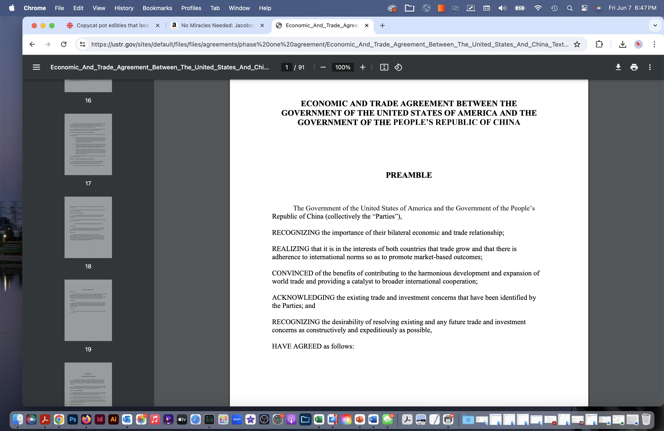
CHINA TECHNOLOGY CONTROL ACT
U.S. China Economic and Trade Agreement: This 2020 agreement provides an optimal solution to the U.S.-China trade dispute over intellectual property. It has a strong enforcement mechanism.
China IP Protection Strong Now: China pays significant royalties to U.S. companies doing business in China; Chinese law now protects IP; China itself files patents and trademarks in the U.S.
Trade Secrets are the major remaining problem: This is the 4th division of IP: Not copyrights, patents, or trademarks.
https://ustr.gov/sites/default/files/files/agreements/phase%20one%20agreement/Economic_And_Trade_Agreement_Between_The_United_States_And_China_Text.pdf

Slide 11
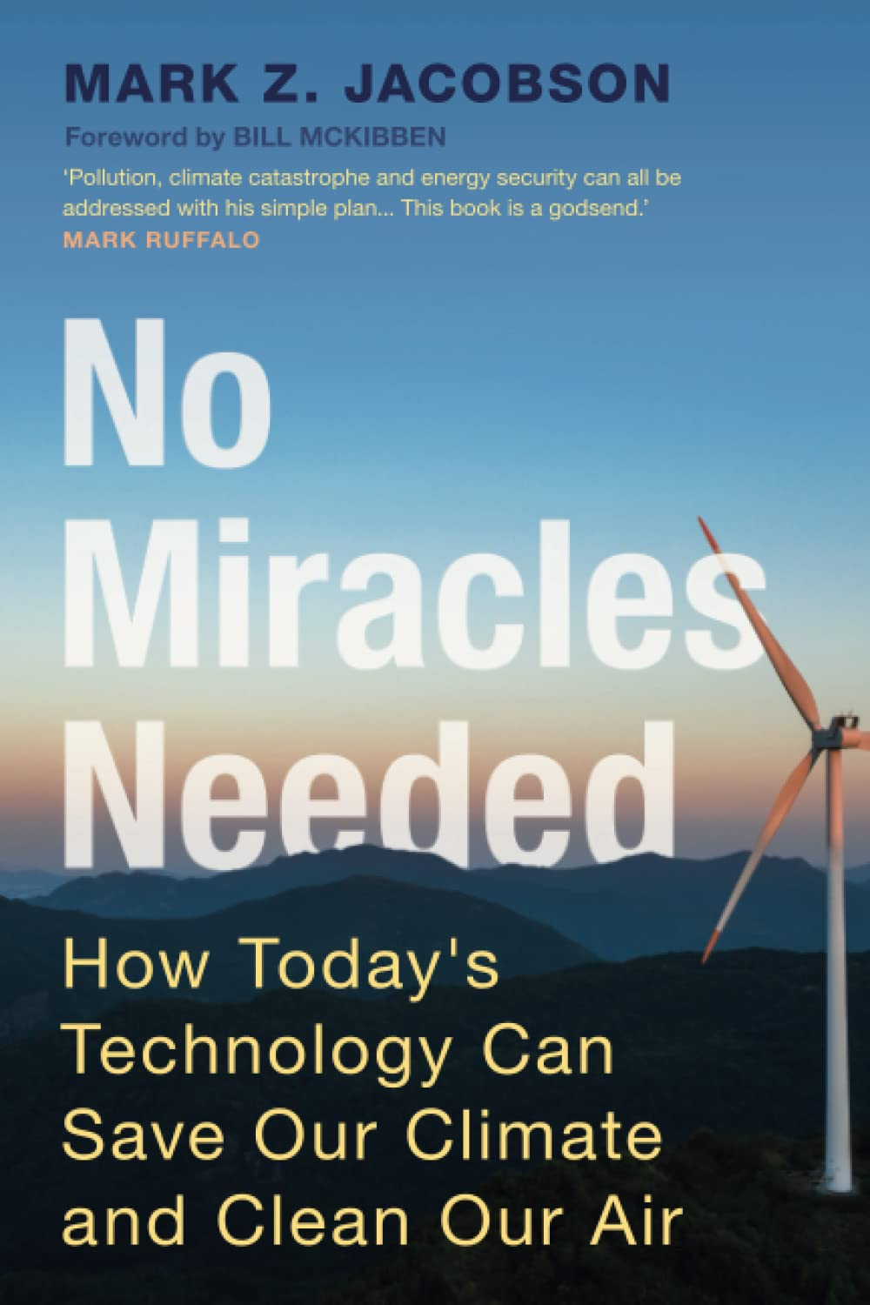
GREEN TECHNOLOGY PATENTS
No Tech Miracles Needed: We already have the renewable technologies to deal with climate change; the problem is not the lack of tech, but the lack of action.
Inflation Reduction Act: The federal government is now directing funding the green transition – hundreds of billions worth.
Geoengineering/CO2 Removal Risks: Geoengineering risks catastrophe; CO2 removal technologies actually sustain the continued use of fossil fuels.
$10.20 on Amazon

Slide 12
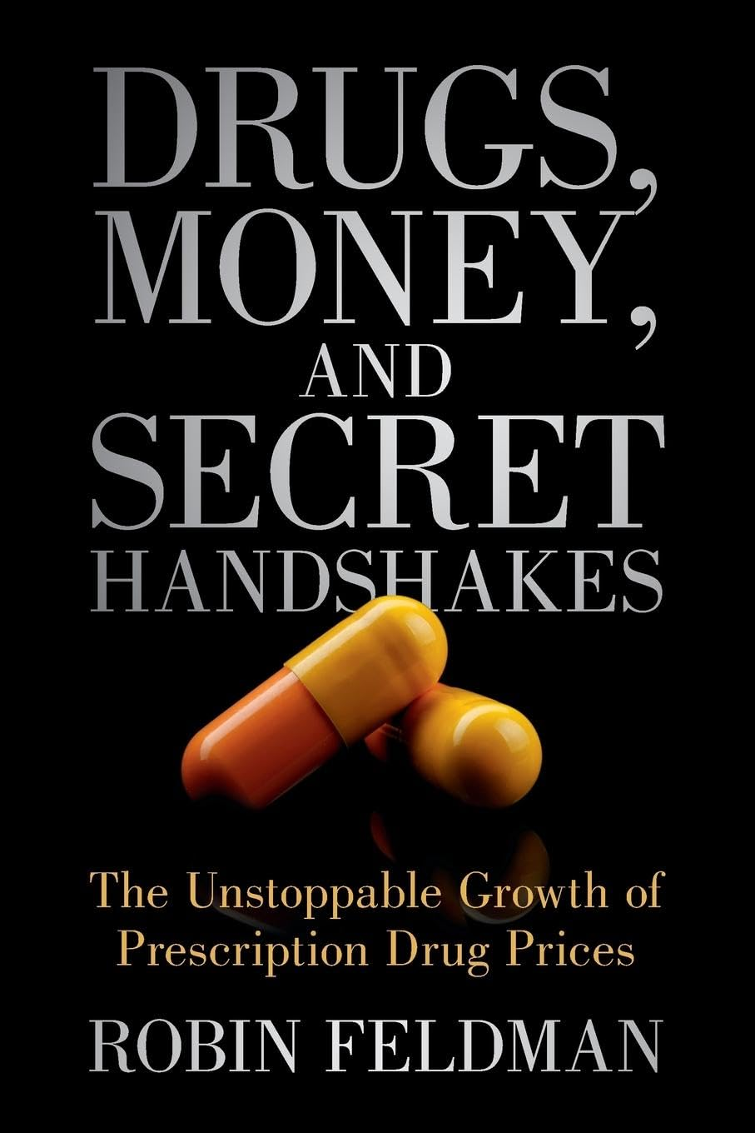
“March-In Rights” in the Bayh-Dole Act
Patents do not produce innovation: Pharmaceutical companies mainly use their huge profits to reward their stockholders; most research funding comes from the government.
Prices/profits are too high: Profits are too high and far out of line with other segments of the economy; some new drugs cost over $100,000 per year.
Patents block generics: Generic medications are essential to treat diseases in developing countries.
$18.60 on Amazon

Slide 13
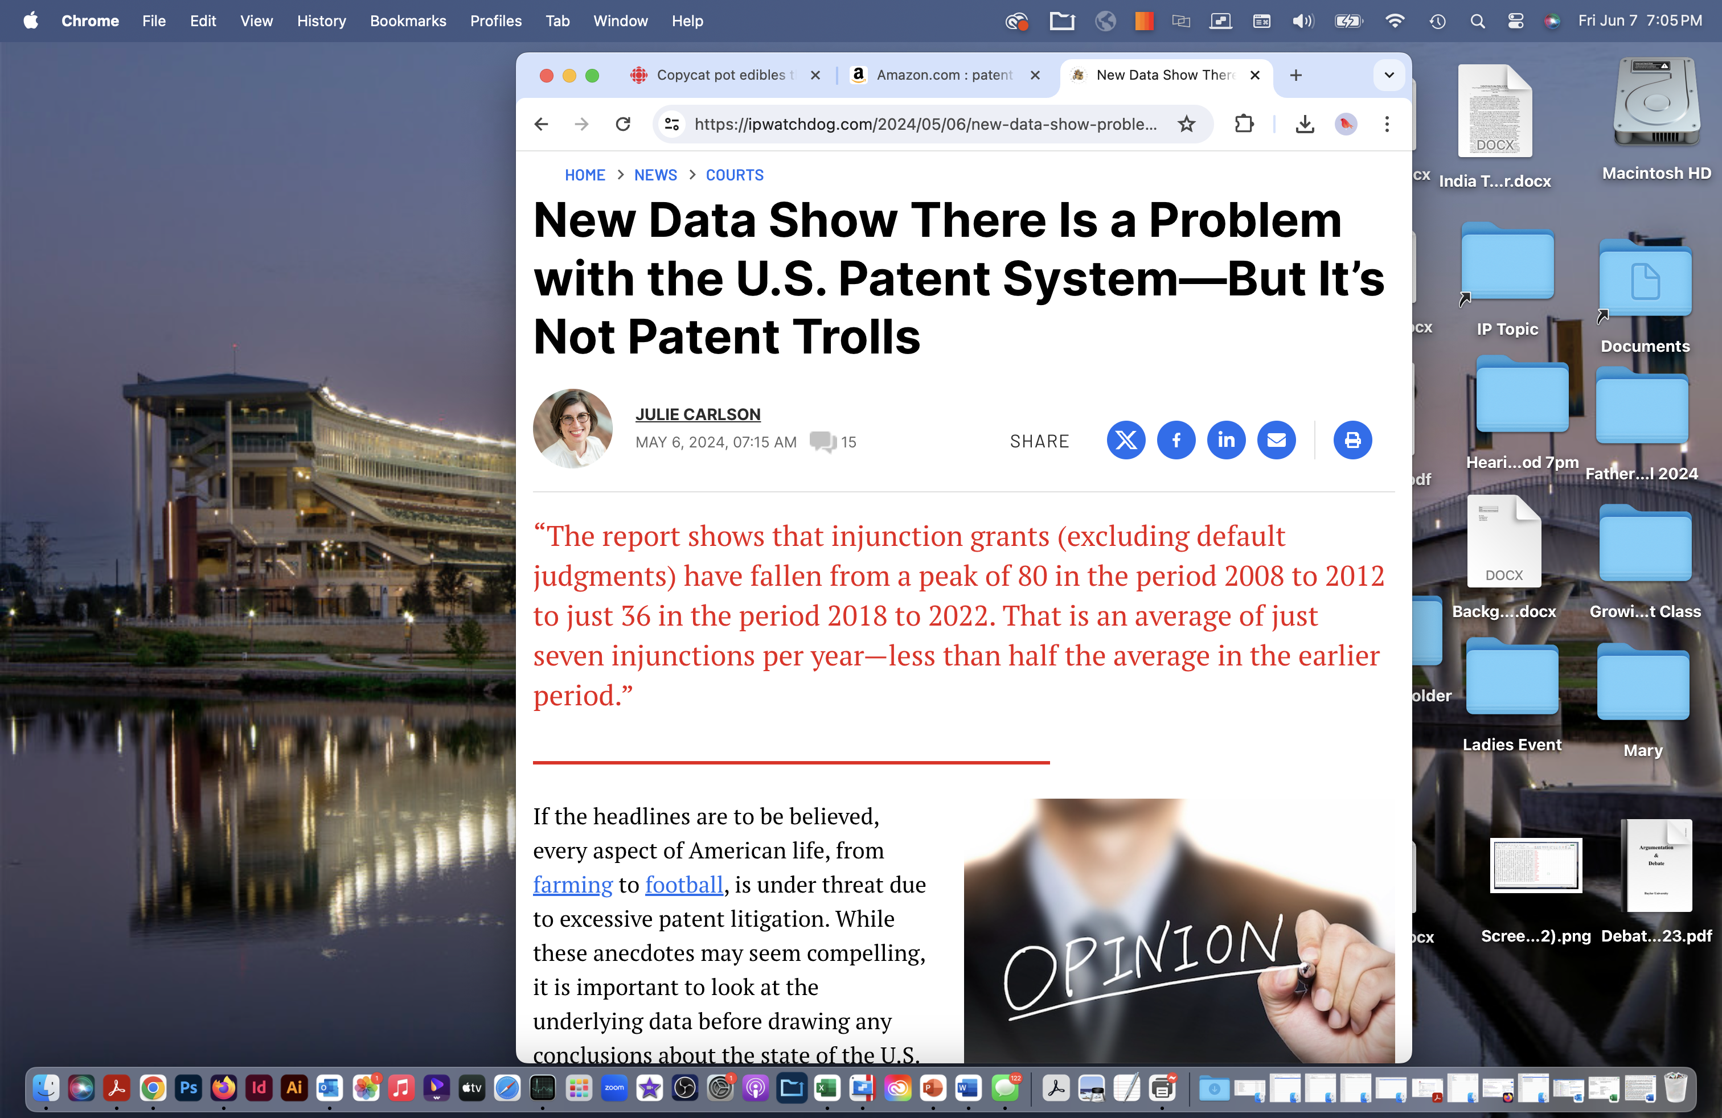
stopping patent trolls
The America Invents Act Properly Limits Patent Trolls: The AIA created review mechanisms: Inter Partes Review and the Patent and Trademark Appeal Board.
Exaggeration of the Problem: There is little evidence that patent trolls represent a significant problem.
Banning Cease and Desist Letters Wouldn’t Solve: This solution would push everyone to use the far more expensive court and patent review mechanisms.
“overall patent litigation is declining, injunction grants are low, and litigation by non-practicing entities (NPEs) is not pervasive.”
https://ipwatchdog.com/2024/05/06/new-data-show-problem-us-patent-system-not-patent-trolls/id=176149/#

Slide 14
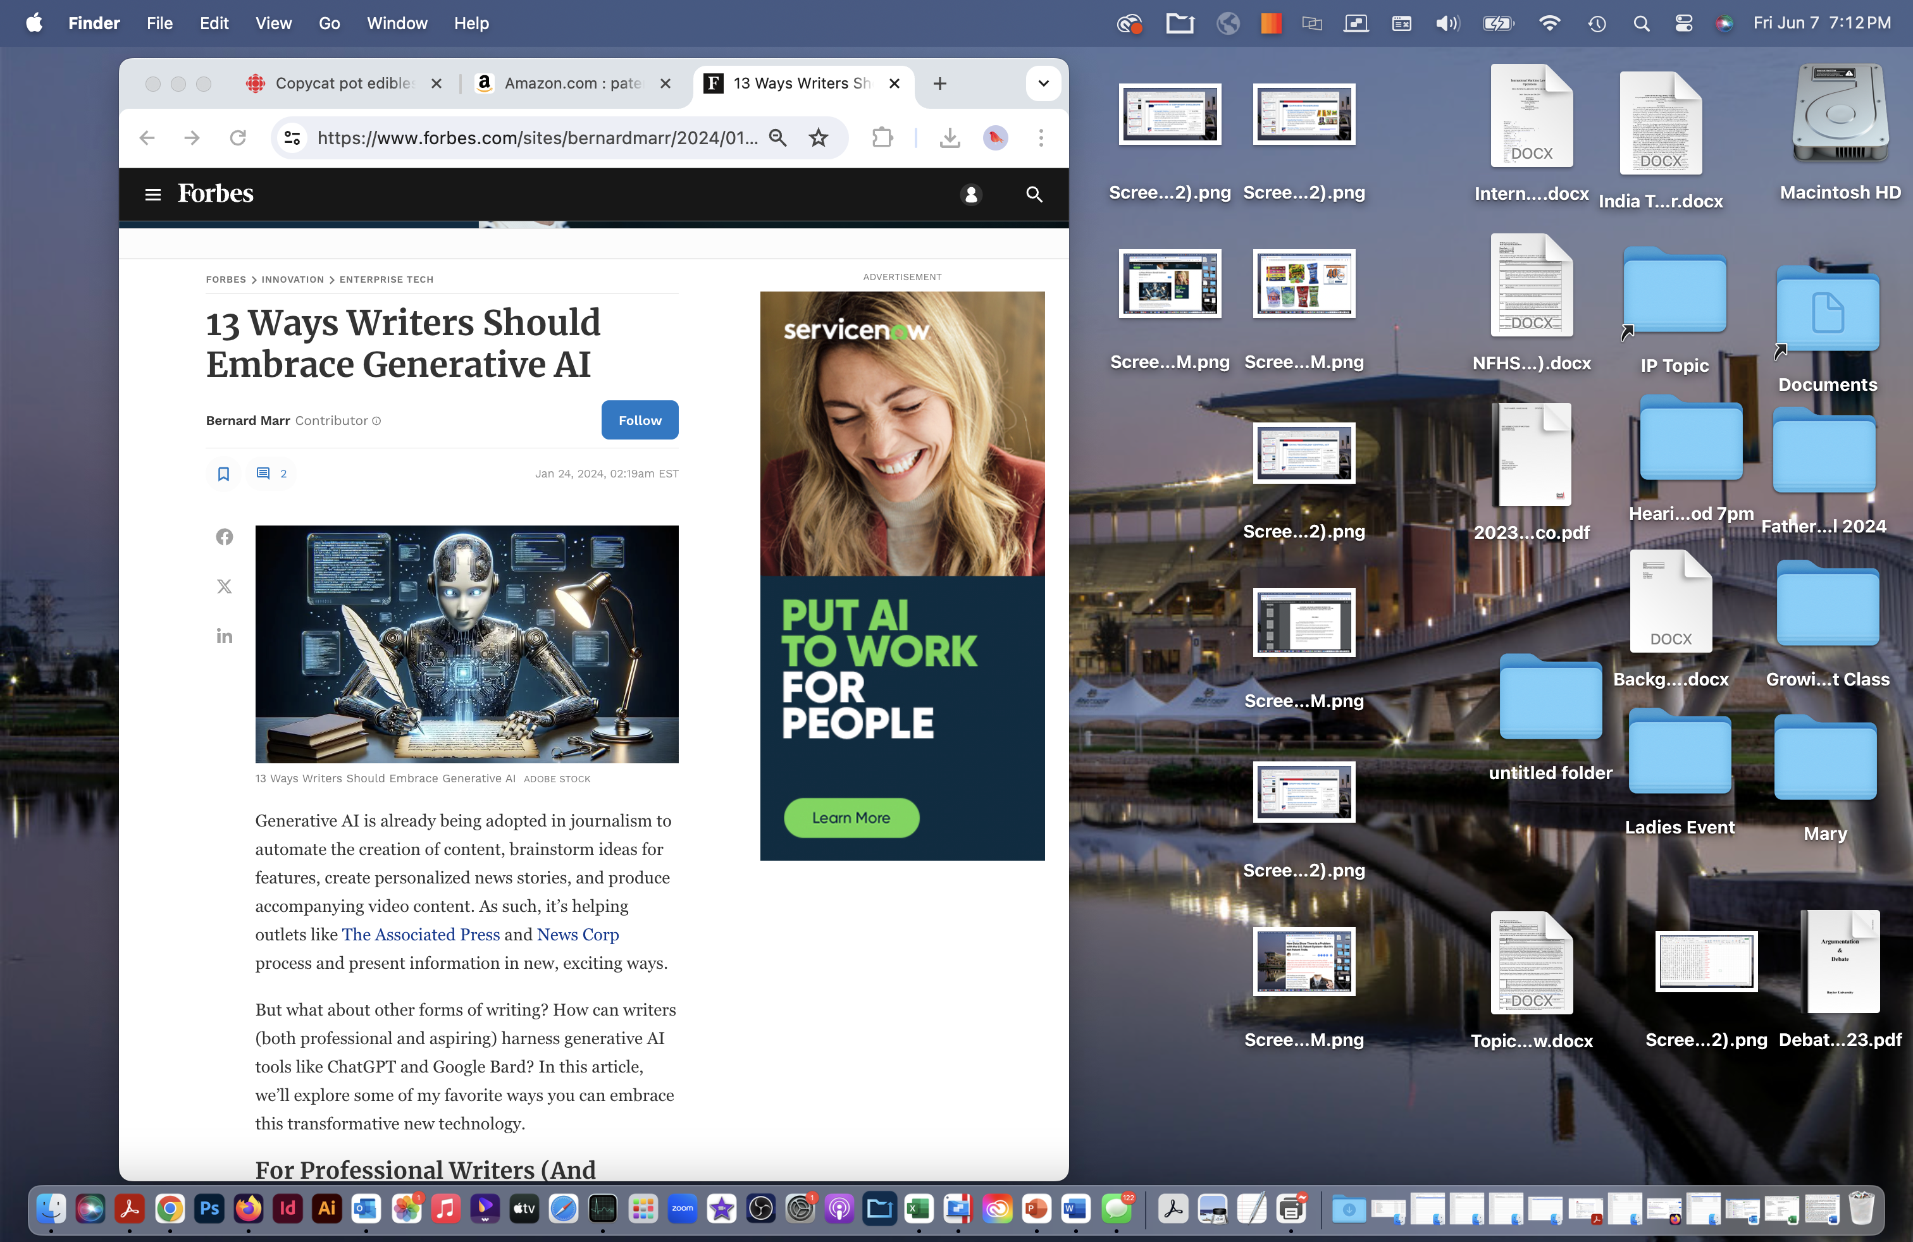
Generative AI Copyright Disclosure Act
No Copyright Violations: As several courts have now ruled, generative AI programs learn in the same way that human artists, musicians, and writers learn when they go to college – they learn from others. AI does not copy, but actually generates new material.
Useful Tool: Creatives report that they are discovering ways to become more efficient with the work that they do; it does mock-ups, it aids with brainstorming, it serves as an unpaid assistant.
Disclosure is unworkable: Copyrights do not have to be filed; impossible to notify billions of users.
https://www.forbes.com/sites/bernardmarr/2024/01/24/13-ways-writers-should-embrace-generative-ai/

Slide 15
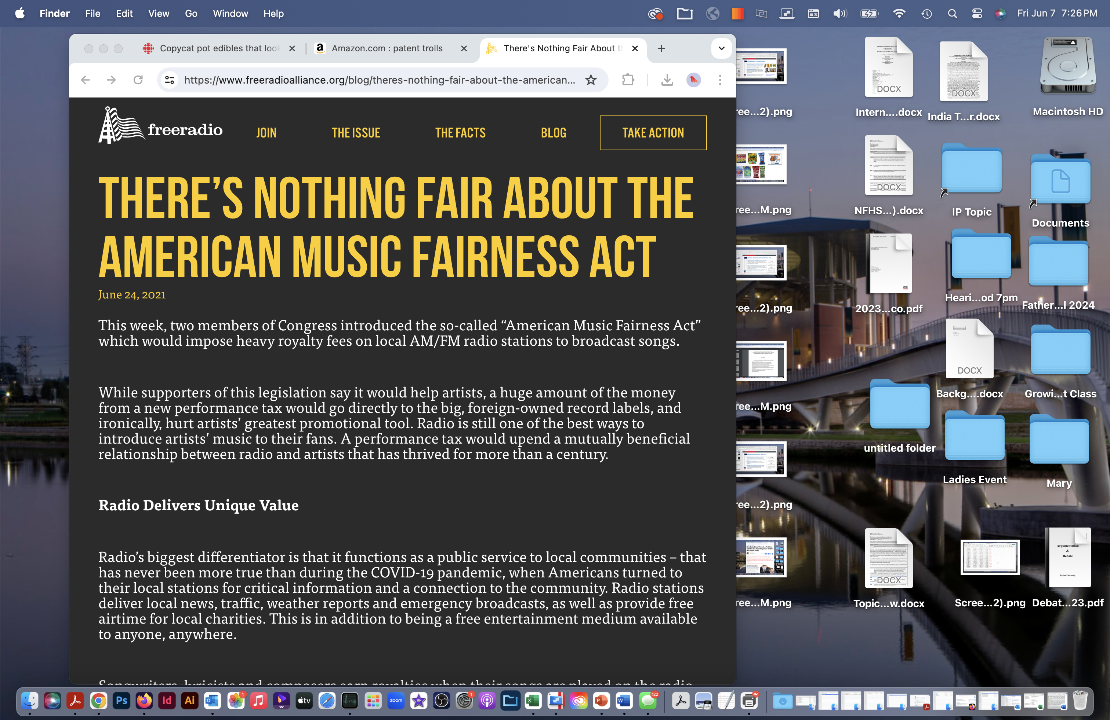
AMERICAN MUSIC FAIRNESS act
Terrestrial Radio Is Different From Streaming: St Terrestrial radio is free; streaming services are not. Terrestrial radio is required to perform public services (emergency services, weather notifications, etc.), streaming services do not have these requirements.
Fair Compensation: The Playing music on AM/FM radio has historically served the financial needs of musical performers, offering exposure, concert announcements, etc.
https://www.freeradioalliance.org/blog/theres-nothing-fair-about-the-american-music-fairness-act/

Slide 16
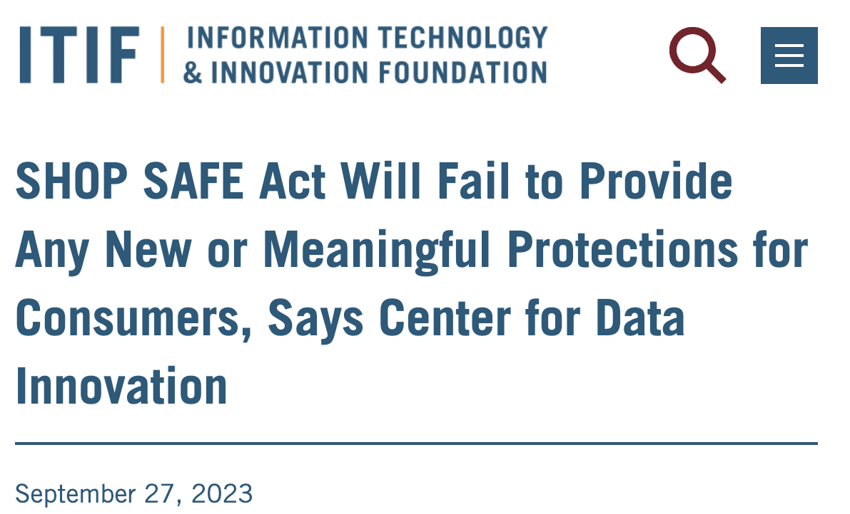
SHOP SAFE Act
Losses Are Exaggerated: No reason to presume consumers would spend the additional money to buy the real brand names, but the loss figures assume this.
Large Penalties Under Existing Law: The Trademark Enforcement Act, the Stop Counterfeiting in Manufactured Goods Act, and the Prioritizing Resources and Organization for Intellectual Property Act all criminalize counterfeit sales.
Criminalizing Internet Providers Is a Bridge Too Far: Section 230 of the Communication Decency Act creates the “Safe Harbor” provision; it should be maintained.
Provisions in the SHOP SAFE Act would make online shopping more of a hassle without even bolstering safety in e-commerce. American consumers opt to shop online due to the convenience, selection, savings, and safety. However, the SHOP SAFE Act would create additional barriers for sellers and platforms, ultimately reducing consumers’ options for online shopping, without providing any new or meaningful protections for consumers.
https://itif.org/publications/2023/09/27/shop-safe-act-will-fail-to-provide-any-new-or-meaningful-protections-for-consumers-says-center-for-data-innovation/

Slide 17
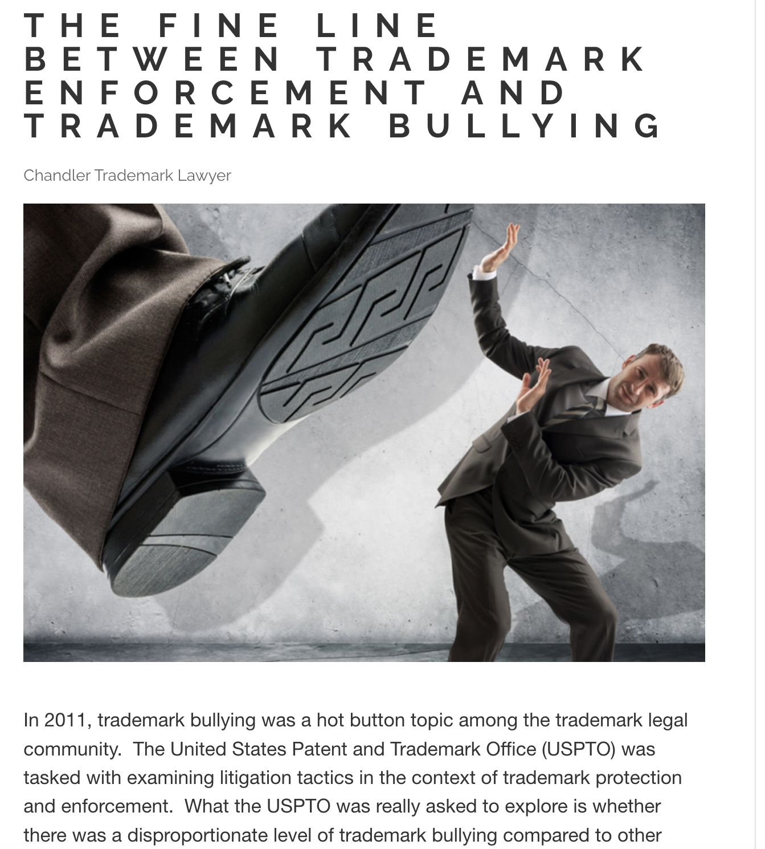
Trademark bullies
Shaming Provides Protection Against Bullying: Social media mechanisms give small companies a defense mechanism that costs them almost nothing.
Razor’s Edge: Current trademark law contains a “laches” provision – meaning that any trademark infringement that is ignored over a period of time can now not be challenged. This forces trademark holders to aggressively defend their mark or risk losing it. The affirmative plan creates a razor’s edge because now trademark holders can lose their mark if they aggressively defend it.
https://chandlertrademarklawyer.com/project/the-fine-line-between-trademark-enforcement-and-trademark-bullying/

Slide 18
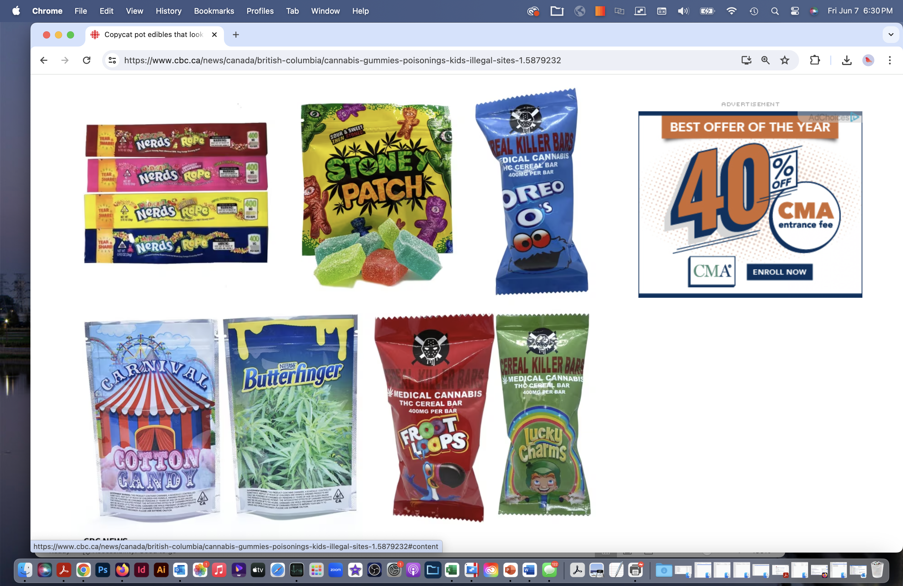
cannabis trademarks
Cannabis Companies Are Themselves Notorious for Trademark Infringement: Major brands are GSC (Girl Scout Cookies), Fruity Pebbles, Gorilla Glue, Stoney Patch Kids, Keef Kat, Froot Loops, Lucky Charms, Nerds, Oreo-O’s.
Long-Standing Precedent: In numerous other cases, the US has not allowed trademark filings for the sale of illegal products – this would set a bad precedent.
Promotion of Sales: Issuing a trademark would promote sales of products that are harmful.
https://www.cbc.ca/news/canada/british-columbia/cannabis-gummies-poisonings-kids-illegal-sites-1.5879232

Slide 19
INTELLECTUAL PROPERTY: NEGATIVE

