Slide 1


INTELLECTUAL PROPERTY: Affirmative
Resolved: The United States federal government should significantly strengthen its protection of domestic intellectual property rights in copyrights, patents, and/or trademarks.
A look at possible affirmative cases, provided by Rich Edwards, Baylor University

Slide 2
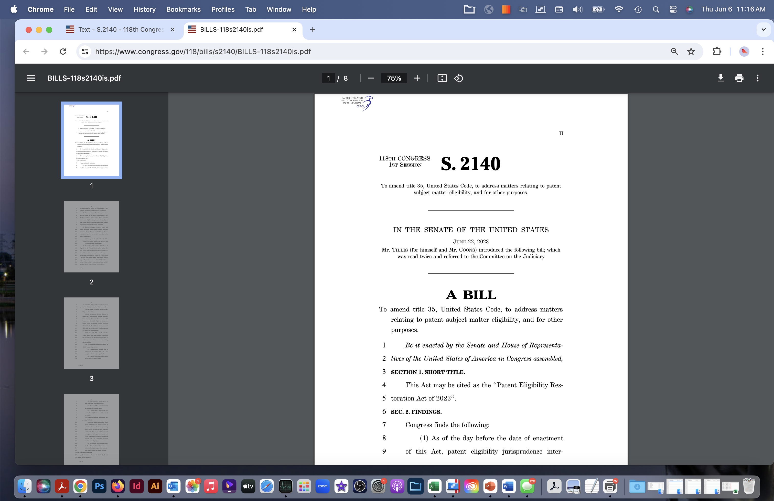
patent eligibility restoration act
Harm: Patent uncertainty undermines U.S. innovation in genetic research, biologics, AI, and other high tech areas; this uncertainty undermines investment; key research centers are moving overseas.
Inherency: Recent Supreme Court decisions (Mayo, Myriad, Alice) have made undermined patent certainty.
Solvency: The Patent Eligibility Restoration Act (PERA) would re-establish certainty, promote investment in high tech areas, and restore U.S. leadership.

Slide 3
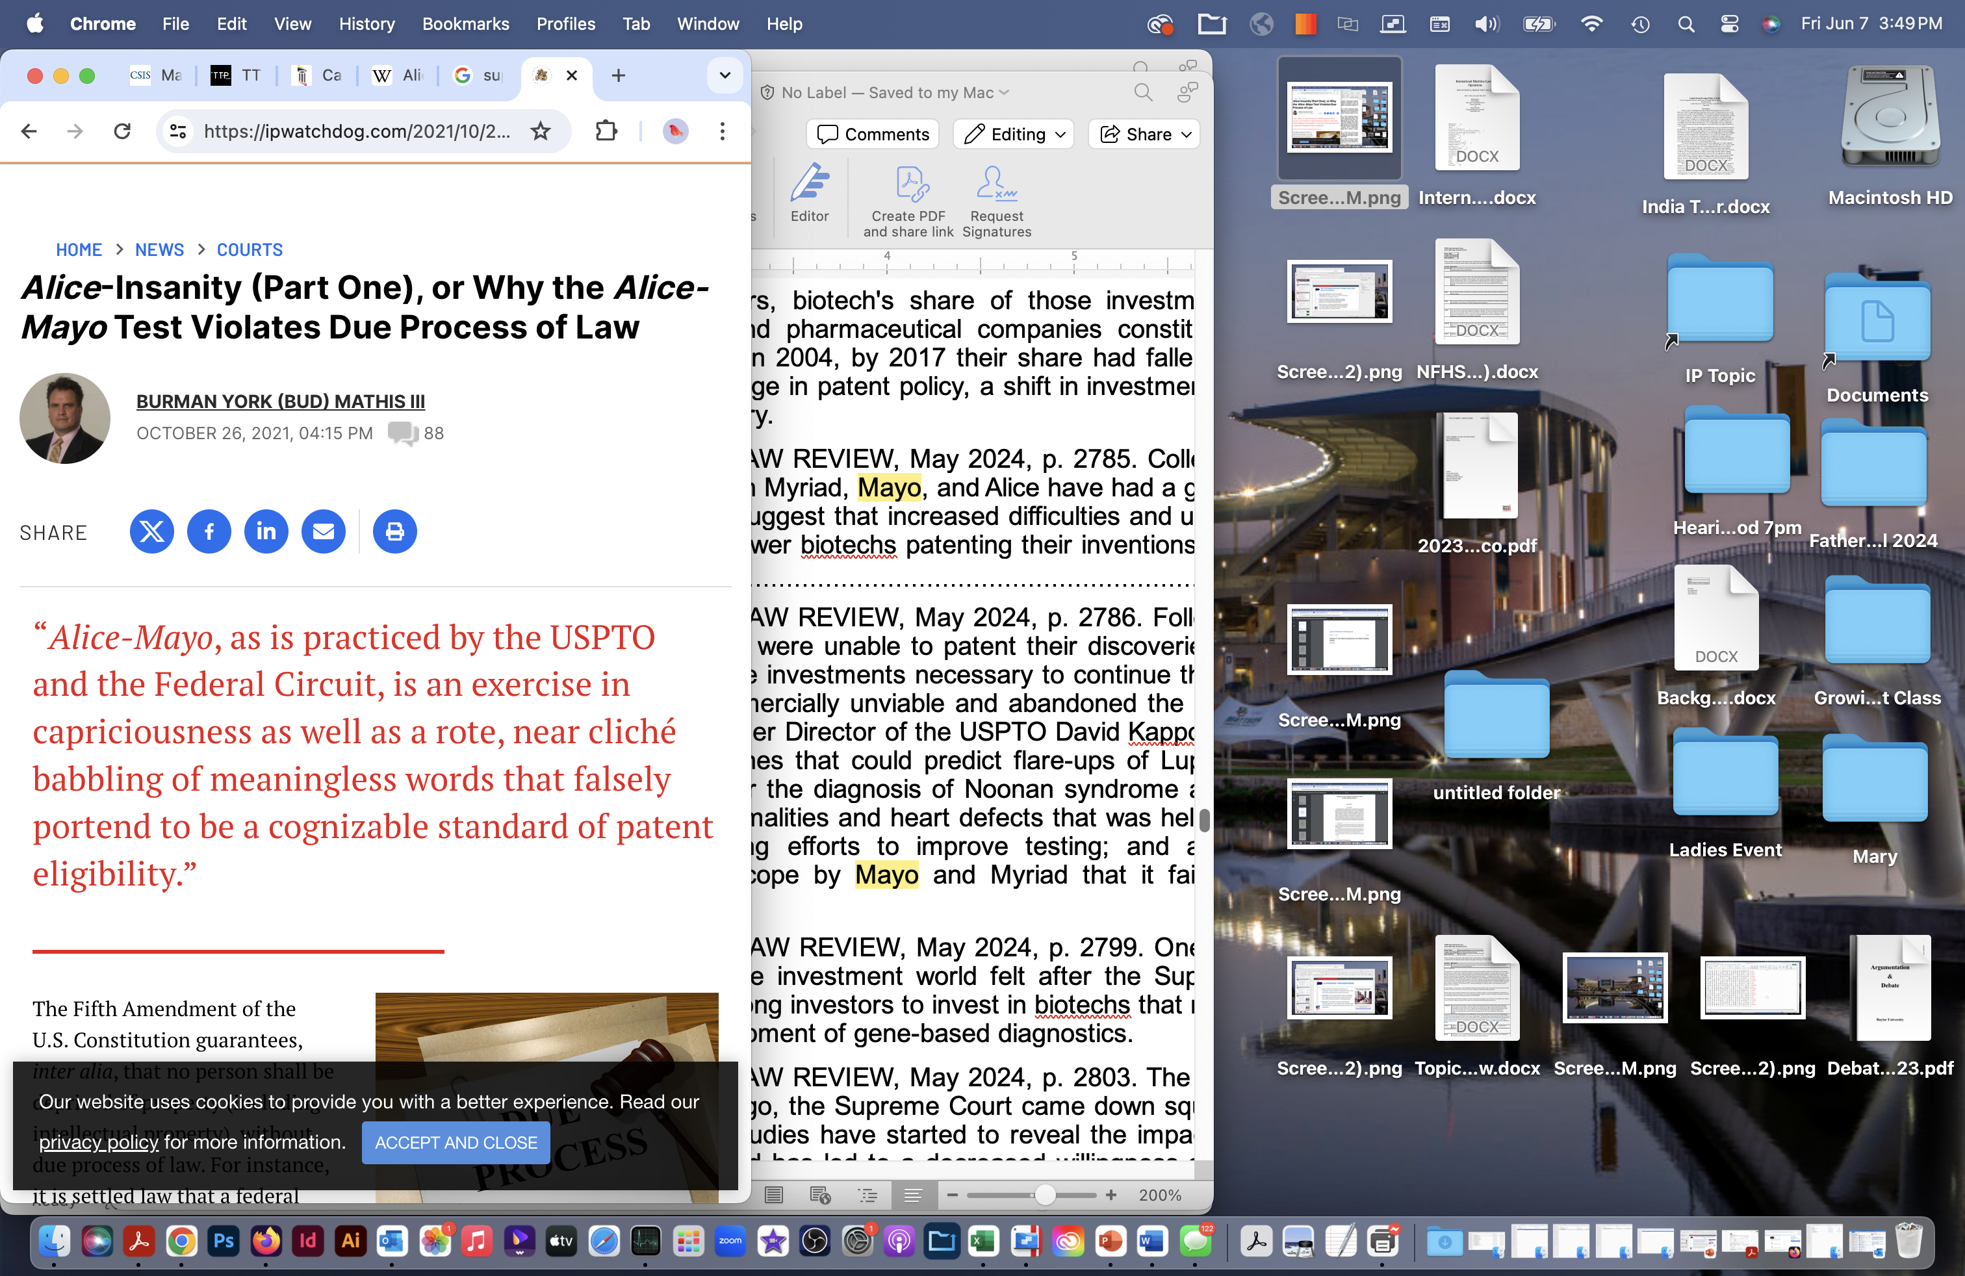
key supreme court cases dealing with patents
Mayo: Mayo Collaborative Services v. Prometheus Laboratories, Inc. (2012): Processes that target the application of natural law are not eligible for patents.
Myriad: Association for Molecular Pathology v. Myriad Genetics, Inc. (2013): Discoveries of gene sequences & genetic tests not available for patent protection.
Alice: Alice Corp. v. CLS Bank International (2014): An abstract idea cannot be patented. Established a two-step standard: (1) is it an abstract idea?; (2) Does it add to the idea “something extra” that embodies an “inventive concept?”
https://ipwatchdog.com/2021/10/26/alice-insanity-part-one-alice-mayo-test-violates-due-process-law/id=139229/

Slide 4
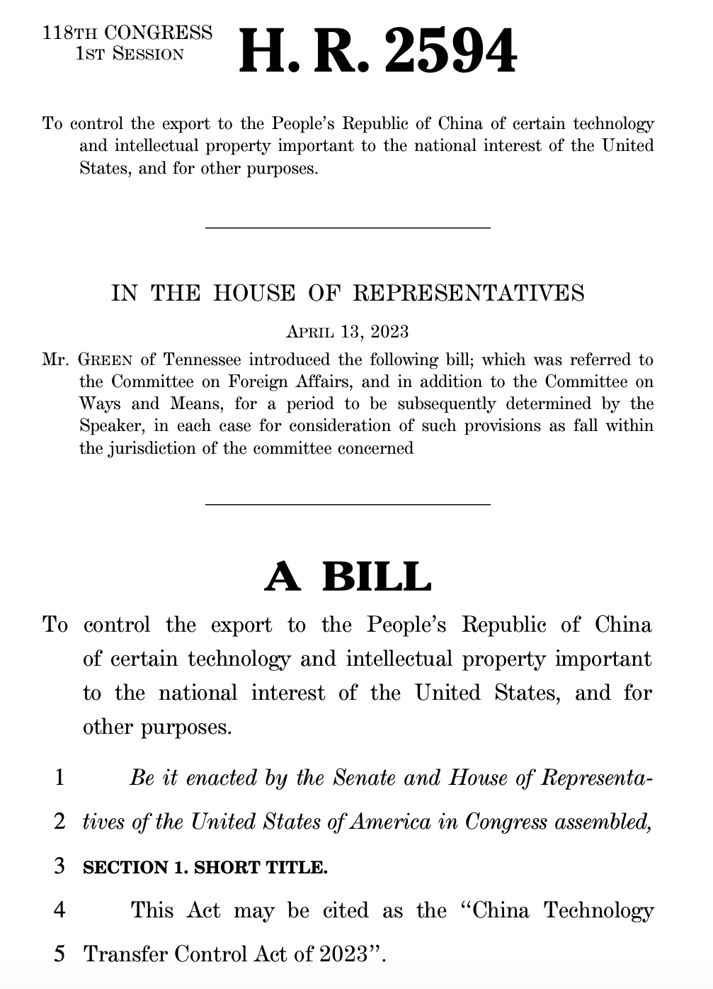
CHINA TECHNOLOGY CONTROL ACT
Harm: The U.S. and China are currently engaged in competition for leadership in AI, quantum computing, and numerous other areas of advanced technology. Chinese economic advances are funding a military buildup that will culminate in an attack on Taiwan and resulting war with the U.S.
Inherency: The Biden administration fails to take action to stop Chinese theft of U.S. intellectual property.
Solvency: The China Technology Control Act would stop China from acquiring sensitive U.S. technology and intellectual property.

Slide 5
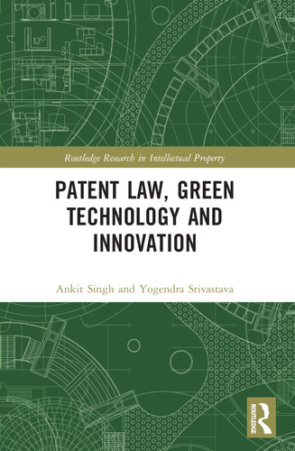
GREEN TECHNOLOGY PATENTS
Harm: Patent protection is the key to the promotion of technological innovation. The promotion of technological innovation is essential to slow climate change. Climate change is an existential threat.
Inherency: Though the U.S. Patent and Trademark Office operates green patent promotion programs, the incentives are inadequate as compared to the reality of the threat.
Solvency: The U.S. should provide additional incentives for the filing of green technology patents.
$54.95 on Amazon

Slide 6
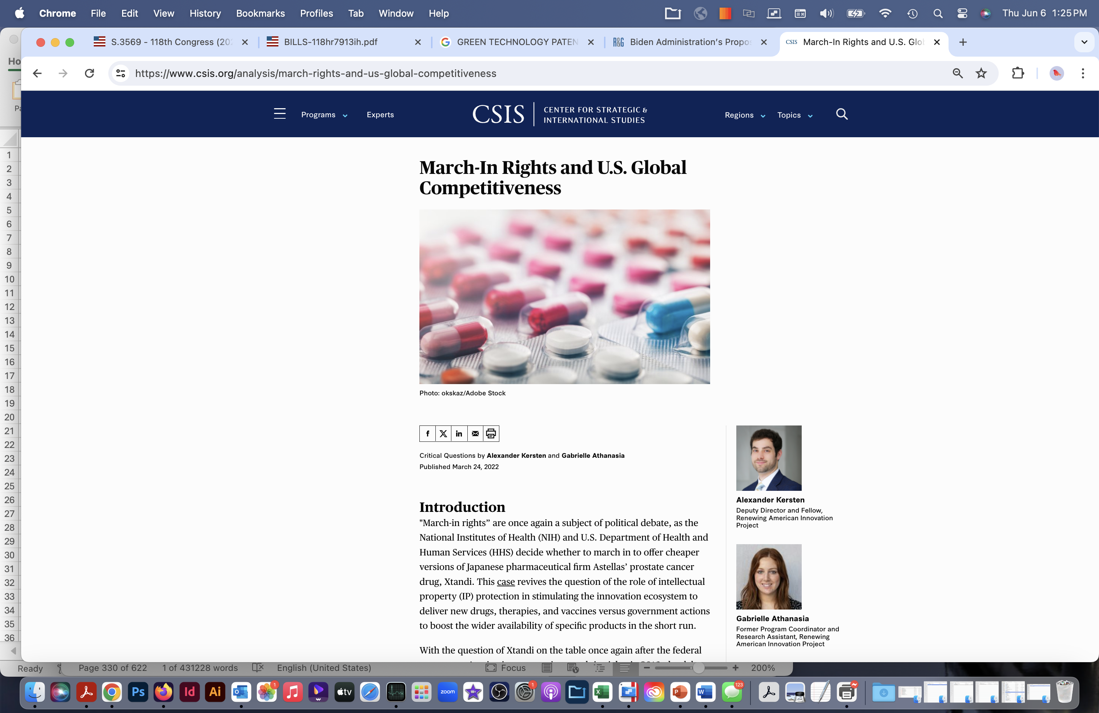
“March-In Rights” in the Bayh-Dole Act
Harm: Patent certainty is key to preserve innovation in the pharmaceutical industry. Such innovation is essential not only for discovering disease cures but also critical to preparation for future pandemics.
Inherency: The Biden administration has announced its intention to claim “March-in Rights” under the Bayh-Dole Act as a means to control pharmaceutical pricing.
Solvency: The U.S. federal government should restore the certainty of drug patent protection by eliminating the “March-In Rights” provision of the Bayh-Dole Act.
https://www.csis.org/analysis/march-rights-and-us-global-competitiveness

Slide 7
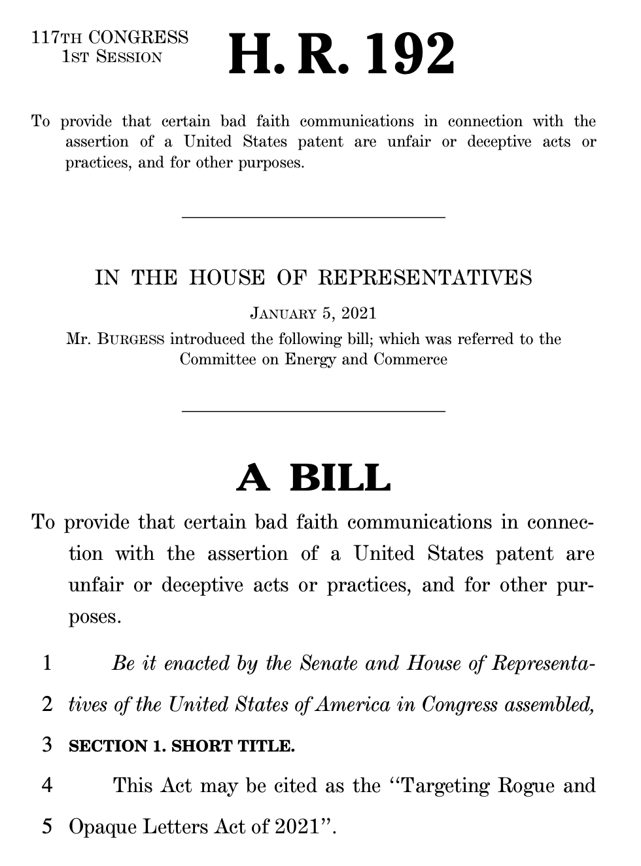
stopping patent trolls
Harm: The U.S. patent system should be improved by taking action against the patent trolls that currently undermine U.S. innovation and leadership in technology.
Inherency: Current law allows “patent assertion agencies” to use “cease and desist” letters to threaten patent action, knowing that small businesses do not have the financial means to defend themselves in the expensive court or Inter Partes Review processes.
Solvency: Passing the “Targeting Rogue and Opaque Letters Act” would take necessary action to stop patent trolls.

Slide 8
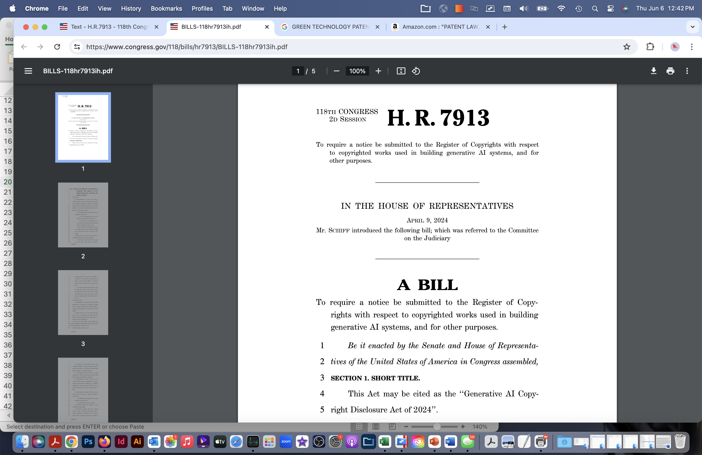
Generative AI Copyright Disclosure Act
Harm: Human creativity is currently being marginalized as artists, musicians, and writers are having their livelihoods threatened by generative AI software programs.
Inherency: At present, the learning processes of generative AI software programs are allowed to use vast troves of copyrighted materials without permission, acknowledgment, or payment of royalties.
Solvency: The Passage of the Generative AI Copyright Disclosure Act will protect the rights of creatives.

Slide 9
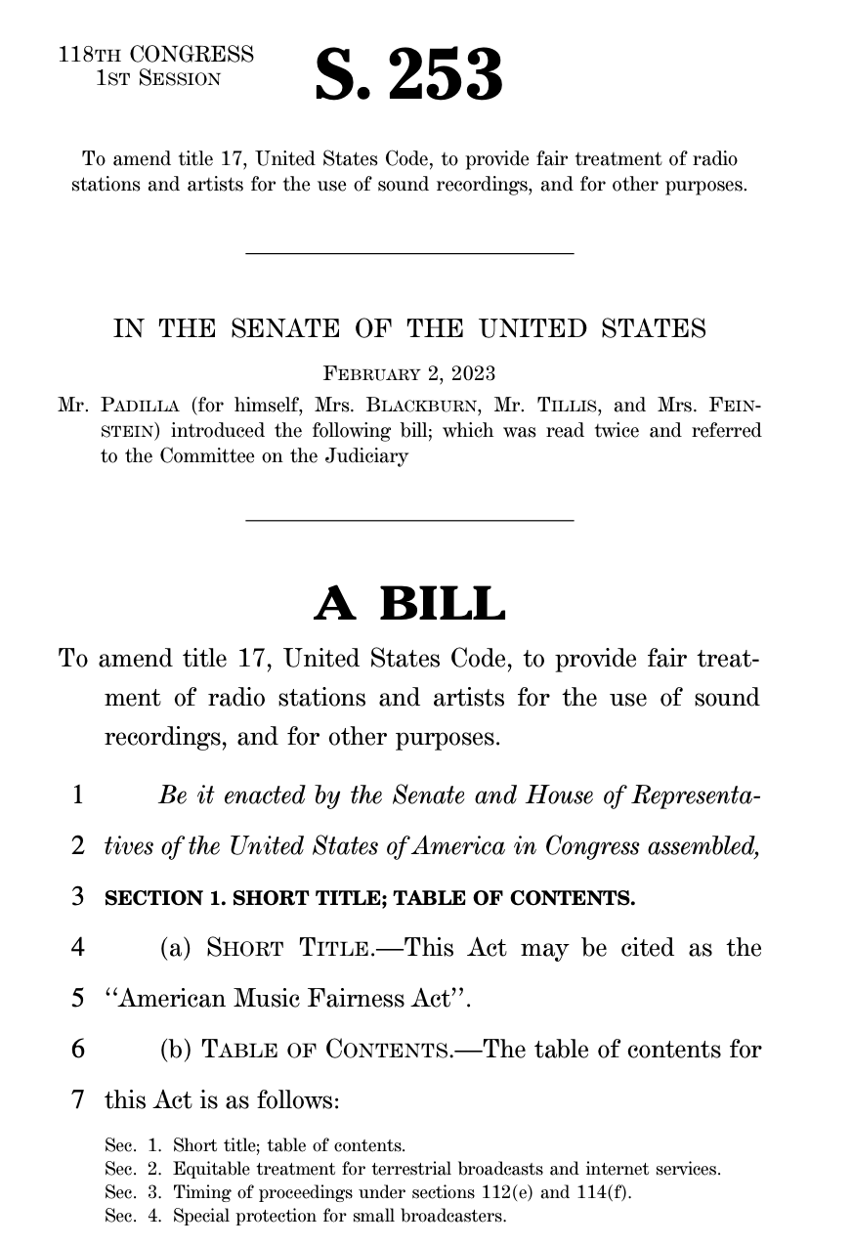
AMERICAN MUSIC FAIRNESS act
Harm: Recording artists are denied the royalties they ae due when their music is played on AM/FM radio stations. The U.S. is the only developed country not honoring copyrights in the playing of music. This results in the denial of reciprocal payments from abroad.
Inherency: The 2018 Music Modernization Act exempts terrestrial radio stations from the requirement to pay royalties when playing copyrighted music.
Solvency: The American Music Fairness Act would eliminate the exemption and restore royalty rights.

Slide 10

SHOP SAFE Act
Harm: Counterfeit product sales damage the economy and threaten the health of consumers both in the U.S. and throughout the world.
Inherency: Current law makes regulation a useless game of “whack-a-mole.”
Solvency: Passing the Stopping Harmful Offers on Platforms by Screening Against Fakes in E-commerce Act or the SHOP SAFE Act would solve by making eCommerce platforms responsible for sale of counterfeit drugs and other products.

Slide 11
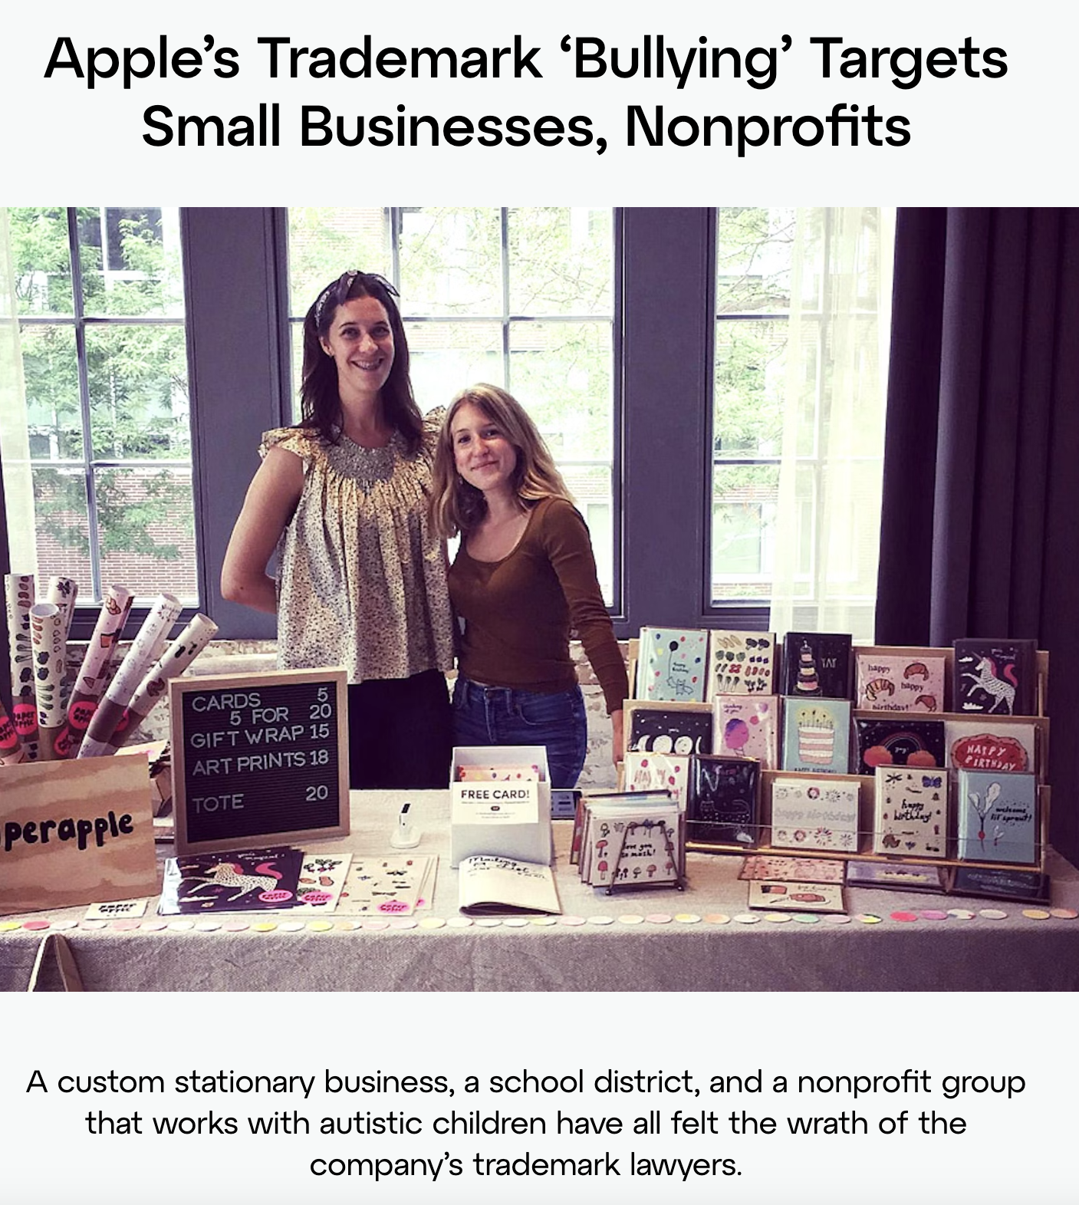
Trademark bullies
Harm: Trademark bullying undermines U.S. innovation; large companies, especially those in the tech field, abusively harass small businesses.
Inherency: Current law provides only an insistence upon aggressively defending a trademark without any countervailing penalty for bullying behavior.
Solvency: The solution requires establishing a “misuse doctrine” in the Lanham Act, enforced with the threat that a trademark bully will lose their own trademark.
https://www.techtransparencyproject.org/articles/apples-trademark-bullying-targets-small-businesses-nonprofits

Slide 12
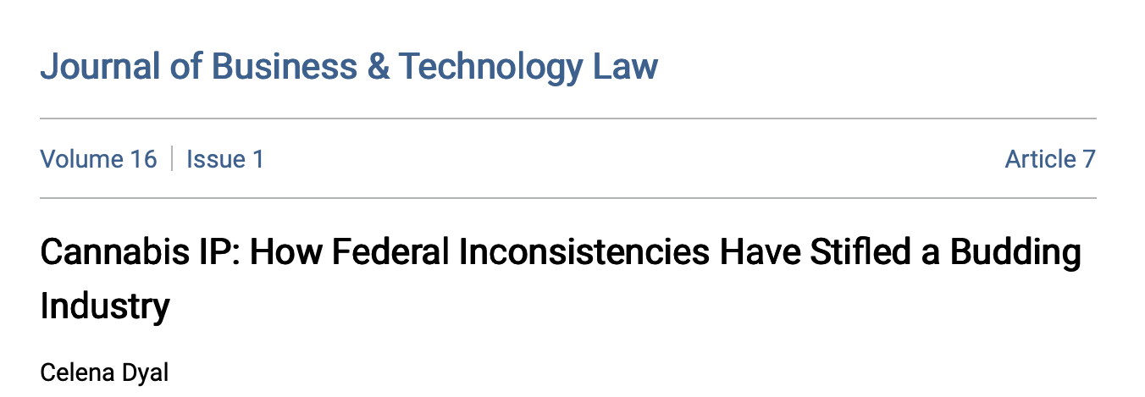
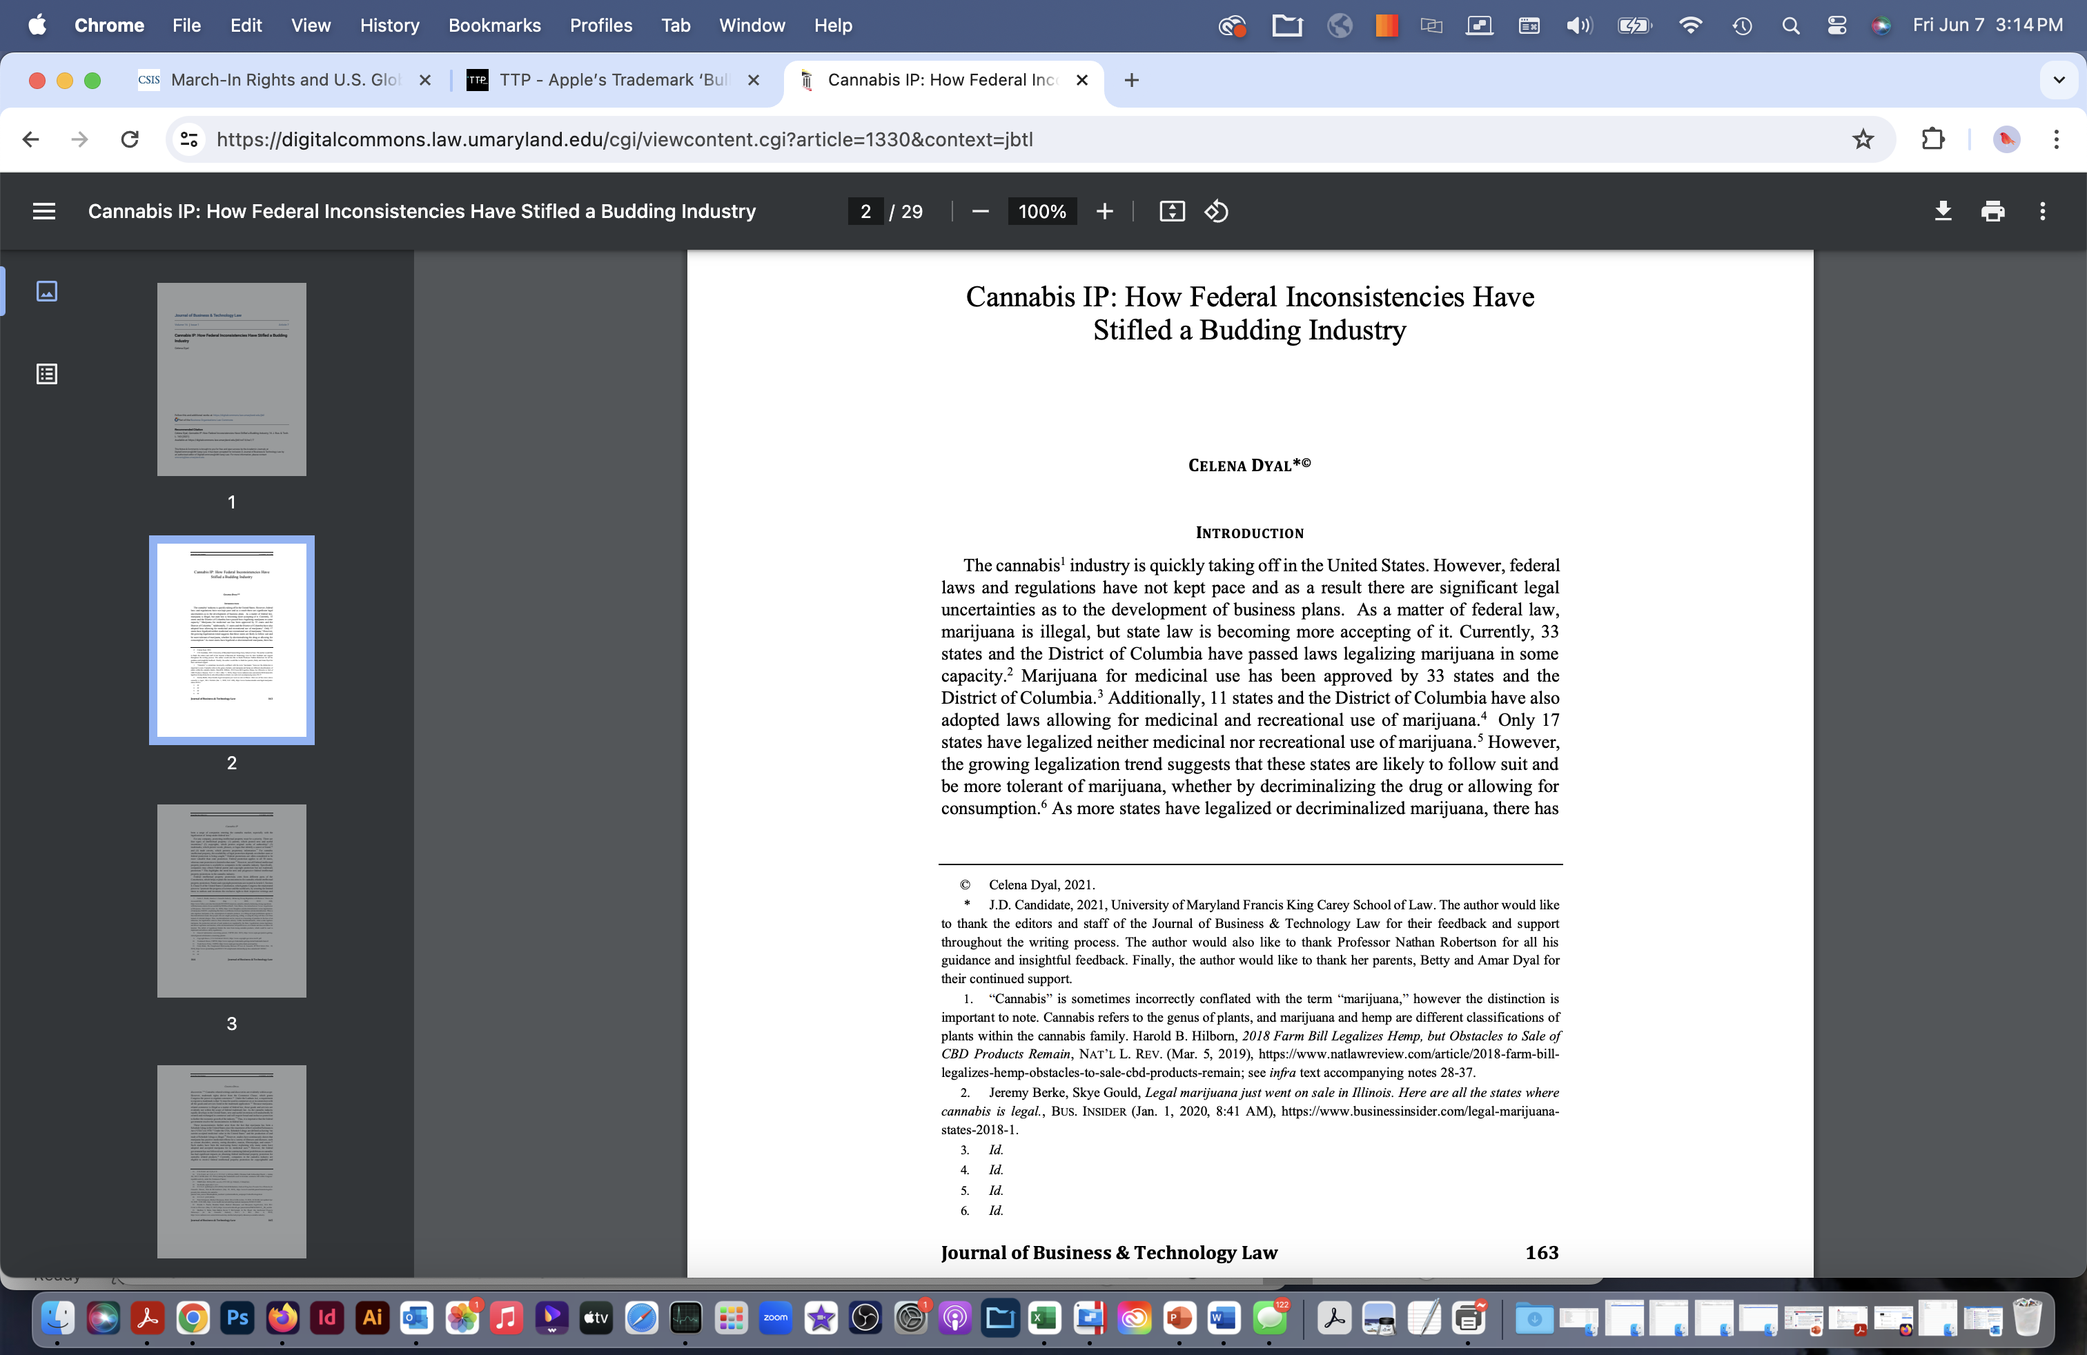
cannabis trademarks
Harm: More than half of U.S. states have legalized cannabis sales. The current state-by-state trademark filings for cannabis sellers creates confusion and risks consumer safety.
Inherency: At present, the U.S. Patent and Trademark Office does not allow trademark filings for any product illegal under federal law.
Solvency: The illegal product exemption in the Lanham Act should be removed. The U.S. already allows patents and copyrights for cannabis products.
https://digitalcommons.law.umaryland.edu/cgi/viewcontent.cgi?article=1330&context=jbtl

Slide 13
INTELLECTUAL PROPERTY: Affirmative

