Slide 1

Intellectual property: Topicality Arguments
Resolved: The United States federal government should significantly strengthen its protection of domestic intellectual property rights in copyrights, patents, and/or trademarks.
A look at negative topicality arguments provided by Rich Edwards, Baylor University

Slide 2
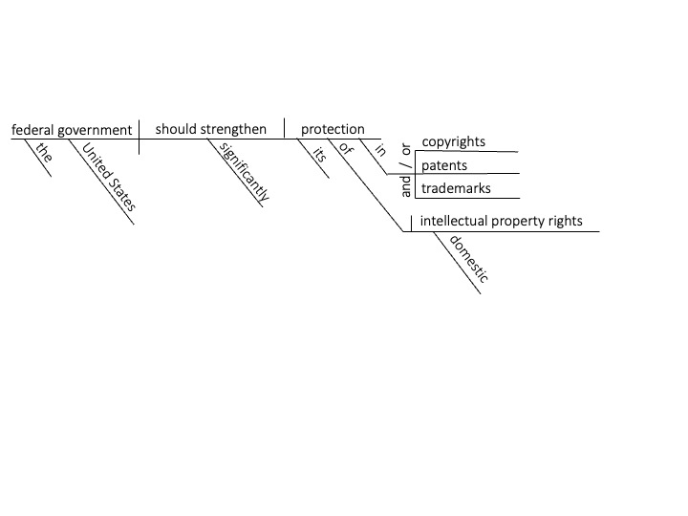
“Domestic” means not involving other countries
The intellectual property issues allowed in the resolution do not involve other countries.
Longman Dictionary Of Contemporary English, 2005, p. 463.
Domestic: Relating to or happening in one particular country and not involving any other countries.

Slide 3
“STRENGTHEN” REFERS TO THAT WHICH ALREADY EXISTS
Strengthen means to “make stronger,” not to make new. Plans that promote the creation of new patents are not topical.
Allen Walker Reed, (Ed.), New International Webster’s Comprehensive Dictionary of the English Language, 2004, p. 1013.
Protection: To shield or defend from attack, harm, or injury; guard, defend.

Slide 4
“PROTECTION” DOES NOT MEAN TO ABOLISH
Affirmative cases dealing with patent trolls or trademark trolls are really about making it easier to cancel or abolish patents or trademarks, not the protection of those patents that have been filed.
Collins English Dictionary, 2006, p. 1302.
Protect: To defend from trouble, harm, attack, etc. (Anderson et al., 2006, p. 1302)

Slide 5
“trademarks” Have nothing to do with deepfakes
The only element of intellectual property involved in deepfakes is the right of publicity – meaning the right to control one’s own likeness or image. The right of publicity is not one of the three elements of the resolution.
Mark Lee, (Attorney), ARTIFICIAL INTELLIGENCE AND THE RIGHT OF PUBLICITY, Sept. 19, 2023. Retrieved May 4, 2024 from https://www.rimonlaw.com/artificial-intelligence-and-the-right-of-publicity-the-undiscovered-country/ What is the right of publicity? Arguably, the most intuitive of intellectual property rights. If copyright and patent law protect what you create, and trademark law protects what you symbolize, the right of publicity protects who you are. It prohibits the unauthorized commercial exploitation of one’s name and likeness, and sometimes, voice or other indicia of one’s identity.

Slide 6
THE “intellectual property” category of “trade secrets” is not in the resolution
The current IP issue with China involves “trade secrets” which is distinct from copyrights, patents, and trademarks.
Jessica Brum, (Attorney), Georgetown Journal Of International Law, Spr. 2019, p. 711. Intellectual property generally refers to a set of rights that protects commercially valuable human ideas. It includes copyright, patent rights, trademark, and trade secrets.
Charles Duan, (Prof. Law, American University Washington College of Law), BELMONT LAW REVIEW, Fall 2023, p. 99. Among other things, the territorial nature of patents explains why current concerns about IP theft in China are largely unrelated to U.S. patent law.

Slide 7
Intellectual Property: Topicality Arguments

