Slide 1
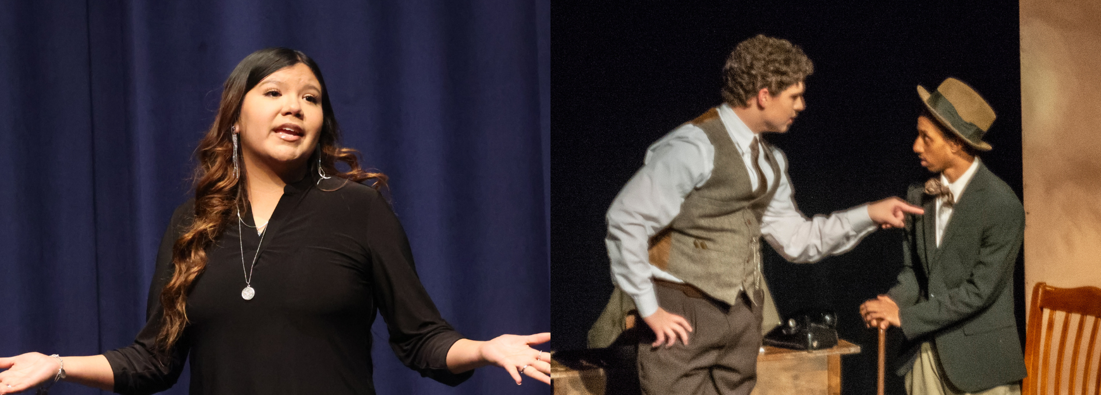
2023-2024 NFHS Speech, Debate, and Theatre Points of Emphasis
Jana Riggins – NFHS Speech, Debate, Theatre and Academics Committee Chair
Dr. James Weaver – NFHS Director of Performing Arts

Slide 2
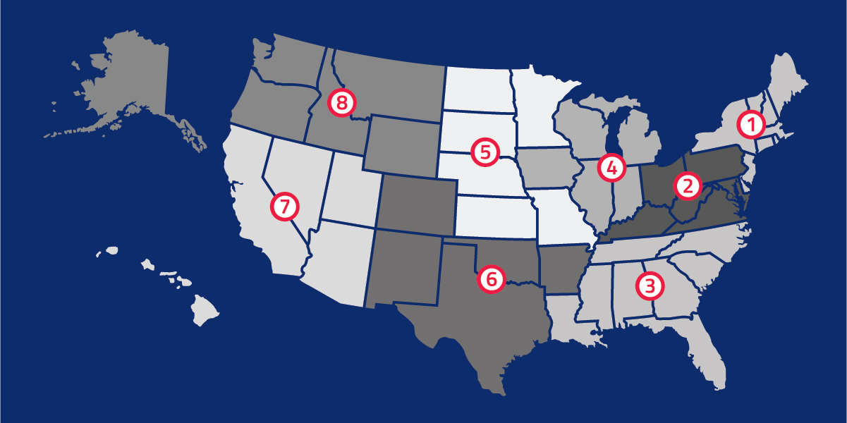
National Federation of State High School Associations
NFHS (located in Indianapolis, IN – Est. 1920):
National leader and advocate for high school athletics and performing arts programs.
Serves 51 state associations, 19,500 high schools and 12 million student participants.
Offers online education courses for high school coaches, officials, parents, students and others.
Ensures that students have opportunity to enjoy healthy participation, achievement and good sportsmanship in education-based activity programs.

Slide 3
NFHS Speech, Debate, Theatre and Academics Committee
James Weaver
NFHS Staff
Liaison
Jana Riggins Texas
Chairperson
Brian Manuel New York
Section 1
Shawn Knight Virginia
Section 2
Rachel Clapper Mississippi
Section 3
Susie Knoblauch Illinois
Section 4
Amy Doherty Minnesota
Section 5
Jennifer Denslow Oklahoma
Section 6
Doug Welton Utah
Section 7
Dana Facer Idaho
Section 8
Lauren Wells-Mann
Illinois
At-Large Member Representing Section 1 and 4
Rich Edwards
Texas
Policy Debate Quarterly Editor Liaison
Kevin Minch Missouri
NFHS Consultant
Kara Smith
Iowa
NSDA
Cory Wilkerson
Ohio
EdTA

Slide 4
2023-2024 points of emphasis

Slide 5
Access
The NFHS believes that all students should be provided equitable access to speech, debate and theatre. Coaches/directors should reasonably provide equal access to electronic resources, supplies, attire, etc. and reasonably provide accommodations for those who lack access. Coaches/judges/directors should not penalize students based on their access to these resources. The focus of the performing arts competition should be the excellence of the student content.

Slide 6
Copyright Compliance
Schools should comply with all U.S. Copyright Laws when working with their performing arts programs. Coaches/directors should exercise due diligence to protect programs against costly fines and potential litigation when using copyrighted material. There are many companies that will assist in securing copyright compliance www.copyright.nfhs.org and be sure to take the NFHS Learning Center course on Copyright Compliance at nfhslearn.com.

Slide 7
Artificial Intelligence
As AI continues to evolve, it is recommended that practitioners create policies and procedures as needed to continuously facilitate the responsible use of AI to foster transparency and trust. Coaches/advisers/directors should work to balance the opportunities of AI with the need for the preservation of the student’s voice. While further exploration of AI’s role in performing arts can offer exciting new possibilities for exploration, collaboration and innovation, it’s essential for all involved to remain mindful of the boundaries and responsibilities that come with this powerful technology.

Slide 8
Excellence
Excellence is a journey, which should be the guiding principle for a student’s experience in the performing arts. Excellence is not limited to only competitive success and should prioritize one’s behavior, hard work, integrity and uplifting spirit toward others. Achieving excellence benefits not only the individual but also the broader community and society. The focus on excellence should be successful when it improves the quality of dialogue, self-confidence and personal relationships of students.

Slide 9
Event Safety and Security
A diverse range of event management and event security challenges confront the operators of speech, debate and theatre events. Prevailing best practices and standards have emerged addressing the reasonable care to protect the safety and well-being of participants, spectators, coaches, judges, event workers and other third parties present at a venue. Event organizers should assess, mitigate, communicate and monitor the risks during all speech, debate and theatre events. Planning and implementation of event security including minimizing the risk and maximizing the security for all can affect the safety and success of any event.

Slide 10

Notes:
The NFHS Learning Center is the home to more than 90 online professional development courses for everyone within the interscholastic community - coaches, students, officials, parents, administrators, and individuals within performing arts programs. More than 60 courses are available for free.
The NFHS is an Accredited Institution and has delivered more than 15 million courses on its NFHS Learning Center platform since its inception in 2007. In receiving national accreditation by Cognia, the NFHS has upheld itself to rigorous standards that focus on productive learning environments, equitable resource allocation that meet the needs of learners, and effective leadership.
The NFHS Learning Center features its flagship coaching course, “Fundamentals of Coaching,” as well as several health and safety courses that have been completed by millions of individuals, such as “Concussion in Sports,” “Heat Illness Prevention,” “Sudden Cardiac Arrest” and “Protecting Students from Abuse.” The NFHS Learning Center offers several national credentials that can be earned by individuals who complete specific NFHS courses. Through the School Honor Roll Program, schools can earn a physical banner to hang in their school.
To learn more and start your professional development journey, please visit the NFHS Learning Center at NFHSLearn.com.

Slide 11
Thank You
National Federation of State High School Associations PO Box 690 | Indianapolis, IN 46206 Phone: 317-972-6900 | Fax: 317.822.5700 www.nfhs.org | www.nfhslearn.com | www.nfhsnetwork.com

