Slide 1


economic inequality: NEGATIVE RESPONSES
Resolved: The United States federal government should substantially increase fiscal redistribution in the United States by adopting a federal jobs guarantee, expanding Social Security, and/or providing a basic income .
A look at possible negative responses, provided by Rich Edwards, Baylor University

Slide 2

Negative toolbox
Topicality
Disadvantages
Case
Counterplans
Kritiks
A brief look at Disadvantages and Case Arguments will be provided here; see other NFHS slide series for Topicality and Counterplans. Kritiks are not acceptable in all parts of the country and will not be discussed here. Consult the NFHS publication, Policy Debate Quarterly #4 for a full discussion of negative options on the income inequality topic.
https://www.nfhs.org/nfhs-for-you/speechdebate-theatredirectors-judges/policy-debate-quarterly

Slide 3
What are the elements of a disadvantage?
Uniqueness: Explain (with evidence) why the disadvantage is not happening in the present system.
Link: Explain (with evidence and/or by citing claims made in the Affirmative case) why the adoption of the plan will cause the disadvantage.
Impact: Establish (with evidence) why the disadvantage would cause great harm.

Slide 4
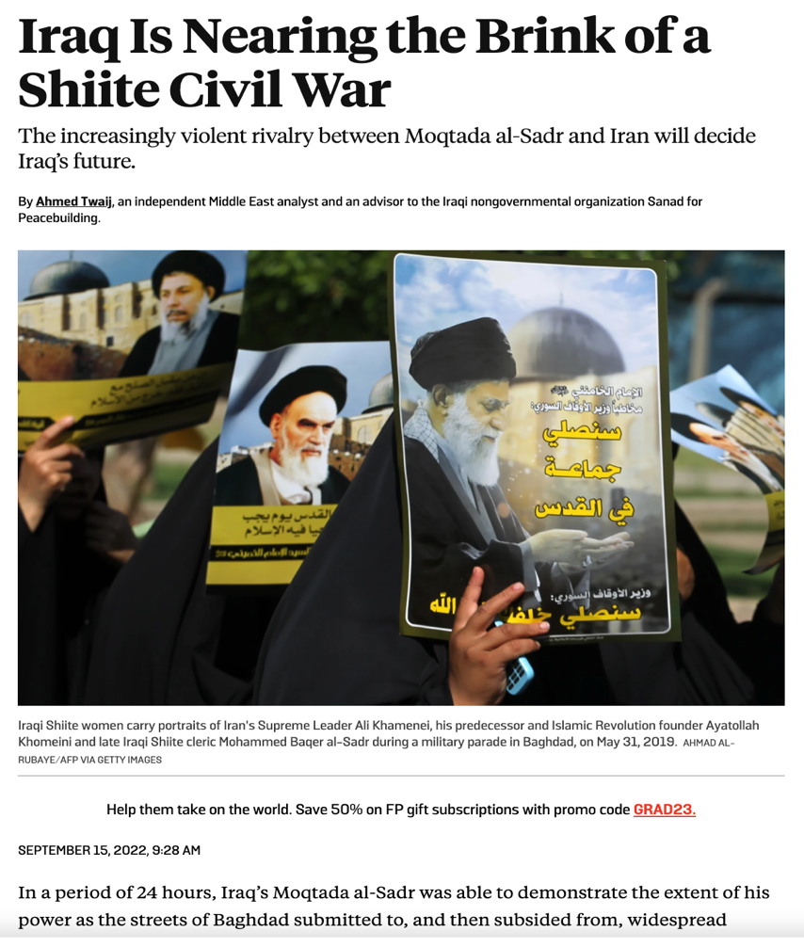
Disadvantage: SPENDING TRADE-OFF
Uniqueness: The recent budget agreement has averted economic disaster, but Congressional Pay-As-You-Go (PAYGO) rules will require compensating cuts if there is more mandatory spending.
Link: The plan spends a lot of money.
Impact: Congressional Republicans will chop U.S. aid to Iraq as part of the PAYGO compensation cuts; the result will be conflict and nuclear escalation in the Middle East.
https://foreignpolicy.com/2022/09/15/iraq-sadr-iran-shiite-civil-war/

Slide 5
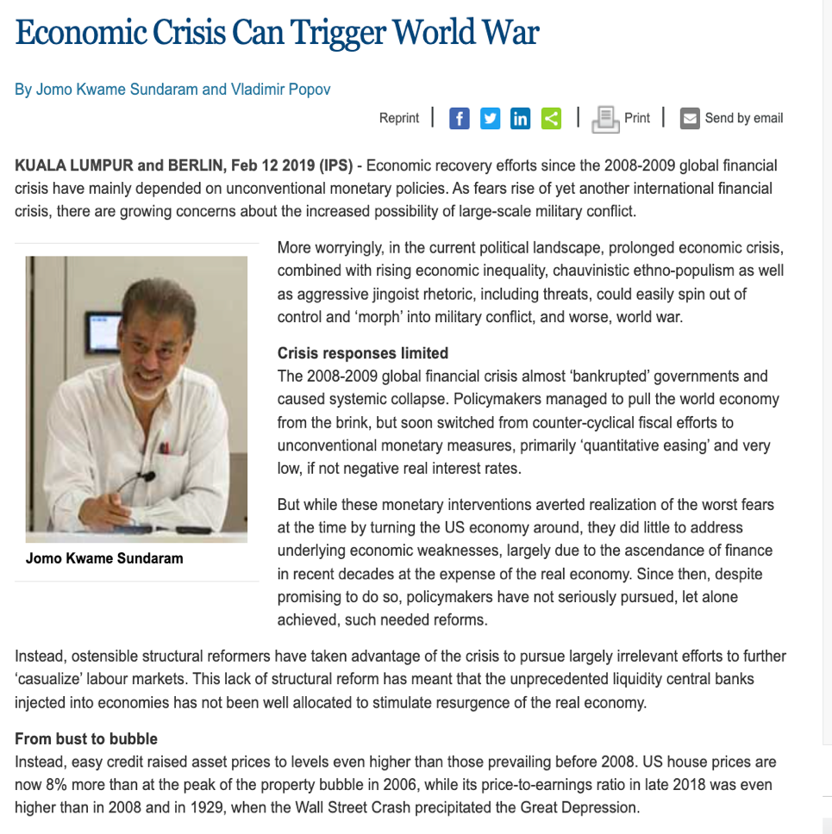
Disadvantage: BUSINESS CONFIDENCE
Uniqueness: The U.S. economy currently will avoid recession, but only narrowly so; any loss of investor confidence will tip the economy into recession.
Link: The plan will harm private businesses and destroy investor confidence (a jobs guarantee would drive up wages in order to compete with federal jobs; any increase in taxes such as a wealth tax, a capital gains tax, a value added tax, or increasing the top limit on Social Security taxation would cause the impact.
Impact: Economic crisis causes conflict and war.
http://www.ipsnews.net/2019/02/economic-crisis-can-trigger-world-war/

Slide 6

Disadvantage: INFLATION
Uniqueness: The Federal Reserve Board is now bringing inflation back under control, but reasons for concern remain.
Link: The economic stimulus provided by the affirmative plan will overwhelm efforts to control inflation, leading to a loss of U.S. economic leadership vis-a-vis China.
Impact: Loss of U.S. economic leadership leads to great power war: Kroenig, 2020, p. 6 – (see book at right): “Many fear that a power transition between Beijing and Washington would produce a similar catastrophic result. Continued American leadership, therefore, could forestall this transition and may be necessary for continued peace and stability among the major powers. “
$17.31 Online

Slide 7

Disadvantage: GROWTH BAD
Uniqueness: The affirmative case establishes that the U.S. economy is stagnating at present.
Link: The affirmative solvency argument claims that the plan will jump-start U.S. economic growth.
Impact: Increased economic growth will push the world past the brink for climate change, risking human extinction.
https://soapboxie.com/social-issues/Are-Humans-Facing-Near-Term-Human-Extinction-Due-to-Global-Warming

Slide 8
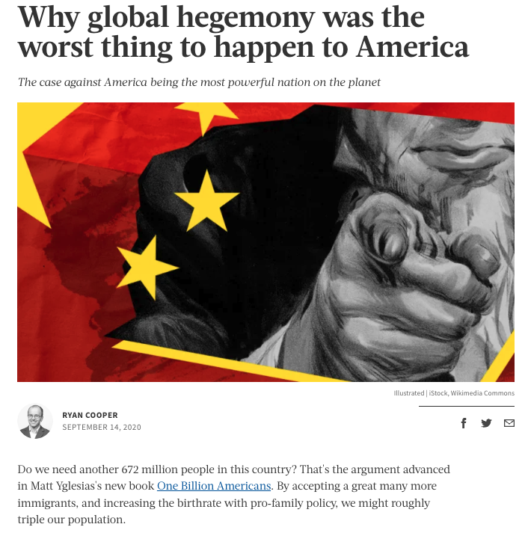
Disadvantage: U.S. Hegemony Bad
Uniqueness: The case claims that the U.S. is currently losing its leadership position on the world stage.
Link: The plan claims to restore and build U.S. soft power and leadership.
Impact: A U.S. return to world leadership and dominance results in unending wars.
https://theweek.com/articles/937094/why-global-hegemony-worst-thing-happen-america

Slide 9
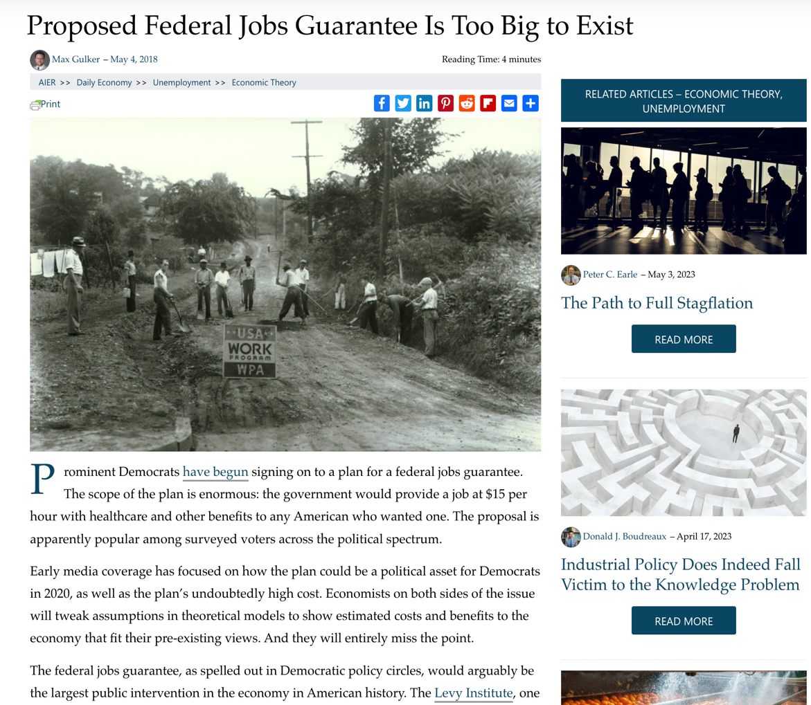
Universal federal jobs guarantee
Harm: The current rate of unemployment is historically low, including for minorities.
Inherency: The Earned Income Tax Credit adequately compensates for low-paying jobs.
Solvency: Useful federal jobs could never be created on the scale proposed; the jobs guarantee would eliminate any incentive for skills development.
https://www.aier.org/article/proposed-federal-jobs-guarantee-is-too-big-to-exist/

Slide 10

green new deal
Harm: The shift to renewables is now happening at high speed; wind and solar power is now cheaper than fossil fuels.
Inherency: The Inflation Reduction Act provides major tax incentives for private creation of green jobs.
Solvency: Federal job guarantee workers would not have the skills to perform the complex solar and wind power installations that private energy companies already have trained workers to perform.
https://www.zmescience.com/science/solar-is-now-the-cheapest-energy-in-history/

Slide 11
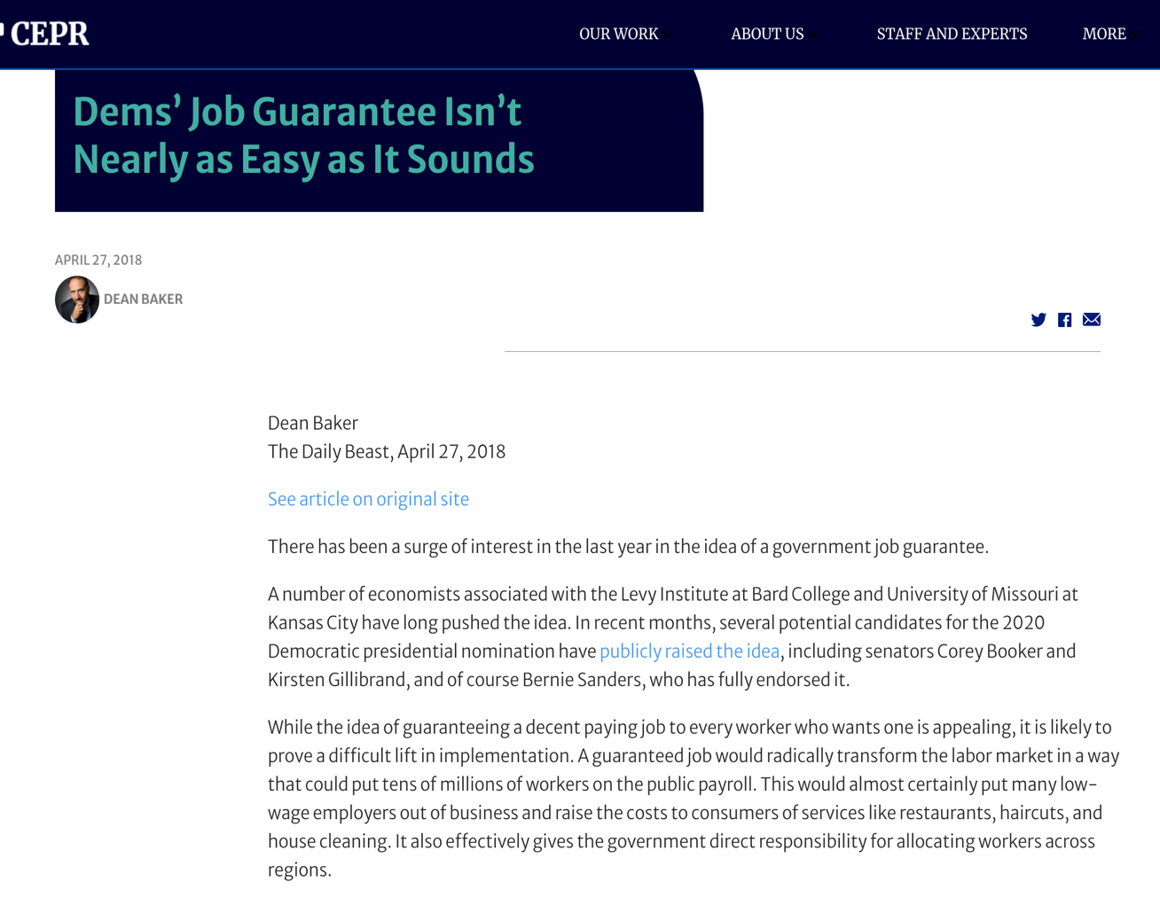
national investment employment corps (niec)
Harm: Unemployment is already at historic lows.
Inherency: The Inflation Reduction Act provides tax incentives for private job creation.
Solvency: Federal jobs would be make-work positions; employees would do shoddy work because they couldn’t be fired; the skills to accomplish infrastructure projects would be lacking.
https://cepr.net/dems-job-guarantee-isn-t-nearly-as-easy-as-it-sounds/

Slide 12
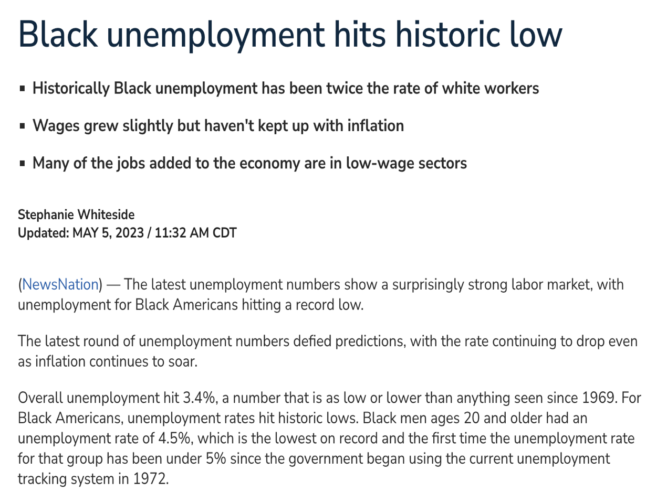
center for american progress plan to save depressed areas
Harm: Unemployment is at historic lows throughout America, but this is also true for minorities.
Inherency: The federal government already has dozens of programs designed to stimulate private sector job creation in depressed areas.
Solvency: Efforts to provide assistance based on geography are less effective than targeting assistance to people with low incomes, regardless of location.
https://www.newsnationnow.com/business/black-unemployment-hits-historic-low/

Slide 13
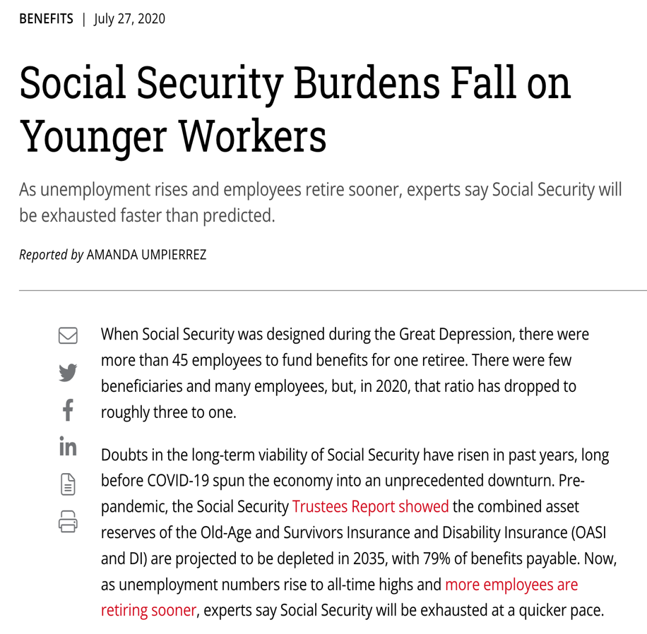
retirement security
Harm: Elderly Americans are living longer, are healthier, and remain major contributors to the labor force. Delaying retirement benefits both the economy and the health of the elderly.
Inherency: Private retirement savings in the U.S. are massive, they supplement Social Security in retirement.
Solvency: Expanding Social Security harms worker health and the economy by incentivizing early retirement. It also places an unfair burden on young workers who must carry the increased load.
https://www.plansponsor.com/social-security-burdens-fall-younger-workers/

Slide 14
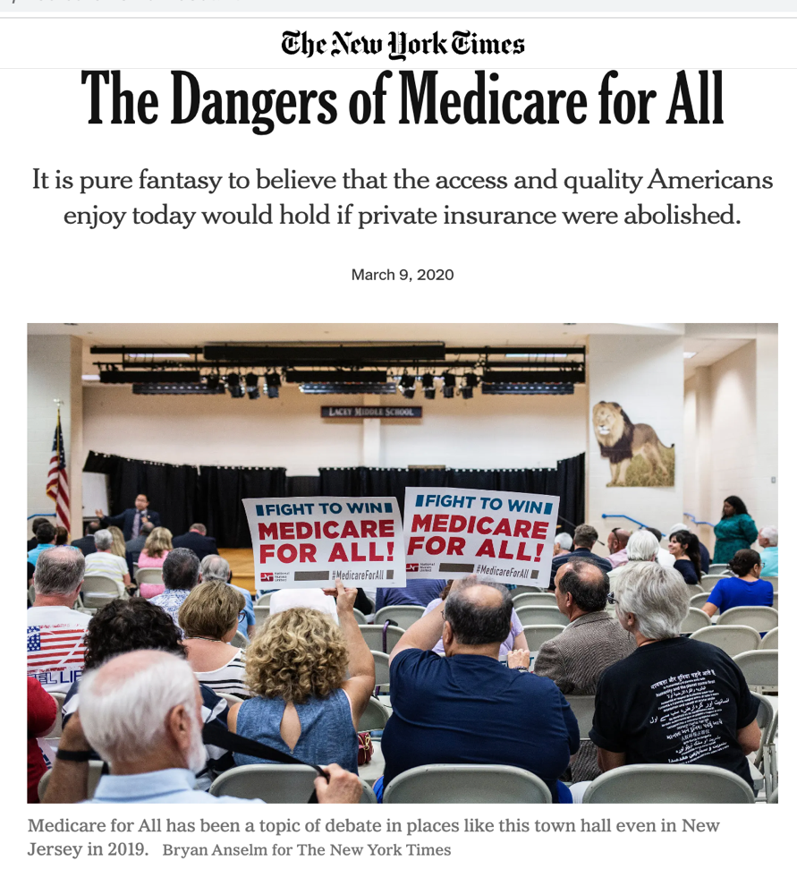
medicare for all
Harm: The quality of U.S. health care is good and costs are in line with other developed countries; Medicare costs are low only because of cost shifting to private health insurance companies.
Inherency: Community health centers, the Emergency Medical Treatment and Labor Act (EMTALA), and the Affordable Care Act (ACA) ensure necessary care for all.
Solvency: The plan would lead to rationing, hospital closures, and medical professionals retiring rather than accepting dramatically lower payments.
https://www.nytimes.com/2020/03/09/opinion/medicare-for-all-cost.html

Slide 15
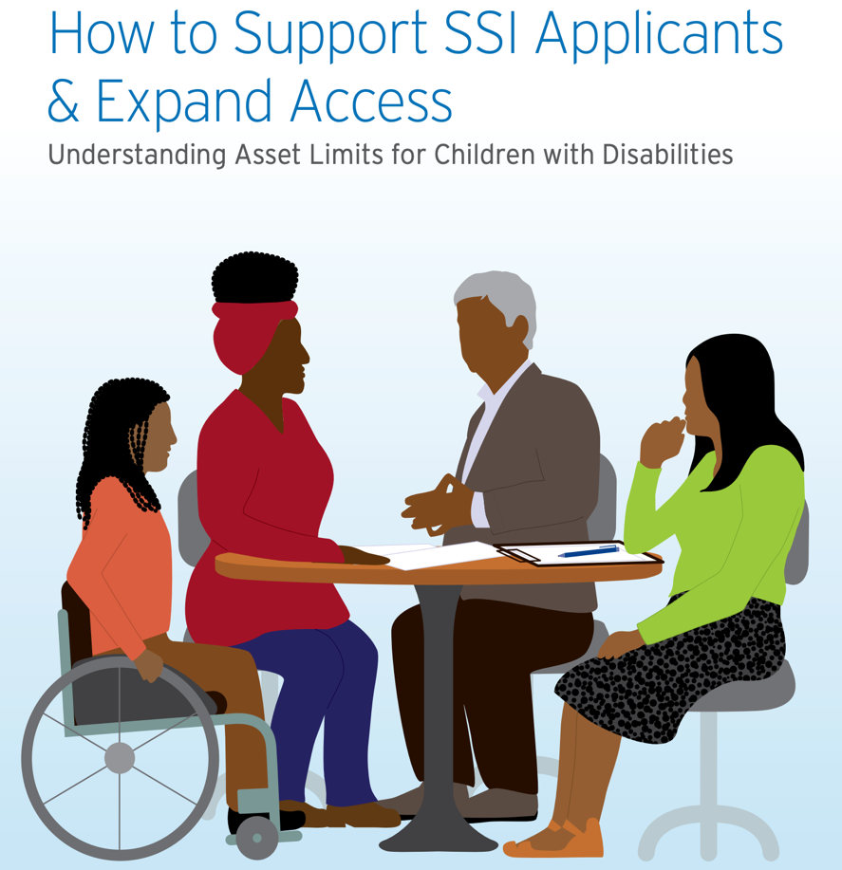
supplemental security income (ssi)
Harm: The asset requirement is not that serious a problem considering that a home and automobile are excluded.
Inherency: Persons with disabilities can also receive Social Security Disability Income (SSDI) which has higher payments and no asset limits.
Solvency: Even if asset limits are lifted, SSI payment levels are insufficient to lift people out of poverty; the real solution is fairness in employment for persons with disabilities, as provided by the ADA.
https://www.changelabsolutions.org/sites/default/files/2021-10/Asset_Requirements_for_SSI_Factsheet_FINAL-20210113_ACCESS.pdf

Slide 16
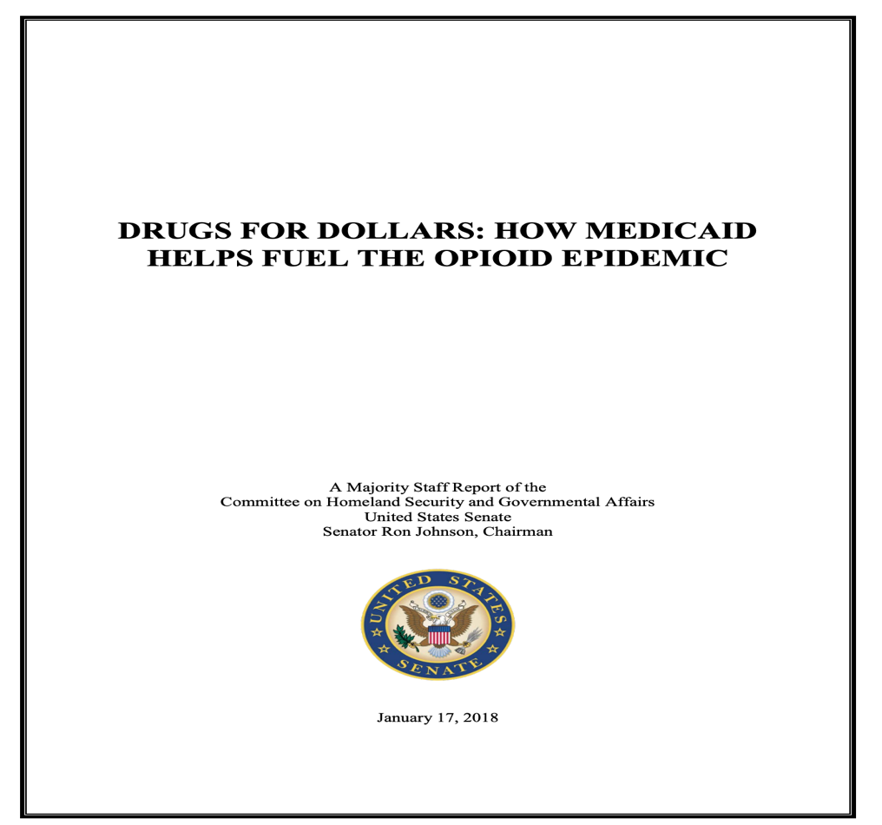
medicaid expansion
Harm: Medicaid expansion has been associated with worse health outcomes due to opioid addiction; states should be able to make their own decisions about expansion.
Inherency: Under the current terms of the Court decision, states are given the option for expansion.
Solvency: Medicaid is a state-administered program; cooperation of each state government is essential if the program is to work; this is a prime reason for allowing choice.
https://www.hsgac.senate.gov/wp-content/uploads/imo/media/doc/Statement%20for%20Record-HSGAC%20Majority%20Staff%20Report-2018-01-17.pdf

Slide 17
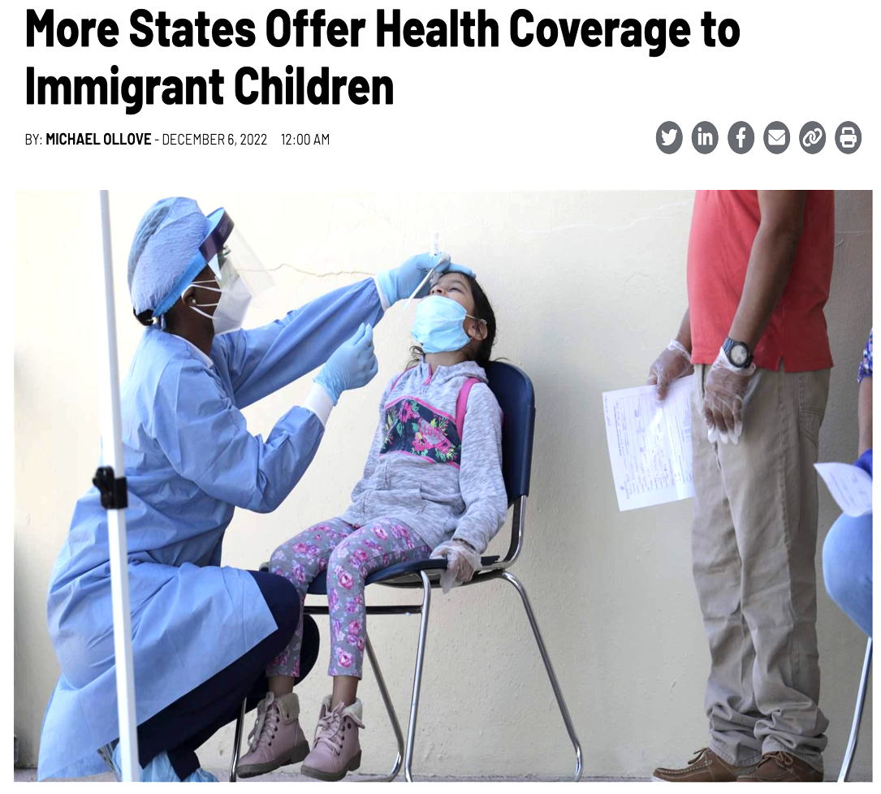
children’s health insurance program (chip) for immigrants
Harm: States are now given the option to offer CHIP coverage through the terms of the 2015 Children’s Health Insurance Program Reauthorization Act (CHIPRA).
Inherency: Immigrant children can receive necessary care through Community health centers and the Emergency Medical Treatment and Labor Act (EMTALA).
Solvency: The real reason that immigrant children avoid receiving care is concern about exposing immigrant families to ICE attention.
https://stateline.org/2022/12/06/more-states-offer-health-coverage-to-immigrant-children/

Slide 18
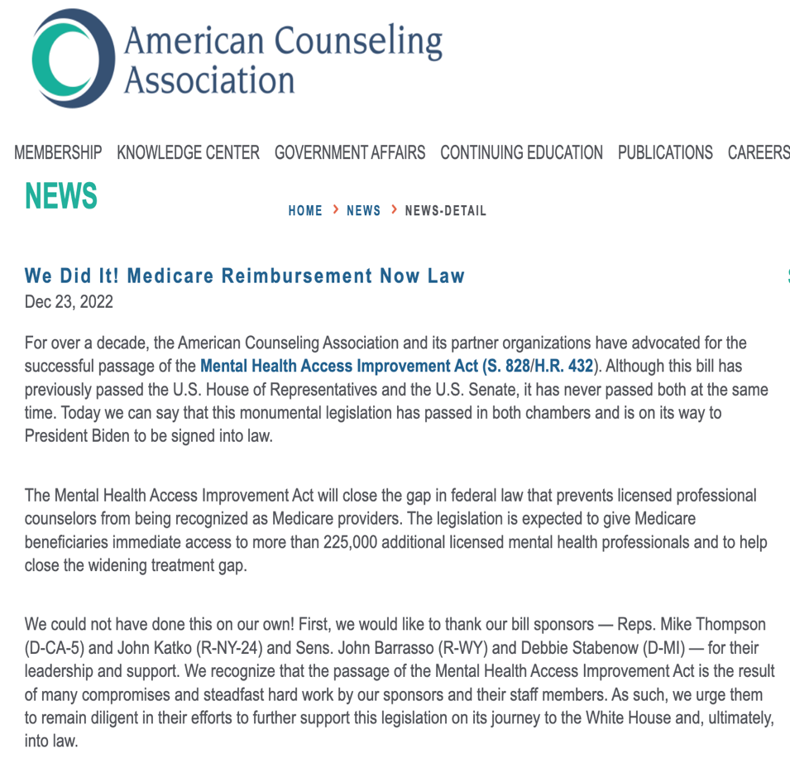
mental health care in social security
Harm: The elderly have access to mental health care, including substance abuse treatment.
Inherency: The Mental Health Access Improvement Act passed in late December 2022, dramatically increasing Social Security coverage of mental health care.
Solvency: The plan does nothing to solve the real cause of poor access to mental health care – the shortage of mental health professionals who are willing to accept Social Security reimbursement rates.
https://www.counseling.org/news/news-detail/2022/12/23/we-did-it!-medicare-reimbursement-now-law

Slide 19
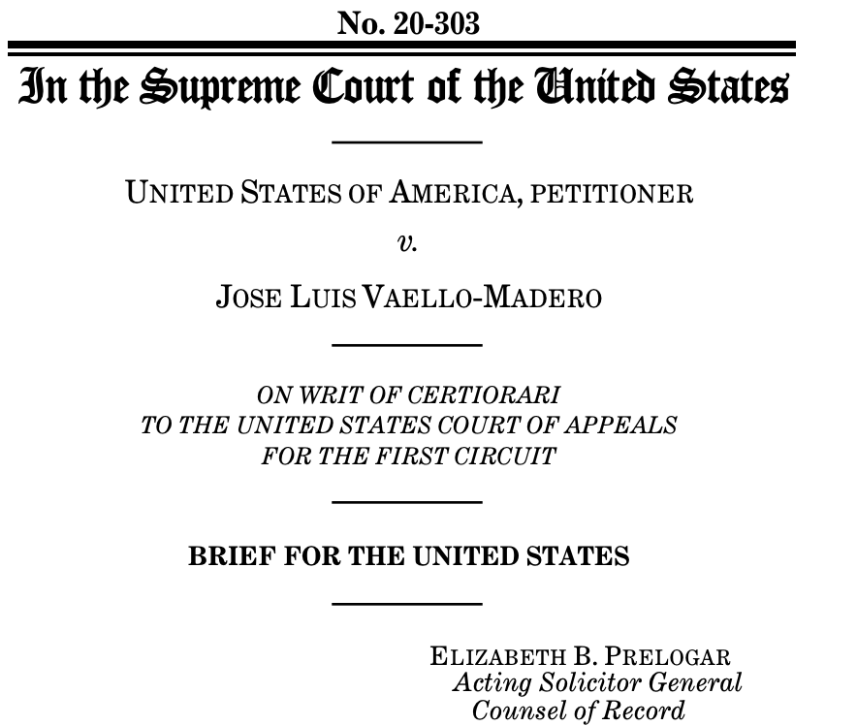
supplemental security income in the u.s. territories
Harm: Residents in territories do not pay federal taxes, which is why denial of SSI benefits is appropriate; the territories could provide their own program for the disabled.
Inherency: Disabled residents in the territories do receive Aid to the Aged, Blind, and Disabled (AABD); payment levels and qualifications are up to them.
Solvency: SSI is not a highly optimal program for the disabled; it has difficult qualification criteria and a low asset limit.
https://www.supremecourt.gov/DocketPDF/20/20-303/181129/20210607194124315_20-303tsUnitedStates.pdf

Slide 20

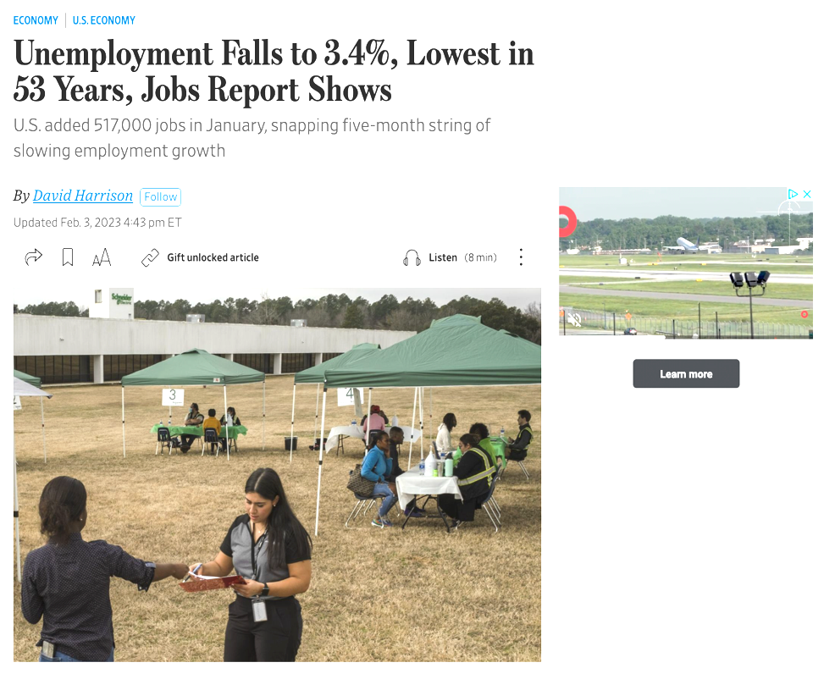
expand unemployment insurance
Harm: Unemployment is at historic lows; workers have options.
Inherency: In the event of high periods of unemployment or another pandemic-related downturn, we could expand the program temporarily as we did during the pandemic.
Solvency: Unemployment insurance is primarily administered by the states; expanding coverage without their cooperation is unlikely to succeed.
https://www.wsj.com/articles/january-jobs-report-unemployment-rate-economy-growth-2023-11675374490

Slide 21
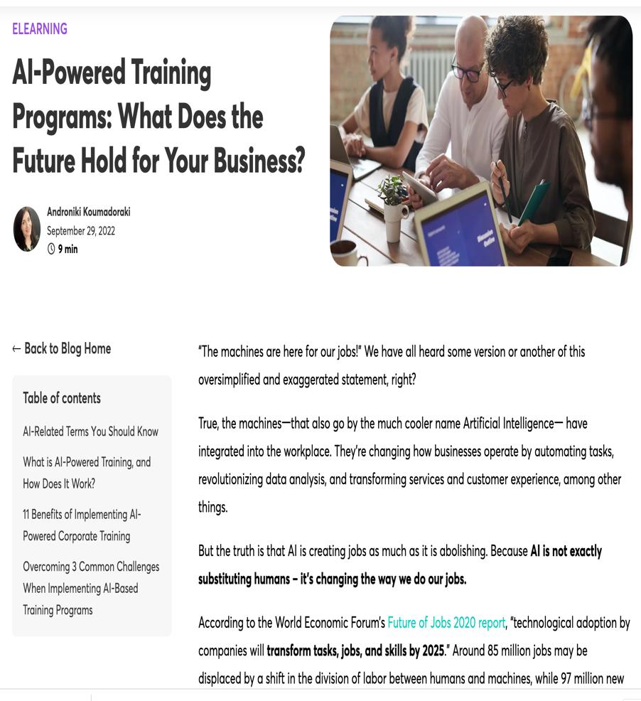
universal basic income
Harm: AI creates more new jobs than it takes away.
Inherency: Private companies are committed to providing the training necessary to adjust to AI; actually, AI itself is making this training process easier: Source at right: “Would you like to hear something funny? Artificial Intelligence can actually help solve the skills gap problem that it’s creating.”
Solvency: UBI does not accomplish fiscal redistribution and will lead to less freedom since it will increase dependence on government.
https://www.learnworlds.com/ai-powered-training-programs/

Slide 22
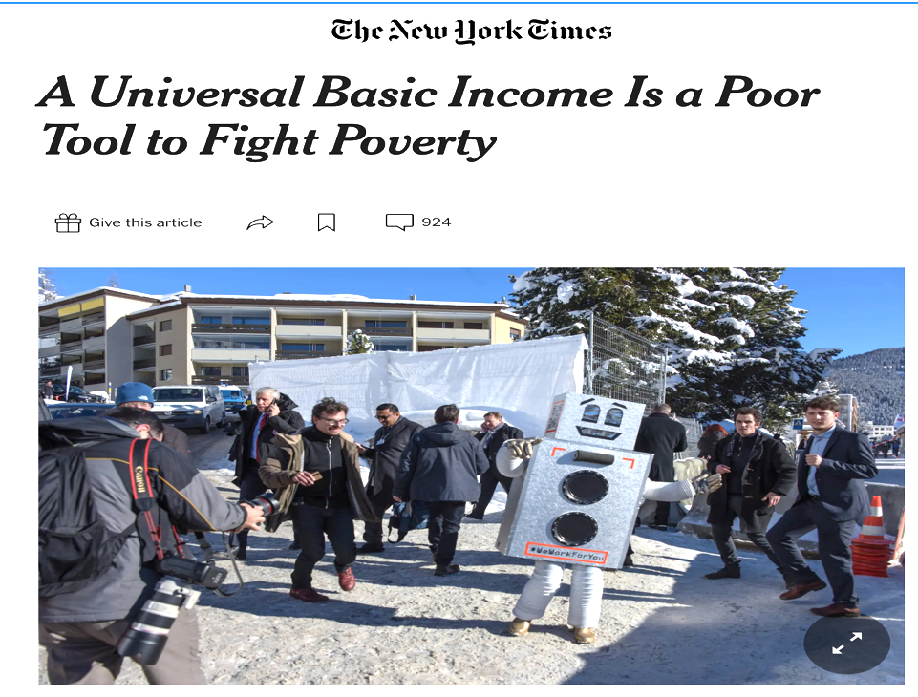
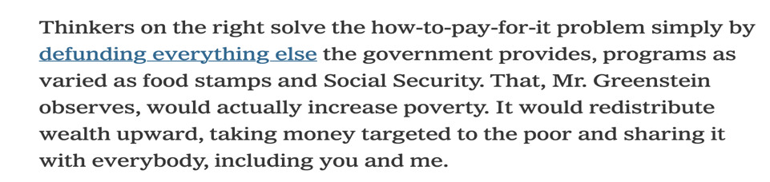
a universal basic income: the conservative case
Harm: Welfare program administration cost is much less than conservative critics claim.
Inherency: The Earned Income Tax Credit (EITC) is now the leading anti-poverty program; there is no stigma, and its administrative costs are tiny.
Solvency: Ending all welfare programs and replacement with a $10,000 or even $12,000/ year UBI would dramatically increase poverty, while costing the federal government trillions.
https://www.nytimes.com/2016/06/01/business/economy/universal-basic-income-poverty.html

Slide 23
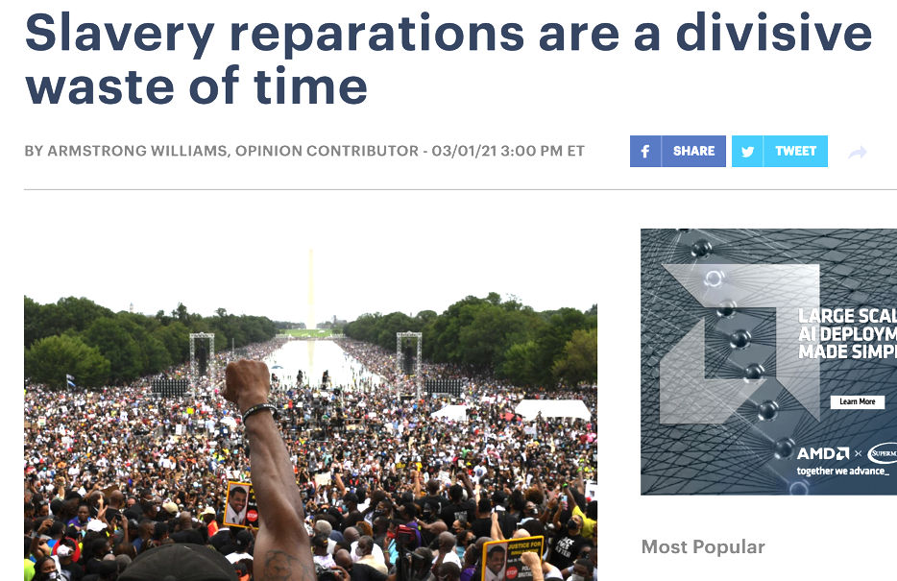
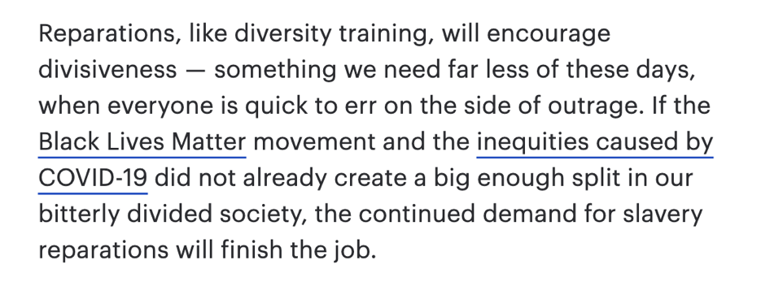
reparations
Harm: The notion of heritable guilt is a dead end; slavery was a worldwide phenomenon; most white Americans never owned slaves; descendants of Union soldiers in the Civil War should not be considered guilty. Why should recent Black immigrants receive compensation? Why should other minority groups have to pay?
Solvency: Reparations will only increase racial resentment and division; if a UBI is to be adopted, justifying it as a reparations solution would unnecessarily generate division and backlash.
https://thehill.com/opinion/civil-rights/540812-slavery-reparations-are-a-divisive-waste-of-time/

Slide 24
economic inequality: NEGATIVE

