Slide 1

‘Shake It Up’ – A Mindset for Living the Best Life You Can
2022 NFHS Performing Arts Conference
Notes:
Notes:
This is a message that has resonated with me as someone who always wants to improve but sometimes has struggled to improve.
We all want to get better, we all want to be better, we all want to foster relationships that are powerful and significant.
How do we get there in a world that is tough and changing rapidly around us?

Slide 2

Opening Thought
What is the difference between a bottle with a fixed amount and a bottle that is overflowing?
Notes:
In the last couple years, I've been a journey of maturing and growth that has been very fruitful. But even in that, I've been caught looking back at what makes the difference between the growth I want and the lack of results I sometimes see?
I found the answer in a bottle of pop.

Slide 3
‘Shake It Up’ Mindset
We achieve the best in our lives when we instigate positive change, when we do things differently, when we shake up our static mindsets and operate in a manner that embraces disrupting the patterns that have led to predictable results.
Notes:
We get the best in life when we shake things up. We get the best in life when we are willing to do things different, to be different, to live differently.

Slide 4
Today’s Discussion
‘Shaking Up Your Business’
‘Shaking Up Your Relationships’
‘Shaking Up You’
Notes:
Shaking up Your Business - How do I become the best at what I do professionally?
Shaking Up Your Relationships - How do I build strong relationships with other people that are vibrant and fruitful?
Shaking Up Your Person - How do I become a version of myself that I'm fulfilled with?

Slide 5

‘Shaking Up Your Business’
Creating A Culture of Change That Generates Unanticipated Growth
Notes:
This is the reason why most people came to this conference - to get better at your business. In a way, you coming to this conference is already living a little bit of what we're going to go into bigger detail on, as you're shaking up your mindset on your business by learning.
But I want to examine some attributes of what shaking up your business looks like, examining some of our thought traps, and then assessing examples of people who've put these attributes into effect in their own individual way.

Slide 6
‘The Words and Phrases We Use’
Static thinkers
Growth thinkers
‘Stale.’
‘It’s good enough as it is.’
‘This is what we’ve always done.’
‘Our organization is too big to change.’
‘Change requires too much work.’
‘I’m comfortable with our process as it is.’
‘Our organization has no room left to grow.’
‘Vibrant’.
‘This could be better.’
‘We have room to get improved results.’
‘The work of making things better is exciting.’
‘Look at how much room our organization still has to get bigger.’
Notes:
I think it's important for us to examine the words and phrases we use to describe ourselves and each other. Our words tell a lot about who we are and what we're trying to project. And let's be honest - there is a big, humongous, expansive difference between the words and phrases that are used by 'Growth Thinkers' and 'Static thinkers'.

Slide 7

Tangible Examples of Business Leaders Who ‘Shook Things Up’

Slide 8
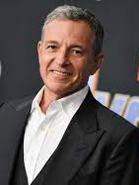
Bob Iger
Former CEO of the Walt Disney Company, serving from 2005-2020
Oversaw Disney’s acquisition of Pixar, Marvel Studios, Lucasfilm, and 21st Century Fox
Oversaw creation of ‘Disney+’
Personally negotiated with Chinese Government to open ‘Shanghai Disneyland’.

Slide 9
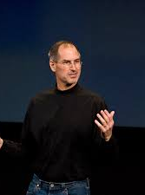
Steve Jobs
- Embraced computer industry, particularly the idea of technology such as GUI
- Saw value in different business categories, such as education
Multi-faceted interests ranged from animation (PIXAR) to entertainment
Returned to Apple and created projects such as iTunes, iPhone, iPad
Notes:
Steve Jobs was a visionary, a contrarian, a guy who saw the world completely different than everyone else. He was a millionaire at 23, was building circuit boards and hardware in his early 20's, and created a product that is part of people’s identity before he was 30. But he suffered through immense personal and professional turmoil, created unreasonable amounts of tension, and could be such a force of personality that it became a negative. But even in that, he used his setbacks and defeats to remake himself, eventually growing in a way that led him to return to Apple and rebuild the company into something that resembled a business empire of the likes of the Carnegies or the Rockefellers.

Slide 10
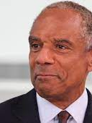
Kenneth Chenault
Former CEO of the American Express Company, serving from 2001-2018
Only the third African-American to serve as a CEO of a Fortune 500 company
Currently serves on the Board of Directors for Berkshire Hathaway

Slide 11
Key Takeaways
The status quo is so yesterday (kind of).
Ignoring conventional thinking can lead to unanticipated opportunities and results.
The future success of your business lies in how much you’re willing to adapt for your future growth.

Slide 12
Questions For You
Is my business succeeding at the level it should be?
What role am I playing in making my business the success that it should be?
How can I ‘shake up’ the tasks and goals I’m assigned?

Slide 13

‘Shaking Up Your Relationships’
Establishing Relationships That Aren’t Constrained And Preconceived

Slide 14
‘The Words and Phrases We Use’
‘Static thinkers’
‘growth thinkers’
‘They’ll never be capable of that.’
‘They’ll never change.’
‘This relationship doesn’t matter very much in the grand scheme of things.’
‘They’re not worth much.’
‘They have a lot of skills that we can use.’
‘How can we help equip them with the confidence they can succeed?’
‘Every person has talents that matter.’

Slide 15
‘What if….’
What would happen if we looked at every interaction with other people from this mindset?
‘The greatest thing we can do is to show someone they’re loved and capable of loving.’ – Fred Rogers

Slide 16

What ‘Shakes Up’ a Relationship?
Three words that can transform average relationships into extraordinary ones

Slide 17
'Shake It Up’ Key Words for Relationships
Listening
Caring
Forgiveness

Slide 18
Key Takeaways
The more we invest into other people, the more we realize from those relationships.
When we show people genuine care, they are enabled to do things they didn’t think they were capable of, changing the lives of so many people.
Forgiveness repairs brokenness, allowing for new growth to take root.

Slide 19
Questions For You
When I’m talking with people, am I really listening to them?
How many times a day do I let people know how much I appreciate them?
How many relationships do I have that remain broken because of a lack of forgiveness?

Slide 20

‘Shaking Up… You’
Living A Life That Isn’t Limited By what you Think you see

Slide 21
'The Words and Phrases We Use’
‘Static thinkers’
‘growth thinkers’
‘I’ll never be capable of that.’
‘This is all I will ever be.’
‘Why is this happening to me?’
‘I’m not sure I matter.’
‘What will it take for me to achieve that?’
‘What can I be?’
‘Look what is happening to me!’
‘I’m a special creation.’

Slide 22

How do we become the best version of ourselves instead of being stuck as the worst version of ourselves?

Slide 23
‘The Best You’
Accept
Accept the Worst About Yourself
Challenge
Challenge Yourself
Embrace
Embrace Change

Slide 24
Questions For You
When is the last time you asked yourself if you’re feeling challenged and fulfilled?
When is the last time you told yourself that you forgive yourself for making mistakes, hurting people you care about, and missing opportunities?
When is the last time you looked at a situation in your life you wanted to change and looked at changing it?

Slide 25

Group Activity
A mixture of introspection and fun

Slide 26

Closing Thoughts
Pathway to a new life

Slide 27
Takeaways
Our best life comes from shaking up our mindsets and seeing what overflows.
Holding on to what we know keeps us stuck in a lesser version of what we can be.
It’s never too late.

Slide 28
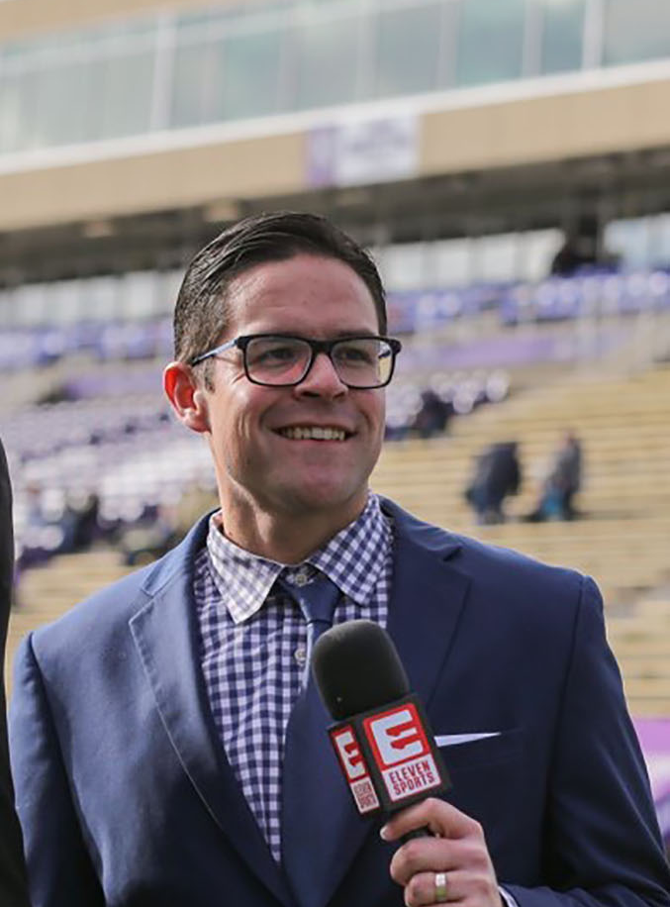
For Additional Discussion
Jon Oglesby
Email – joglesby@uhsaa.org
Cell Phone – 702-672-8974

