Slide 1
Extemp Inclusion
Shannon LaBove

Slide 2
Why do we even need this?
How will my family eat if this happens?
Should welfare reform be a priority?
Should Affirmative Action be eliminated?
Will I be able to get into college?
People think I am a crisis and I have to talk about it?
What should be done about the refugee crisis?
Should deportation be increased?
Will my parents be kicked out of this country?

Slide 3
Extemp can sometimes be that last thing…
Lets play a game

Slide 4
Let’s talk about the 4 D’s
Detailed
Directed
Deliberate
Diverse

Slide 5
Detailed
Practice tip 1:

Slide 6
Should deportation be increased?
What policy?
Deportation of whom?
Who is the actor?
What led us to this question?
Do we have an idea in our head of who should be deported?
How is this supposed to happen in real life?

Slide 7
This is when we maximize details!
Not great
Should deportation be increased?
Better
Should Biden's plan regarding deportations be explored?
Best
What policy steps should leaders take regarding deportation?

Slide 8
Directed
Practice tip 2:

Slide 9
What do we want people to answer
What should be done about the refugee crisis?
Come up with a creative idea for immigration reform?
What steps can be taken to prioritize people who are nationless?
What can be done to change our mindset about people who are nationless?
Should this specific policy be passed?
Should political parties prioritize this?
Should states increase or decrease border funding?

Slide 10
Deliberate
Practice tip 3:

Slide 11
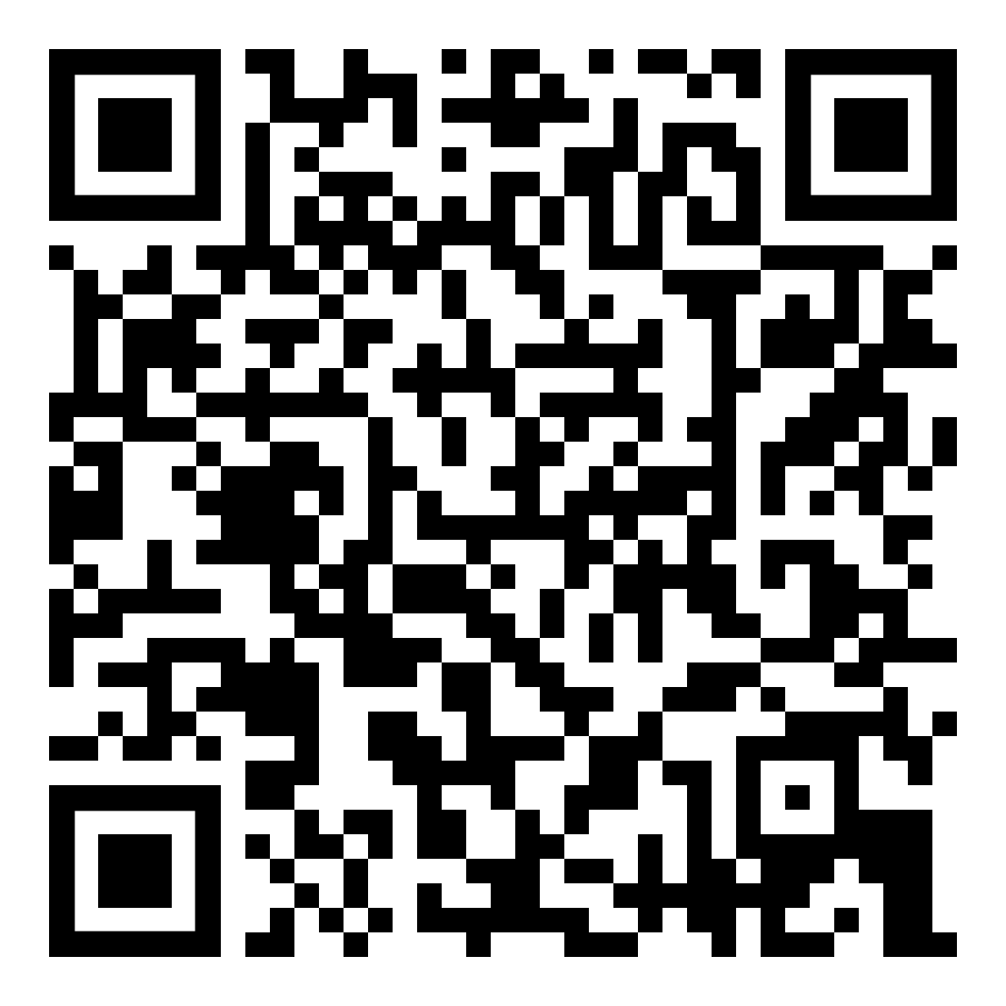
Deliberate choices
Person first language
Avoid idioms, jargon, and acronyms
Avoid phrases that suggest victimhood-“afflicted by,” “victim of,” “suffers from”
Use gender-neutral terms and pronoun choices.
Capitalization matters-The names of races, ethnicities, and tribes should be capitalized
Remember who can distance themselves from trauma
Watch out for saviorism
National Assembly of State Art Agencies

Slide 12
Diverse
Practice tip 4:

Slide 13
Diversify your topics and your mindsets!
AFA_NIET 2016 Round II
Even by Chinese standards, is President XI Jinping too aggressive of late in silencing dissent?
HBCU Nationals 2018
Reuters January 20, 2018 Amid forthcoming water crisis and further economic divide between the rich and poor within South Africa, African National Congress Leaders outlined the party’s program. Should South Africa’s ANC force president Jacob Zuma to step down from his role as president and head of the African Union?

Slide 14
Let’s move to practice Radical Imagination!
Radical imagination sees the world not as it is, but as it could be: a healthy planet that is just and equitable for all. Radical imagination does not blindly accept the status quo, it recognizes that the world can and should change. And how the world could be is not simply better, it’s radically different. Radical imagination is the courage to envision a future that is completely unlike the world we have today. It is limitless. It doesn’t react to or gets discouraged by current realities. It imagines — without constraint — that anything is possible and that, collectively, we are capable of achieving the impossible. –Everyday Activism Network

