Slide 1
NATO/Emerging tech Topic: Topicality Arguments
Resolved: The United States federal government should substantially increase its security cooperation with the North Atlantic Treaty Organization in one or more of the following areas: artificial intelligence, biotechnology, cybersecurity.
A look at negative topicality arguments provided by Rich Edwards, Baylor University

Slide 2
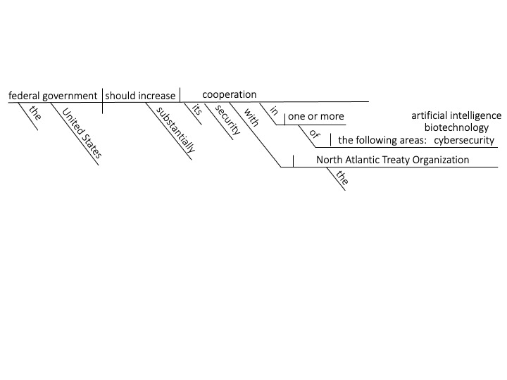
Topicality: “Security Cooperation” = Building Up Foreign Security Forces
Cases that have nothing to do with the security forces of other NATO countries are not topical.
U.S. Department of Defense, DOD LAUNCHES SECURITY COOPERATION CERTIFICATION PROGRAM, Jan. 2, 2020. Retrieved May 29, 2022 from https://www.defense.gov/News/News-Stories/Article/Article/2048832/dod-launches-security-cooperation-certification-program/ Security cooperation is the effort to advance U.S. national security and foreign policy interests by building the capacity of foreign security forces to respond to shared challenges. That effort involves, among other things, building and maintaining military-to-military relationships, combined training efforts, and foreign military sales.

Slide 3
Topicality: “Security Cooperation” Must be conducted by the Department of defense
Cases that involve non-military applications of emerging technologies are not topical.
Kevin D. Scott, (Vice Admiral, US Navy), SECURITY COOPERATION. May 23, 2017. Retrieved May 29, 2022 from https://www.jcs.mil/Portals/36/Documents/Doctrine/pubs/jp3_20_20172305.pdf
Security cooperation (SC) encompasses all Department of Defense (DOD) interactions, programs, and activities with foreign security forces (FSF) and their institutions to build relationships that help promote US interests; enable partner nations (PNs) to provide the US access to territory, infrastructure, information, and resources; and/or to build and apply their capacity and capabilities consistent with US defense objectives.

Slide 4
Topicality: “Cooperation” = Both sides want the end that is achieved
Cases that attempt to change NATO’s position on an issue are not topical.
Stephen Bullon, (Ed.), LONGMAN DICTIONARY OF CONTEMPORARY ENGLISH, 4th Ed., 2005, 347.
Cooperation: When you work with someone to achieve something that you both want.

Slide 5
Topicality: AI means a computer system capable of human level cognition
Cases that deal with things other than advanced computer systems are not topical.
Kelley Sayler, (Analyst in Advanced Technology & Global Security, U.S. Congressional Research Service), EMERGING MILITARY TECHNOLOGIES: BACKGROUND AND ISSUES FOR CONGRESS, Aug. 4, 2020, 2.
Although the U.S. government has no official definition of artificial intelligence, policymakers generally use the term AI to refer to a computer system capable of human-level cognition.

Slide 6
Topicality: “biotechnology” means the processing of materials made by biological agents
Cases that deal with research and not “applications” are not topical
Ronit Langer, (Research Analyst at Talus Analytics), THE BLESSING AND CURSE OF BIOTECHNOLOGY: A PRIMER ON BIOSAFETY AND BIOSECURITY. Nov. 20, 2020. Retrieved May 19, 2022 from https://carnegie endowment.org/2020/11/20/blessing-and-curse-of-biotechnology-primer-on-biosafety-and-biosecurity-pub-83252
Biotechnology, as defined by the Organization of Economic Cooperation and Development, refers to “the application of scientific and engineering principles to the processing of materials by biological agents to provide goods and services.”

Slide 7
Topicality: “Cybersecurity” means to protect networks and devices from unauthorized access
Cases that deal with computers having nothing to do with unauthorized access are not topical.
Cybersecurity & Infrastructure Security Agency, WHAT IS CYBERSECURITY?, Nov. 14, 2019. Retrieved Mar. 21, 2022 from https://www.cisa.gov/uscert/ncas/tips/ST04-001
Cybersecurity is the art of protecting networks, devices, and data from unauthorized access or criminal use and the practice of ensuring confidentiality, integrity, and availability of information.

Slide 8
Topicality: “With” means action in coordination: Unilateral actions are not topical
Cases that involve purely U.S. actions are not topical
Carol-June Cassidy, (Ed.), CAMBRIDGE DICTIONARY OF AMERICAN ENGLISH, 2nd Ed., 2008, 1005.
With: Preposition used of people or things that are together or doing something together.

Slide 9
Topicality: “Substantially” means dealing with substance and not procedure
Cases that establish a procedure for invoking Article Five are not topical.
Merriam-Webster, 2020. Retrieved May 21, 2020 from https://www.merriam-webster.com/legal/substantial%20right
Legal Definition of substantial right : an important or essential right that merits enforcement or protection by the law : a right related to a matter of substance as distinguished from a matter of form

Slide 10
Topicality: “Substantially” means without qualification
Cases that condition the plan on a response from NATO are not topical
Keith T. Smith & Shawn H.T. Denstedt, (Bennett Jones Verchere, Calgary), ALBERTA LAW REVIEW, 1992. Retrieved from HeinOnline, May 15, 2018.
Black's Law Dictionary defines "substantially" to mean: Essentially; without material qualification; in the main; in substance; materially; in a substantial manner. About, actually, competently, and essentially.

Slide 11
Topicality: “Increase” means the plan must increase existing cooperation with nato
Cases that “create” a new program of cooperation with NATO are not topical.
WORDS AND PHRASES, 1960, 381. “Increased,” as used in West’s Ann.Cal. Const. art. 12, § 11, providing that the stock and bonded indebtedness of corporations shall not be increased without the consent of the person holding the larger amount of the stock, does not include or apply to the first creation of bonded indebtedness. To give it such meaning would be to inject into the provision the word “create.”

Slide 12
NATO/Emerging Tech Topic: Topicality Arguments

