Slide 1
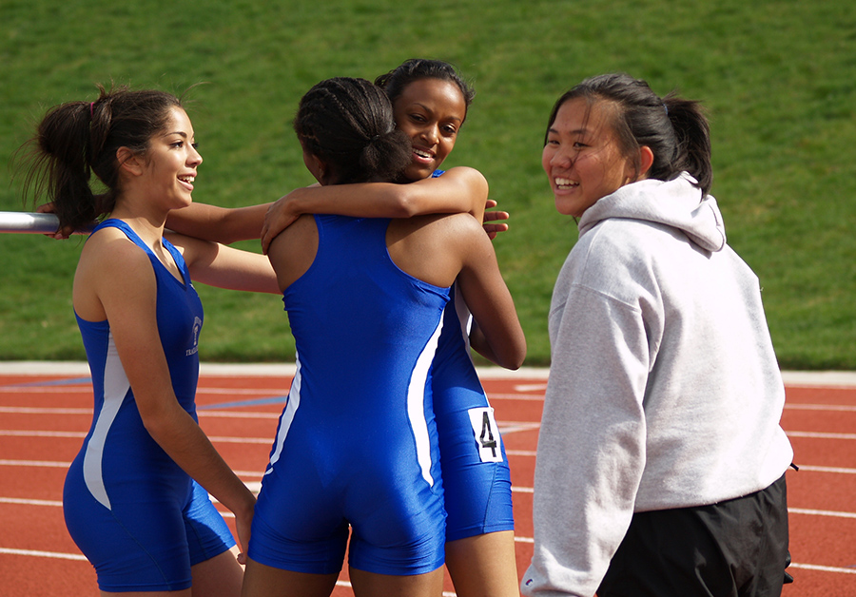
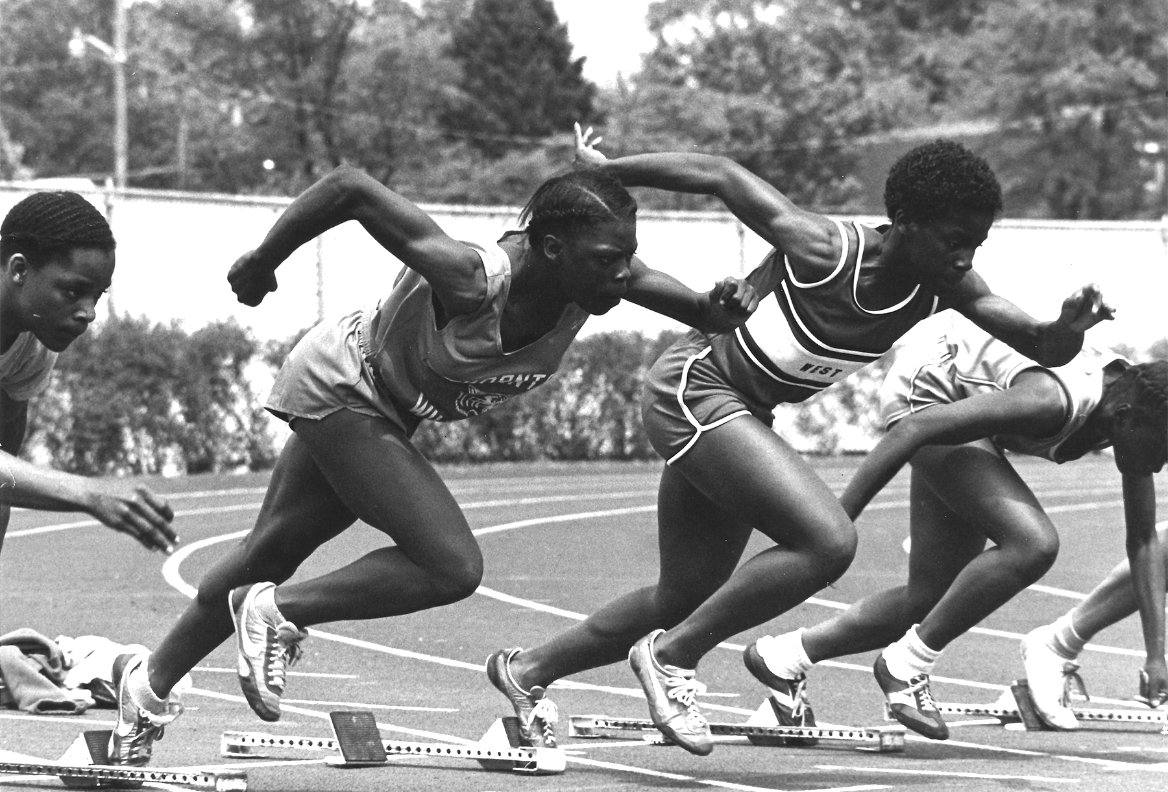


PAST, Present and Future of title ix celebrating 50 years
Notes:
Peg

Slide 2
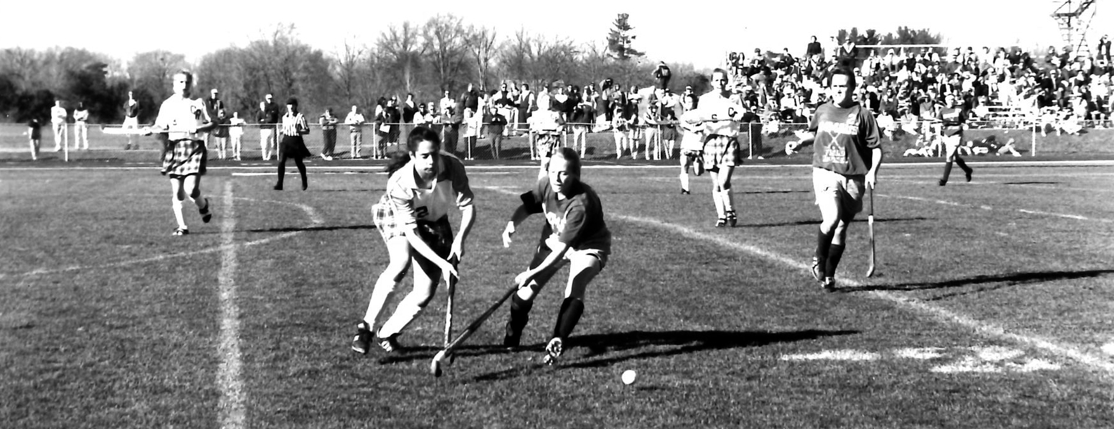

Title ix PAST
Notes:
Peg

Slide 3
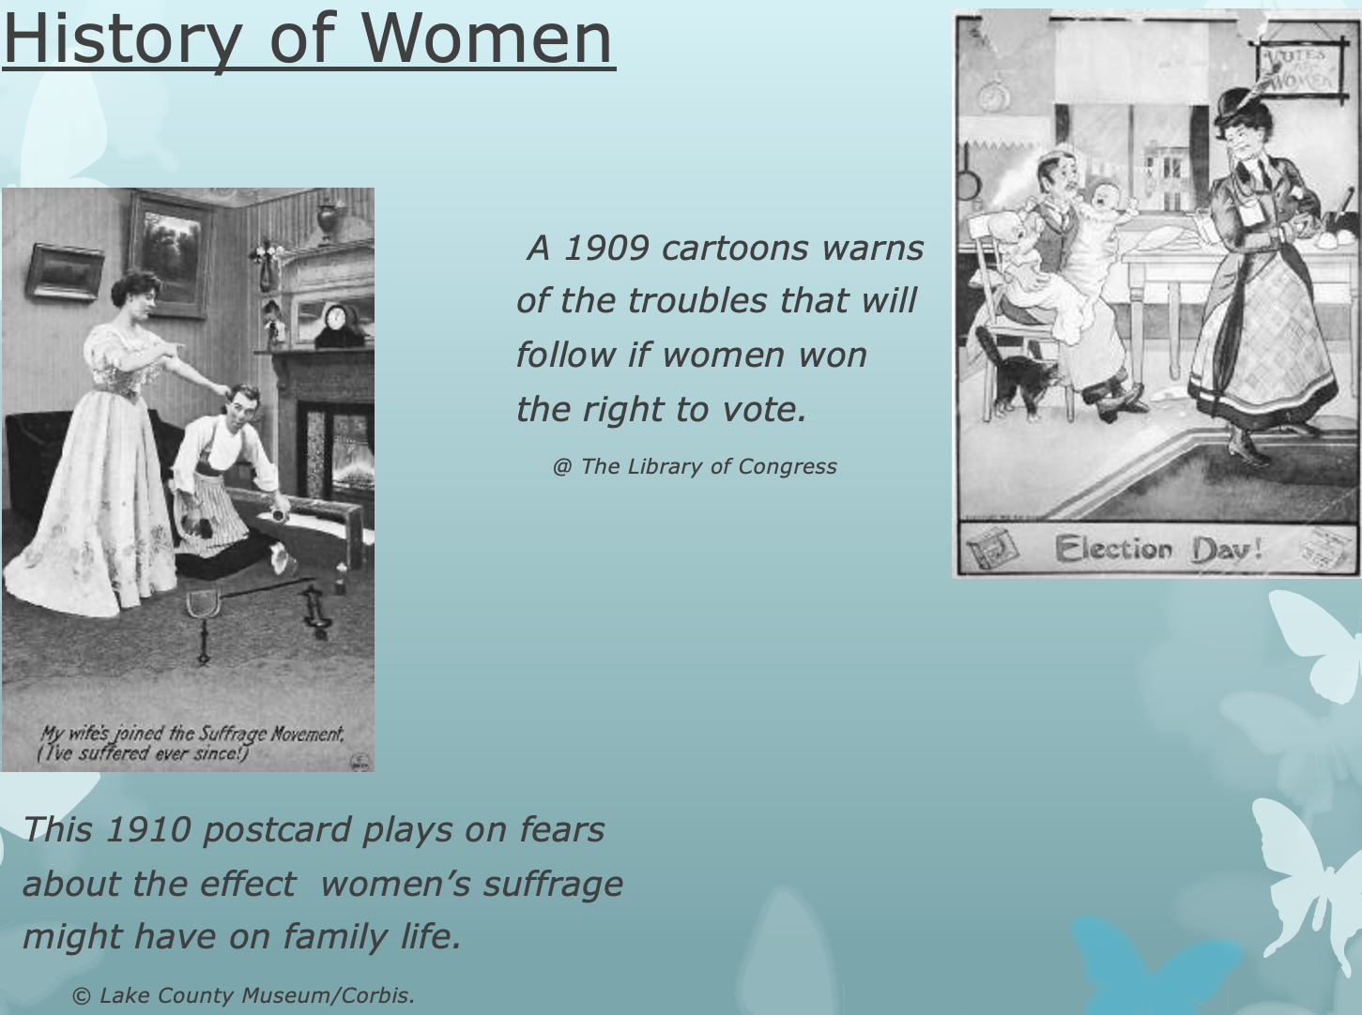
A history of overcoming gender-stereotypes…and fears.

Slide 4

Berniece Sandler, the godmother of Title IX stated that, “Title IX is probably the most important law passed for women and girls in Congress since women obtained the right to vote in 1920.”

Slide 5
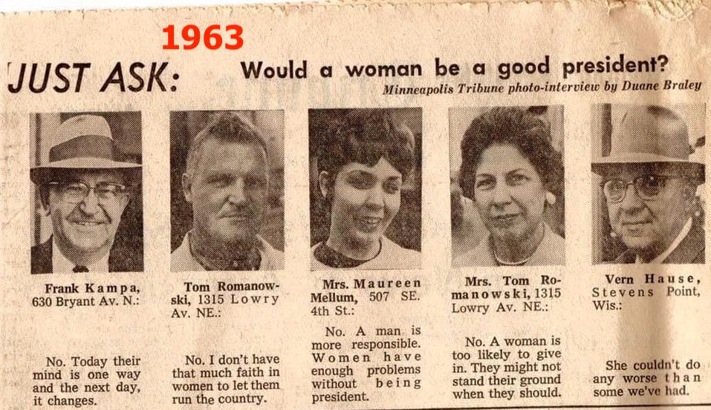

Slide 6
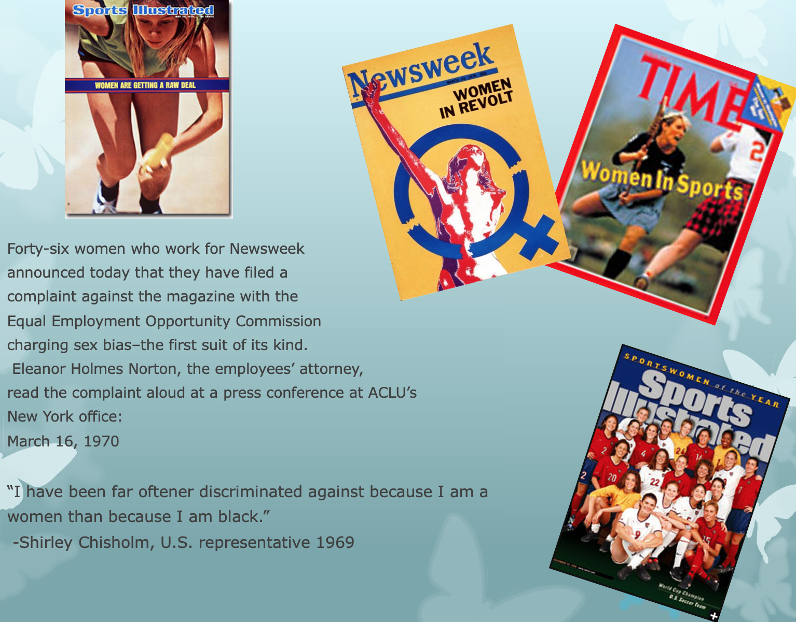
Women begin
to take action.

Slide 7
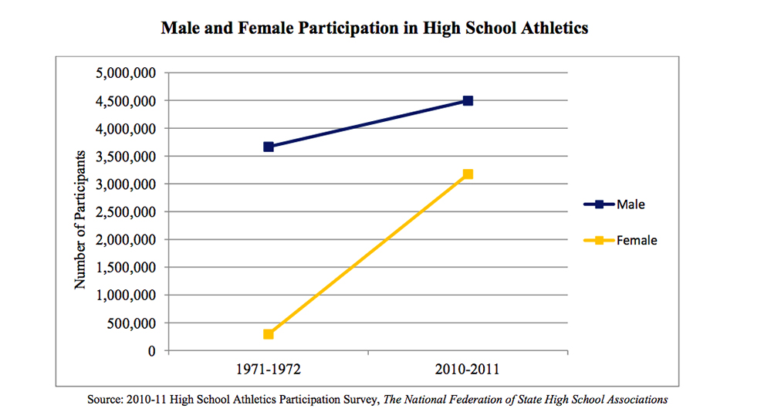
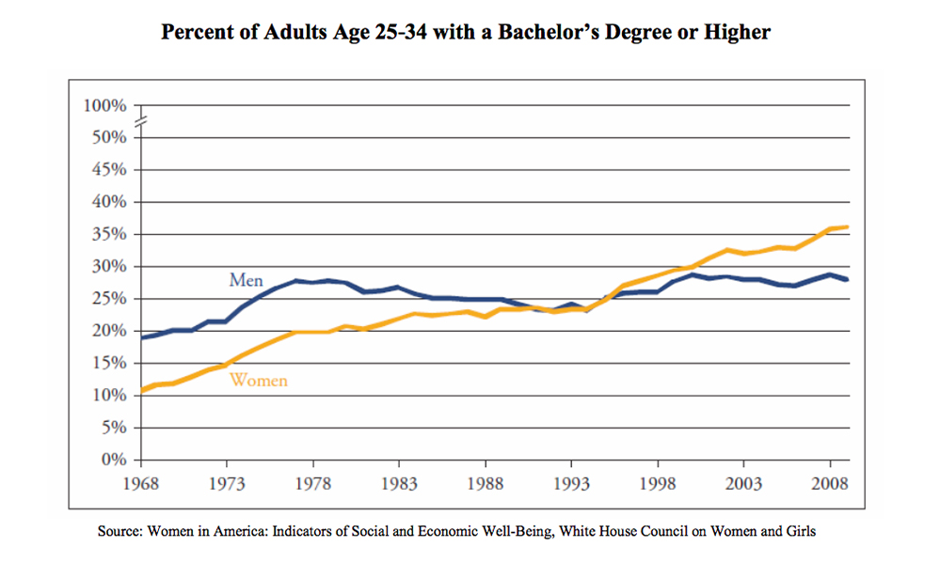

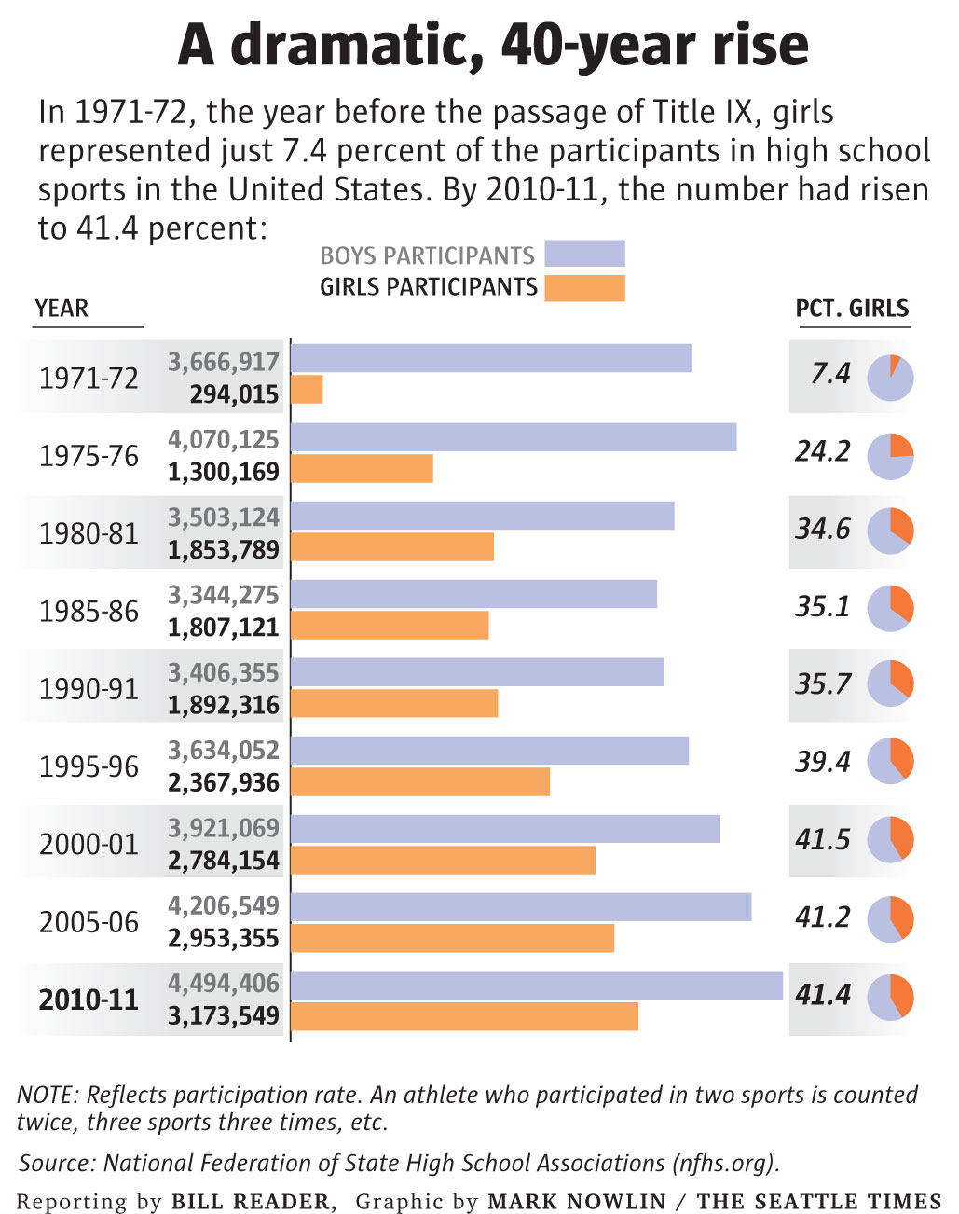

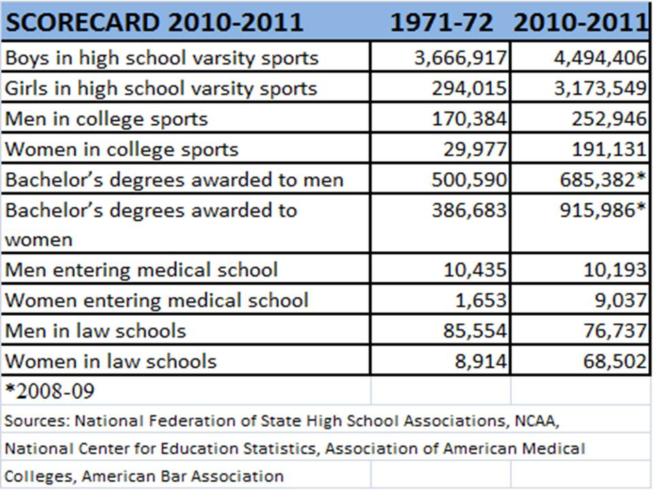
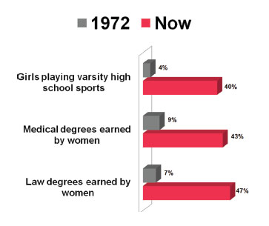
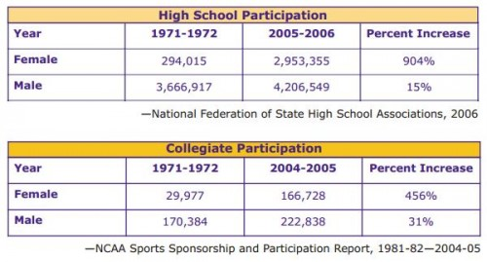

Slide 8
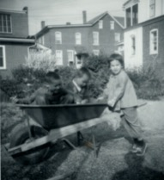
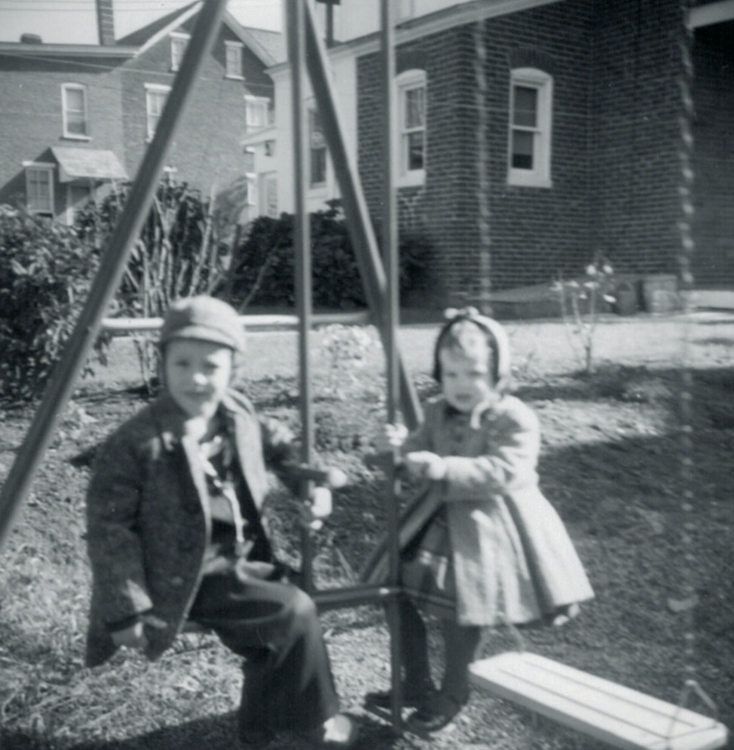


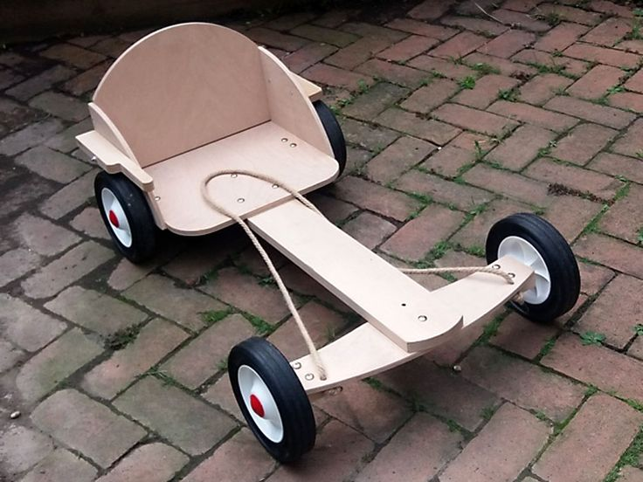
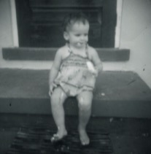
My Story…..the Early Years…

Slide 9
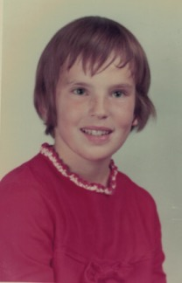

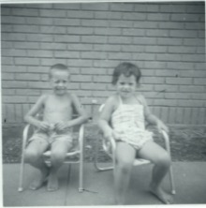
My Story…Elementary School Years…
In Recess Football, I was a
2-year starter!

Slide 10
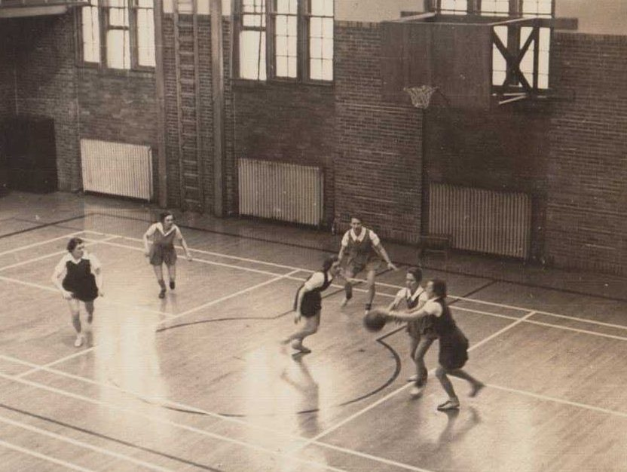
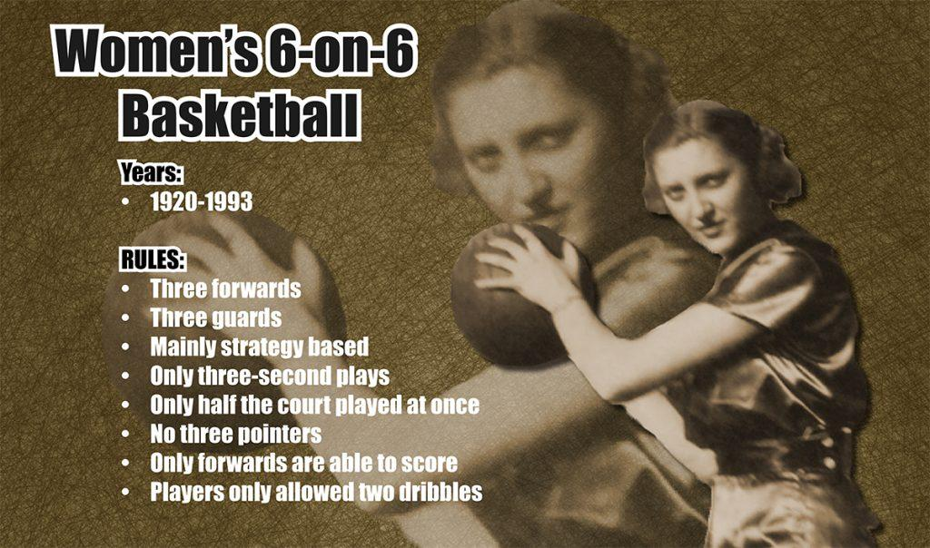
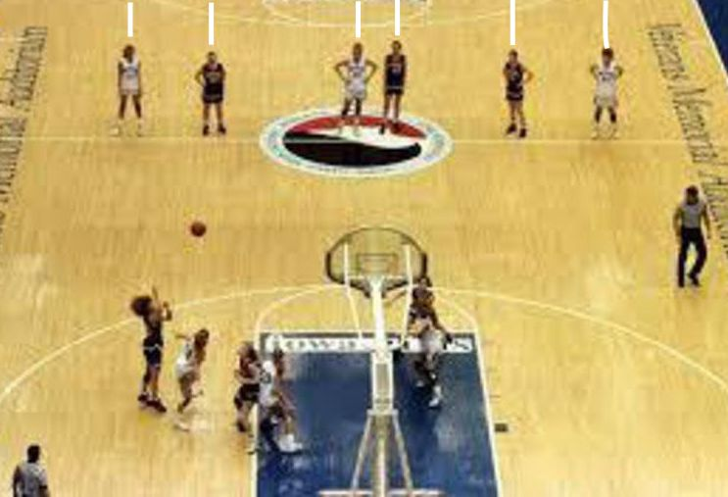
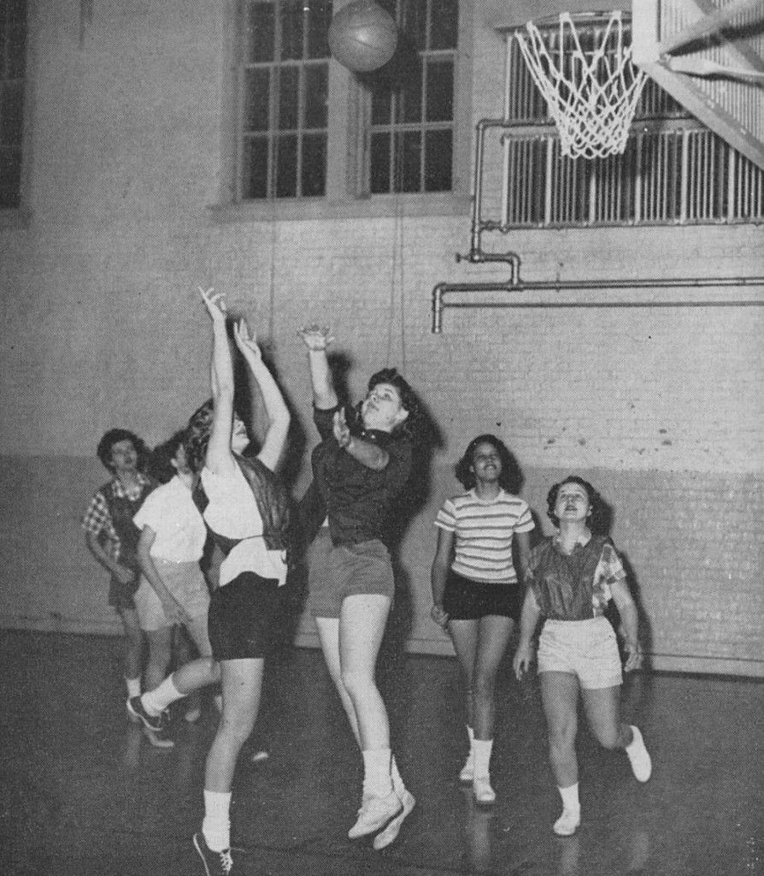
My Story….Middle School Years…
PE Class… Basketball
6 – Man Basketball…say what?!!!

Slide 11
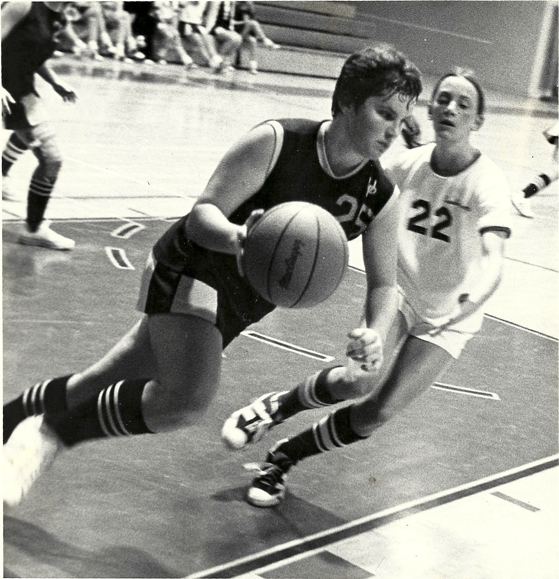
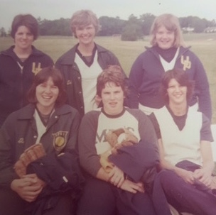
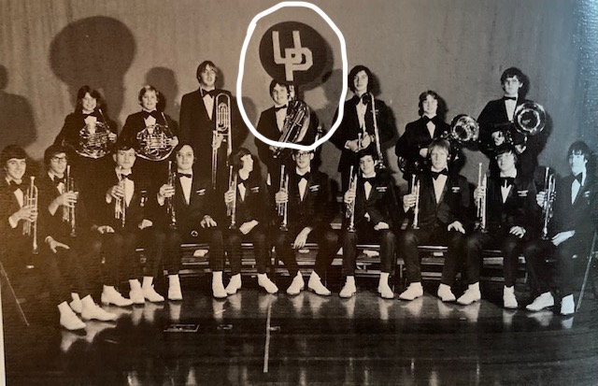

My Story…High School – 1972-1976
Basketball
Softball
Band

Slide 12
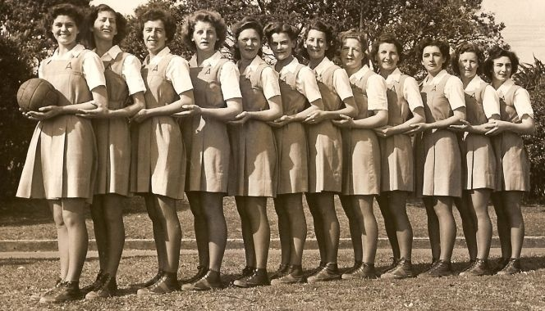
Time Out…
Let’s talk Tunic…

Slide 13
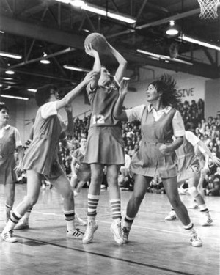
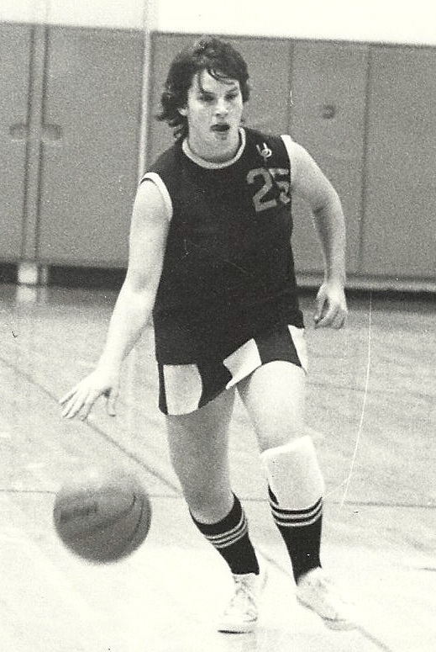
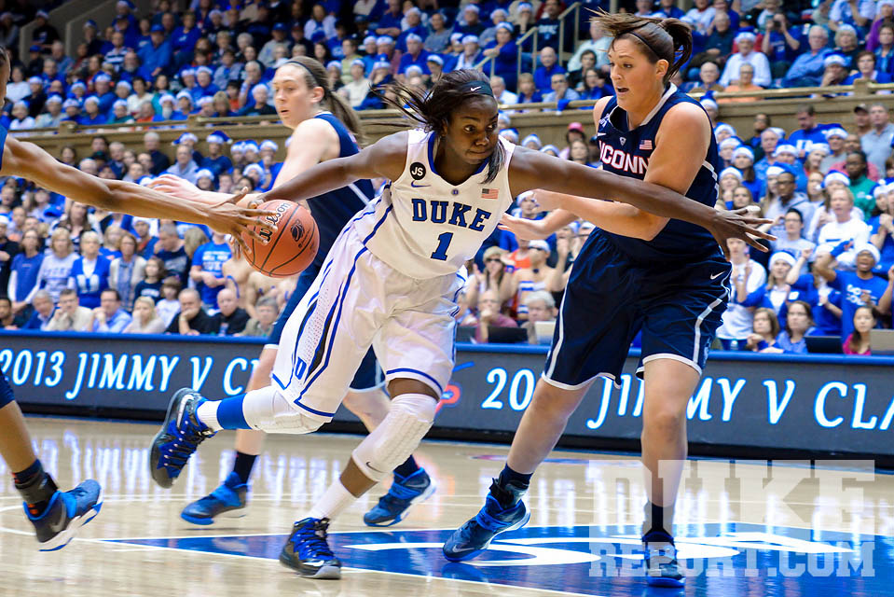
The Evolution of the Tunic!
Converse ->

Slide 14
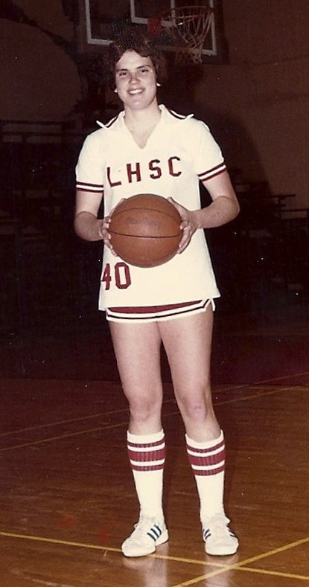
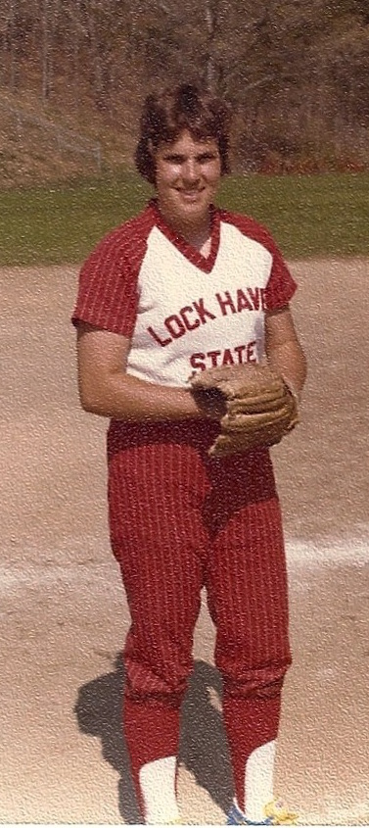
My Story…College – 1976-1981
Basketball
Softball
Adidas ->

Slide 15
What the words “Title IX” meant to us in 1975-76…
Girls could go out for boy’s teams and boys could go out for girls’ teams.
It was about who was ‘better’.

Slide 16
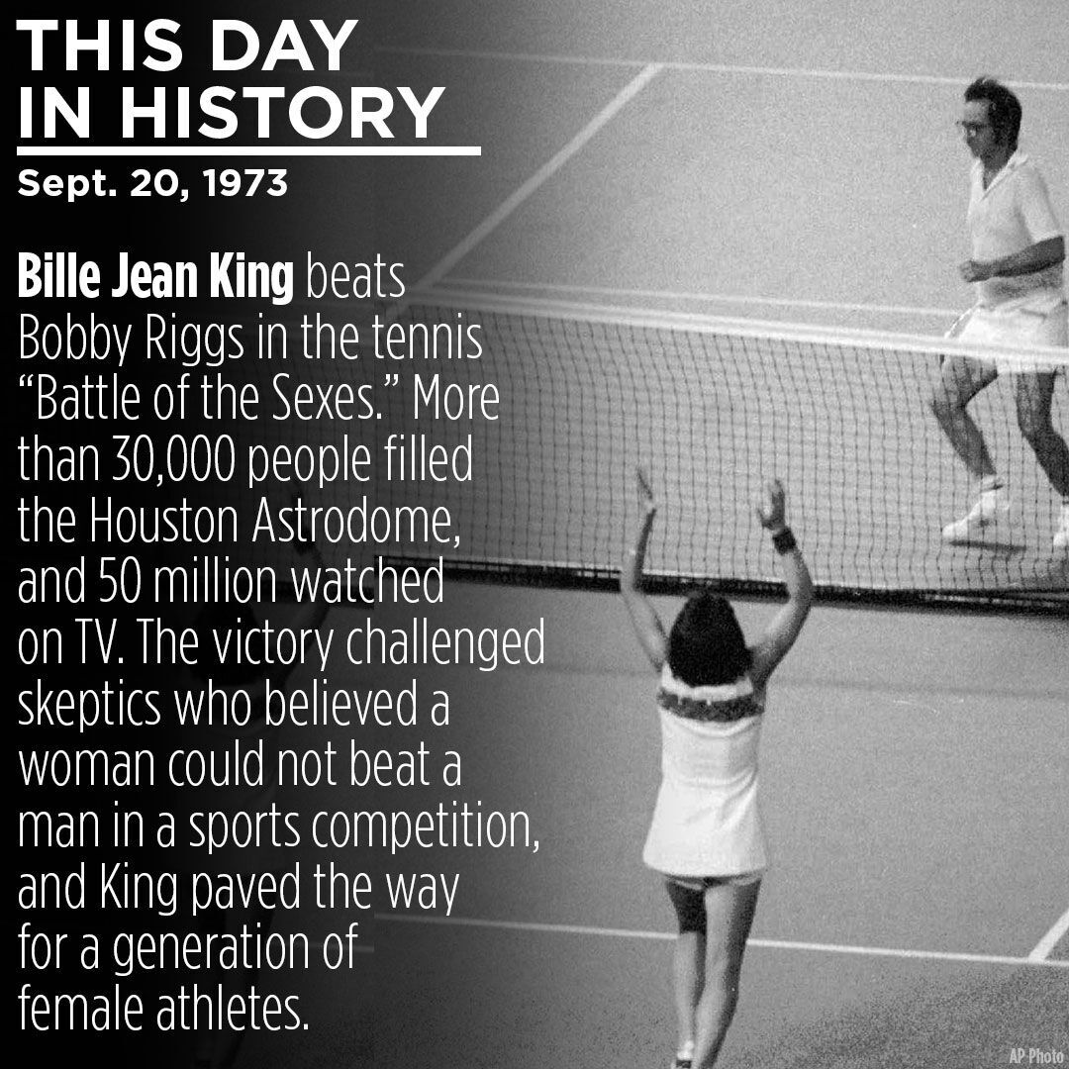

Slide 17
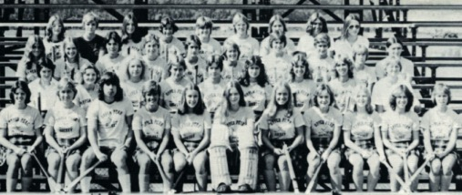
UPHS Fall 1975 Varsity Field Hockey

Slide 18
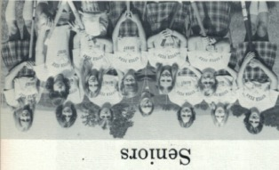

Slide 19
High School Basketball
Played with a boy’s size basketball.
No 3-point line.
The 5-on-5 player format was only 3 years old when I was a freshman in high school.
Girls played fewer games.
Girls’ games were played after school.

Slide 20
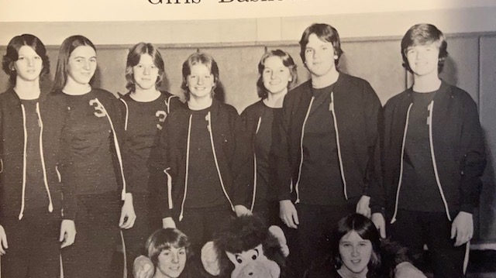
We knew that things were changing…

Slide 21
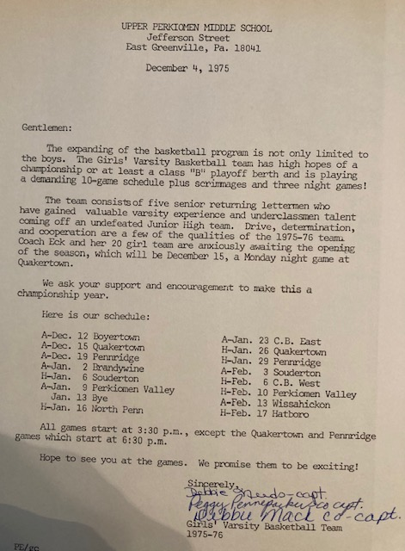

Slide 22



22
15

Slide 23
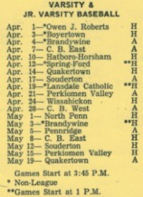
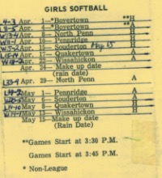

Baseball/Softball
Baseball
Softball
19
12

Slide 24
We just wanted to play!!!
We knew the boy’s basketball team played more games than the girls.
We knew that we played after school and boys played at night.
We knew that pep rallies were only for the football team.
We knew that the cheerleaders only cheered for boys’ teams.
We knew the band only played at football games and the pep band played at boy’s basketball games.
We knew that only our parents came to our games.
In the end…we didn’t care or complain or worry about all of that …because…

Slide 25
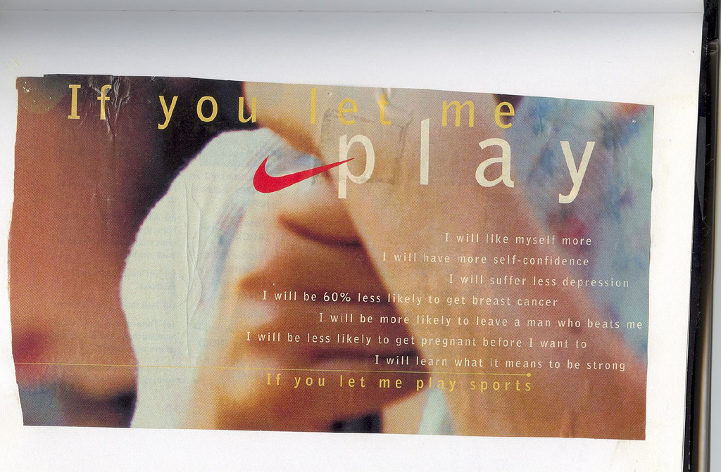
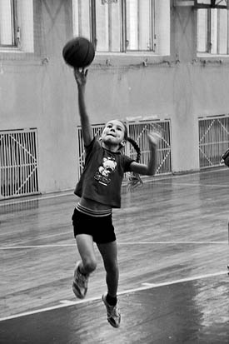
If you let me play…

Slide 26
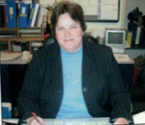
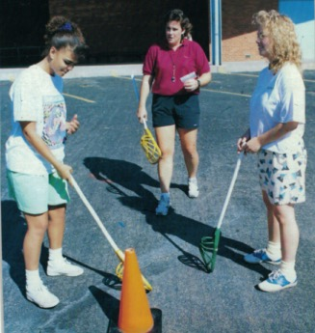
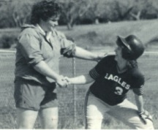
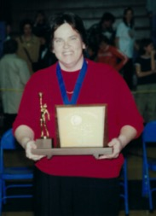
High School/College student-athlete, Teacher, Coach, Athletic Director
“I fell in love with the goodness of playing sports.”
Because of Title IX, I got to be….

Slide 27
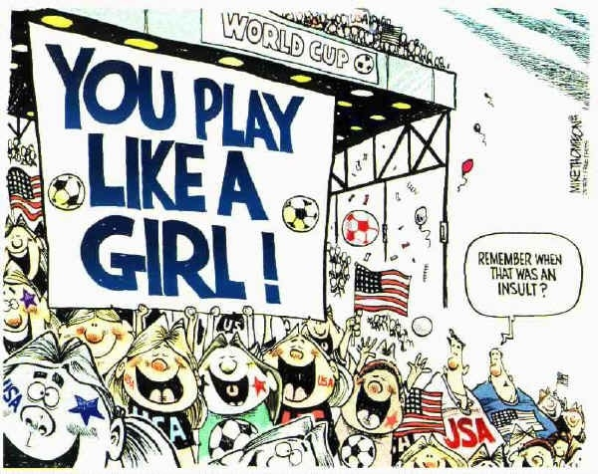

Slide 28
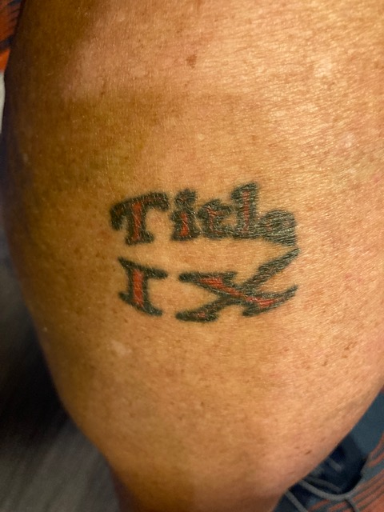
Yes…I do have a Title IX tattoo!

Slide 29
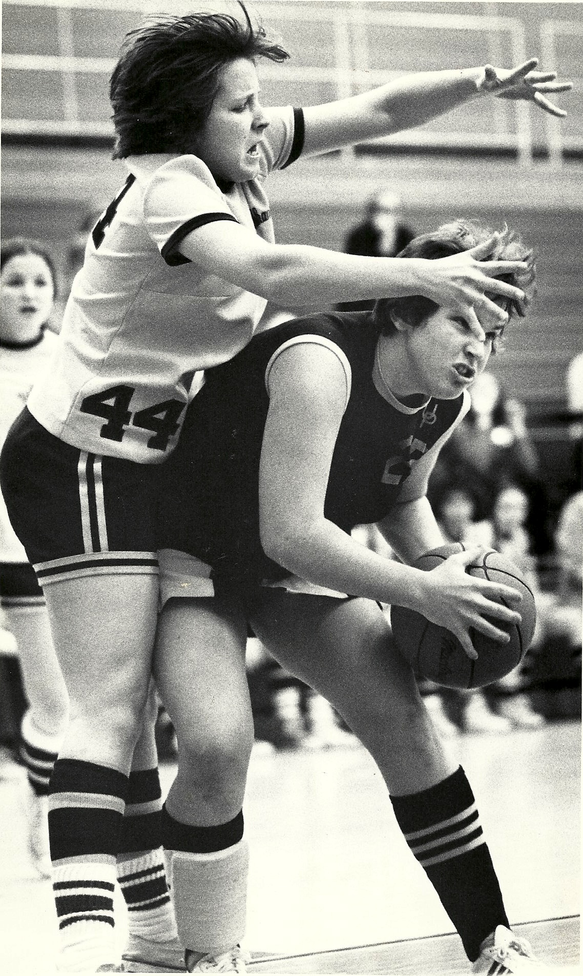
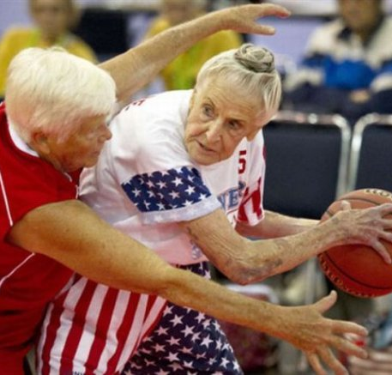
At the end of the day… I want to keep playing!

Slide 30
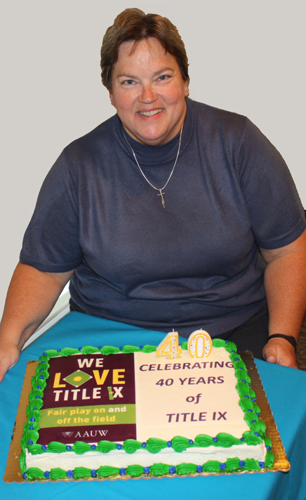
Let’s keep CELEBRATING!!!

Slide 31
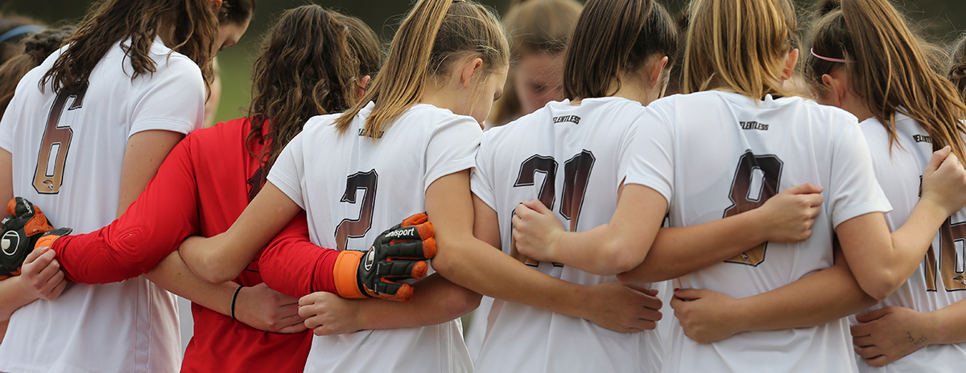
Title ix PRESENT
Notes:
Jean

Slide 32



LET ME PLAY
District Wrestlers, 2019
Coach John Wooden, 1973
Senior Year (1976)
**Girls’ Athletic Association (GAA)**
Notes:
Start with What it felt like to be a freshman in all girls classes and playing basketball outside on the blacktop.
1972-1976 Title IX had just passed and it was time to “Let Me Play”--the Nike slogan resonated with me in high school and I watched as opportunities for girls expanded and participation numbers skyrocketed. 1/27 girls participated in sports pre-Title IX and now ⅓ play. Those 37 words changed Peg’s life and mine also. My four years of high school were focused on school and sports. After my freshman year of high school, I asked my parents if I could go to the John Wooden Basketball Camp in Pt. Loma and I got the nod of approval, so the five kids loaded up the station wagon and made the 8 hour drive down to San Diego where I was dropped off and the rest of the family spent the next few days at the zoo and sea world and the beach. It was the first time “girls” were allowed at the camp and it was amazing--so much so that I went back my sophomore year. Those four years of high school were marked with continued improvements in the conditions for girls sports including facilities and visibility. It was so powerful to see more and more women involved in the world of athletics.

Slide 33


NGWS Luncheon, Class of 2019

Slide 34


Women’s History Month, 2020

Slide 35


STILL TODAY . . .
Keep Working
Make both diamonds a source of pride
Make equitable
Provide media with positive stories
Rallies, team meals, and more for all
Today’s Discrepancies
Softball & Baseball diamonds
Practice times and contest times
Media
School support

Slide 36


GIVING BACK
Show the Good!
Catch the Female Spirit
Notes:
Here to emphasize current student-athletes. This is Jordyn, a point guard for the Vikings who surprised me at the CCS Championship ceremony with a full sprint into my arms. Luckily, I had braced myself for this embrace. Jordyn is now involved in the athletic arena and went on to play rugby. This year we had a girl score the first varsity football touchdown in school history. Daeja is a junior who is an amazing basketball player who happens to love football. These girls have directly benefited from the work of Peg and others like her.

Slide 37


The Next Generation
Julia, age 28, High School English Teacher
Riley, age 26, 2nd Grade Teacher
The Ashen Family, 2018
Notes:
These two are my present and watching the benefits that athletic participation has had on their lives. The oldest is a teacher at my high school and the youngest teaches second grade two hours away. Even more present are our two granddaughters and I think about what the future holds for them and after listening to Julie you will see how bright that future is for our girls.

Slide 38


Slide 39


Flashing, Blinking Neon Sign
Surround yourself with ALL sports!
Trish, Annette, Dory, Jean, 2012
Notes:
Who do we see in the present as Athletic Directors?? When I started 25 years ago, I was often the only woman in the room at league meetings, on the football sideline, at state and national meetings, but now our numbers are growing. I take my responsibilities seriously to welcome the new women into the athletic arena. There are so many more resources now for a rookie AD--Women in Leadership FB group, the Global Community of Women in Sports, ADInsider, podcasts, and more. At our site we celebrate the present with our high school seniors in an annual NGWS luncheon to promote giving back to sports in some way upon graduation–maybe coaching, officiating, athletic training, or even athletic administration. Our students are
Talk about the conversations at gatherings and being a “flashing, blinking, neon sign”

Slide 40

Title ix Future
Celebrating and Growing Opportunities
Notes:
Julie
Briefly share my story
Share NFHS Title IX plan and our Why
Celebration of the past and growing opportunities in the now and future.
Excellent opportunity to take advantage of the spotlight and grow opportunities.

Slide 41


Webpage on nfhs.org dedicated to #TitleIXat50
#TitleIXat50
Notes:
The NFHS developed a web page specifically for the Celebration.
Dr. Niehoff welcomes all on the page
Content Calendar
Tool kit

Slide 42
State Specific Assets
Download your state specific toolkit!
  https://www.nfhs.org/resources/title-ix/
Included in the toolkit is:
  Social media graphics (Facebook, Twitter, Instagram)
  Zoom Background
  Email signature
  Website graphics in various sizes
  Print Ads
  Floor Decals and much more
Need a specific size? Let us know!
#TitleIXat50

Slide 43








#TitleIXat50
Notes:
A quick view of some of the items in the tool kit download.

Slide 44



Title IX Timeline on nfhs.org
#TitleIXat50
Notes:
As you scroll down the webpage the NFHS created a High school timeline.
Highlighting trailblazers and moments of magnitude around the nation.
We are continually updating this timeline with new information.

Slide 45


Women in Leadership Facebook Group
Mission:
Create a community that champions women to lead and be intentional in their actions by providing mentorship and networking opportunities that foster personal and professional growth.
Notes:
In the process of discussing the celebration for title ix, the NFHS Women’s leadership team began a Facebook group for High School Coaches, officials, administrators and state association members.
We envision an NFHS community where women are empowered at all levels of interscholastic activities

Slide 46

Better Together – Women and Sport Leadership Summit.
May 1-3, 2022
Notes:
TitleIX@50 initiative to empower and grow future and current female leaders in sport led the Federation to host the first ever national virtual summit designed by and for female high school sport leaders.
Better Together – Women and Sport Leadership
Hosted Virtually, May 1-3, 2022.
For: Coaches, Officials/Adjudicators and Administrators
Save the Date Card available at the door on your way out.

Slide 47

Agenda
Day 1 – Breaking Down Barriers
Day 2 – Reimagining Through Innovation
Day 3 – Realizing Your Power
Coaches, Administrators, and Officials Tracks
Notes:
The summit is designed to address systemic barriers, develop meaningful relationships, create actionable solutions to continue the growth of women in the field of sports – coaching, officiating and administration.
If there is one thing, we have learned from the pandemic is that we can “gather” virtually and learn.
The format will be a hybrid of pre-recorded and live sessions with tracks for coaches, officials and administrators as well as daily general sessions for everyone.

Slide 48

Vital Role of the Ad for the future
Providing opportunities for female students
Hiring women to coach
Promoting your sport teams and activities
Mentoring female assistant AD’s.
Notes:
Title IX
prohibits sex discrimination in any educational program or activity receiving any type of federal financial aid
There was a great article in HS Today November Issue “Athletic Directors, Female Coaches Working for Equity in High School Sports By Monique Paris
Monique had a great line I want to quote, Monique stated that the law “created equal opportunities for females to participate in athletics, but there still needs to be a shift for more equitable practices in high school athletics.”

Slide 49

Providing opportunities and Promoting sports and activities
Providing opportunities for female athletes
Change Traditions
Build Community Support
Equal vs. Equitable
Notes:
Opportunities:
do the boys get the prime playing nights or do you rotate?
Are you creating a community to draw people in for both boys and girls sports?
How do you encourage your teams to support each other? FB team at VB matches… if you are an activities director do you cross over sports teams supporting fine arts and vis versa?
2. Traditions: are they all around celebrating male athletic programs?
a) How do we change or rethink these to be more inclusive?
3. Building community support: Equal vs Equitable (maybe the boys program already draws good community support so you can spend more time, money and resources on building that support for the girls program)
a) do you conduct promotions at both boys and girls games?
b) Do you advertise at both? Social Media for both?
c) Do you have cheerleaders at both?
d) Build relationships with middle school coaches and athletes to help build programs.

Slide 50

Hiring practices
Analyze your coaching staffs
  Do they represent the students they coach?
Be Proactive
  Listen to your female coaches.
  Have frequent reviews.
  Create an open environment for good communication.
  Professional development for all coaches
Notes:
Analyze: do your staffs match the respective gender of the population they coach? Is it your belief that women should be coached by women?
Create environment where students can see female staff members
This creates pathways, support and mentorship for female leadership and participation.
Diversity and Inclusion: do you have inclusive job description?
Do you expand where you advertise for jobs? (Widening and deepening the candidate pool)
Proactive Retaining: create a culture of valuing women coaches
challenge existing narratives and resist blaming women for the lack of women coaches. The system was built for men to coach.
Providing support for working mothers.
Create an inviting culture for all coaches to bring their kids to practices and games (Coloring books, candy, open and inviting)
Set clear expectations that if a head coach is male, he should strive to have female role models on staff.
Professional development for all shows commitment to creating good culture and environment
As AD’s you may not be the individual who contracts or hires officials in your school. How do you encourage females within your school to seek out officiating as an opportunity to stay involved with sports?
Current coaches, faculty, students, moms of students…
Tie it in to giving back to the school/community

Slide 51
Mentorship Programs
87% of Millennials rate professional development and career growth opportunities as important to them in a job.
Good tool to have in coaching and officiating.
Mentorship programs can:
  Develop new coaching and official pipelines
  Retain high potential talent
  Foster Diversity and inclusion
  Demonstrates your commitment to the development of your coaches
  Improves employee engagement
Notes:
DO YOU HAVE MENTORSHIP PROGRAMS IN YOUR SCHOOL AND CONFERENCE?
87% of Millennials rate professional development and career growth opportunities as important to them in a job.
Retention - Research shows that a lack of mentoring is one of the main reasons your most talented employees decide to leave.
Investing in a comprehensive mentoring program can give you the long-term support they want and encourage them to stay at your company.
DEI – mentoring programs boost representation of black, Hispanic and Asian American women.

Slide 52
Notes:
IDEAS AROUND THE COUNTRY
These are things you can implement at the school, conference, district and state levels.
WIAA - Women in Sport was created by the WIAA to support women as leaders, change agents, connectors and collaborators in the world of athletics. Through this initiative, the WIAA is proud to provide women in athletic leadership with a series of conferences, workshops, and networking opportunities to inspire growth and engagement.
MHSAA - The MHSAA Women In Sports Leadership Conference is designed for those interested in becoming a high school coach, administrator, official or athletic trainer and is held in Lansing every other year.
MIAA –
NMAA -

Slide 53

questions
What is one thing you are doing to promote girls’ participation in interscholastic activities?

Slide 54

questions
What is one thing you are doing to recognize students?

Slide 55

questions
What is one thing you are doing to attract female coaches and encourage young women to join the officiating ranks?

Slide 56
Thank You
SPEAKERS:
Peg Pennepacker pegpennepacker@gmail.com
JeanKinn Ashen
jeankinn.ashen@salinasuhsd.org
Julie Cochran
jcochran@nfhs.org
PO Box 690 | Indianapolis, IN 46206
Phone: 317-972-6900 | www.nfhs.org
www.nfhslearn.com
www.nfhsnetwork.com

