Slide 1
Future of Large Group Contests and Festivals:
Mike Plunkett, OSSAA
Alan Greiner, IHSMA
What Changes will Stay?

Slide 2
Lessons Learned: past 18 months
Be Flexible
  Traditional deadlines and dates were not going to be possible
  Lots of last minute changes/cancellations
Adapt
  New technologies/trainings were necessary
Don’t think outside the box. Think as if there is no box.
  Don’t limit your thinking by past practice - it may not yield the best solution.

Slide 3
IHSMA Year at a glance
Marching Band - Virtual only (October, 2020)
  Schools had a deadline for uploading performance recording
  47 bands participated (normal year 156) - 2 sites/judge panels
  CompetitionSuite was judge platform
  Zoom mtg to coordinate listening
All-State Festival Auditions - Virtual only (October, 2020)
  Individual auditions only - customized judging platform
  Video (used school google drives and provided judges links to those performances
  76% participation from a normal year.

Slide 4
IHSMA Year at a glance - cont.
Jazz Band Festival - In-person and Virtual Options (Jan/Feb, 2021)
  In-Person events - bell covers/face masks required
  CompetitionSuite used as judge interface for both formats
  Zoom used to coordinate judge panels for virtual festivals.
  Virtual - 56 bands; In-Person- 52 bands - normal year is 139 (78% participation)
Show Choir Festival - In-person and Virtual Options (Jan/Feb, 2021)
  In-Person events - bell covers/face masks required
  CompetitionSuite used as judge interface for both formats
  Zoom used to coordinate judge panels for virtual festivals.
  Virtual - 12 choirs; In-Person- 21 choirs- normal year is 52 (63% participation)

Slide 5
IHSMA Year at a glance - cont.
Jazz Choir Festival - In-person and Virtual Options (Feb, 2021)
  In-Person events - bell covers/face masks required
  CompetitionSuite used as judge interface for both formats
  Zoom used to coordinate judge panels for virtual festivals.
  Virtual - 22 choirs; In-Person- 39 choirs- normal year is 79 (77% participation)
Solo-Small Ensemble Festival - Virtual Option (Mar/April 2021)
  Used All-State judging platform and adapted it.
  Video Performance via google drive link
  Score pdf’s provided google drive link
  5,834 entries participated virtually - 2019 was 11,817 entries (49% participation)
    financially, this festival saved the IHSMA in 2021- minimal site expense - no judge mileage or hotel.
  Judges had 3 days to complete their assignments

Slide 6
IHSMA Year at a glance - cont.
Large Group Festival - In-person and Virtual Options (May, 2021)
  In-Person events - bell covers/face masks required
  In-Person events used a “Bubble Format” whenever possible
    2 venues - bands, choirs, orchestras all warmed-up, performed in venue. Judge panels rotated between venues. Each venue had its own entrance for performers and spectators.
  CompetitionSuite used as judge interface for both formats
  Zoom used to coordinate judge panels for virtual festivals.
  Virtual - 219 ensembles; In-Person- 455 ensembles; normal year is 886 ensembles (76% participation)

Slide 7
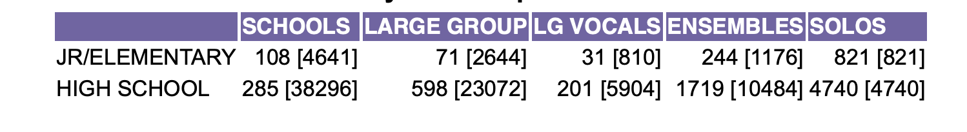
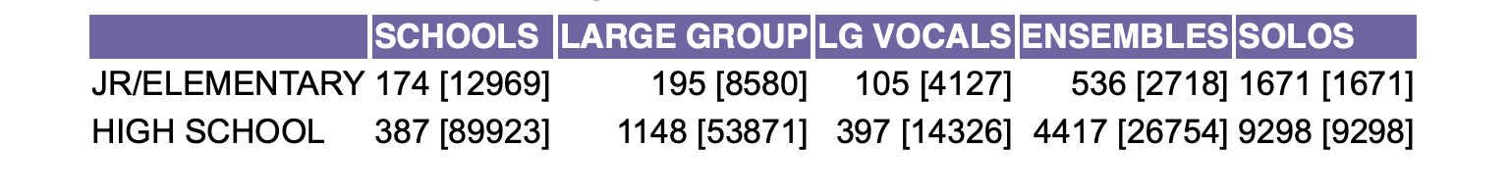
OSSAA Year at a glance
Marching Band - Face to Face (October, 2020)-Example of reduced participation
  85 bands participated (normal year 160) - 6 sites/judge panel
Numbers were down considerably, but all events were offered. The boss said “find a way to make it happen for the fine arts kids”!
Comparison of music participation Covid vs Non-Covid

Slide 8
Oklahoma Financial Impact of Covid
OSSAA: Last year's income for music was $178,947.00 (normally have 94 contests, all money is through entry fees, no tickets required to enter)
OSSAA: Last “normal” year income was $370,000.00
(Expenses were also less, but not as much as you might expect in 2020-21)
“It costs the same to rent a piano for 2 solos or 60 solos”-Attributed to Confucius-471 BC
IHSMA: The Covid pandemic consumed 30% of IHSMA’s reserve funds. Loss is estimated at around $180,000.

Slide 9
“If we can Wrestle and play Football, then why can’t I have a band contest?”
Attributed to Mike Plunkett-2020 AD
Unlike Iowa who has their own music association, Oklahoma is part of an Activities Association.
Pros and Cons:
If I want to do something in the fine arts, it has to be similar to the athletic world
If I lose money, or don’t make my budget, the other activities “pick up” the slack
I do not have a board of directors who understand fine arts and the possible changes I want to implement (normally former coaches)

Slide 10
Iowa-Keepers: Stuff we want to carry over
CompetitionSuite or other similar judge interface for all large ensemble festivals
  Cell phone technology vs association owned digital recorders ($30,000 savings)
  Immediate results to schools
  Lack of written commentary forces schools to review recordings
Iowa - retain All-State and Solo-Small Ensemble online adjudication tools
  No more paper ballots
  Legible
  Immediate feedback for schools
  90% of judge training is now done
Bubble Format
  Keep or discard?

Slide 11
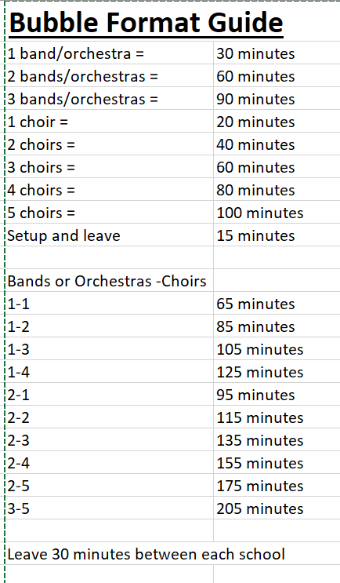
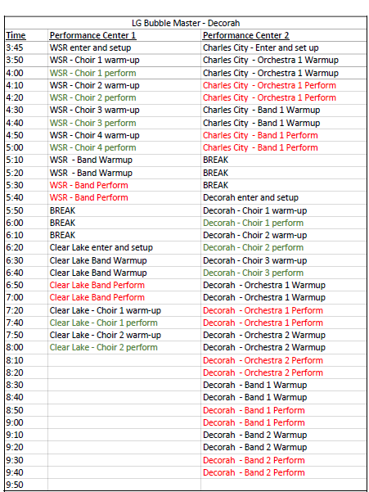
What is a Bubble Format?

Slide 12
Bubble Format: Pros and Cons
Pros:
  Aerosols are contained within a community (reduces possibility of cross community spread)
  Really reduces rushed feel for participating schools
  Schedule for judges is very relaxed
  Teachers loved it
  Promotes a real sense of community
Cons:
  It is not an efficient use of Judges Time
  Doesn’t allow participating schools to see other performances
  It is not cost effective - requires more host sites and rooms for “case storage”
  No concessions income

Slide 13
CompetitionSuite: Pros and Cons
Pros:
  Cost ranges from Free - $10 per entry (depending on what package/features you want) - IHSMA used the $7 package
  It is extremely easy to use from the Site Manager/Judge/School perspective once the event has been set up.
  Teachers have immediate access to results.
  Site has the ability to control when results are released.
  No more digital recorders ($30,000 savings for IHSMA)
  Email tech support is extremely responsive and you get the actual programmer that can immediately address your problem.
  Schools must listen to judge recordings to have any feedback other than the numbers on the ballot
Cons:
  Cost
  Setting up your event the first time can be extremely daunting and is not intuitive. The language used to describe different features is not universally understood.
  Requires judges to have a smartphone (iPhone or Android)
  Requires some training and setup for judges.
  No phone tech support (only by email)
  Minimal if any written commentary

Slide 14
In-Person vs Virtual: Pros and Cons
Pros:
  Virtual - better adjudication in that judges are able to re-listen to make sure they got it right.
  In-person - Students are provided a valuable “real life” scenario in which they can either succeed or fail. One shot.
  Virtual - very cost efficient (no mileage expense, minimal site expense, no hotel or food expense)
  In-Person - opportunity for gate receipts
  Virtual - students are able to provide their “best take”.
  In-Person - students have the opportunity to hear other performances
  Virtual-Judges can adjudicate on their own timetable or schedule
  Schools travel cost and loss of “classroom” time is eliminated
Cons:
  Recording quality is not always reflective of the actual ensemble sound
  Virtual - judges can struggle actually “see” what’s occurring
  In-Person - risk of aerosol exposure and cross community spread
  Virtual - students ability to create multiple takes and then choose the best one to submit (can be seen as a negative - some might see this as a positive)
  Young adjudicators do not get to interact and “learn” from veteran judges

Slide 15
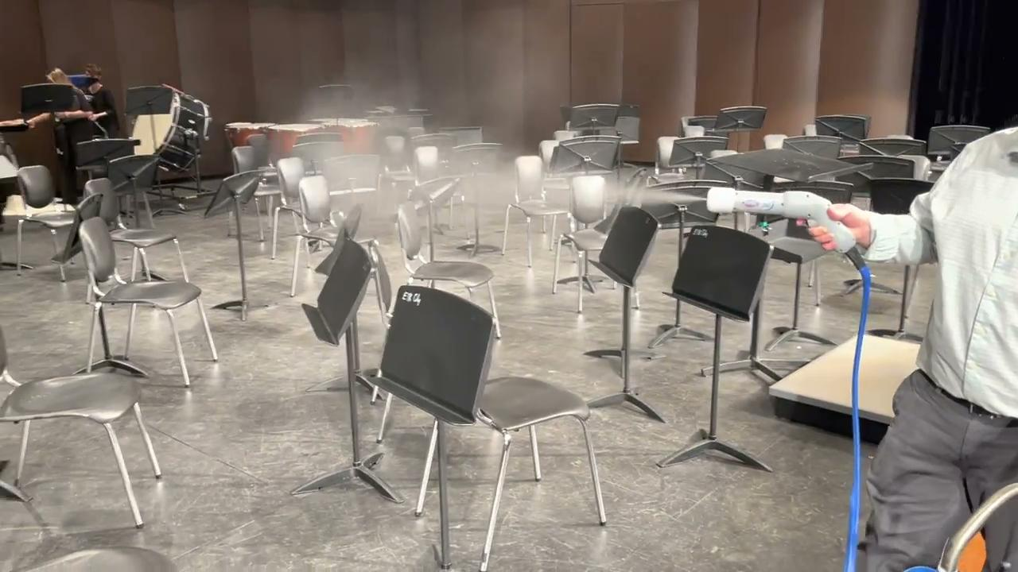
Oklahoma-Changes and carry over
Allow Superintendents to decide if students are safe to participate, no questions asked in “pandemic mode”(similar to saying it's too icy to run the busses)
Students need to come, perform and leave (not educationally sound, but safer during pandemic), stay in your bubble! Laminated and wiped down sight-reading music for some contests

Slide 16
Balancing safety with quality
Highest degree of safety (for all parties involved - students, teachers, adjudicators, spectators) - Full Mitigation as recommended by NFHS
Highest degree of quality - no mitigation
The answer doesn’t have to be one or the other - time to redesign the box.

