Slide 1
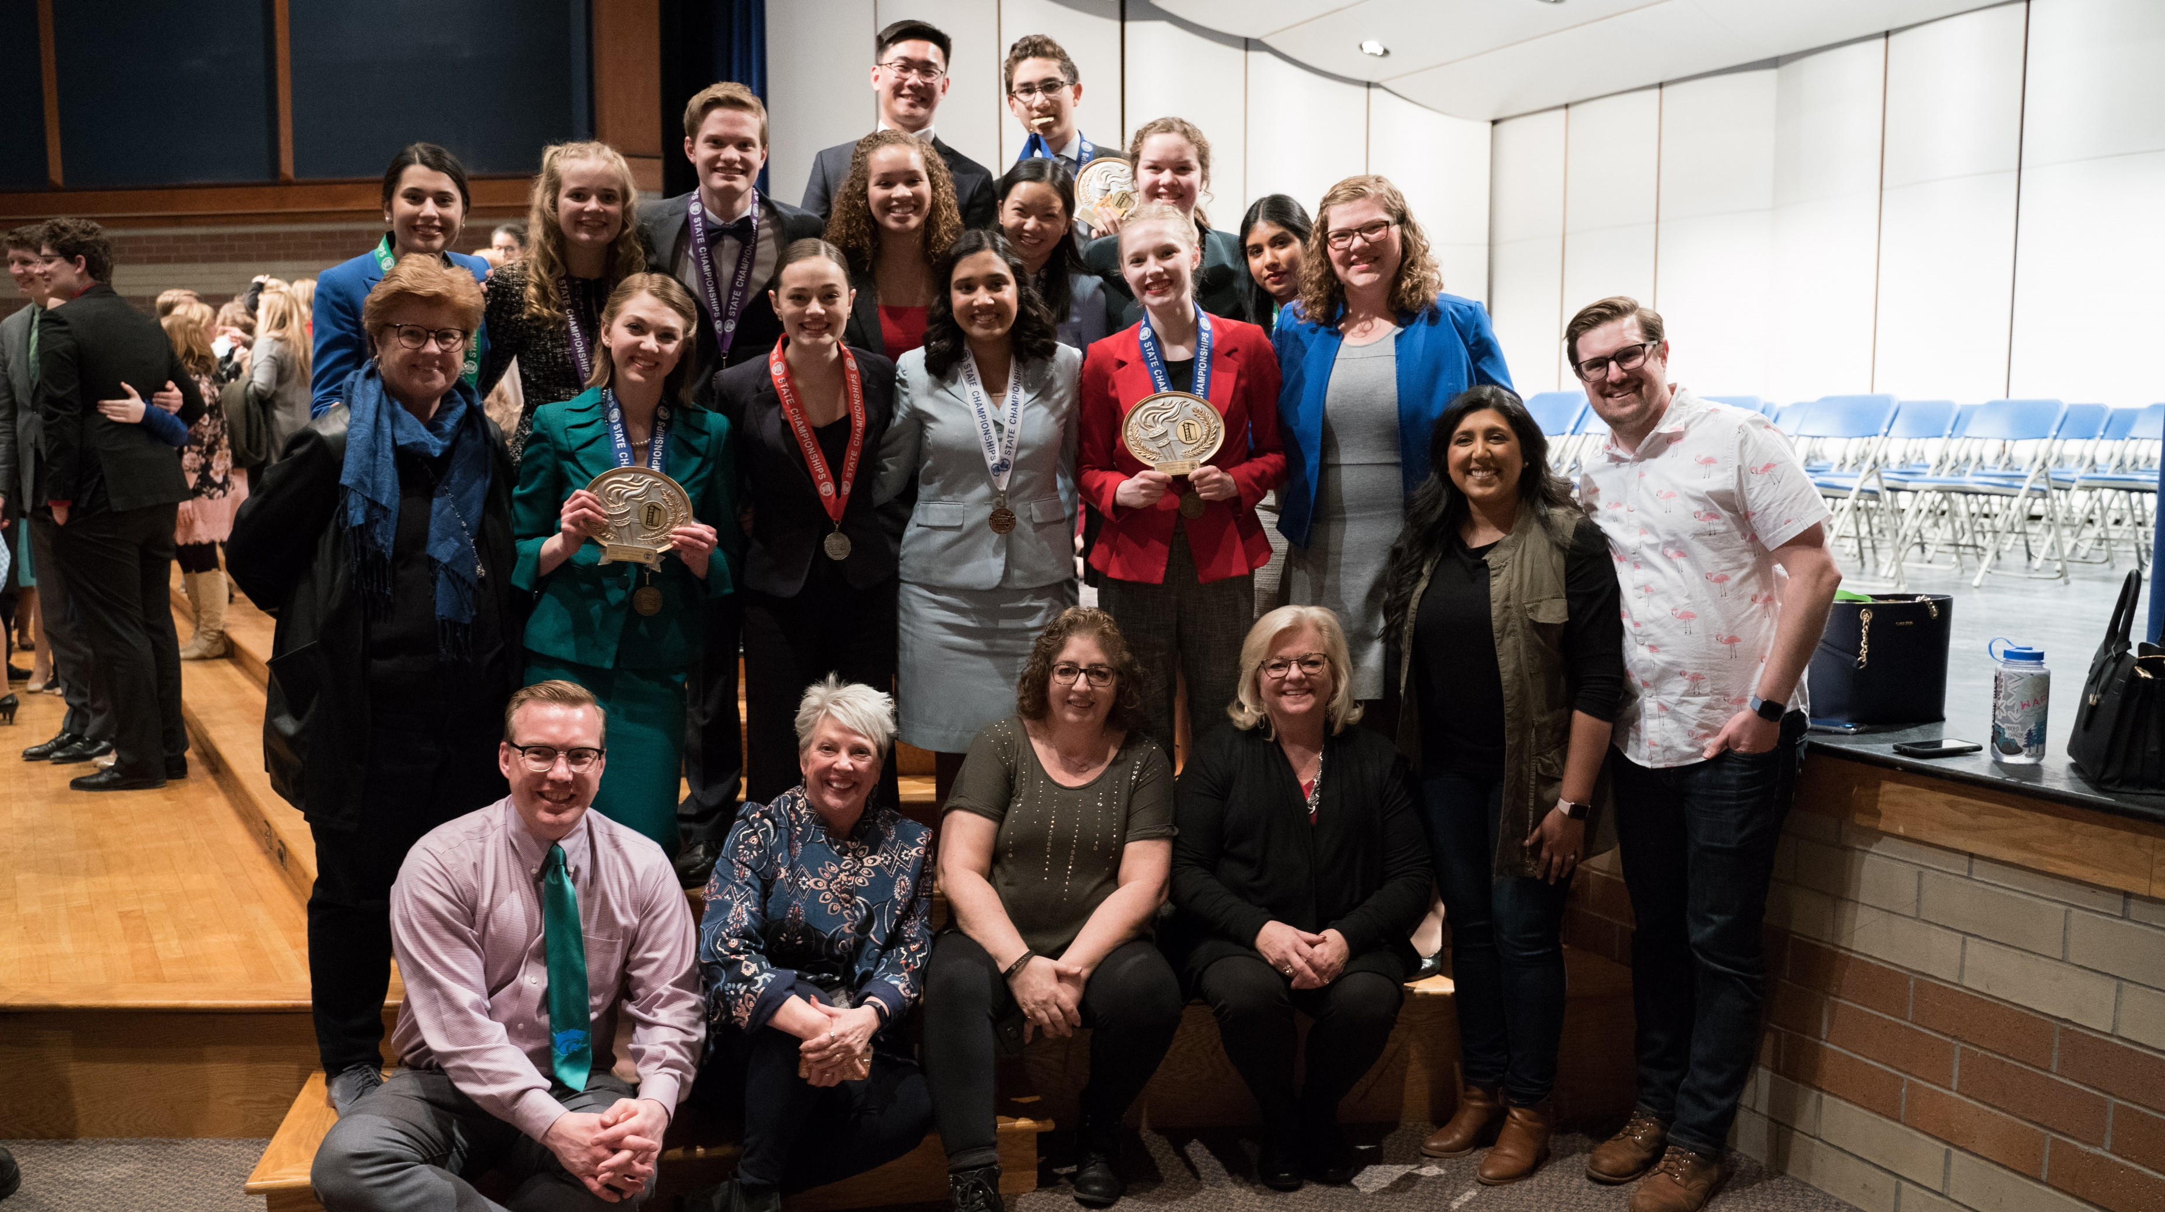
Recruiting Students & Rebuilding Programs NFHS Performing Arts Conference September 20, 2021 Amy Doherty, MSHSL

Slide 2
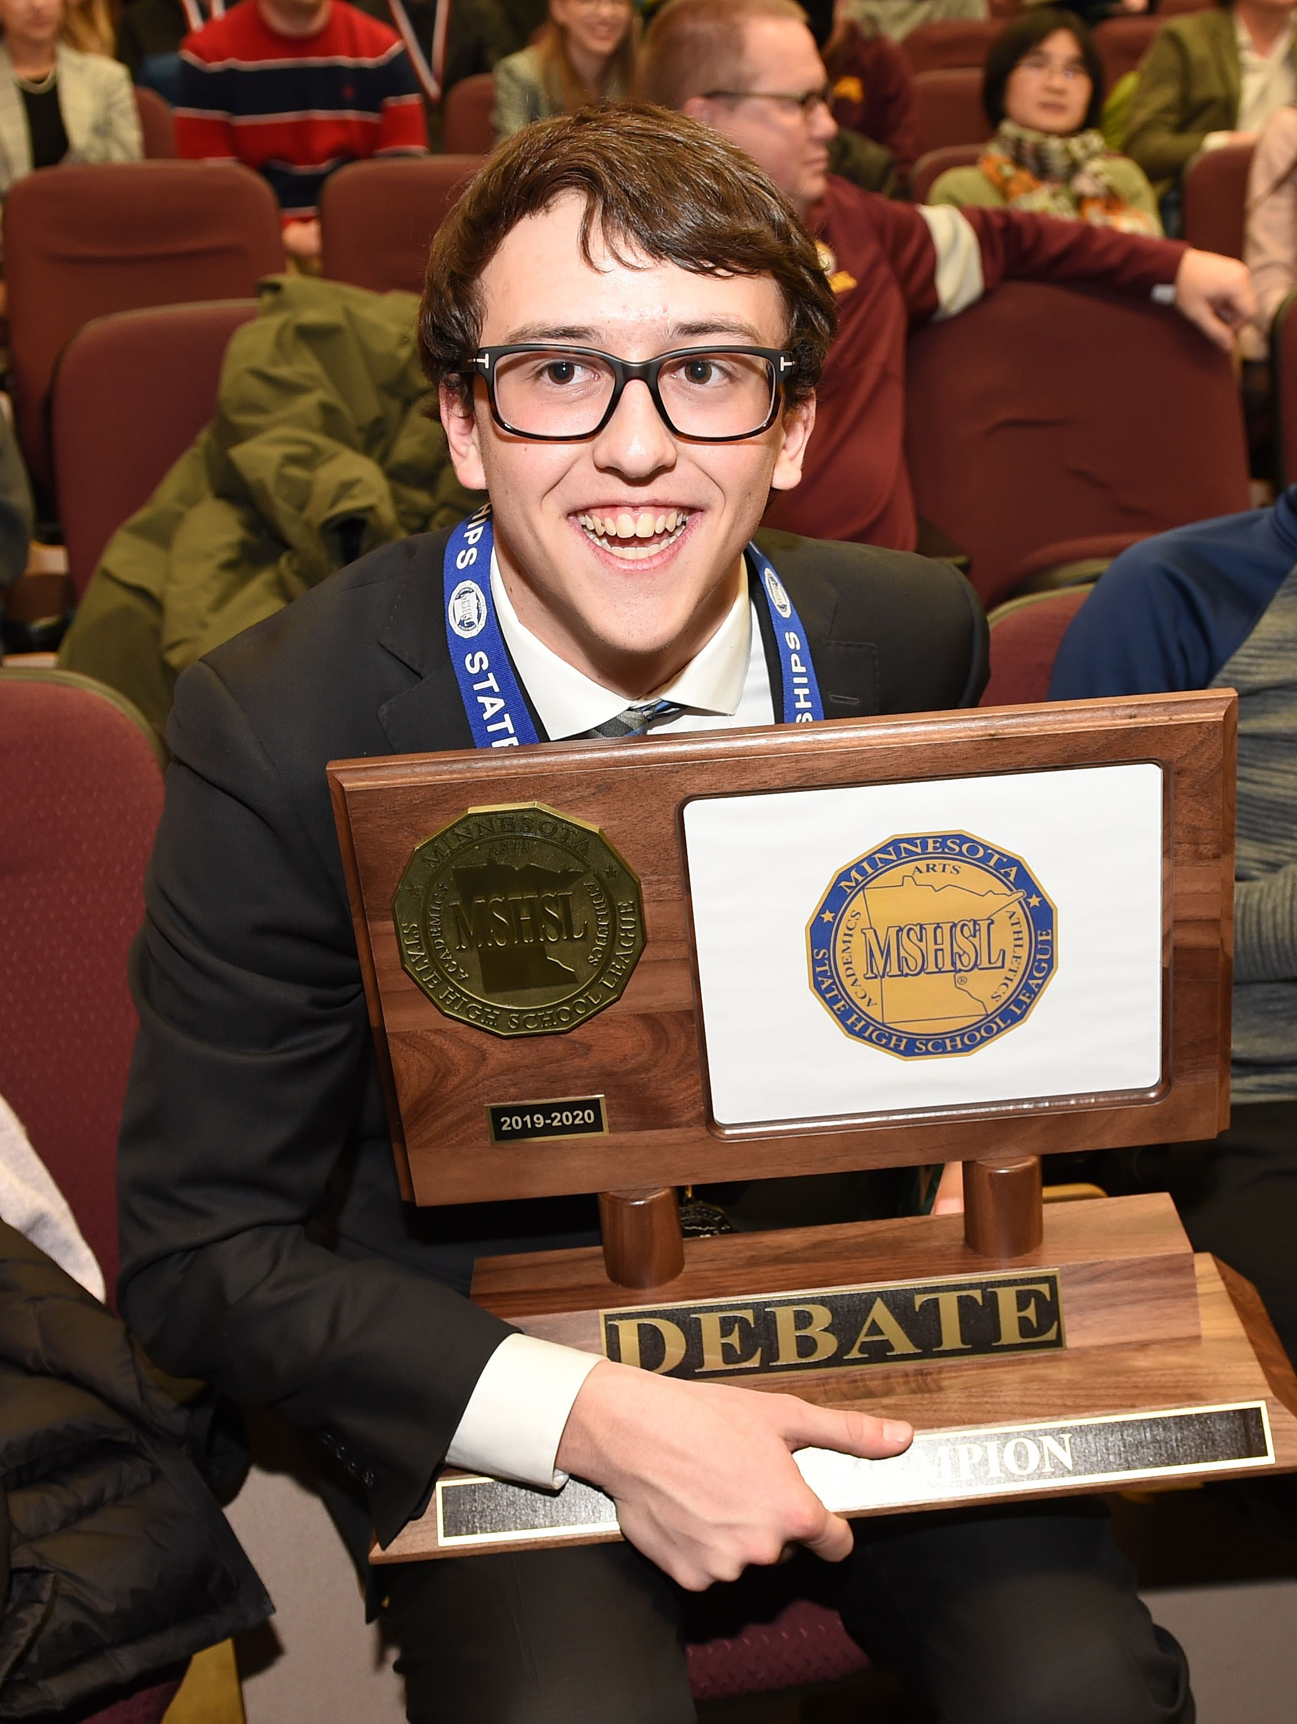
Rebuilding Requires Recruiting
“When I took over as coach on my team 5 years ago there were 6 students, mostly juniors and seniors. After 2 years I had 20, 7th - 12th grade.”
School and Team Initiatives Teacher/Coach Initiatives Student-Led Initiatives Parent/Community Involvement Statewide Policies and Culture

Slide 3
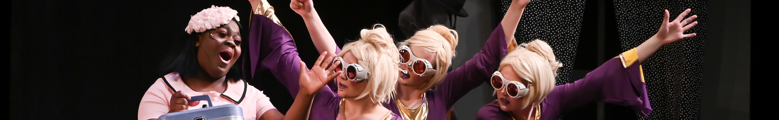
Recruiting – School and Team Initiatives
Club and Activity Fair
One Act Play for 7th and 8th graders, including crew - set, lights, sound, costumes
Speech units in middle school English/Language Arts focusing on one or more high school speech categories
Work with other sports and activities, sharing students
Notes:
Our school has had a club fair in some years...groups, clubs, teams...can put up a booth or table and have members or officers answer questions as the students mill around.
Every other spring we have a play, then a musical. In the years we have a play, the 7th and 8th graders do a one act play and get to have their own crew (set, lights, sound, costumes, etc). This helps them understand how important all the jobs are, not just acting.
The main thing I do to get kids involved is work around the sports and other events in their lives. I have had athletes, FFA officers, knowledge bowl members. I make sure the coaches know when I need kids and ask that they share from their end. This works great for our small school.
Communication with the parents is imperative! They need to know my expectations, especially 7th graders and other first timers. Parents need to know the OAP is a serious varsity team and that spring play, although fun and not competition, needs to be a quality show.

Slide 4
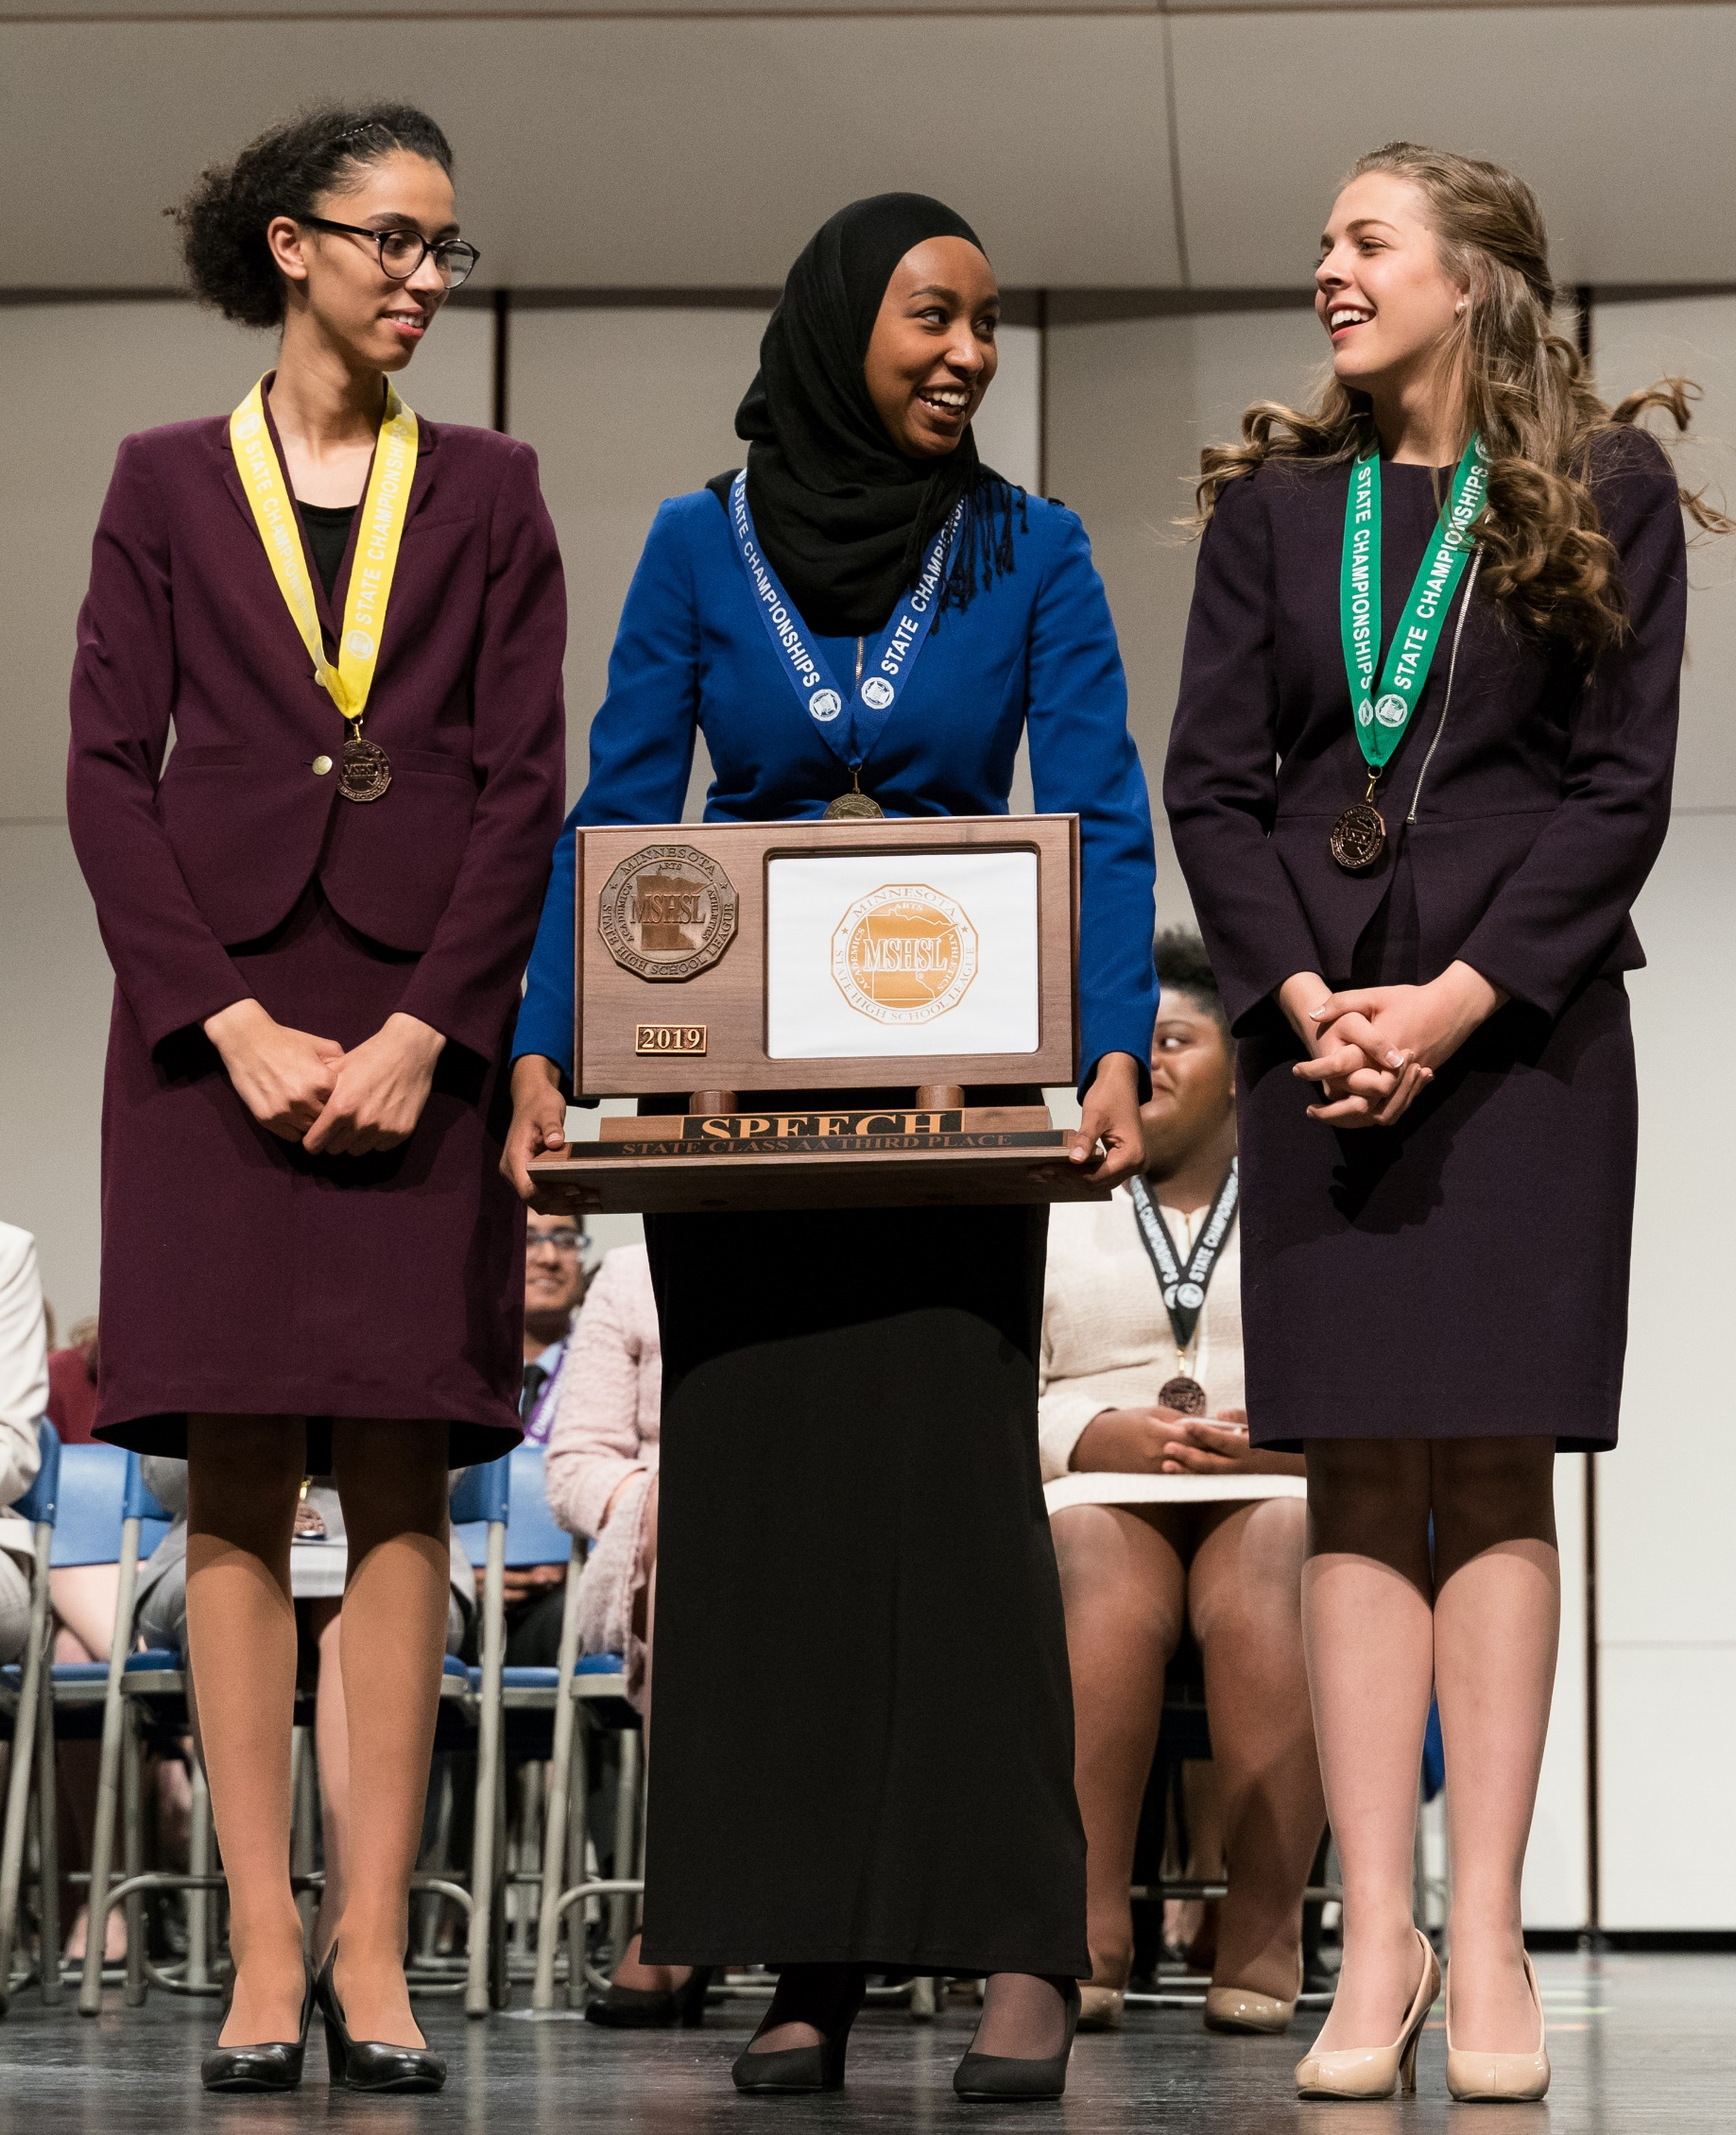
Recruiting – School and Team Initiatives
Small, rural schools traveling to bigger meets
Overnight trip
To large school in large city
Additional activities beyond meet
When virtual, schools participated in wider variety of meets with more programs
“Being in a remote small school, building the connection to the larger state speech program built excitement for the team.”
Notes:
We set a goal of traveling to bigger meets. We are in International Falls and compete mainly with small schools on the Iron Range. However, I took 15 students on a 3 day/2 night trip to Minneapolis to compete at the Chanhassen High School meet. While there we visited museums and had some fun. We had planned to travel to Boston to compete in the Harvard HS meet but COVID shut it down. I still hope to take the team sometime.
Being in a remote small school, building the connection to the larger State Speech program built excitement for the team. While our numbers slumped during the 20-21 season, we participated in more meets in more places than ever before. Being virtual, we competed in Shakopee, Chanhassen, SMSU State, and other "big school" meets. We ended up qualifying half the team for State.

Slide 5
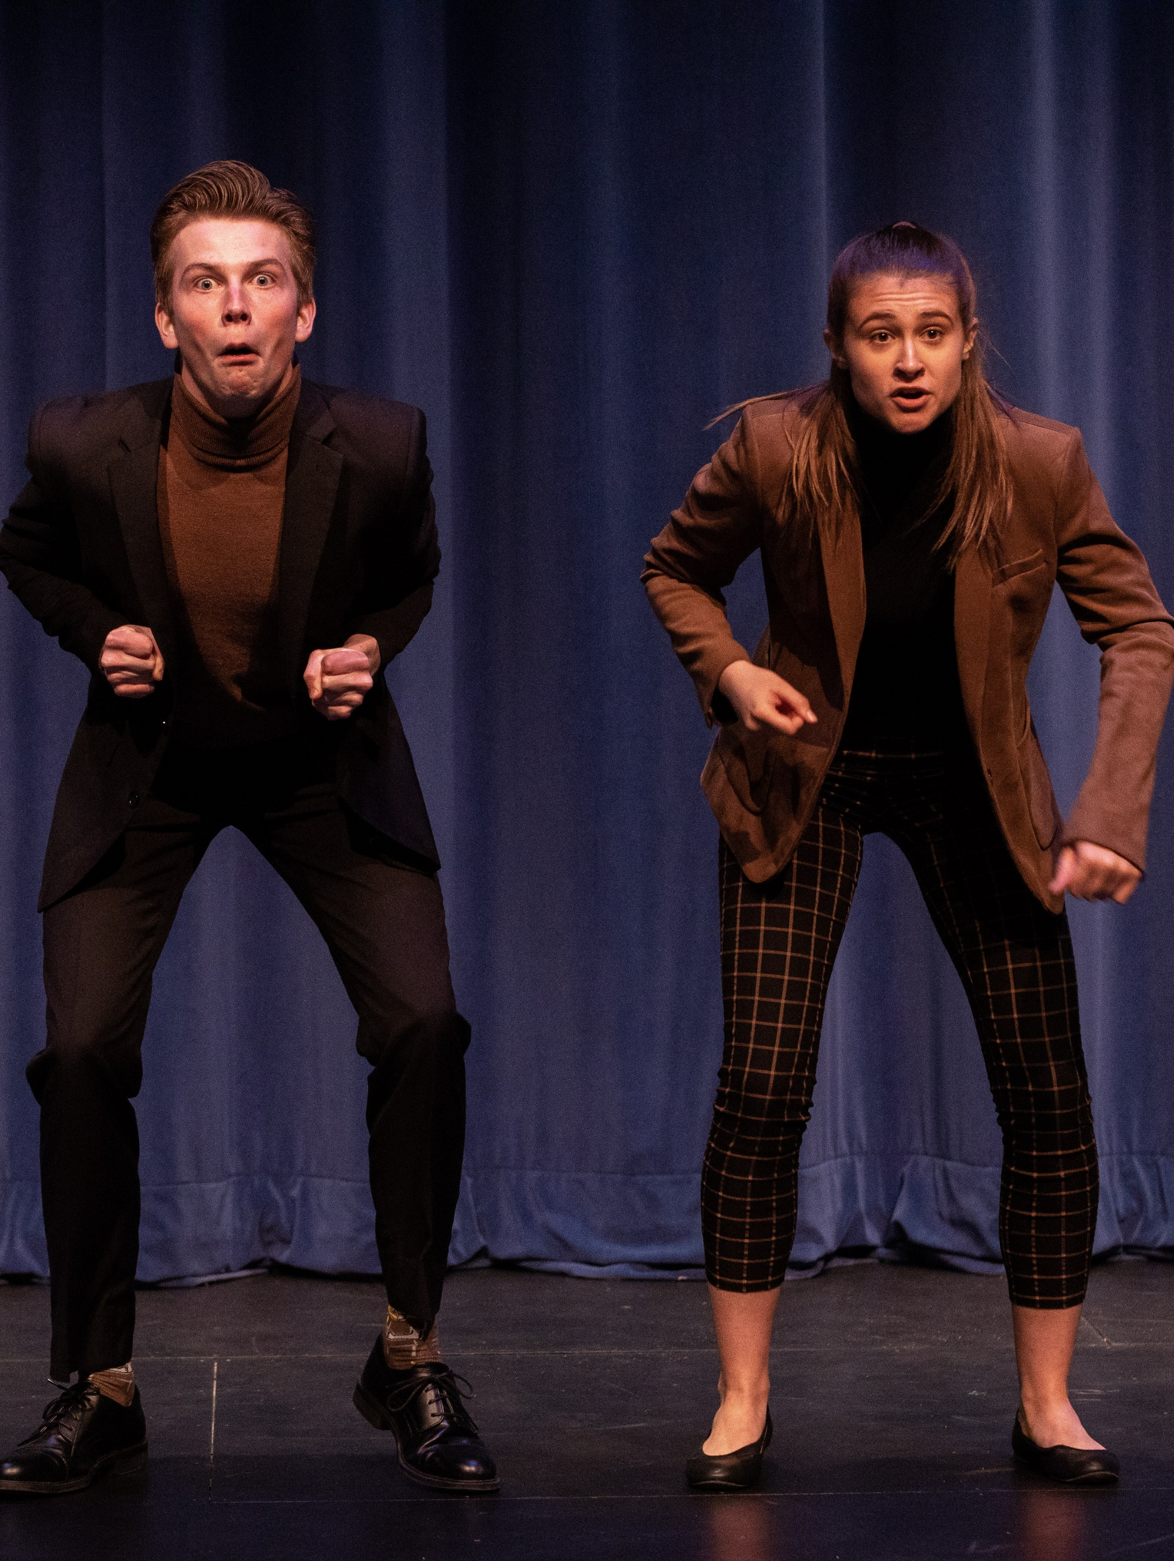
Recruiting – Teacher/Coach Initiatives
Switch advisory or other classes with teachers to spread news
Mingle and meet students at lunch.
Connect with all students, not just AP/Honors
“Simply putting it in the announcements is not enough ... you have to visit with the kids.”
Notes:
I teach/advise 7th grade so that helps me tell the new kids how to get involved. Switching with other teachers so I can visit with another grade is a good way to spread the news of a new show coming up. Also mingling at lunch with students I don't see in my classes. Simply putting it in the announcements is not enough...you have to visit with the kids.
I also discuss with the choir, band, and art teachers to look for designers, techs, and musicians. Their advice can lead to a really great kid I never knew!
Communication with the parents is imperative! They need to know my expectations, especially 7th graders and other first timers. Parents need to know the OAP is a serious varsity team and that spring play, although fun and not competition, needs to be a quality show.

Slide 6
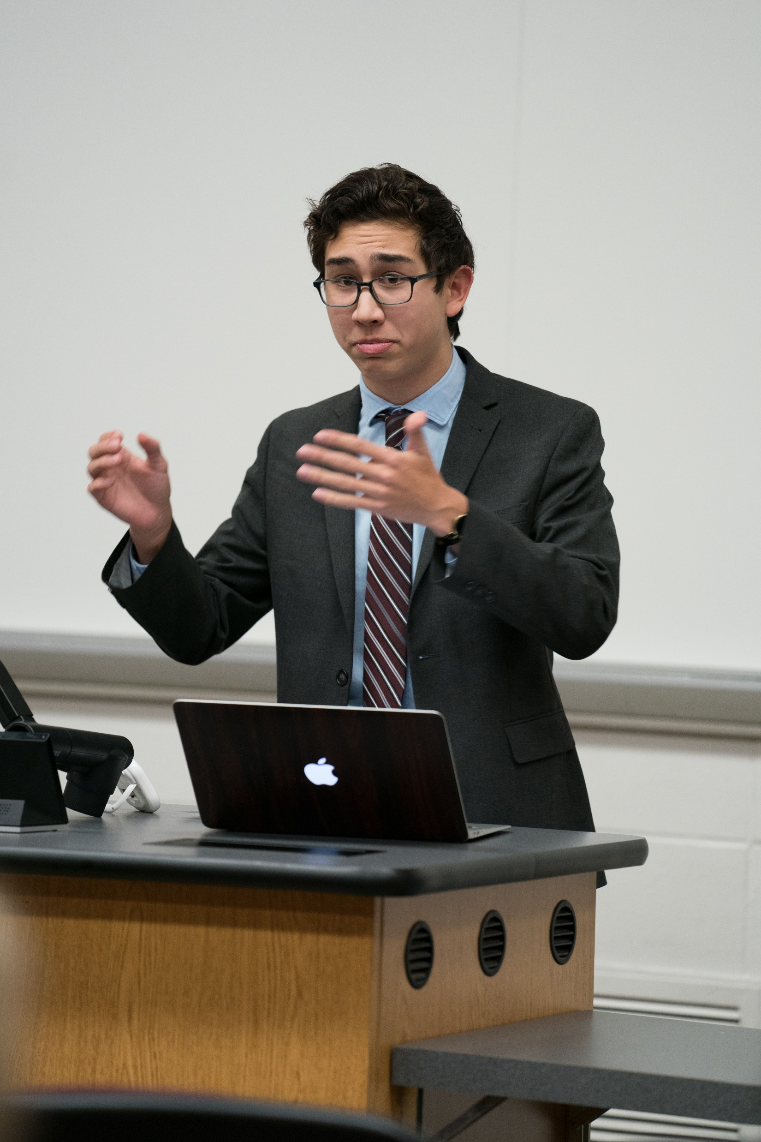
Recruiting – Teacher/Coach Initiatives
Ask other teachers if participants can practice in front of their classes.
Ask choir, band, art and tech teachers to look for designers, techs, and musicians.
“Their advice can lead to a really great kid I never knew!”
Notes:
I teach/advise 7th grade so that helps me tell the new kids how to get involved. Switching with other teachers so I can visit with another grade is a good way to spread the news of a new show coming up. Also mingling at lunch with students I don't see in my classes. Simply putting it in the announcements is not enough...you have to visit with the kids.
I also discuss with the choir, band, and art teachers to look for designers, techs, and musicians. Their advice can lead to a really great kid I never knew!
Communication with the parents is imperative! They need to know my expectations, especially 7th graders and other first timers. Parents need to know the OAP is a serious varsity team and that spring play, although fun and not competition, needs to be a quality show.

Slide 7
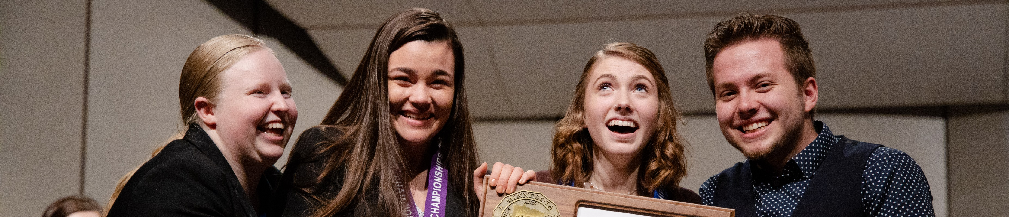
Recruiting – Teacher/Coach Initiatives
Engage administrators.
Get non-coaching teachers on board.
Invite teachers and administrators to a showcase. Participants can write personalized invitations to favorite teachers.
Notes:
I teach/advise 7th grade so that helps me tell the new kids how to get involved. Switching with other teachers so I can visit with another grade is a good way to spread the news of a new show coming up. Also mingling at lunch with students I don't see in my classes. Simply putting it in the announcements is not enough...you have to visit with the kids.
I also discuss with the choir, band, and art teachers to look for designers, techs, and musicians. Their advice can lead to a really great kid I never knew!
Communication with the parents is imperative! They need to know my expectations, especially 7th graders and other first timers. Parents need to know the OAP is a serious varsity team and that spring play, although fun and not competition, needs to be a quality show.

Slide 8
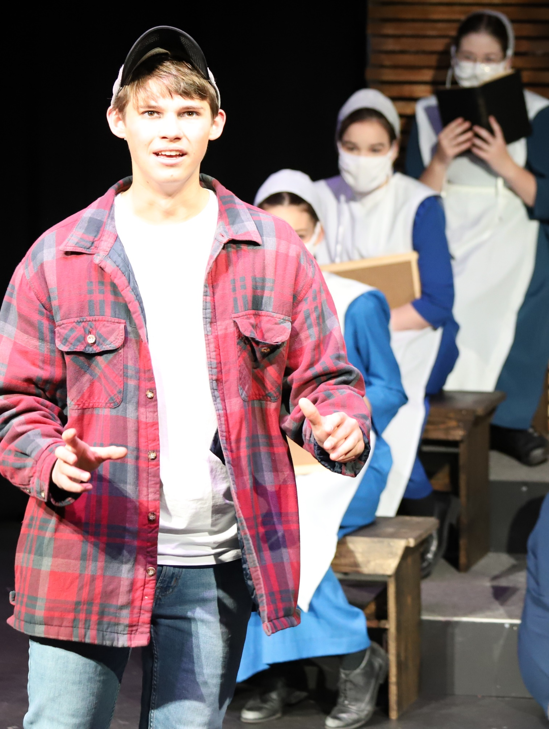
Recruiting – Student Leadership
Give captains ownership. Recruitment is a big role. Start right after the season ends.
Leadership/mentorship succession - model of at least one senior captain, and two sophomores or juniors.
Veteran team members give presentations to middle school English classes.
Notes:
I had 3 captains and gave them a lot of responsibility and ownership of team management. We got into a model of at least 1 Senior as captain, and two sophomores or juniors. It set up a leadership mentorship succession. Recruitment is one of their big roles and it starts in Spring right after the season ends.
I relied heavily on the team members to do recruiting. Indeed, as I do not work at the school, they do almost all of it.
Veteran team members - especially those who went to State or placed highly - made direct contact with English teachers in the Middle School. They made presentations to 6th, 7th and 8th grade English classes. We found English teachers to be great advocates for the Speech team.

Slide 9
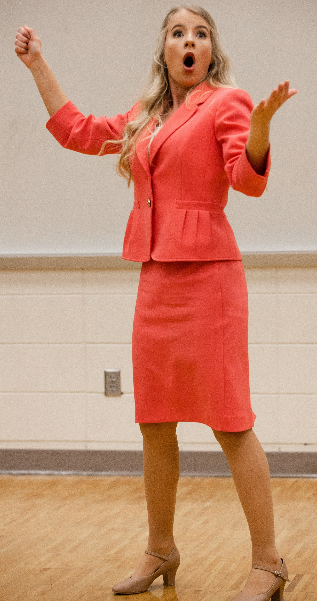
Recruiting – Student Leadership
“I tried to instill a sense of ownership, responsibility, pride and excitement in the team … most of those who joined the team joined because someone on the team personally recruited them. Students are the #1 way to connect with other students. Give them that responsibility and they run with it.”
Notes:
I had 3 captains and gave them a lot of responsibility and ownership of team management. We got into a model of at least 1 Senior as captain, and two sophomores or juniors. It set up a leadership mentorship succession. Recruitment is one of their big roles and it starts in Spring right after the season ends.
I relied heavily on the team members to do recruiting. Indeed, as I do not work at the school, they do almost all of it.
Veteran team members - especially those who went to State or placed highly - made direct contact with English teachers in the Middle School. They made presentations to 6th, 7th and 8th grade English classes. We found English teachers to be great advocates for the Speech team.

Slide 10
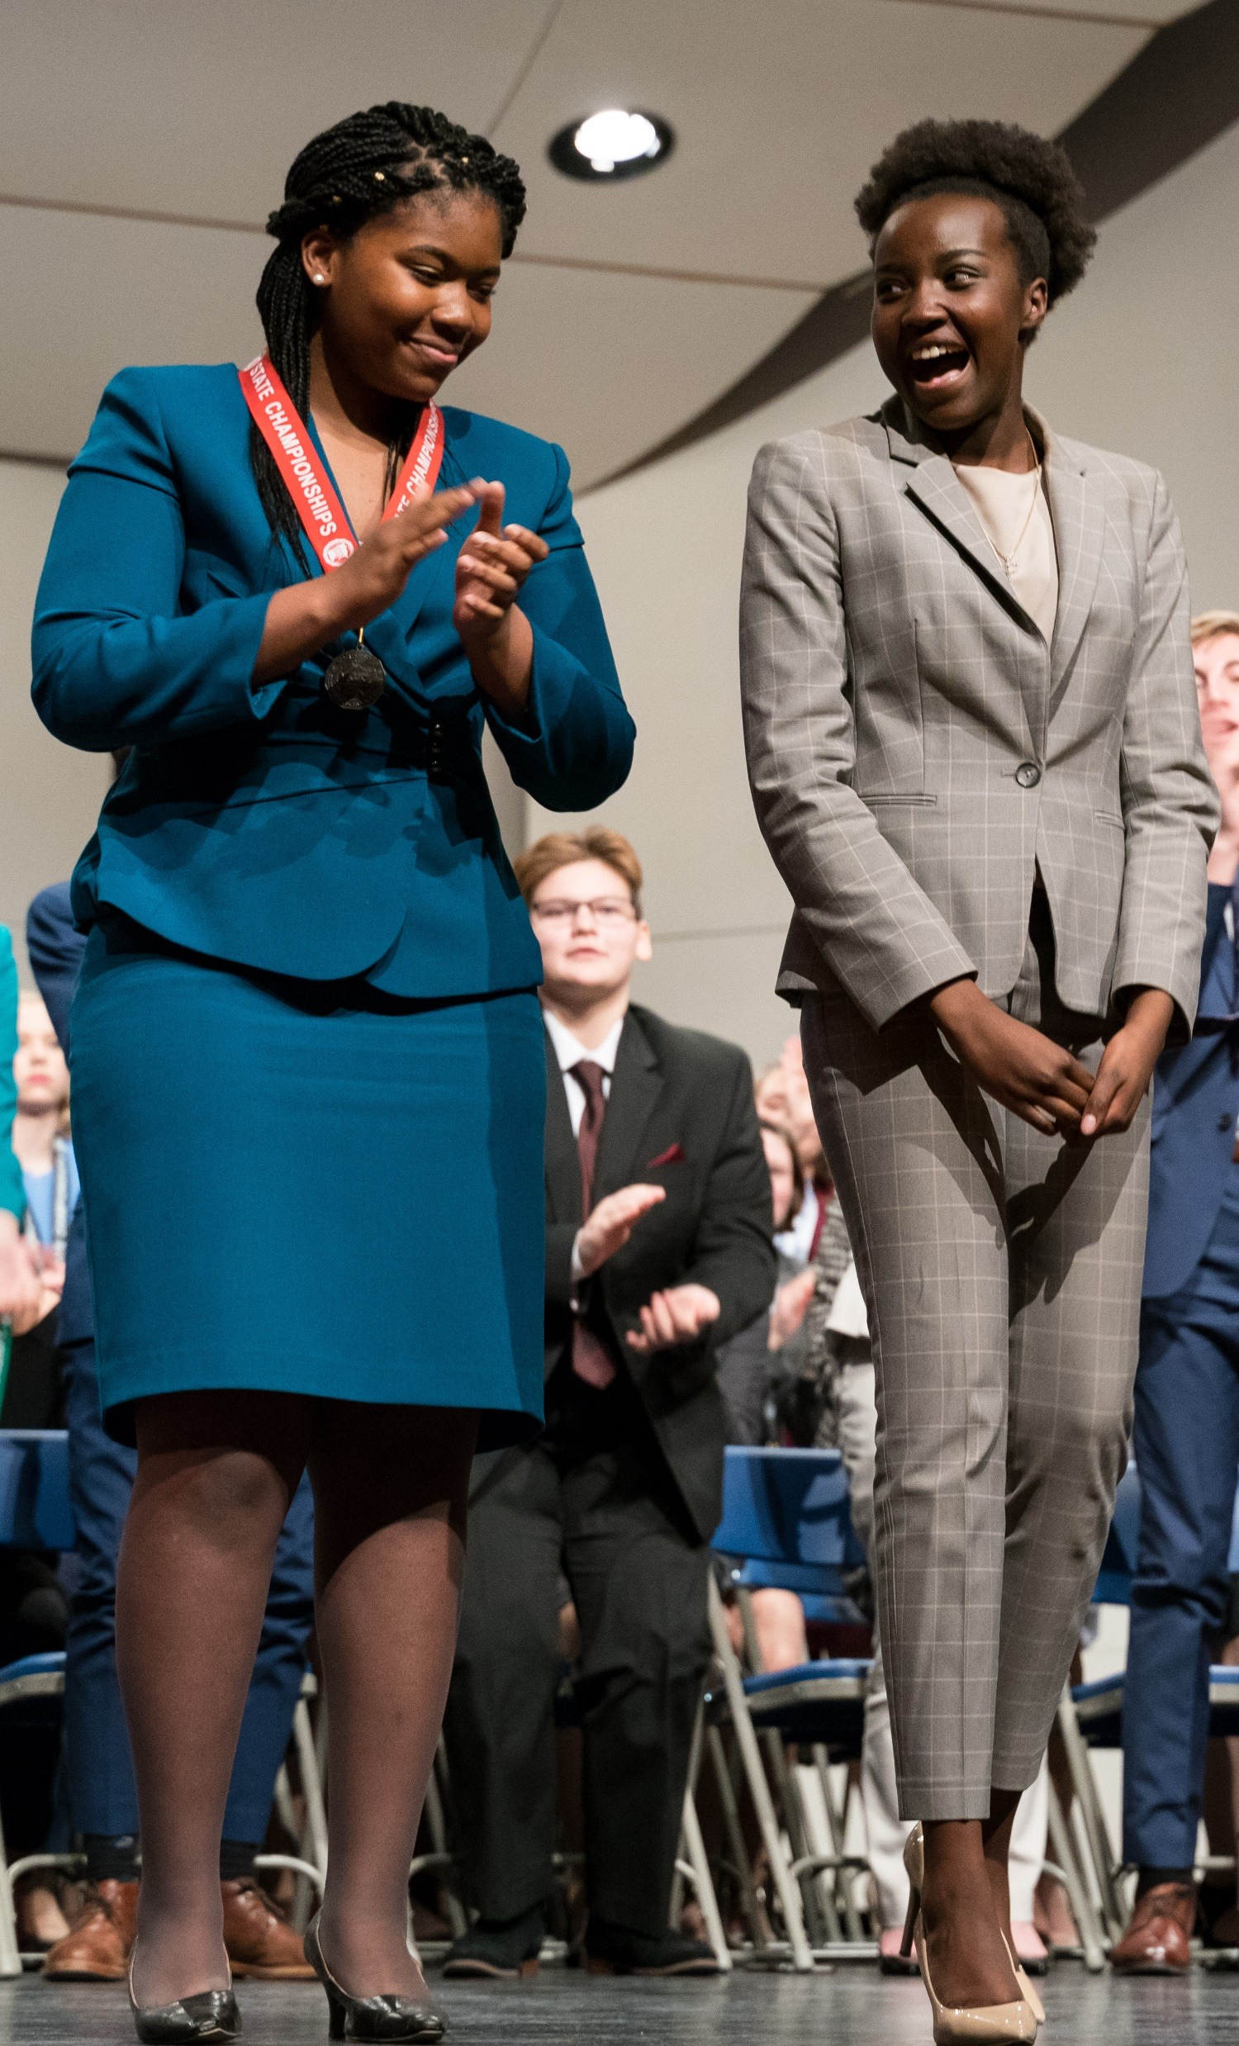
Recruiting – Parent/Community Involvement
“Communication with the parents is imperative! They need to know my expectations, especially first timers. Parents need to know this is a serious varsity team.”
Mentality that parents are your people
Make parents feel like an active, valuable participant with ownership.
Word spreads to other parents, who sign up their kids because they hear about it, and think it’s a good opportunity for kids.
Engaging parents helps engage administrators (open enrollment).
Notes:
Parents
Communication with the parents is imperative! They need to know my expectations, especially 7th graders and other first timers. Parents need to know the OAP is a serious varsity team and that spring play, although fun and not competition, needs to be a quality show.
Schools that offer great judge clinics – non-MSHSL judges. Parents and alumni (Ross Eichele – has an agenda). And in debate, new judges are taken off of one round, observe and write a practice ballot. Mentality that your parents are your people – make parents feel like an active, valuable participant. Parents can actually feel like they are a part of it/ownership. Then word of mouth to other parents, and those parents sign up their kids because they hear about it and think it’s a good opportunity for kids.

Slide 11
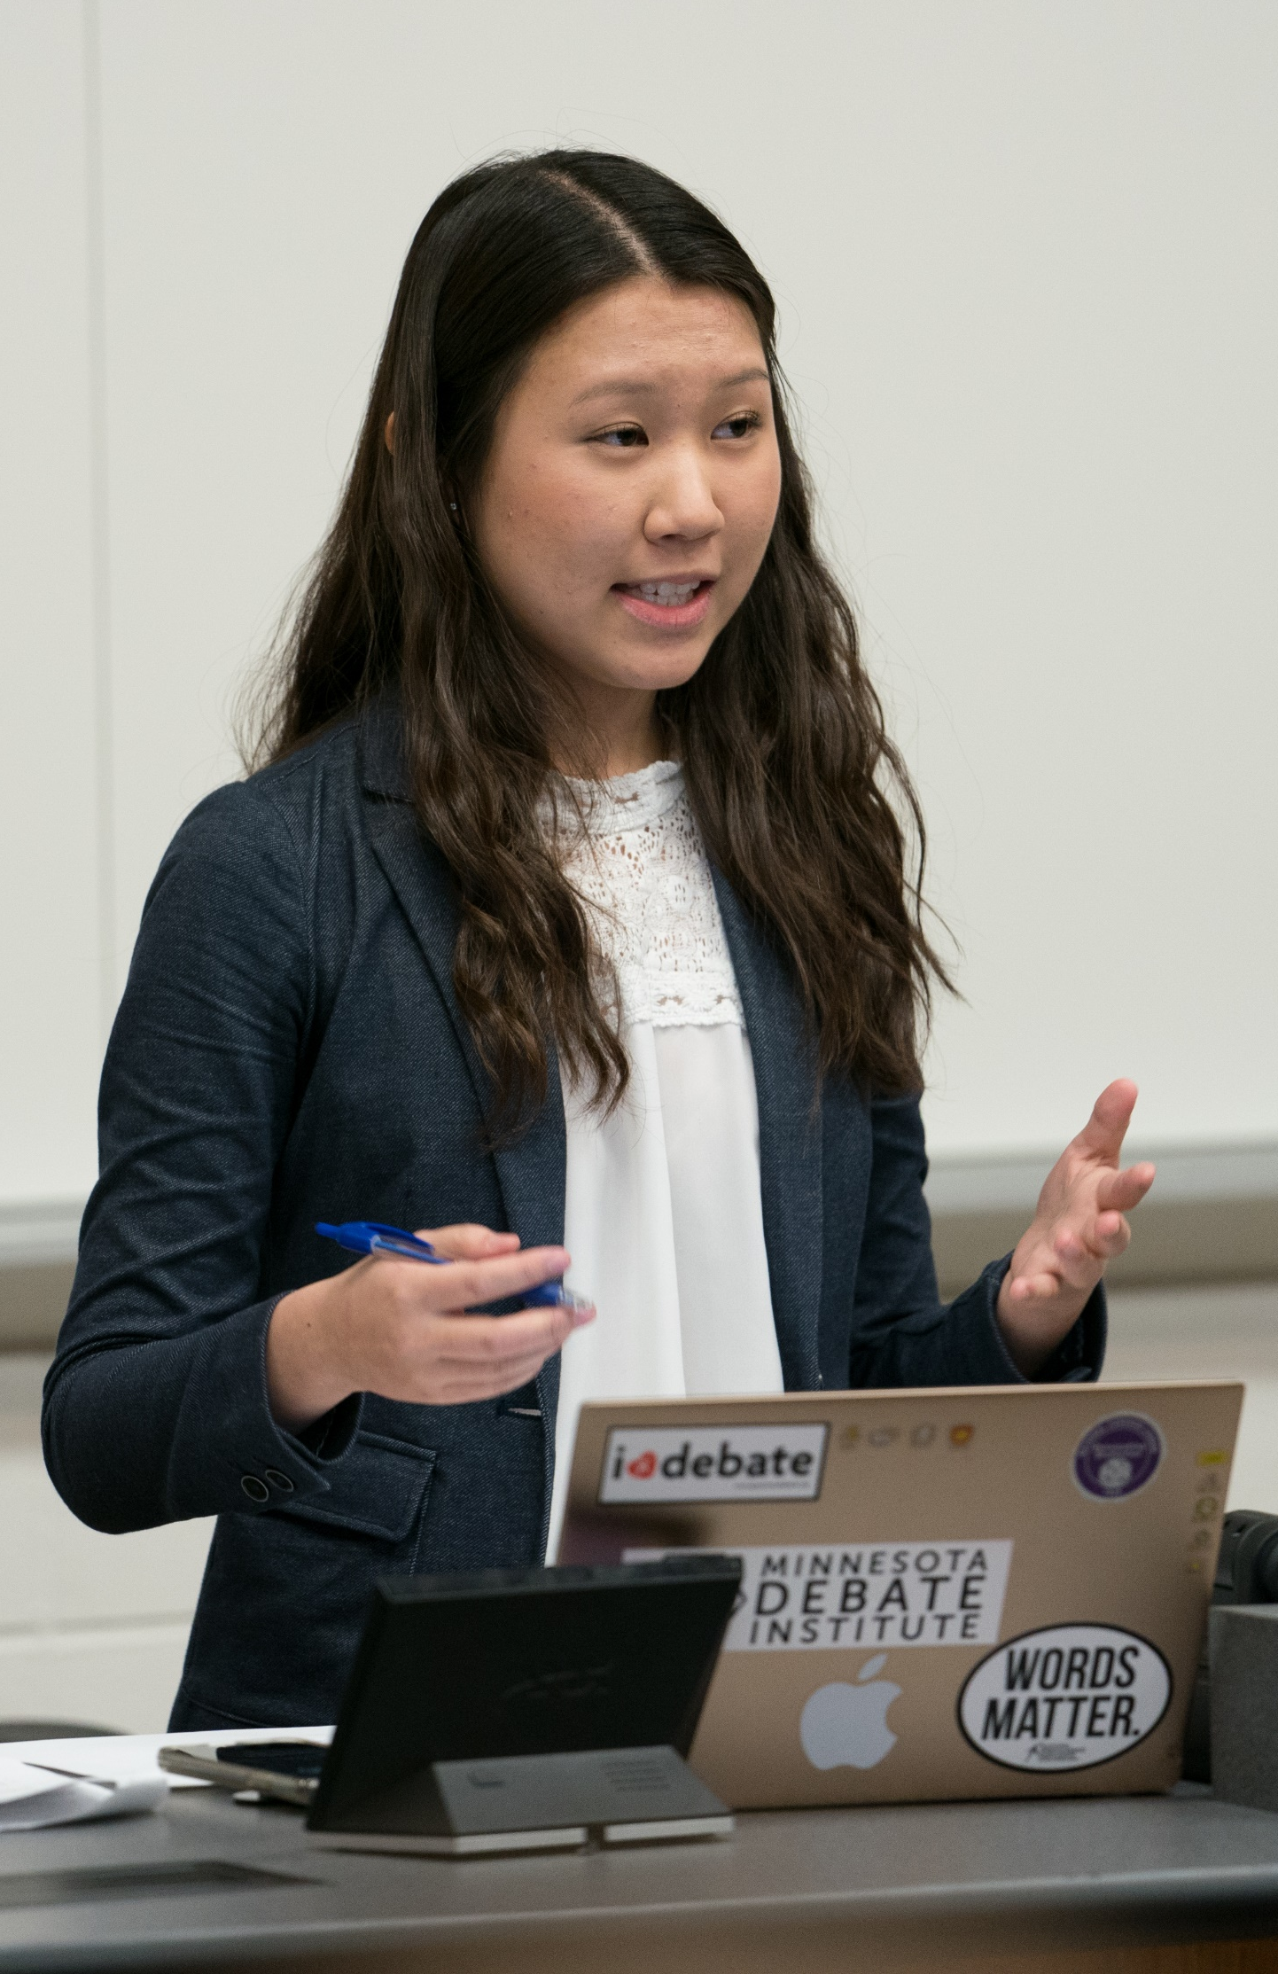
Recruiting – Parent/Community Involvement
Schools offer judge clinics for non-MSHSL judges - parents and alumni. Partner with other schools.
New and parent judges take off one round, observe and write a practice ballot.
Notes:
Parents
Communication with the parents is imperative! They need to know my expectations, especially 7th graders and other first timers. Parents need to know the OAP is a serious varsity team and that spring play, although fun and not competition, needs to be a quality show.
Schools that offer great judge clinics – non-MSHSL judges. Parents and alumni (Ross Eichele – has an agenda). And in debate, new judges are taken off of one round, observe and write a practice ballot. Mentality that your parents are your people – make parents feel like an active, valuable participant. Parents can actually feel like they are a part of it/ownership. Then word of mouth to other parents, and those parents sign up their kids because they hear about it and think it’s a good opportunity for kids.
Engaging parents helps engage administrators (open enrolling). Work to make your speech add value to the school. Use kids as community outreach (nursing home and elementary presentations). Nerve-wracking but makes them confident.
1. Build a Team Website » If your school has a website, talk with the webmaster about creating a space for your team. The team site can include a membership roster, your mission, a note about online vs in-person speech and debate, a tournament calendar, team/school forms, news/press releases on the success of the team, and most importantly, your contact information.

Slide 12
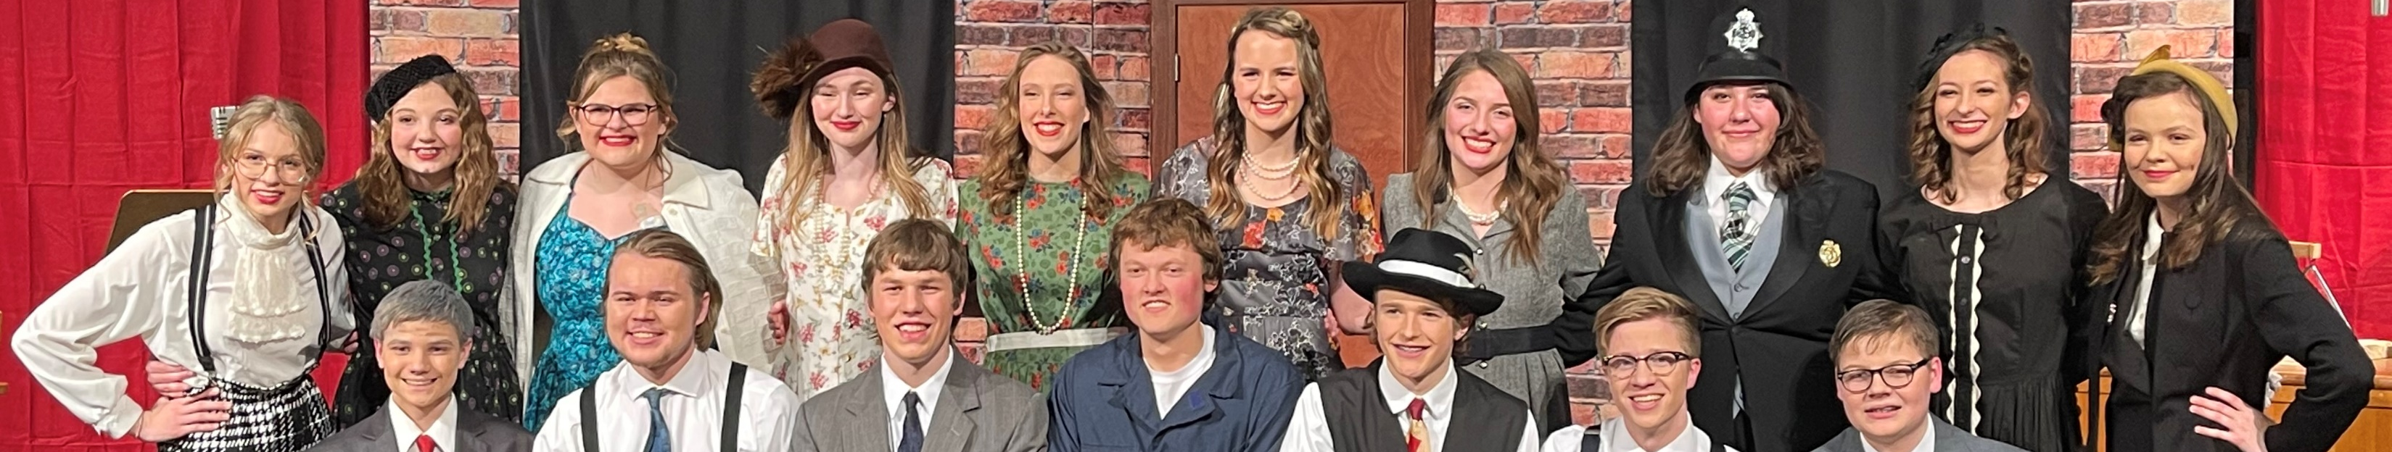
Recruiting – Parent/Community Involvement
Build a team website. Include roster, mission, calendar, team/school forms, news/press releases, contact information and pictures of students at practice and events.
Have programs/teams add value to your community. Team as community outreach:
Nursing home, elementary school, community event presentations and showcases
“It’s nerve-wracking but makes them confident.”
Notes:
Engaging parents helps engage administrators (open enrolling). Work to make your speech add value to the school. Use kids as community outreach (nursing home and elementary presentations). Nerve-wracking but makes them confident.
1. Build a Team Website » If your school has a website, talk with the webmaster about creating a space for your team. The team site can include a membership roster, your mission, a note about online vs in-person speech and debate, a tournament calendar, team/school forms, news/press releases on the success of the team, and most importantly, your contact information.

Slide 13
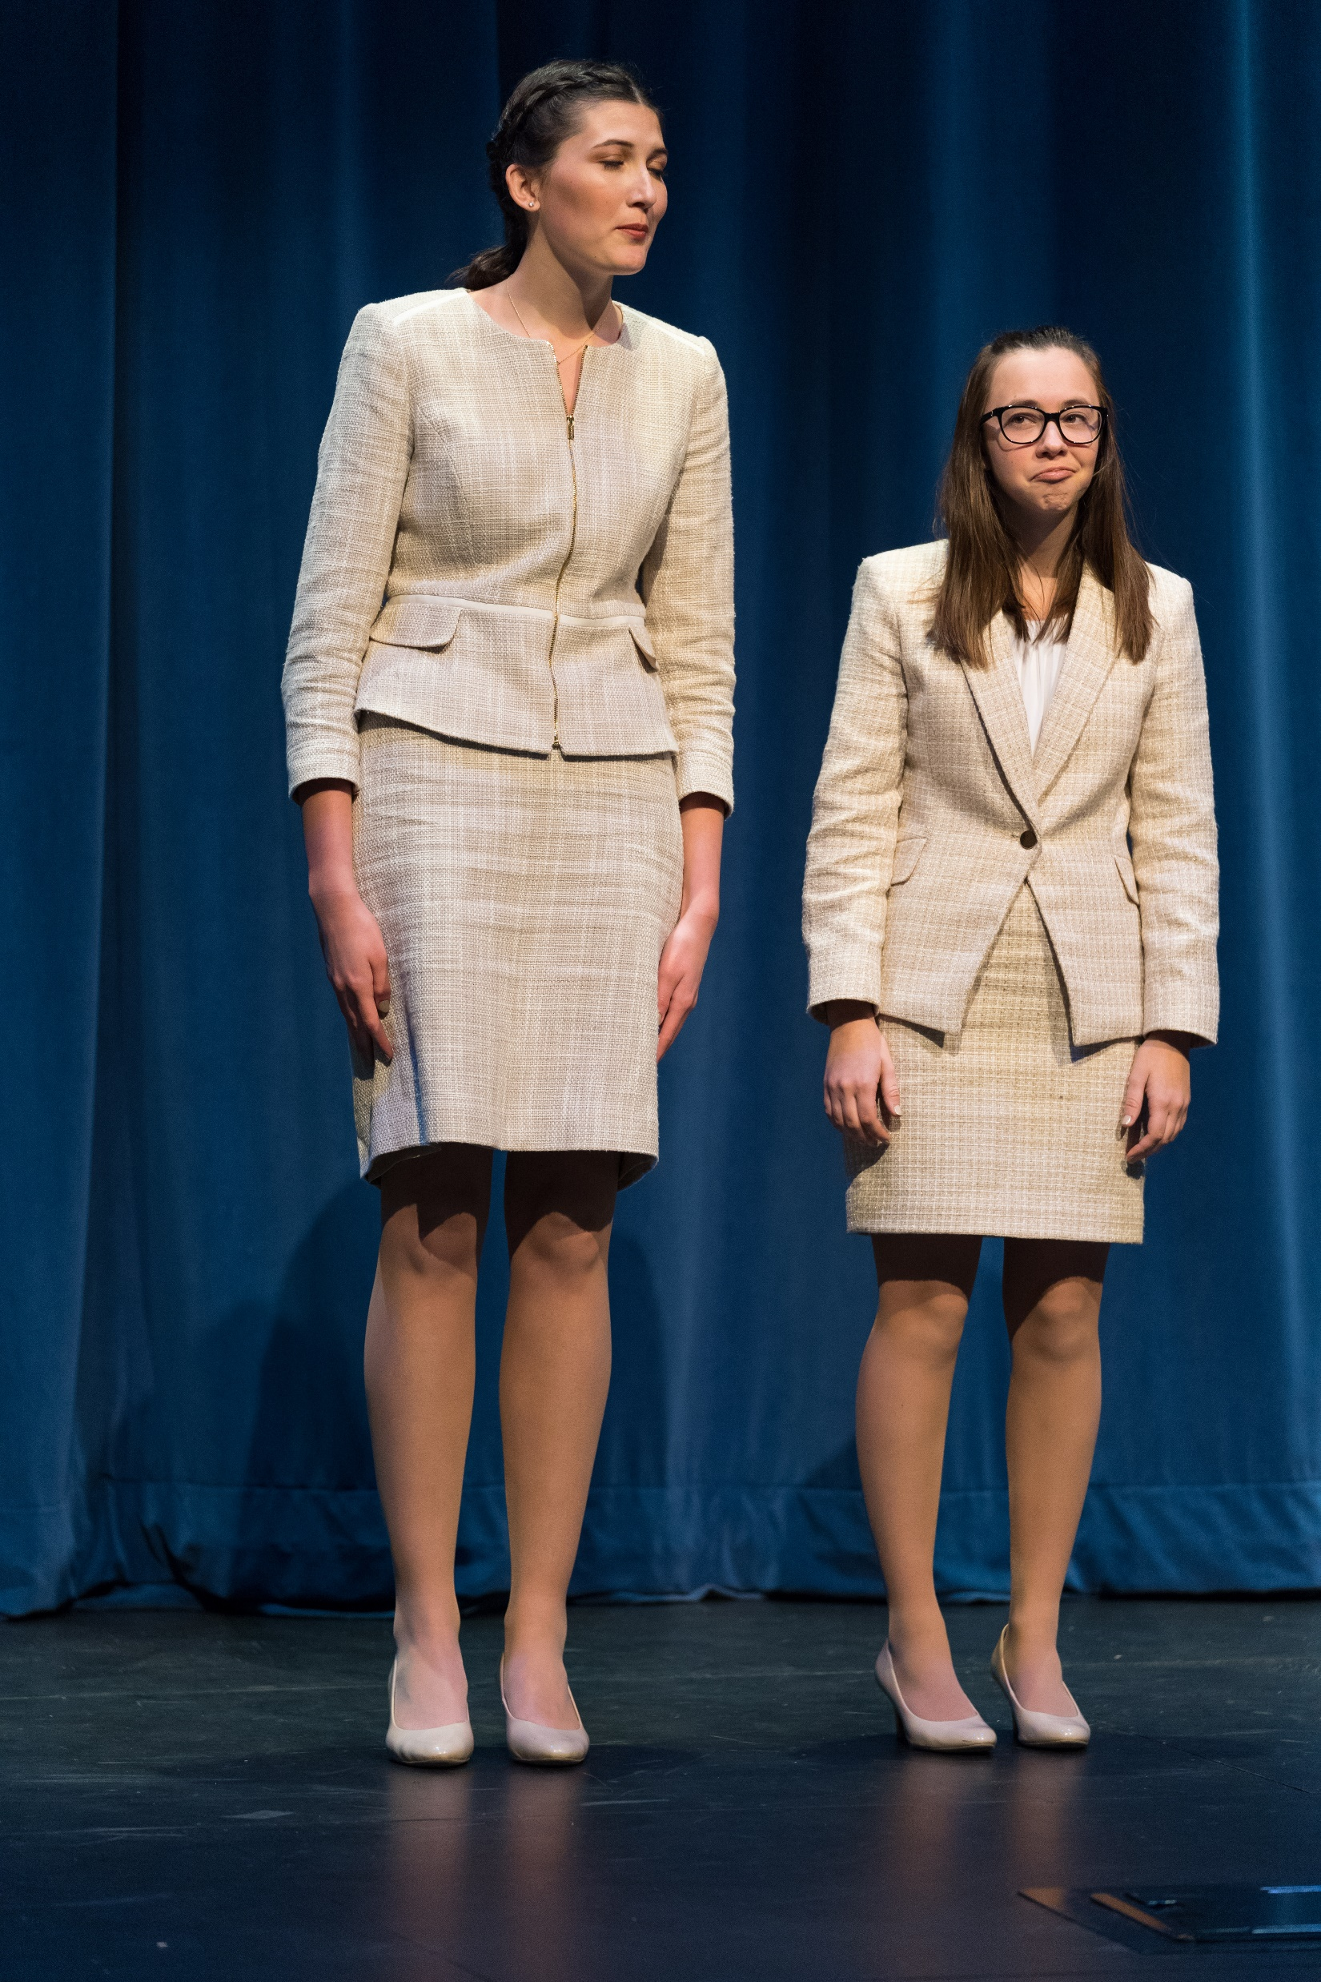
Statewide Policies and Culture
Two-class system (similar to athletics)
Divided by size; schools can “opt-up”
Opens up access
10 coaches for 80 students vs. 1 coach for 40 students – hard to compete
Don’t have formal classes at invitationals.
Some Class A participate in tournaments hosted by Class AA schools for competition or experience.
Successful Class AA schools do not sign up for tournaments hosted by Class A schools (unless an invite for a handful of students).
Notes:
Very few states that have a class system – rarity in Speech. Opens up access. 10 coaches for 80 students vs. 1 coach for 40 students. More involvement. Don’t have classes at invitationals. Circuit of tournaments with a lot of AA, and a lot that focus on A (AA schools respect that, and may send a couple if asked, but otherwise stay away). The A ones that come opt for it, either for experience or competition.

Slide 14
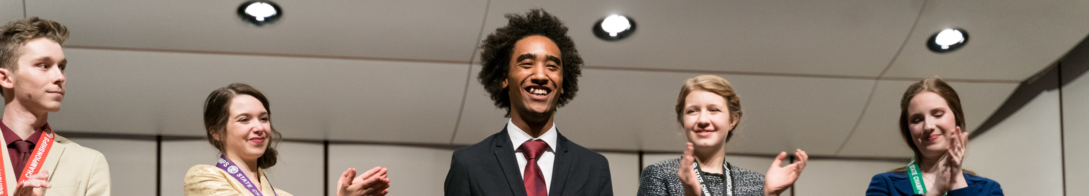
Statewide Policies and Culture
Statewide mentoring system for coaches/directors
Coaches/directors are happy to share information. Extremely competitive but like each other
Statewide clinic – Both new and experienced coaches/judges, program grants for new coaches/programs, variety of sessions and social opportunity
Notes:
Very few states that have a class system – rarity in Speech. Opens up access. 10 coaches for 80 students vs. 1 coach for 40 students. More involvement. Don’t have classes at invitationals. Circuit of tournaments with a lot of AA, and a lot that focus on A (AA schools respect that, and may send a couple if asked, but otherwise stay away). The A ones that come opt for it, either for experience or competition.
Built in mechanisms for mentoring and support. Official mentoring for Speech, unofficial for debate. Ability to know what’s happening. Good at spreading information. Jody Saxton-West. Official and unofficial.
CTAM – great sessions by experienced coaches. Extremely competitive but like each other. New people at CTAM every year. Offer program grants for new coaches/programs. Good opportunity to connect.

Slide 15

Doug Lowthian
International Falls High School
Kasey Wacker
Perham High School
Zach Prax
Eastview High School
Jackie Whitacre, Fillmore Central Public Schools

Slide 16
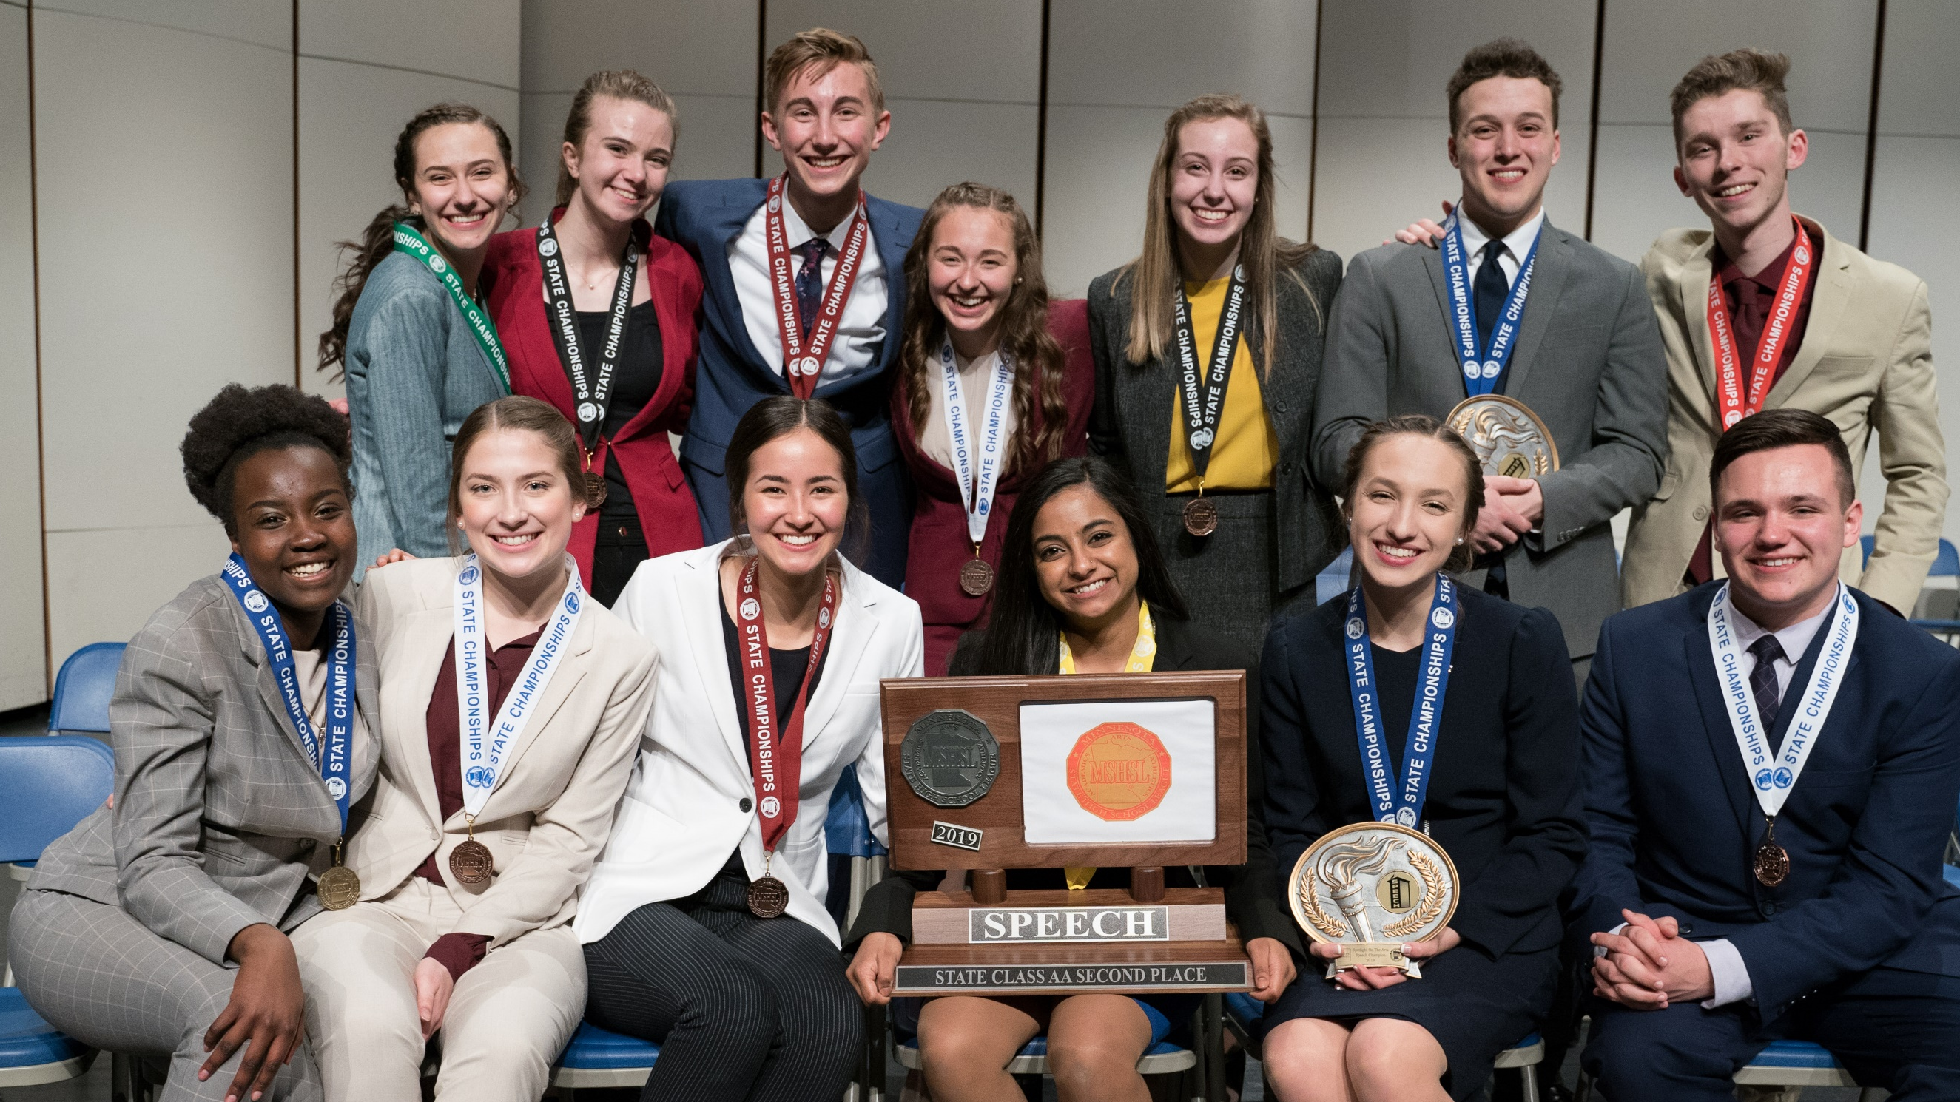
Questions?

