Slide 1

RETURNING TO in-person events
NFHS Performing Arts Conference
September 22, 2021
Mick Bridgewater, Executive Director
Indiana State School Music Association
Email: mbridgewater@issma.net
ISSMA Website: www.issma.net

Slide 2



Emergency Action Plan for State Events
Presented by
Eric Arnold
Program Manager
A Presentation of the
Illinois School and Campus Safety Program
Illinois Law Enforcement Training and Standards Board Executive Institute
at Western Illinois University

Slide 3

What if?

Slide 4
PROVIDING A SAFE & RESPECTFUL ENVIRONMENT
Student safety refers to a school’s responsibility to provide an emotionally and physically safe environment for students while students are at school or involved in school-related activities.
Indiana laws governing schools state that school administrators, teachers, aides, bus drivers, and other personnel who supervise students have a legal duty to use reasonable care in providing a safe environment to protect students from harm.
Lawsuits involving student safety are grounded in accusations of negligence. It has been determined that teachers and school officials have a responsibility of anticipating what situations may prove harmful and must adopt measures to limit risk.
In so much as ISSMA provides performance opportunities for students and teachers of school music ensembles, ISSMA has a legal and moral responsibility to adopt rules and policies that limit risk to students while participating in ISSMA events.
ISSMA also has a legal and moral responsibility to provide a safe and respectful environment for workers, adjudicators, volunteers and spectators.

Slide 5
PROVIDING A SAFE & RESPECTFUL ENVIRONMENT
That responsibility includes:
  Asking local hosts to meet with school administrators and law officials to establish emergency management plans to answer the question “What If?”.
  Adopting rules regarding props and staging used at marching band events that limit risk of injury to students and prop personnel.
  Adopting rules regarding props, platforms and staging used at show choir events that limit risk of injury to students.
  When possible, limiting travel times and distances for participation in events.
  Promoting respect, good sportsmanship and concert etiquette at all ISSMA events.

Slide 6

MARCH 2020
COVID-19

Slide 7

EMERGENCY RESPONSE
Contacts prior to decisions
  State Health Department
  Hosts
  Administrators
  Directors
Special meeting of the ISSMA Executive Committee
  Authority to make decisions
  Full State Board
Considerations
  Timing of decisions
  Communication – email, website, press release, interviews
  Strength to embrace unpopularity of decisions

Slide 8
COVID-19: UNPRECEDENTED DECISIONS
JME Organization
State Show Choir & Jazz Finals
HS Organization
Group I Qualifications
State Concert Finals
CANCELLED

Slide 9
ISSMA EVENT CALENDAR
August-November Marching Band
January-February Solo & Ensemble
February-March Jazz/Show Choir
March State Jazz/Show Choir
March-April Concert Organization
April-May State Qualifications
May State Concert Finals

Slide 10
2020 ISSMA MARCHING BAND EVENT GUIDELINES
Established 3 main goals:
Promote social distancing by increasing the proximity to others and wearing facemasks.
Reduce the number of exposures by limiting the number of people who are in close contact.
Reduce the duration of each exposure by limiting the contact time with others.
Governor Holcomb identified 5 Stages in his “Back on Track Plan” to guide restrictions and recommendations as Indiana moved to reopen. In response, ISSMA outlined mitigation strategies for each goal in relationship to Stage 5 and Stage 4 with the understanding that if Indiana returned to Stage 3, all ISSMA marching band events would be cancelled.

Slide 11
2020 ISSMA MARCHING BAND EVENT GUIDELINES
PROMOTE SOCIAL DISTANCING |  | STAGE 5 | STAGE 4
1 | All directors, staff, equipment personnel, volunteers, ISSMA workers, and judges must wear face coverings. | Required | Required
2. | All student performers must wear face coverings while not in performing sequence | Recommended | Required
3. | All audience members must wear face coverings to gain admittance to the stands | Recommended | Required
4. | Place markers 6 feet apart in all public areas including spectator entrance, stands, restrooms, concessions, press box, etc. | Required | Required
5. | Cancel Open Invitational Critique | Required | Required
6. | No “cookouts”, food wagons, etc. allowed on site | Required | Required
7. | Bands not permitted to return to the stadium after their performance | Required | Required
8. | One-way flow in and one-way flow out for spectators | Required | Required
9. | Reduce the number of bands qualifying for Semi-state to 16 per class |  | Required
10. | Reduce the number of bands qualifying for State Finals to 8 per class |  | Required
11. | Schedule Scholastic Finals at 2 sites with 4 judges at each site | Required | Required
12. | If event is moved indoors, the only spectators allowed will be those from the performing band. | Required
13. | An Indoor Performance will not be offered. |  | Required

Slide 12
2020 ISSMA MARCHING BAND EVENT GUIDELINES
REDUCE NUMBER OF EXPOSURES |  | STAGE 5 | STAGE 4
1. | Eliminate traveling penalty sheets, guides, and runners | Required | Required
2. | Provide boxed lunches/prepackaged snacks for judges and workers | Required | Required
3 | Use fast food protocols with limited menu at concession stands | Required
4. | No concessions provided |  | Required
5. | Do not allow the purchasing of additional personnel passes | Required
6. | Reduce personnel passes by 6 |  | Required
7. | Eliminate Senior Retreat at Open Semi-state and Scholastic Finals | Required | Required
8. | Award Ceremony changed to a virtual event | Required | Required
9. | No dressing/changing areas available. Bands must arrive in uniform or be able to “finish” dressing in bus or parking lot. | Required
10. | Bands must arrive ready to perform. |  | Required
11. | Pre-sale admission via directors/no tickets sold at gate |  | Required
12. | Field judges will be allowed on performance field and must wear face coverings | Required
13. | Field judges will remain on sidelines and must wear face coverings |  | Required

Slide 13
2020 ISSMA MARCHING BAND EVENT GUIDELINES
REDUCE TIME OF EXPOSURE |  | STAGE 5 | STAGE 4
1. | Enrollment Classifications for Open and Scholastic Class Bands may be adjusted based on the actual number of entries in each class and enrollment category to provide a reasonable balance of bands. | Required | Required
2. | All 4 classes at each Open Regional site | Required | Required
3. | If needed, start events 1 hour earlier to allow more/larger breaks | Required | Required
4. | Bands limited to 3 ½ hours on site | Required | Required
5. | Schedule bands in blocks of 3 or 4 bands with larger break between blocks (see sample schedule) | Required
6. | Add 5-minutes to schedule between each band (see sample schedule) |  | Required
7. | Spectators only allowed in stands for their block | Required
8. | Spectators only allowed in stands for their band |  | Required
9. | Bands must not arrive more than 65 minutes prior to transit to warm-up | Required | Required
10. | Bands must depart site by 1:15 after their performance ends. | Required | Required
11. | Use 3 Warm-up areas combining Physical & Music Warm-up for a total of 45 minutes in the same area. (Physical 15 minutes/Music 30 minutes) | Required
12. | Eliminate Physical Warm-up and provide 2 Music Warm-up areas with each band allotted 30 minutes for warm-up. |  | Required

Slide 14

2020 ISSMA IN-PERSON MARCHING BAND EVENTS
CANCELLED
In July of 2020, the decision was made to cancel all in-person ISSMA Marching Band events.

Slide 15

FULFILLING OUR MISSION
Sponsored by Paige’s Music

Slide 16
COPYRIGHT & PLATFORM DECISIONS
Considerations:
  Video recordings must not be able to be shared.
    Uploading process built into platform that is private
  System to get music scores to adjudicators.
    Teach Act
    Permissions from publishers
    PDF of legally purchased music sent via email
    Must not be printed and only distributed to the judge
  Scoring should be digitized version of current adjudication forms.
    Written vs recorded commentary
    Judging panel vs individual judge
  Process for entry.
    Directors of member schools make entry via Directors Only are of ISSMA website
  Technology
    Accessibility
    Ease of use

Slide 17
SELECTED PLATFORMS
Solo & Ensemble Assessments
HeartOut
Marching Band & Organization Assessments
CompetitionSuite

Slide 18


FALL VIRTUAL ASSESSMENTS
  Less pressure and reduced costs
    Advanced, Intermediate, or
Beginner designations
    Video submissions with no"minimum” performance times
No “restrictions”/pre-conceived requirements regarding the type of music performed
    Emphasis of the assessment/feedback
      Digital commentary and ratings
Four offerings for feedback and growth
  May repeat music
    Digital certificates

Slide 19
ISSMA “VIRTUAL”
MARCHING BAND ASSESSMENTS
FALL 2020
No recognized Classifications
Evaluated using the ISSMA Festival Class Model – 3 Judges
No minimum performance time or requirements on type of show or genre of music presented
Non-competitive – Focus on Judge Feedback and Assessment
Assessment for Rating only – No Ranking
Trophies with Designations for Gold, Silver, and Bronze
“With Distinction” designations in Music and Visual
Assessments completed via submission of performance videos
Multiple evaluation dates to fit individual school schedules

Slide 20
FALL ORGANIZATION ASSESSMENTS
Provides the opportunity for an external formative assessment focused on enhancing ensemble development and musical growth.
  Panel of 3 judges provide recorded commentary and scores for a rating via CompetitionSuite
  Any traditional performing ensemble
  Directors upload video recording of a recent performance
  No Required List or Classification & no minimum time limits
  Perform 1, 2, or 3 selections
  Digital certificates identifying Gold, Silver, Bronze Rating

Slide 21

2021 QUESTION OF THE YEAR!
Should this year’s events be “live”, in-person events?
or
Should this year’s events be virtual events?
or
Should this year’s events be hybrid events?
This Photo by Unknown Author is licensed under CC BY-SA

Slide 22

TODAY’S REALITY!
Phil McGraw

Slide 23
WEIGHING INITIAL CONSIDERATIONS
External Influences
Who
Internal Influences
Process
Time Frame

Slide 24

DECISION-MAKING PROCESS
Who is ultimately responsible for the decision?
  Executive Director
  Executive Committee
  Board of Directors
  Committee
What other stakeholders need to be included?
  Participating Directors
  Hosts
  Parents
  Students
  Event Workers

Slide 25
Current Hospitalization, Infections, and Death Rates
State & Local Mandates
Copyright Laws
State & National Trends
National Associations
School Administration
State & Public Health Officials
EXTERNAL
INFLUENCES

Slide 26
Health &
Safety
Organization
Policies
Anticipated
Participation
Financial
Risk
Venue
Availability
Adjudicator & Worker Availability
Event
Logistics/
Organization
Capacity
INTERNAL
INFLUENCES

Slide 27
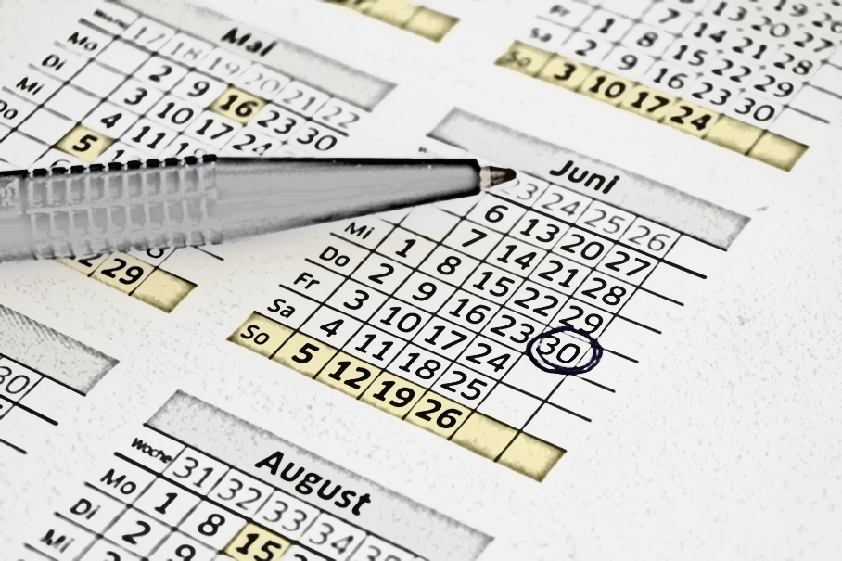
TIME FRAME
1. How far in advance will directors, students, parents, workers, etc. need to know if the event will be in-person, virtual, or both?
2. How much time is needed by your organization to adequately plan the event?
3. Are their contractual deadlines that must
be met to mitigate financial loss?
  Hotels
  Facilities
  Adjudicators
  Vendors
  Printers
  Other?

Slide 28

ISSMA BOARD POLICY
  The ISSMA State Board believes that the health and safety of those involved in ISSMA events must be our highest priority. When the ISSMA Executive Director and the Executive Committee determine any ISSMA event would place an uncontrollable health risk on students, directors, adjudicators, or spectators the live event should be cancelled. If feasible and in compliance with all copyright laws, a virtual option should be considered.

Slide 29
ISSMA MISSION
  The mission of the Indiana State School Music Association Inc. is to provide educationally evaluated music performance opportunities for students and teachers of school music ensembles from member schools in Indiana, to assist in the development of performance-oriented assessment of standards for music education, to promote the inclusion of music ensembles as part of each school’s core curriculum, and to offer educational support to fulfill this mission.

Slide 30



WHAT I HAVE RECENTLY LEARNED
You can lead a horse to water, but
you can’t make them drink!
You can create an effective vaccine, but you can’t get everyone to roll up their sleeve!

Slide 31
CURRENT SAFETY PROTOCOLS FOR UPCOMING ISSMA EVENTS
ISSMA remains committed to providing an environment which reduces the health risks to students, directors, adjudicators, workers, and spectators while providing in-person educationally evaluated performance opportunities for students and directors. In addition to following guidelines from public health officials and local school administrators, ISSMA will follow the recommendations based on scientific data from the International Coalition of Performing Arts Aerosol Study. Specific safety protocols will be implemented as needed to meet the following goals:

Slide 32
GOALS FOR SAFETY PROTOCOLS FOR IN-PERSON ISSMA EVENTS
Promote social distancing by decreasing the proximity to others.
Reduce the number of exposures by limiting the number of people who are in close contact.
Reduce the duration of each exposure by limiting the contact time with others.
Reduce the spread of contaminated particles by encouraging the use of masks and bell covers.
Promote good personal hygiene.
Promote facility cleanliness, sanitation, and air flow.
Prioritize changes in event logistics over personal mandates.

Slide 33
NEED FOR PARTCIPATING DIRECTOR SUPPORT
While the ISSMA Executive Committee can put specific safety protocols in place, it is the responsibility of every participating director to support those efforts through their actions and to communicate to students, staff, parents, and supporters the importance of following these guidelines. Doing everything we can to control the spread of the Covid-19 virus is the only weapon we have in preventing the cancellation of in-person ISSMA events.

Slide 34
POSSIBLE SAFETY PROTOCOLS FOR ALL EVENTS
Set up hand sanitation stations.
Provide disposable masks.
Hire at least one additional custodian
Avoid the use of hand stamps.
Award ceremonies change from in-person to virtual events.
Place additional breaks in performance schedules.
Provide boxed lunches/prepackaged snacks for judges and workers
Reduce the number of volunteers and workers needed at each event.
Post safety recommendations for participants and spectators.
Section off seating for social distancing.

Slide 35
MARCHING BAND EVENT SAFETY PROTOCOLS
Guides will not be provided. It will be the responsibility of each director to review the site map provided by the host, and then lead their band through the warm-up/performance sequence.
The penalty sheet will only be used if there is an infraction.
Judges and workers will be positioned to maximize social distancing.
Bands will be scheduled with additional breaks.
Indoor changing facilities will not be provided.
Formal award ceremonies with drum majors on the field will not be held unless public health officials announce dramatic improvements in the spread of the virus. Additional information concerning awards will be sent as we get closer to the event.

Slide 36
INDOOR MARCHING BAND EVENT SAFETY PROTOCOLS
Maximum of 4 bands permitted inside facility at any one time.
Limited number of spectators permitted in gym.
All ISSMA personnel required to wear masks.
Create one way routing for spectators and performers.
Participants encouraged to wear masks and to use bell covers.
Spectators and volunteer workers required to wear masks.
Awards held virtually.

Slide 37
POSSIBLE SAFETY PROTOCOLS FOR SOLO & ENSEMBLE
Extend the schedule to allow for more frequent breaks and the exchange of air in performance and warm-up rooms
Schedule the use of warm-up rooms to allow for the exchange of air
Limit the spectators in the room to the family members and instructor(s) of the performer
Eliminate the need for judges’ assistants
Create an online State entry process
Position judges to accommodate social distancing from performers and spectators
Encourage/Require the wearing of masks

Slide 38
POSSIBLE SAFETY PROTOCOLS FOR CONCERT ORGANIZATION
Schedule groups from the same school in the same blocks when possible
Extend schedule to allow for more breaks and the exchange of air
Schedule arrival/departure times reducing the number of people onsite
Encourage spectators to exit after each performance block
Eliminate the need for guides and judges’ assistants
Eliminate the sight-reading component
Use of larger performance spaces to allow for social distancing
Encourage/Require the use of masks and bell covers
Require the wearing of masks for all workers and spectators

Slide 39

SAFETY PROTOCOLS FROM YOUR ORGANIZATION
This Photo by Unknown Author is licensed under CC BY-NC

Slide 40

QUESTIONS

