Slide 1



Getting Coaches Back on Board
Steve Meadows

Slide 2






It looks so innocent.
Nope.

Slide 3

Oh what a tangled web we weave When first we practice to deceive
SIR WALTER SCOTT

Slide 4
WE ARE CHARLOTTE.

Slide 5


Slide 6
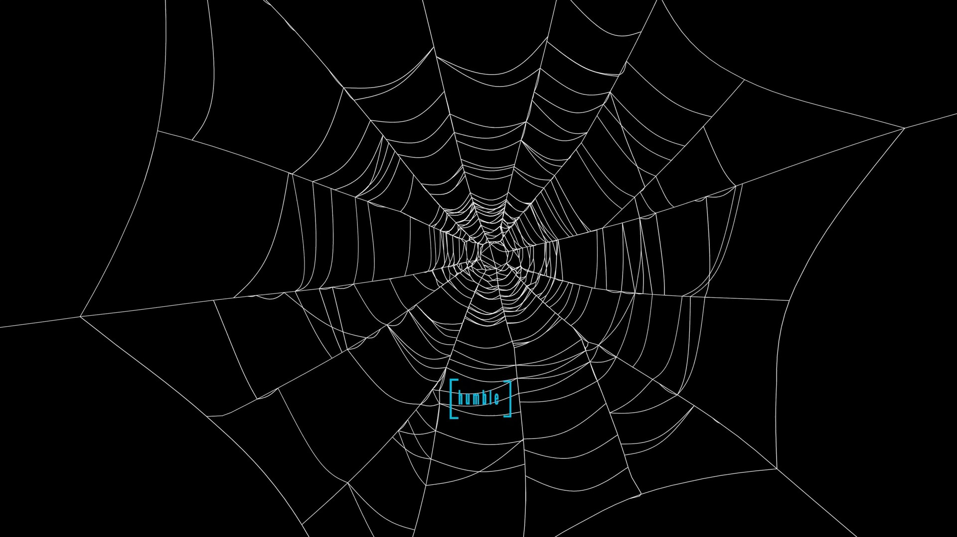

Slide 7
Founded 1920 Part of University of Kentucky Extension Also track and field.

Slide 8
Kentucky High School Speech League formed. Athletics formed own organization.

Slide 9
Housed at University of Kentucky until 1988 as part of University Extension (like 4-H).
SETTLED INTO –
SEVEN REGIONS OF THE STATE
ANNUAL DRAMA FESTIVAL (DROPPED EARLY 2000s)
ANNUAL STATE DEBATE TOURNAMENT (BECAME OPEN STATE)
ANNUAL REGIONAL AND STATE TOURNAMENTS IN SPEECH, JUNIOR AND SENIOR DIVISIONS

Slide 10
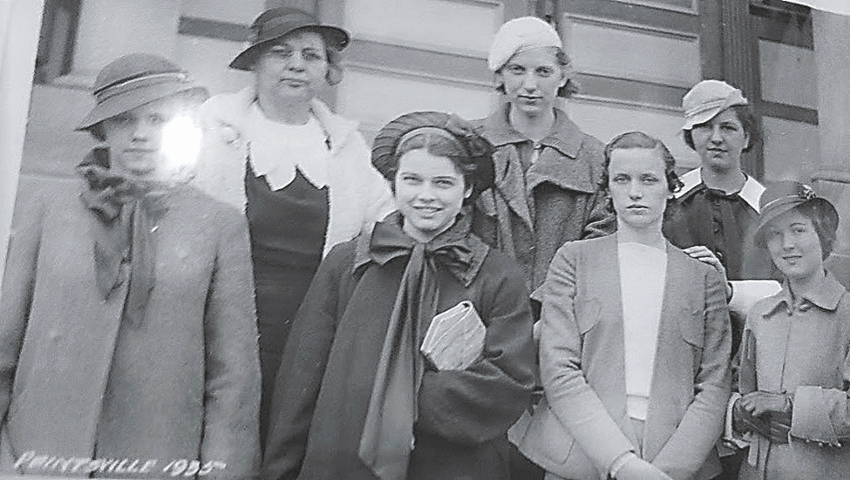
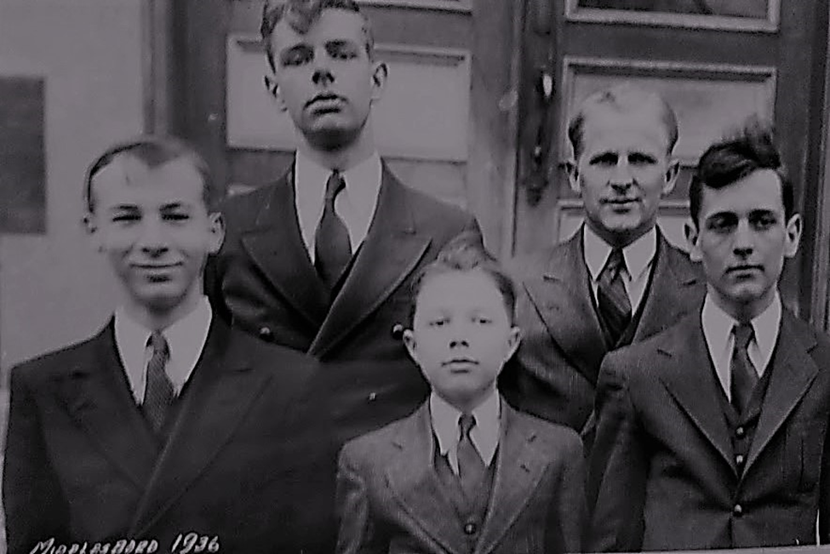

Slide 11


1988 moved to WKU as part of exciting new forensics program.
2011 back to UK.

Slide 12
Deal with UK – We paid half salary of an employee who worked half for them, half for us. He was housed on campus and had University employee privileges. State tournaments hosted at UK – Junior Speech, Senior Speech, and Debate.
2017 Executive Director fired for stealing by both KHSSL and UK.
UK released us. They called and told me, the Vice Chair of the Board who they knew a little as their part-time employee, to come pick up the stuff from the office.
Floating around as an organization (in debt) for two years.
I was hired in 2019 when I retired from teaching and coaching.
League is hosted in my home. I work 82 days a year (was 66 til I got us a grant for two years – mostly spent to put me to work more). 501c3, state tax-exempt.

Slide 13
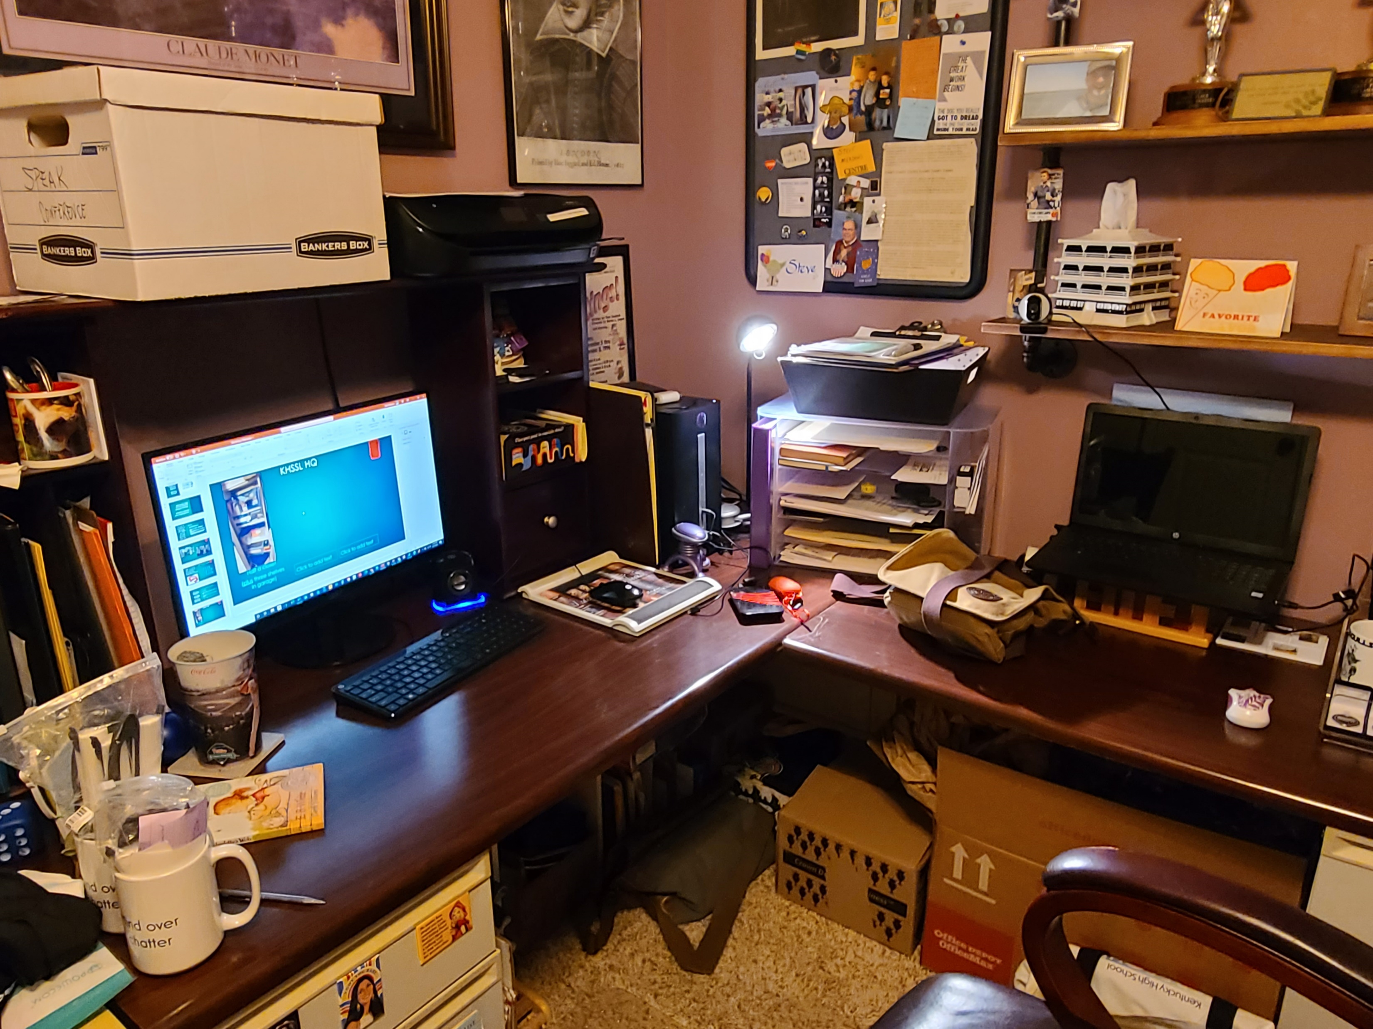
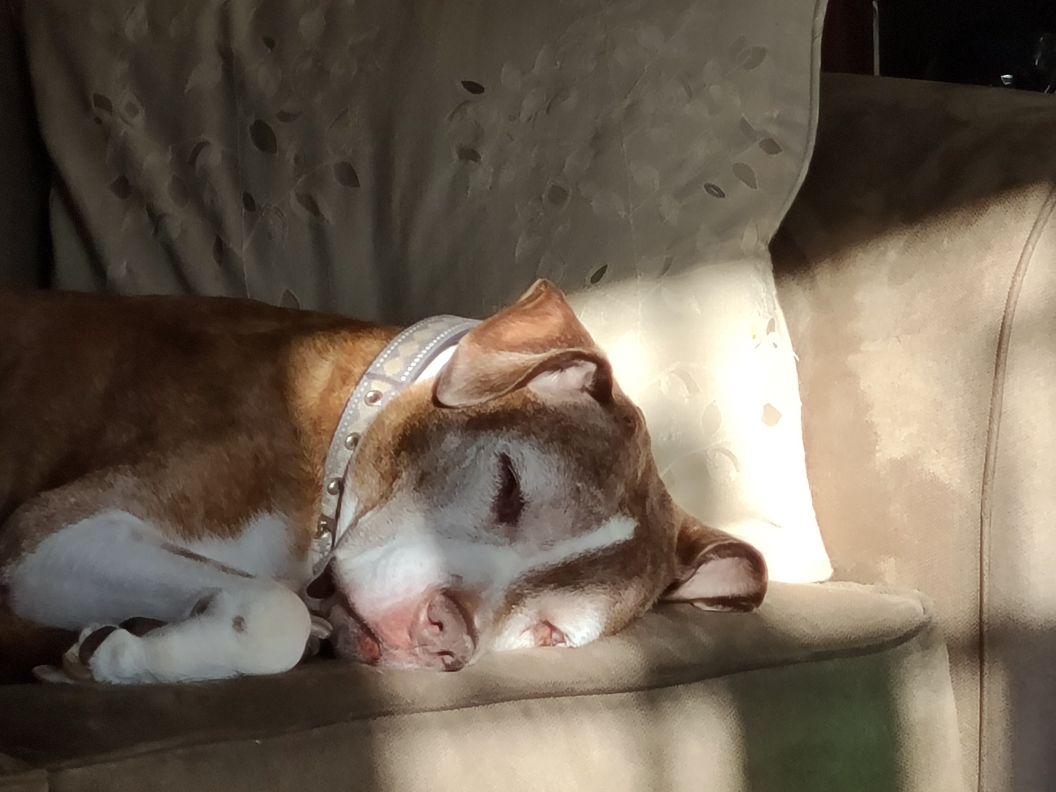
KHSSL HQ
Half a closet
(plus three shelves in garage)
Plus a desk.
My secretary

Slide 14


Slide 15
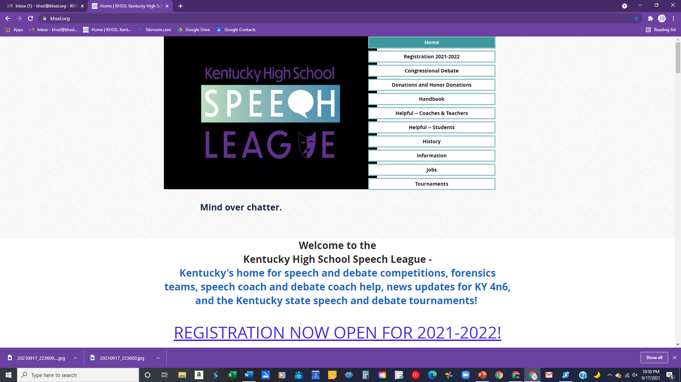

Slide 16
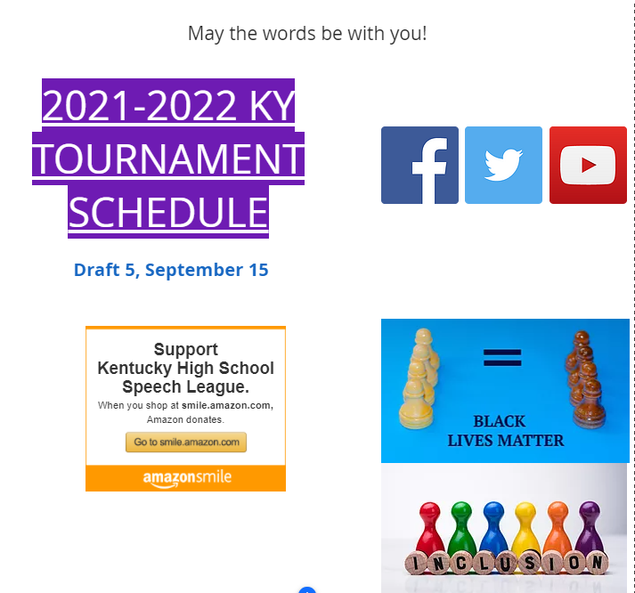

Slide 17
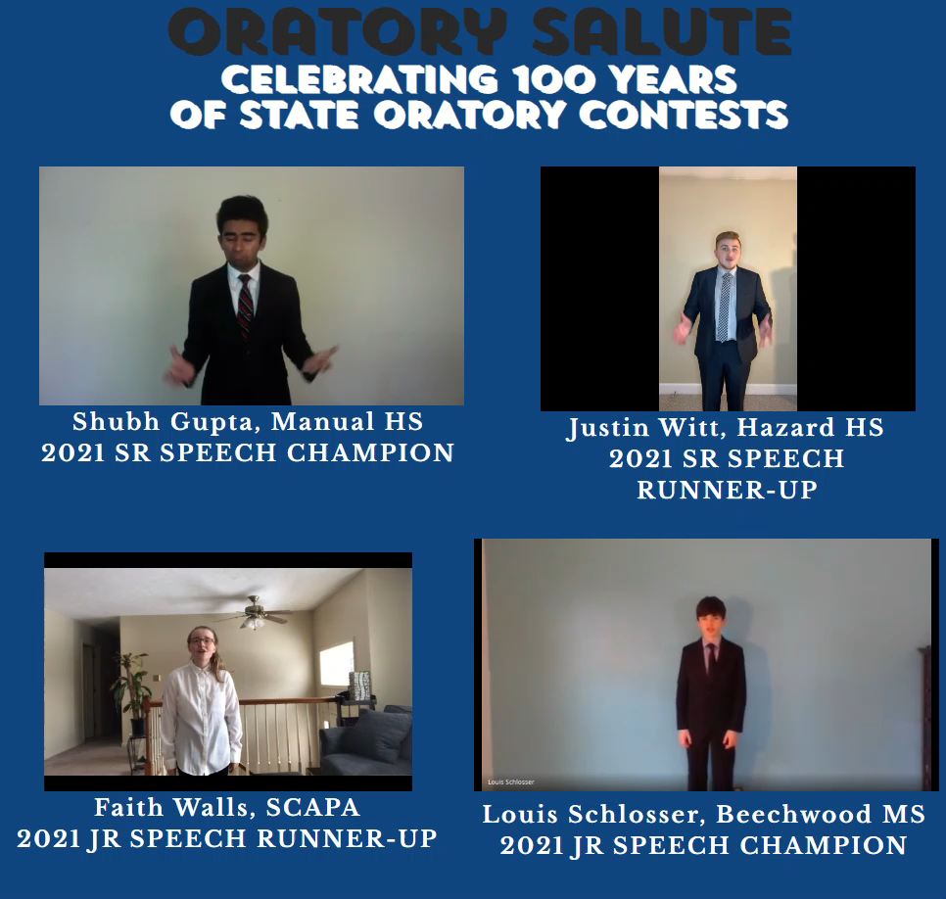

Slide 18
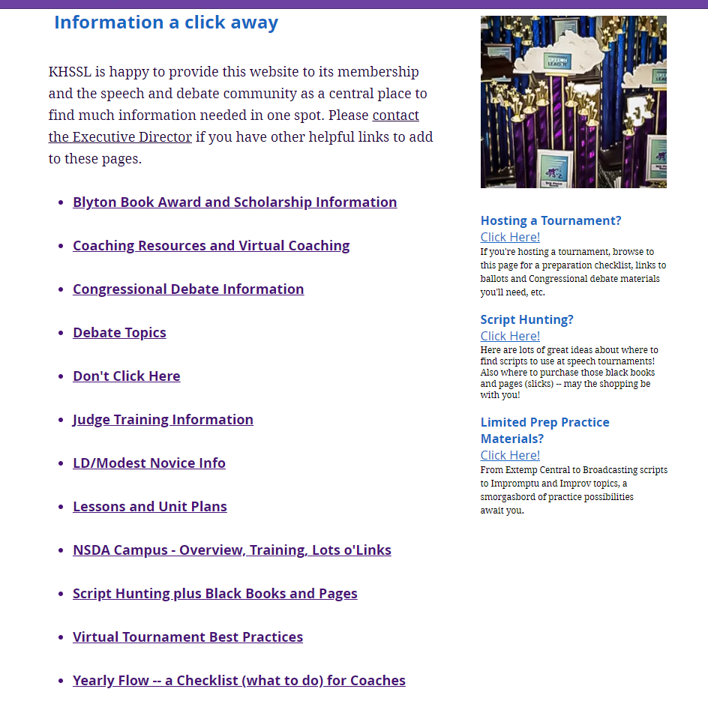

Slide 19

One a month
last year when I
couldn’t do
school visits.

Slide 20
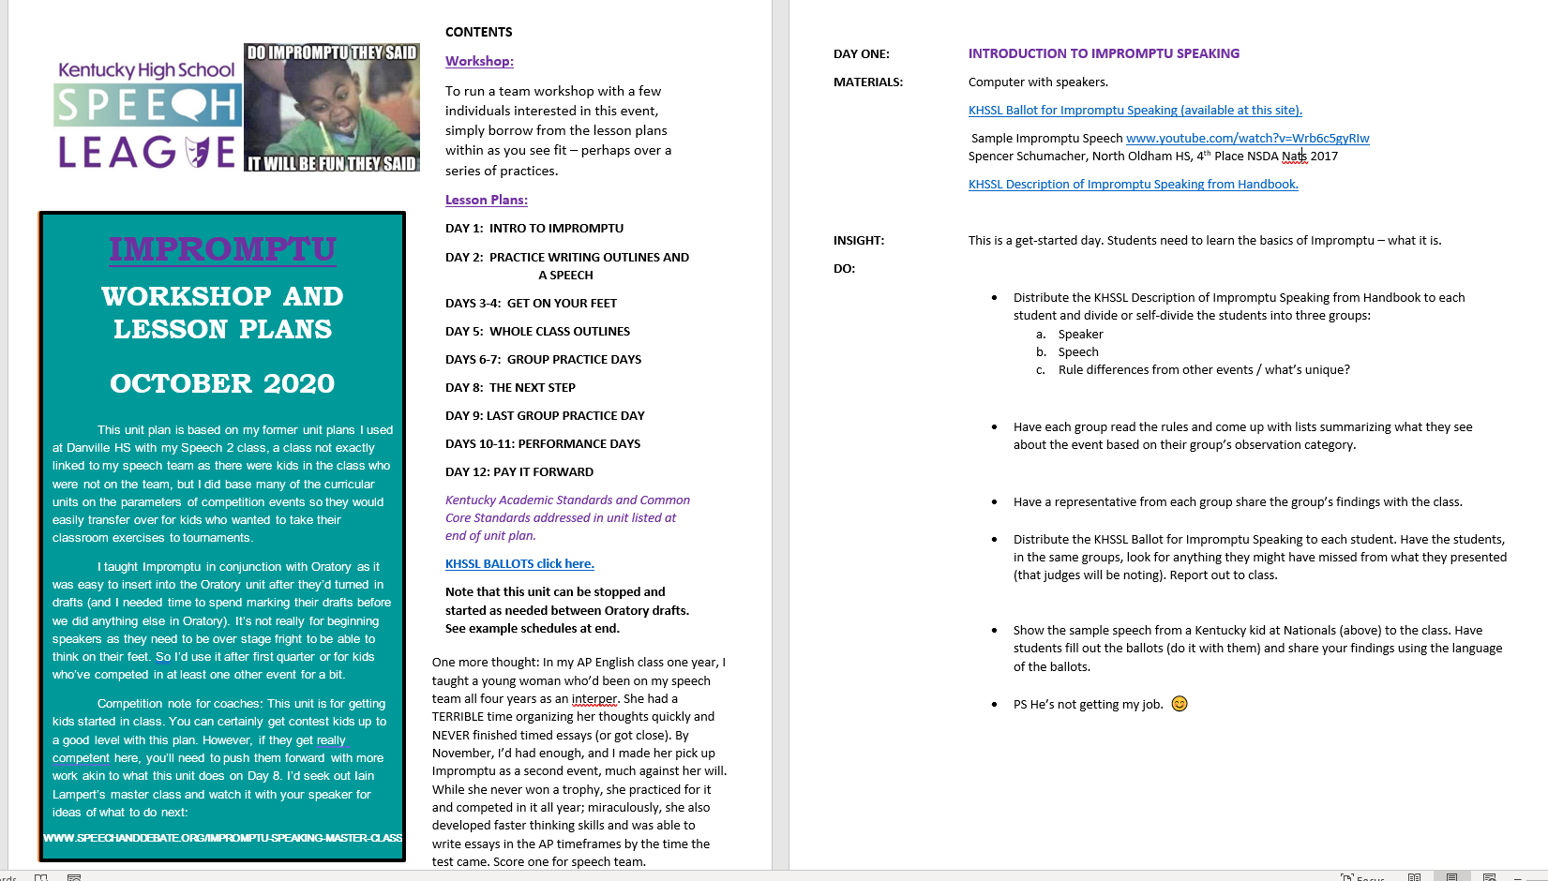

Slide 21
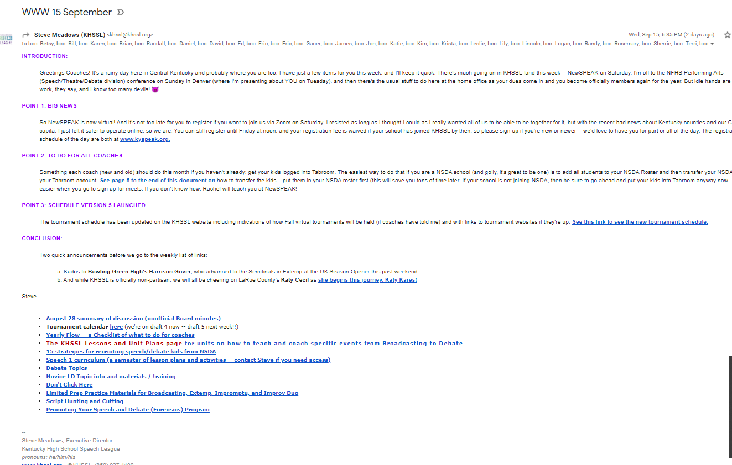

Slide 22
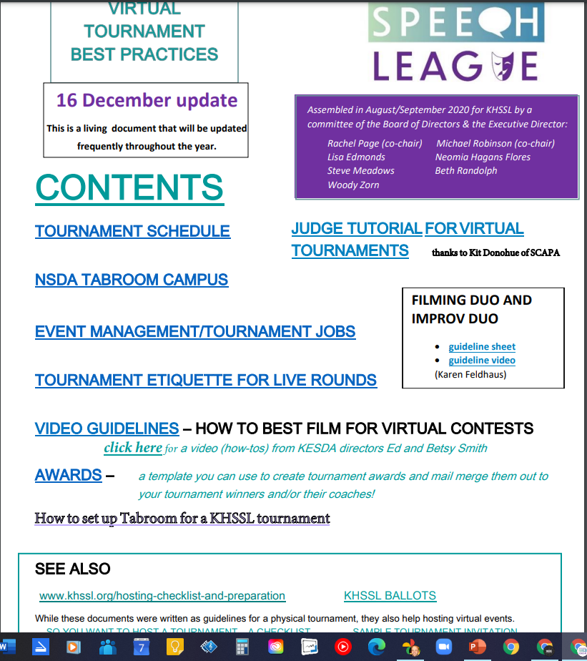



Slide 23
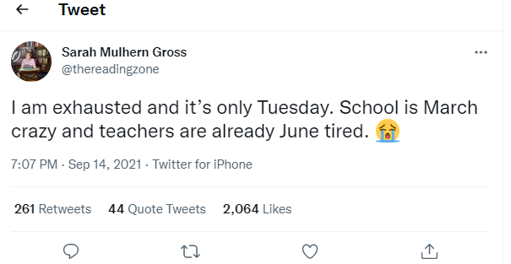

Slide 24
RETURNING COACHES –
Brochure
Business card
Sticky notes
Personal note from me
celebrating something from past years
Stickers

Slide 25
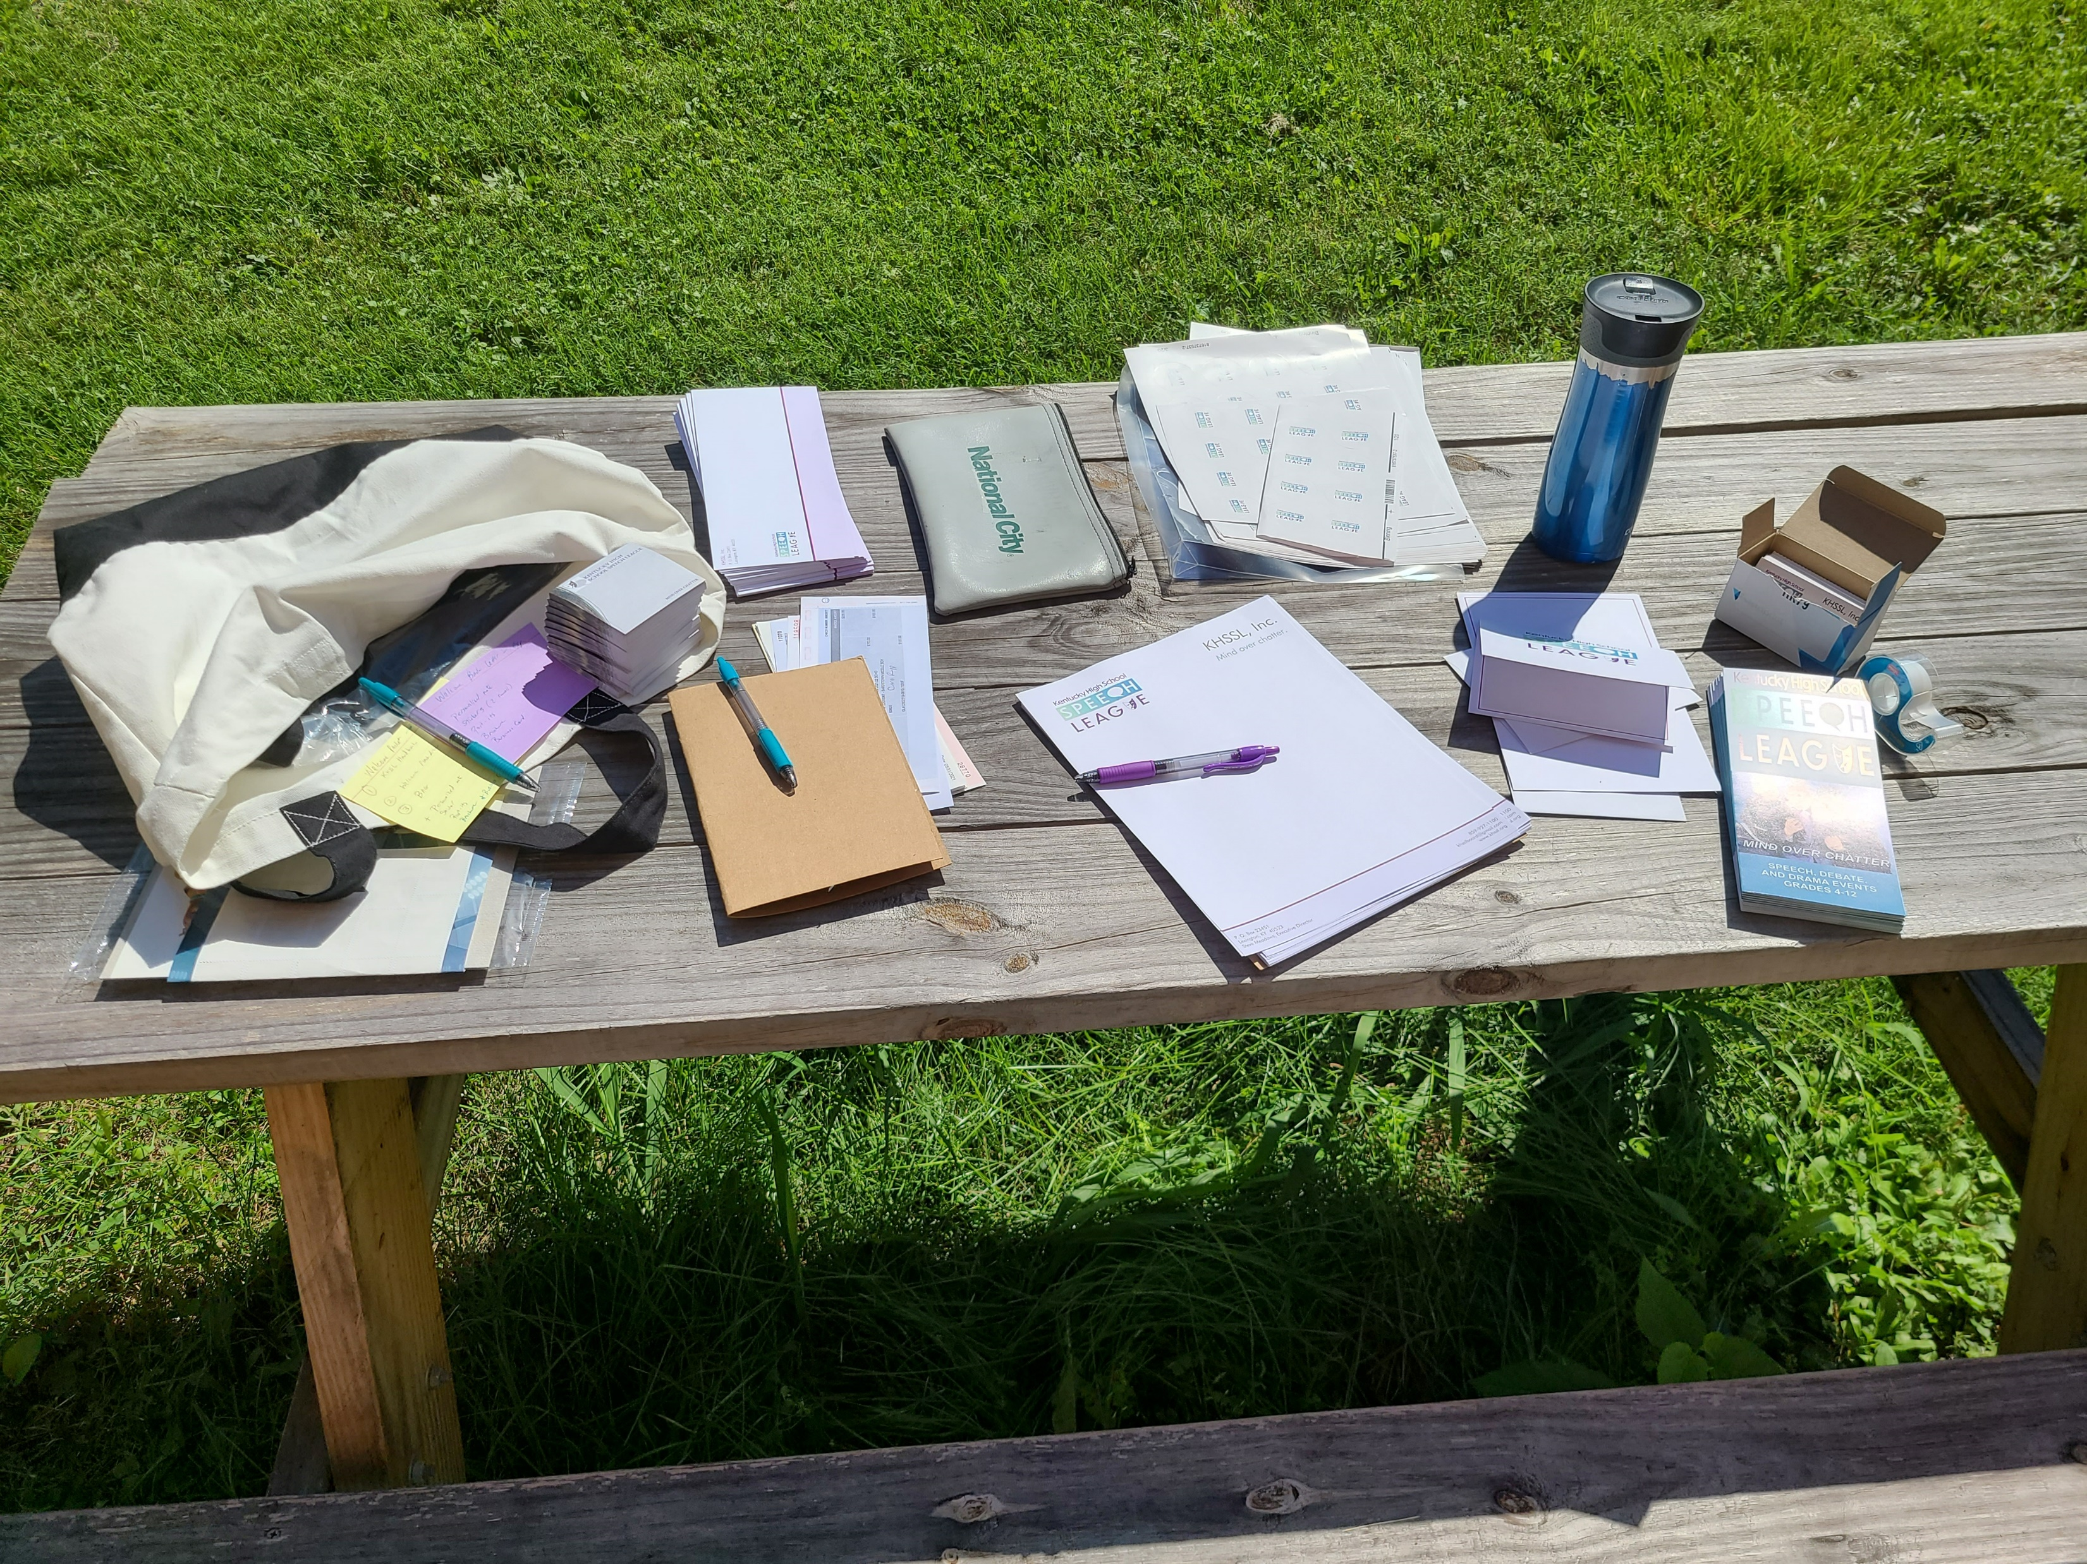

Slide 26


Slide 27

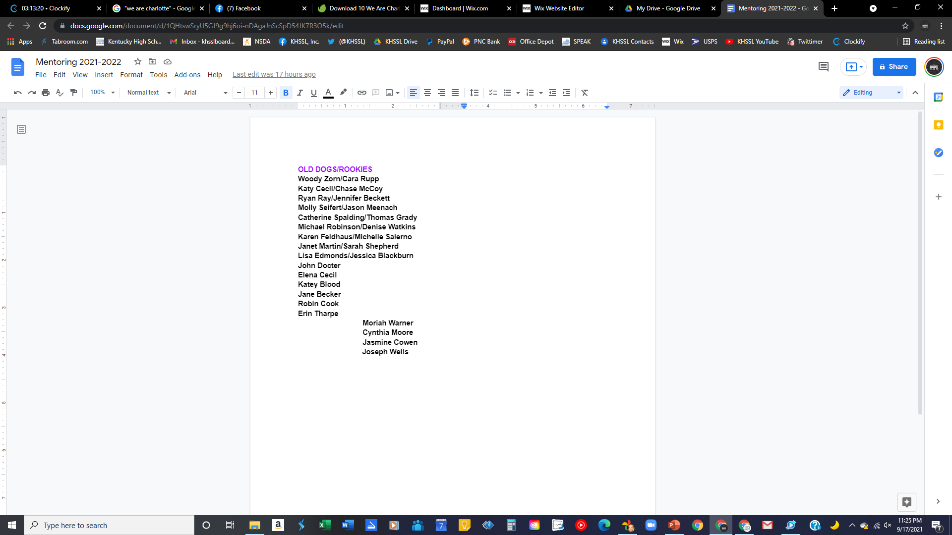

NEW COACHES
NOVICE-ONLY TOURNEYS
MENTORING MATCHES
EXTRA TIME FROM ME (IN MY TIME BUDGET) – conferences and coaching plus team visits (digital or fo real)

Slide 28

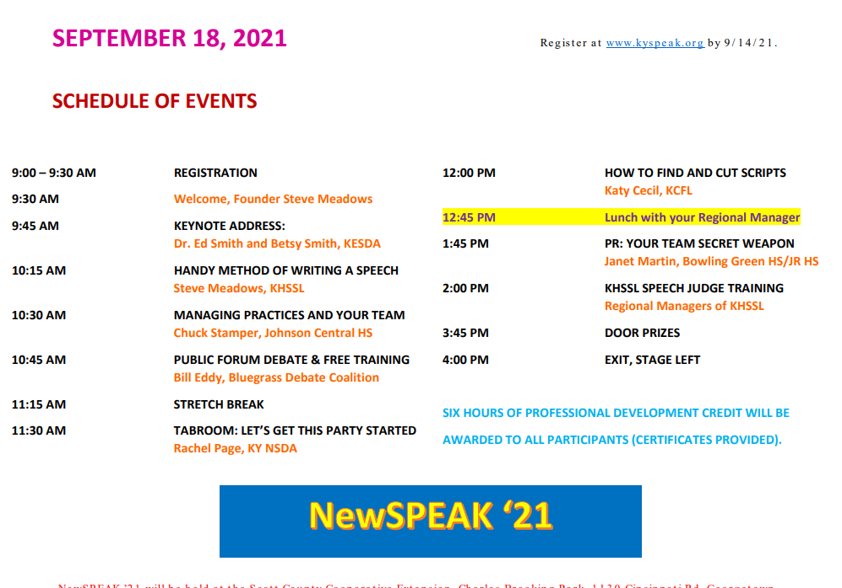
NewSPEAK

Slide 29
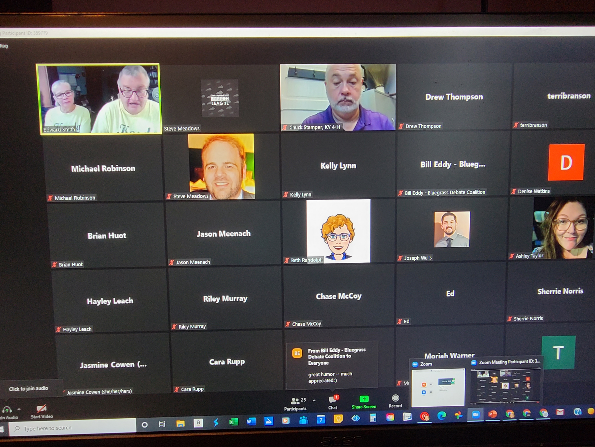
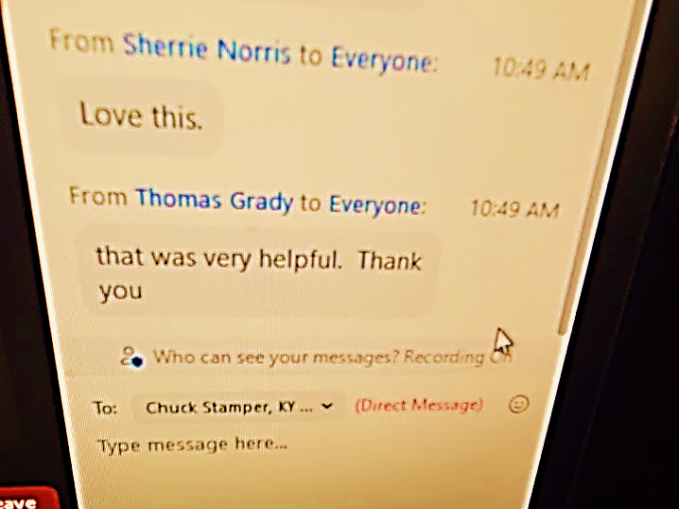
NewSPEAK 2021
18 rookies attended
9/18/21 (SATURDAY)

Slide 30
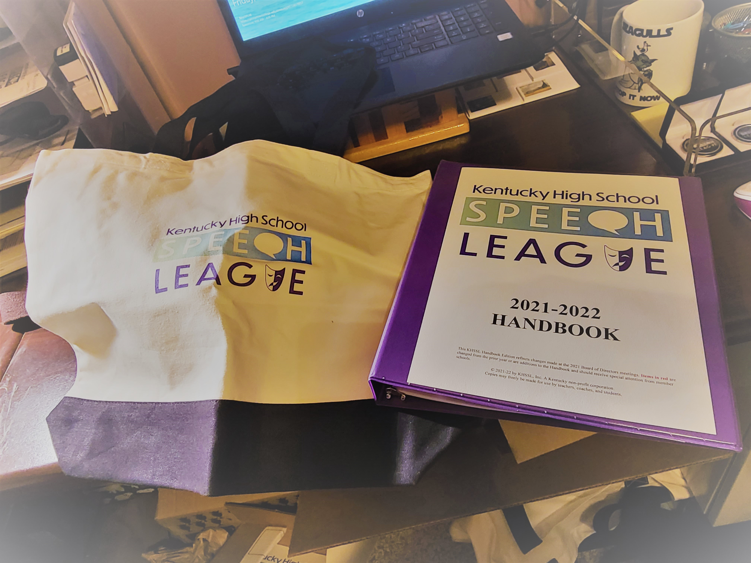
Plus more swag plus the other swag
BRANDED THUMB DRIVE WITH DIGITAL ROOKIE STARTER KIT
Unit plans
Sample scripts in seven Interp categories
How-tos for cutting scripts and cutting POI
Sample legislation and a sample speech for Congress
My Speech 1 curriculum plus some online speech lessons
A copy of the Yearly Flow – a guide to help you keep track of everything you need to do as a coach (and that you can adapt for yourself – it’s nice to have it all written down).

Slide 31


Slide 32


BECOMING A WEBMASTER

