Slide 1
2019 NFHS Performing Arts Converence Chicago, IL
"Changing the Directors' Perception: How Can the State Association Appear More Helpful?"
Craig Manteuffel, Kansas State High School Activities Association, NFHS Music Chair-Elect

Slide 2
Craig’s Prior Life before the Kansas State High School activities association (KSHSAA)
Former Music Teacher of 29 years
  10 years Otis-Bison (5-12 Band/6-12 Choir) Enrollment 120 students
  19 years Hays High School (Director of Bands/SPED Music class 9-12 grades) Enrollment 900 students
  Music Education Involvement
  2013-2015 KMEA State Vice (past) President
  1997-2015 KMEA Northwest District Site-Coordinator
  2013 Member of the NAfME Nominating Committee for the 2017 NAfME President-Elect
  2011-13 KMEA State President
  2009-11 KMEA State President-Elect
  2007-09 KMEA Northwest District President
  2003-05 KMEA State Band Chairperson
  2003-05 Kansas Bandmasters Association Northwest District Representative
  1992-95 KMEA Southwest District Band Chairperson

Slide 3
Craig Joined the KSHSAA in July 2015
Assistant Executive Director of Fine Arts and Spirit
  Music, Debate/Speech/Drama, Cheer and Dance
Sanctioning of Events (Approval of Events)
Sportsmanship
2018 Course Co-writer, “Interscholastic Music Event Management” NFHSLearn.com
2017-19 Co-Presenter NFHS Performing Arts Conference/NFHS Summer Meeting

Slide 4
DISCLAIMER: These thoughts and experiences are from the way we do things in Kansas.
Music Teachers/Directors- We want to learn from you
SAFE ZONE!!!!
If there are items, you would like to see your Music association administrator address for the good of music education in your state, please talk to us!

Slide 5
As a STATE association Administrator, things to consider when working FOR your music directors
listen to what your HS directors are saying and asking
  Explain the protocol for changing/adding rules, events, etc.
Advisory Groups (KMEA Festivals Committee)
  Two meetings per year (October and May)
Write articles for your STATE MEA publications (1-2 per year)
www.NFHSlearn.com
  Free courses that really will help with music teacher/director training!!!
  They will thank you…well, some will!

Slide 6
BE VISABLE and ACCESSIBLE
Attend In-Service Workshops and Clinics
Observer
Presenter
KMEA Board Member (I sit on the KMEA board of directors as the KSHSAA advisor) Non-voting member
KMEA Executive Council presents to the KSHSAA Executive Board each April. Rule change proposals, PowerPoint with updated KMEA Happenings
KMEA President (or designee) is a voting member on the KSHSAA Board of Directors

Slide 7
Annual KMEA In-Service Workshop February (6,000-9,000 attendees)
  Present 2-5 sessions per year
  Speak at the First-Year Music Teachers Breakfast/Lunch
  Speak at the Retired Teachers Luncheon

Slide 8
KS: April is M & M “Miles and Madness”
KS: 17 regionals solos and small ensembles
  Two weekends (Attend 6-8 sites)
KS: 18 Large Group Festivals
  Back to back week days (Attend 6-10 sites)
KS: State Solos and Small Ensembles
  Six Classifications and sites (Attend all 6 sites)

Slide 9
AWARDS
NFHS state awards: turn them in on time and present the award at a school assembly or appropriate school event (play, concert, etc.)
KSHSAA Performing Arts School of Excellence Award
  Make it a BIG DEAL!
  NFHS Model is now a KSHSAA Annual Award
KSHSAA/NFHS Hall of Fame (recognize deserving teachers)

Slide 10
Know your rules book/Manual/Hand Book
never give an answer unless you are 100% sure!
Sometimes you need to be a mentor!

Slide 11
KSHSAA
ANNUAL Music Online Rules meeting
Required Annually for all 9-12 head music directors
  Cover FAQ
  Online Festival Manager Program
  KSHSAA Music Manual

Slide 12
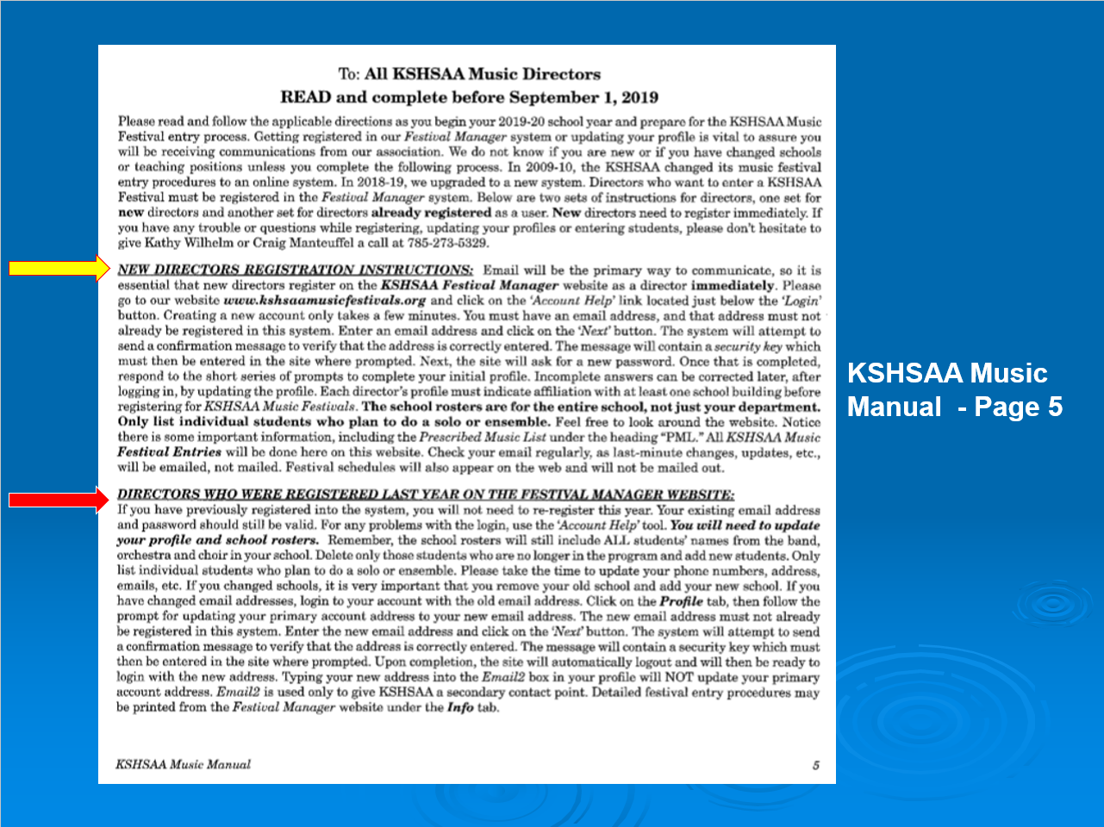

Slide 13
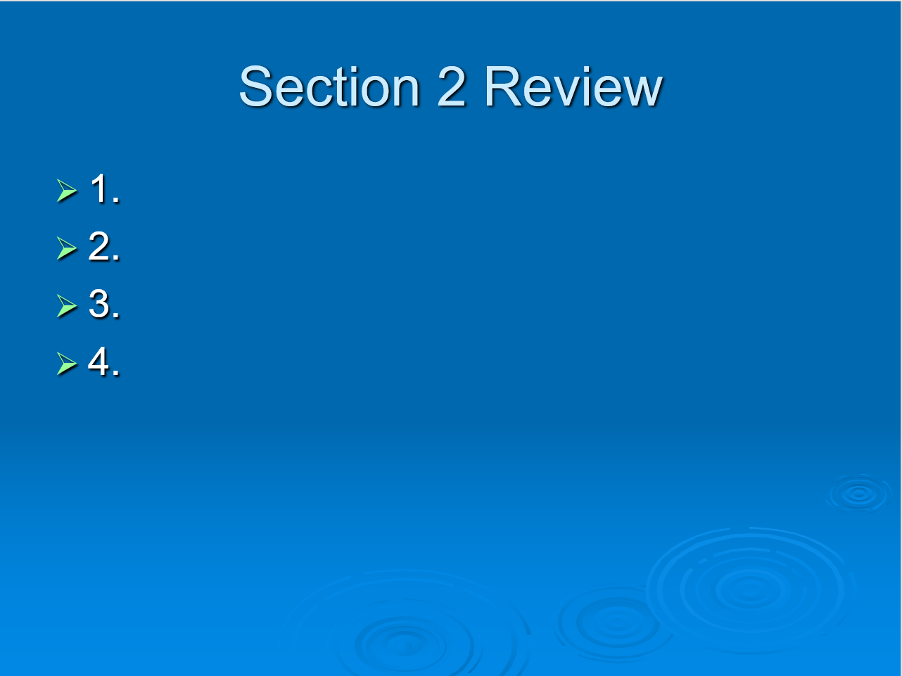

Slide 14
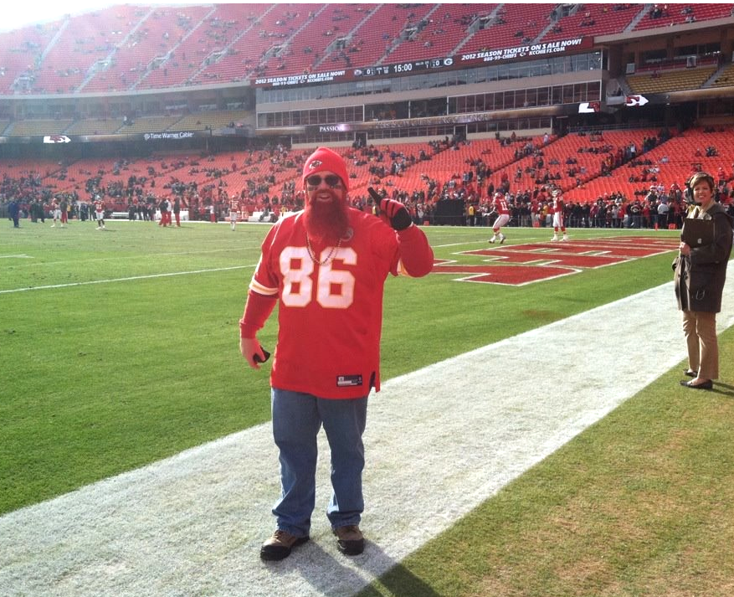
Just BE YOURSELF!!!
​
cmanteuffel@kshsaa.org​

