Slide 1

Paula Rodriguez
UIL State Theatre Director
Austin, Texas
prodriguez@uiltexas.org

Slide 2
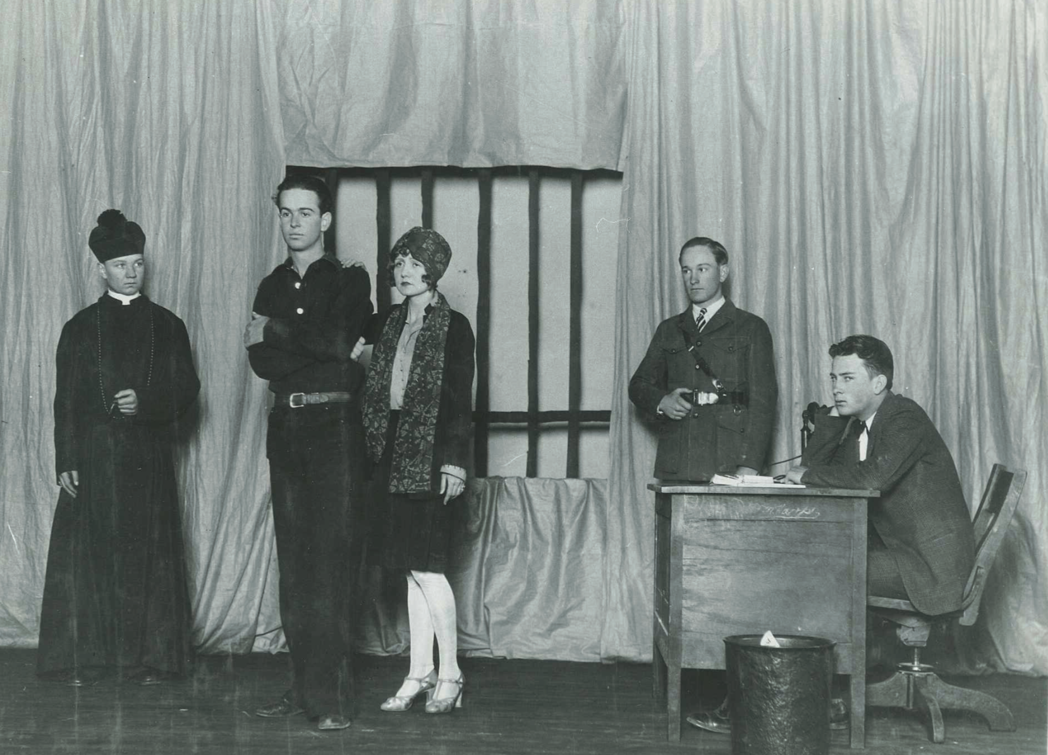
University Interscholastic League’s
One Act Play Contest- History
Contest began in 1927 and is the largest high school play contest/festival in the world.
Considered by historians to be the foundation of educational and community theatre in Texas.
The OAP contest is the motivating factor for the increasing numbers of schools to offer theatre as an academic subject.
Image- Plainview High School State Championship production of The Valiant, Plainview HS, 1928.

Slide 3
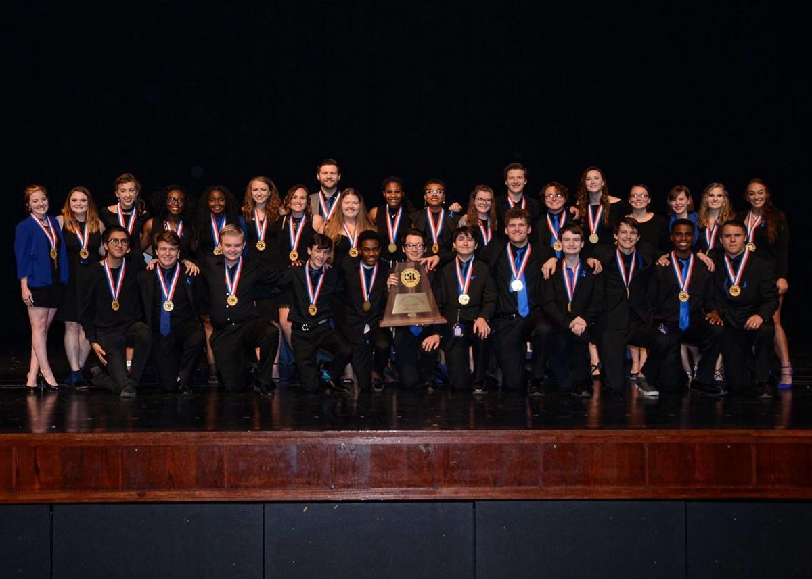
OAP Enrollment
Over 1300 high schools enroll in OAP Competition.
Schools are aligned by conference size. 1A-6A conferences.
Schools are organized into Districts.
Competition begins in March.

Slide 4
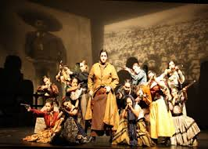
General Contest Facts
There are six possible levels of competition: Zone, District, Bi-District, Area, Region, and State.
  State Meet is held in May.
3 schools advance to each level except for Regionals.
  2 schools from each region advance to State Competition in their division.
The top 8 schools in each Conference advance to State Competition.

Slide 5
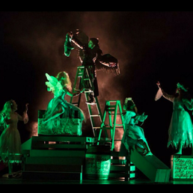
General Contest Rules
Each school enters a one act play of 18 -40 minutes in length.
Schools are allowed a maximum 7 minute set up and 7 Minute Strike.
Company size is a maximum of 20 Cast+ Crew combined.
Directors must be fulltime employees of the school district.
There can be as many as 4 Directors listed on the One Act Play Entry.

Slide 6
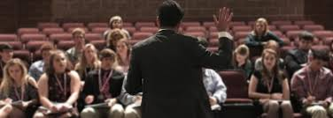
Adjudication and Awards
Lower Level Contests- Zone, District Bi-District may choose a panel of 3 or a Single judge.
Each Panel has a designated Acting judge assigned to award performances
  2 Best Performers
  8 All-Star Cast
  8 Honorable Mention

Slide 7
Adjudication
UIL- OAP uses the same tabulation system- TALK TAB as UIL Speech
After ballots and Awards Ceremony- Critic judges give oral critiques ranging from 15-20 minutes per school.
All schools receive written evaluations and a copy of the tabulation from each judge.
State judges rank 1st through 6th place
Samuel French Award – Outstanding Performer at State.

Slide 8
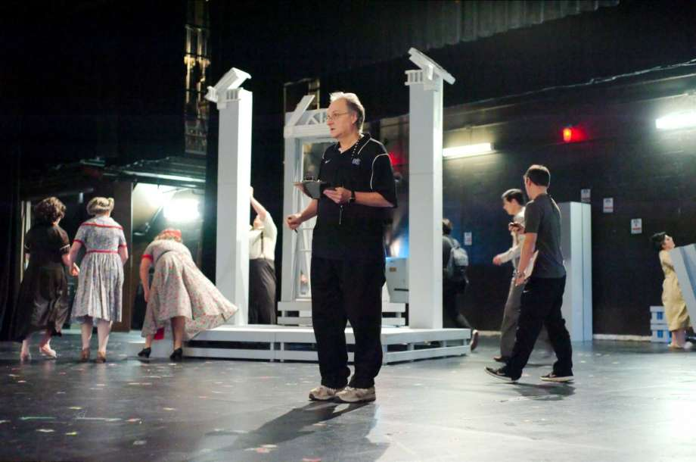
Contest Organization
August 15- Directors begin holding planning meetings to organize the preliminary contest-
  select Contest Manager- the contest official.
  and compile a list of preferred adjudicators.
  All schools share expenses.

Slide 9
Judges and Contest Managers
Adjudicators and CM’s are members of the Texas Theatre Adjudicators and Officials Organization.
Adjudicators must meet requirements established by the organization including Theatre degree or experience.

Slide 10

Play Selection
The League strongly encourages directors to select quality literature for competition.
The League provides 2 Lists of Approved Plays for competition- A list of Short Plays and List of Long Plays.
Directors may also submit original works or other plays through the Play Approval process.

Slide 11
Scenery, Lights and Sound Rules
Scenery- Schools are allotted the use of a 28 piece grey Unit set provided by the host site.
  Platforms
  Flats
  Step units
  Ramps
  Pylons
  The OAP Handbook specifies rules regarding the use of the unit set- mainly for safety reasons.

Slide 12
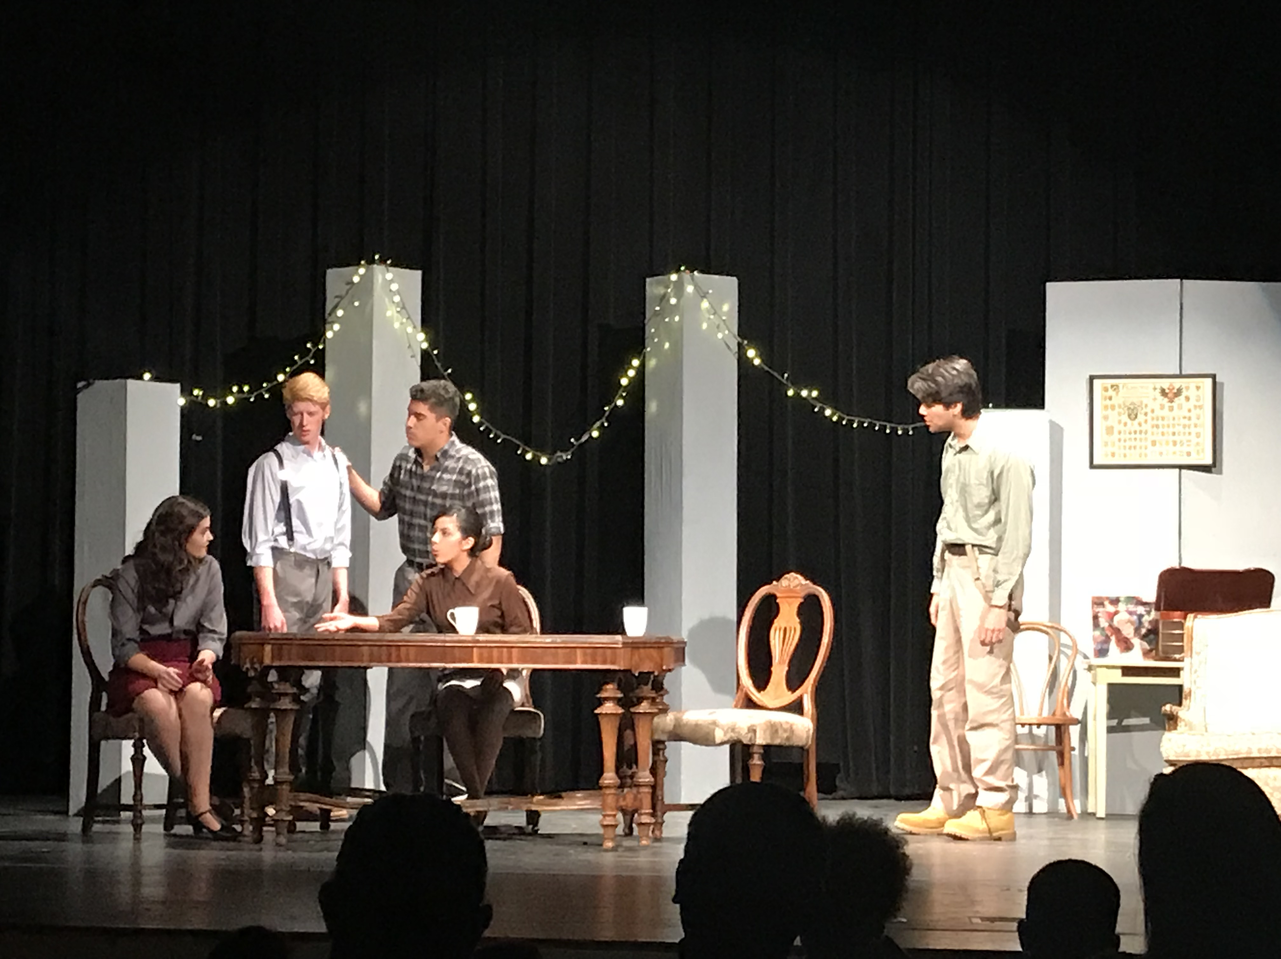
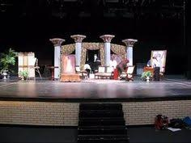

Slide 13
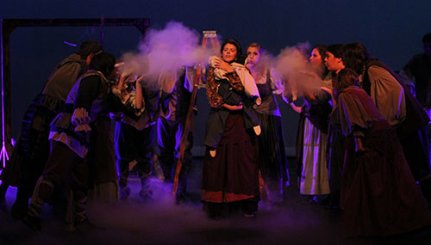
Can we have more rules, please?
Because of the wide participation and diversity of plays produced certain rules and guidelines have been adopted.
These rules are in place to ensure safety, allow for equity, satisfy legal standards, and make the running of the contest practical.

Slide 14
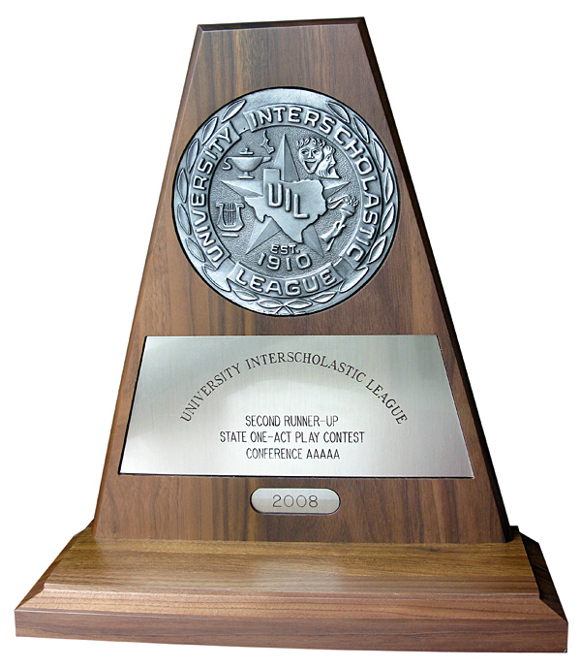
State Meet Schedule
Shows begin at 4:00pm and run back to back with one intermission between Sessions 1 and 2.
Awards Ceremony is held immediately after tabulation.
State Judges do not confer during the adjudication process.
Judges draw for critique order after tabulation.

Slide 15

What are judges looking for?
60% Acting
40% Directing and Stage Mechanics- including design/tech.
In addition to medals, points are awarded to acting awards and advancing plays.
Schools that accumulate the most theatre points in Theatre will win the Overall State Theatre Team Champions.

Slide 16

Other UIL Theatre Contests
Theatrical Design-Schools may enter students in
  Scenic Design
  Costume Design
  Hair and Makeup Design
  Marketing and Publicity
  Two levels- Prelims and State
Junior High One Act Play Contest
  Junior High contests have only one level of competition (District) and plays are ranked 1st, 2nd and 3rd.

Slide 17

Young Filmmaker’s Festival
To explore the art of cinematic storytelling.
Preliminary round +
2 Qualifying Rounds
State Finalist
Finalist films shown at the State Film Festival
Schools are allowed 3 Entries in each
  Narrative
  Documentary
  Animation Film
    Traditional Animation
    Computer/Digital

Slide 18

Austin is BEAUTIFUL in spring!
See y’all there!

