Slide 1
SIGHTREADING: Do you see the importance?
Matthew Rowan
NFHS Performing Arts Conference
September 2019

Slide 2

See spot run.

Slide 3
Run, spot, run!

Slide 4

“Look at Spot go! He really can run. I wouldn't want to be that cat!”
Link

Slide 5
Spot’s Literacy Requirements:
Letter Recognition
Phonics/Sounds
Complete Words
Punctuation
Inflection, Emphasis, Phrasing

Slide 6
LINK

Slide 7
Musical Literacy
Music is simply another language that utilizes concepts such as pitch and rhythmic notation.

Slide 8
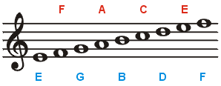
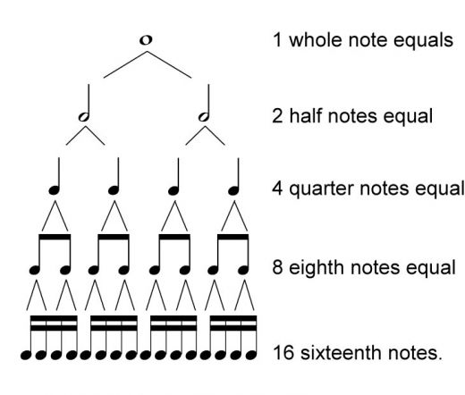
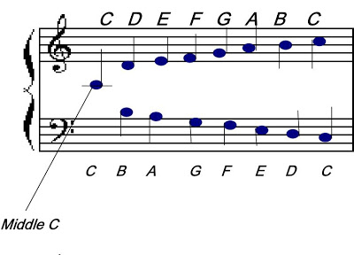
Musical FUNDAMENTALS (Literacy Requirements)
PITCH NOTATION
Rhythmic notation

Slide 9
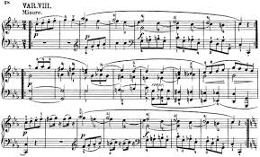
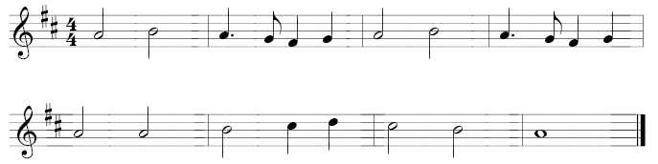
Musical examples
Simple
Complex
Musical Literacy is vital to the growth and sustained success of any musician or ensemble.

Slide 10
Sightreading: What is it?
The ability to read music at sight.
Understanding of Rhythmic Notation, Note and Rest Values, Time Signatures, and Pulse.
Understanding of Pitch, Note Names, and Musical Notation.
The combination of these allow for basic sightreading skills.
Ultimately, sightreading should be a TOOL used to assess FUNDAMENTAL MUSICAL SKILLS.

Slide 11
Sightreading: the Importance
Informal Text to Colleagues: “Why is Sightreading Important?”

Slide 12
Colleague Responses: Why is sightreading important?
“The same reason I am able to read this text and laugh at it…..Literacy.”

Slide 13
Colleague Responses: Why is sightreading important?
“To show that we are teaching our kids the fundamentals of music so they can be independent players. Also, to show that we aren’t rote teaching and only working on the music for a festival or contest.”

Slide 14
Colleague Responses: Why is sightreading important?
“I think sightreading is an important benchmark on teaching effectiveness and aligned curriculum throughout a program. You can tell a lot about what students can and cannot do based on their sight reading recognition.”

Slide 15
Colleague Responses: Why is sightreading important?
“It has its place in the classroom. If fundamentals are being taught as they should, then the sightreading process can be beneficial to the learning environment. It becomes a TOOL to evaluate if fundamentals and musicianship are being taught. If rote teaching is occurring, then sightreading is useless.”

Slide 16
Colleague Responses: Why is sightreading important?
“Without the ability to recognize, play and understand music at sight, everything we do is simply a mechanical action of repeating sounds over and over until it sounds good.”
“Music is a language and, as purveyors of this language we must insist that our students can read it, write it, and speak it. Just as we expect that from our ELA teachers.”

Slide 17
Colleague Responses: Why is sightreading important?
“Because anyone can fluently speak a language and still be illiterate.”
“It accurately measures the music literacy levels of performers. Humans can fluently speak numerous languages without knowing how to read and or write those languages. One of the primary purposes of music education should be to teach people how to read, comprehend, and speak (perform) the language of music.”

Slide 18
LITERACY AND MUSICAL LITERACY
“There is a direct correlation between poverty and illiteracy. Per the Literacy Project Foundation, three out of four people on welfare cannot read. Fifty percent of unemployed individuals between 16 and 21 years of age are not considered literate. On the flip side, as the literacy rate doubles, so doubles the per capita income.” -Success for Every Student by Shelly Pollnow and Oran Tkatchov

Slide 19
Benefits of musical literacy:
Independent Musicians
Increased Achievement and Ability Levels of Individuals and Ensembles
Increased Teaching Efficiency and Enjoyment
Increased Enjoyment for all: Performers, Teachers, Audience Members
Provides the ability to create MOMENTS and MEMORIES that can last a lifetime.

Slide 20
THE VIRTUOUS CYCLE
Practice
Success/Growth
Enjoyment
Confidence
Motivation

Slide 21
Individual and ensemble sightreading
PURPOSE:
To assess the mastery of fundamental musical skills.
Individual Sightreading:
Assesses mastery of fundamentals
Used to compare or rank performers.
Honor Ensembles, Scholarships, Etc.
Ensemble Sightreading:
Assesses Mastery of fundamentals.
Provides feedback in regards to ensemble ability level.
Typically involves the director or teacher in the live assessment and performance.

Slide 22
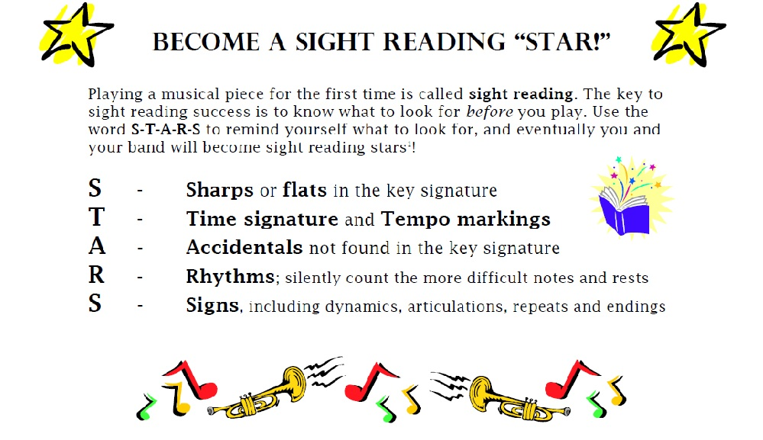
SIGHTREADING INCORPORATION
Teach Fundamentals at ALL levels.
Build Into the ensemble warm-up process.
Teach a PROCESS for individuals and ensembles.
Sightread Daily
Ensure it is aligned with what is being taught.
Start Small and increase length as students progress.
Work Simple to Complex
Don’t move on until the skill is mastered.
Understand Adjudication Requirements/Allowances

Slide 23
Sightreading resources
Habits of a Successful Musician Method Book Series
Ensemble Sightreading Methods
Individual Sightreading Methods
UIL Sightreading Series for Band/Orchestras
www.sightreadingfactory.com
SmartMusic – www.smartmusic.com

Slide 24

SIGHTREADING: Concluding thoughts
Should be a necessary part of the music curriculum at all levels.
Should be used as a tool, both formal and informal, to evaluate the mastery of fundamental musical skills on both the individual and ensemble level.
Can be used as a tool to track consistent growth and progress.
Helps educators understand the ability levels of individuals and ensembles.
Should be routinely incorporated to help produce literate musicians that can participate in musical ensembles throughout their lives.

