Slide 1
Claim Your Impact!
Building Public Support for
Arts & Culture
National Federation of State High School Associations
September 17, 2019
Randy Cohen
Americans for the Arts
@ArtsInfoGuy

Slide 2
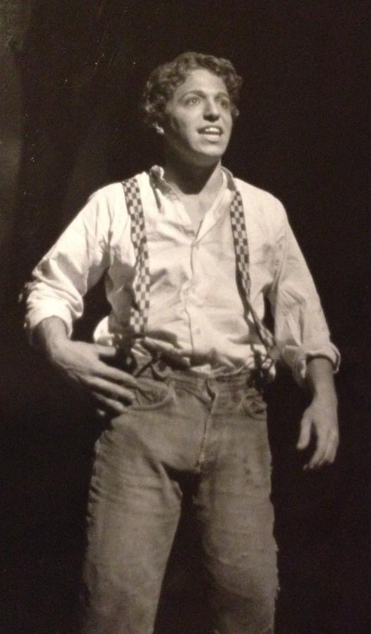
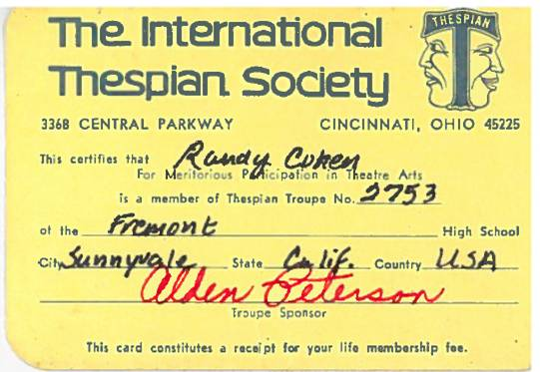

Slide 3
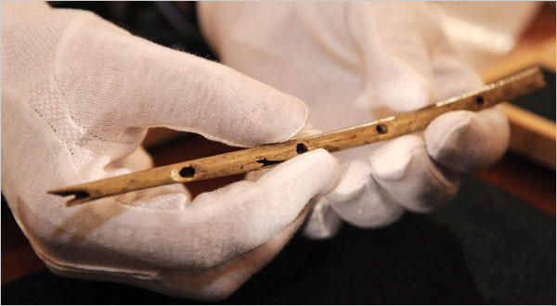
Stone-Aged Flute

Slide 4
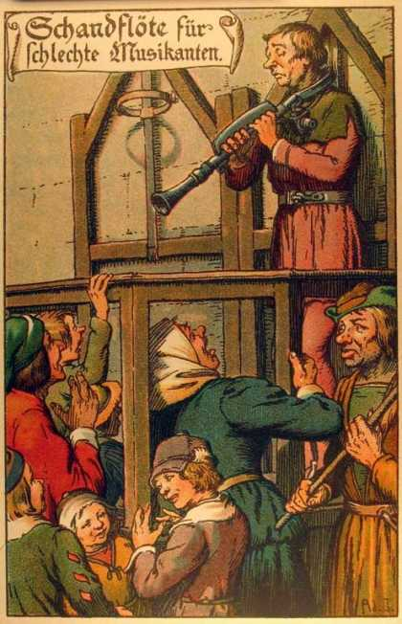
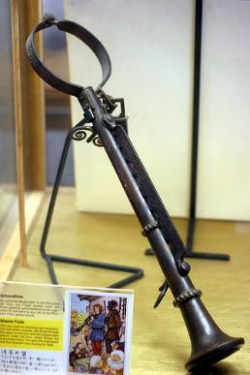
The Shame Flute

Slide 5
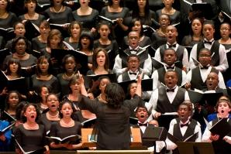
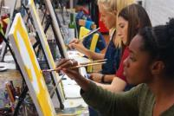
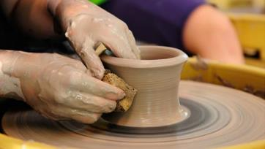

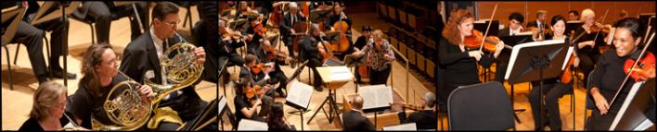
Half of Americans Are
Hands-On Arts Makers

Slide 6
The Many Forms of Creative Expression:
27 Percent of Americans Have Tattoos

Slide 7
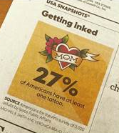
73 Percent of Americans Believe Some/All Tattoos are Art!
@ArtsInfoGuy

Slide 8
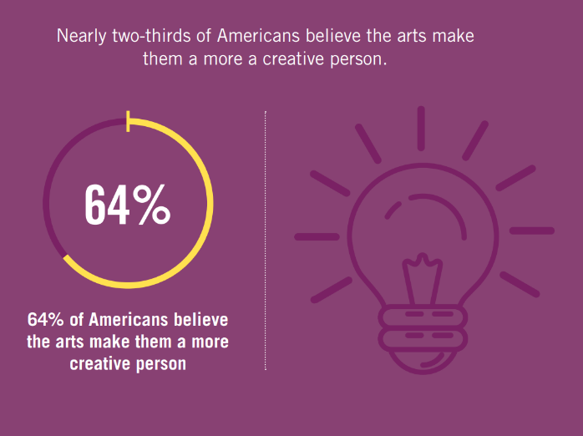
The Arts Make Us Feel Creative!

Slide 9
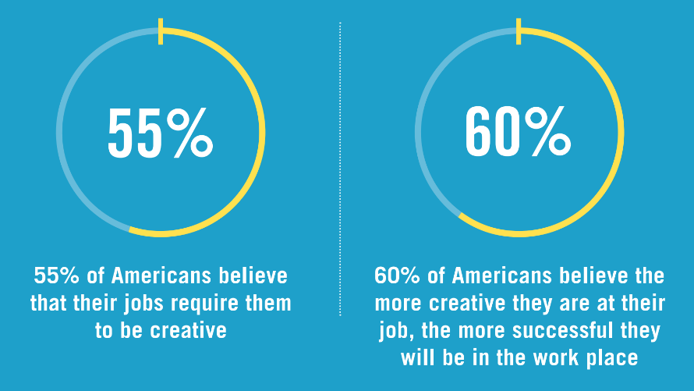
Our Jobs Require Creativity

Slide 10
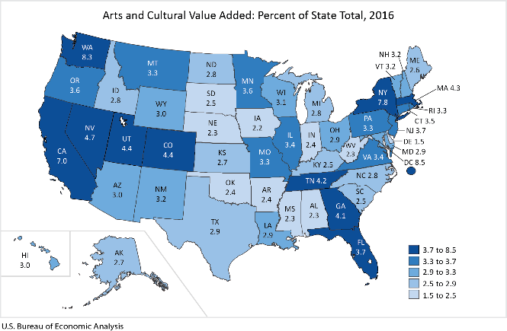
Arts Contribution to the Illinois Economy
(Also in Rural Communities)
$27.2 Billion
3.4% of GSP
211,192 Jobs
Source: U.S. Bureau of Economic Analysis
@ArtsInfoGuy
Notes:
USDA’s Economic Research Service) showed that the concentration of performing arts organizations in a rural community was closely correlated with the presence of innovative firms in that community
The probability that a rural organization will be a substantive #innovator can increase 85% if the rural county hosts four+ #ArtsOrganizations. Via @CityLab bit.ly/2rrkJBe

Slide 11
Creative DuPage County
2,272 Arts-Related Business Employ 14,689 People
4.2% of all businesses
1.9% of all employees

Slide 12
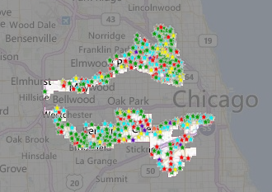
Creative Industries in IL-4
838 Arts-Related Business Employ 3,026 People
4.8% of all businesses
1.7% of all employees
Notes:
Call the zombie!

Slide 13
How Many Arts Businesses in
YOUR COMMUNITY?
www.AmericansForTheArts.org/CreativeIndustries

Slide 14
Notes:
The 2008, the Conference Board published, Ready to Innovate touts the importance of arts education in building the 21st century workplace. Arts participation in the school or in the workplace strengthens our “creativity muscles” which builds our creativity, the fuel that drives innovation.
72% of employers say creativity is of primary concern when they’re hiring, and 85% of these employers can’t find the creative applicants they seek.
Employers who replied to the survey believe creativity has less to do with finding solutions than with the ability to spot problems or patterns others cannot see.
Arts-related study in college is a key creativity indicator to potential employers.
Very few employers test for creativity in the hiring process; a noteworthy 27 percent said they use the candidate’s appearance to assess creative ability.
The Conference Board report concludes, “..The arts—music creative writing, drawing, dance—provide the skills sought by employers of the Third Millennium.

Slide 15
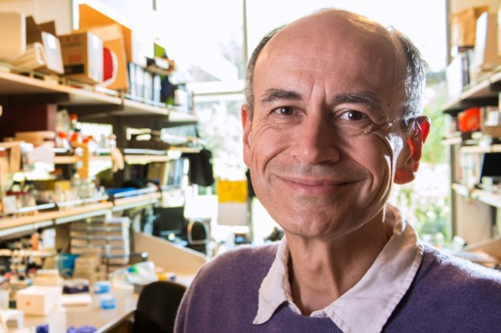
Thomas Südhof
2013 Nobel Prize for medicine:
“I owe it all to my bassoon teacher”
Drive for excellence … Visual thinking … Pattern recognition Problem solving … Perseverance

Slide 16
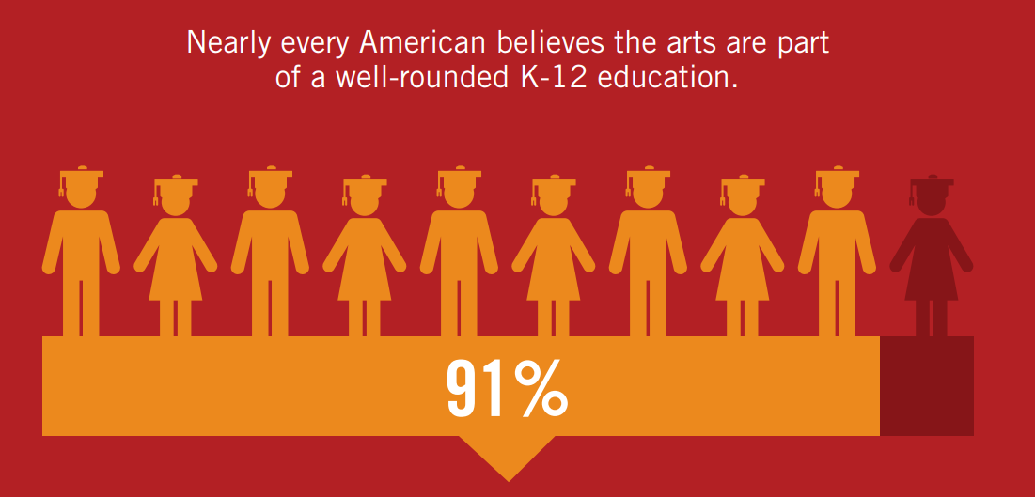
Americans Believe the Arts are Part of a
Well-Rounded Education for K-12 Students
@ArtsInfoGuy

Slide 17

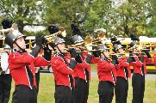
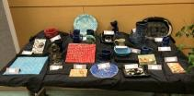
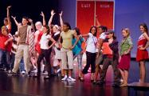
Improved Academic Performance
Notes:
CATTERALL . . .
The academic benefits of arts education go beyond math and reading. An analysis of U.S. Department of Education data by UCLA research James Catterall found that students who were highly involved in the arts performed better on a variety of academic measures than other students (grade point averages, standardized test score, lower drop-out rates, and better attitudes about community service . . . these findings also held when studied across socio-economic strata, suggesting that the arts can "level the playing field" for youngsters from disadvantaged circumstances.
Don’t take my word for it. In a recent commentary in Education Week by Arkansas Governor Mike Huckabee and former U.S. Secretary of Education Rod Paige, they write, “The arts instill in students the habits of mind that last a lifetime: critical-analysis skills, ability to deal with ambiguity and to solve problems, perseverance, and a drive for excellence.”
Now, it's hard to argue with these facts, but policy makers have found ways to ignore them. Too many of our students in our communities and classrooms simply don't have access to arts education. Last year’s report by the Council of Basic Education documented, via surveys of 1,000 school principals, what so many of us are observing. Because of No Child Left Behind laws, our schools are teaching to the test more than ever, and cutting out the liberal arts. 25 percent of the principals reported decreases in instructional time for the arts; 33 percent anticipate future decreases in instructional time.

Slide 18
Arts Education is Deemed Very Important at
All Grade Levels (K-12)
Percent Important
2018 | 2015
94 percent | 88 percent
94 percent | 90 percent
93 percent | 89 percent
89 percent | 83 percent
@ArtsInfoGuy

Slide 19
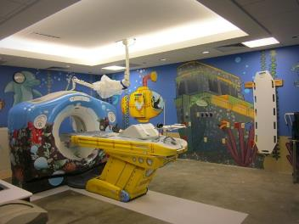
Arts in Healthcare Benefits
Reduced length of hospital stay
Fewer medical visits
Reduced use of pain and anxiety med’s
Improved recovery time
Reduced depression
Notes:
Jeff Koons installation in CAT Scan room of Advocate Children’s Hospital. New York Times.
In a national survey about arts programs in hospitals, more than half of the 2,000 responding hospitals indicated having on-site programming for their patients and staff. The reasons are many, but 73 percent present the arts because it aids in a patient’s mental and emotional recovery.
Arts programs in hospitals serve multiple audiences: 96 percent are designed to serve patients directly; 56 percent include the patient’s family members; and 55 percent include programs for staff, as a means to deal with the stress in the healthcare environment.
Hospital arts programs are largely funded by the hospital itself—66 percent of their budgets come from the hospital’s general fund. These programs are often conducted in partnership with local performing and visual arts organizations, or their local arts agency.
Survey conducted by Joint Commission on Accreditation of Healthcare Organizations, Americans for the Arts, and Society for Arts & Healthcare.

Slide 20
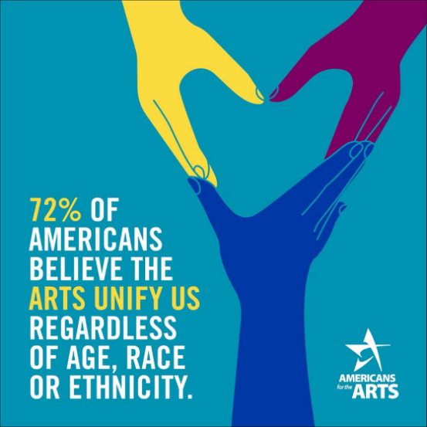
The Arts Unify Communities

Slide 21
“Everyone in my community has equal access to the arts.”
(Just 50 percent of the public agrees)
A Call for Action

Slide 22
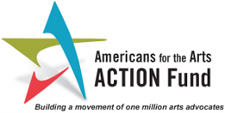
You Make The Difference!
Golden Rule!
Tell your story again and again!
Arts is a non-partisan issue!
You are the expert!
Join the Arts Action Fund

Slide 23
Thank You! www.AmericansForTheArts.org rcohen@artsusa.org
@ArtsInfoGuy

