Slide 1
SDHSAA State One-Act Play Festival

Slide 2
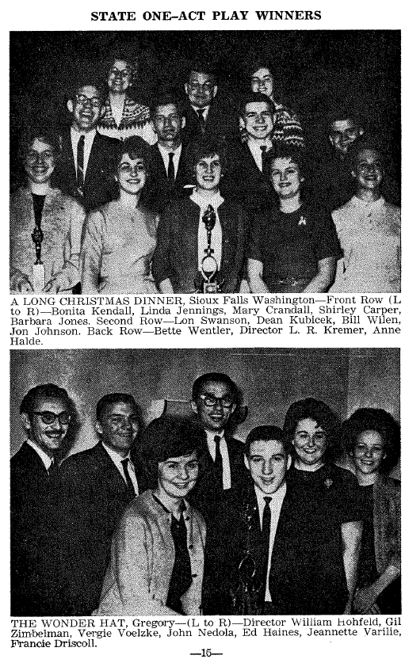
A (very) Brief History
First State One-Act Festival was held in 1956
Schools compete at District and/or regional level contests in order to qualify for the State Festival
30-minute time limit was later changed to 45-minute time limit
Policies have become much more defined since the 1950’s
Notes:
Although policies are now more clearly defined than they were in the early days of the one-act festival, most of the original policies are still in place today.

Slide 3
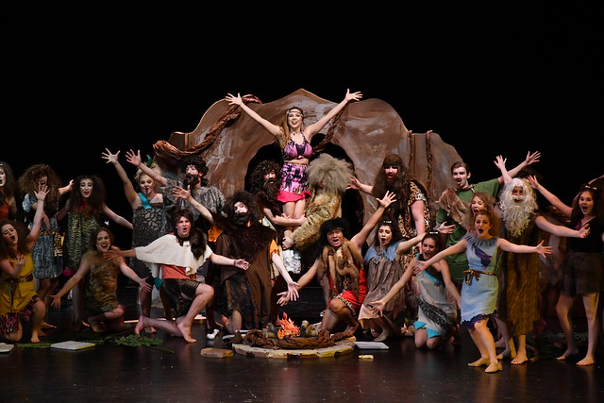
Current Format

Slide 4
3 classifications – AA, A, and B. Determined by school’s grades 9-11 Average Daily Membership
A & B schools begin competition at the Region level
AA schools begin competition at the State level
6 regional contest sites for class A schools/8 regional contest sites for class B schools

Slide 5
Participation
Class B – 55 - 60 schools per year
Class A – 30 - 35 schools per year
Class AA – 15 - 17 schools per year
State Festival hosts an average of 17 (AA), 12 (A), and 16 (B) plays during the 3-day festival

Slide 6
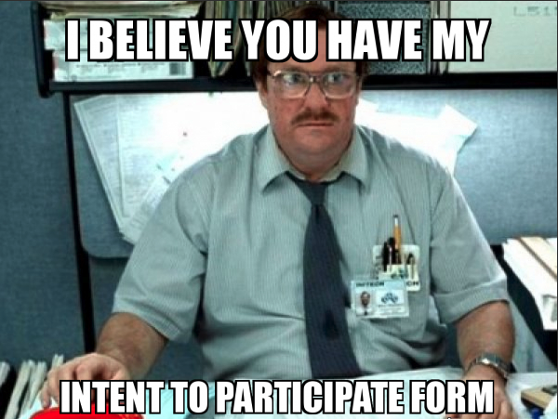
Who Can Participate?
Eligible students in grades 7 - 12
Schools submit an “Intent to Participate” form
Class A & B schools are placed in regions – average participation is 6 - 8 class A & B schools per region
Competition Season – January 13 – February 8
(no season restrictions on practices…only competitions)

Slide 7
Region Contests
Each region has a chairperson and a minimum of 2 directors on the region committee
Chairperson and committee select dates and locations of their contests, hire judges, and handle all region finances
Chairperson gets a stipend - $50 plus $10 for each participating play
Region expenses are equally split up between all participating schools
Top 2 plays in each region advance to the State Festival

Slide 8
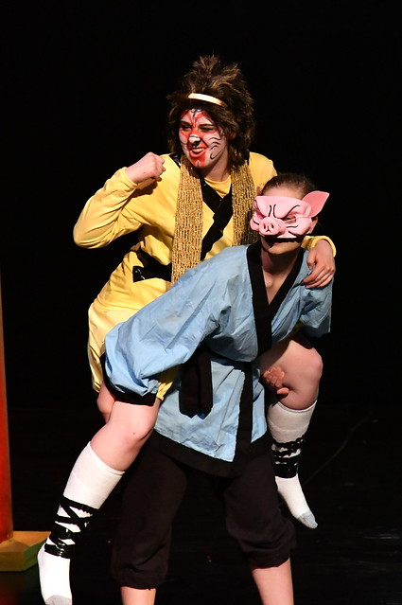
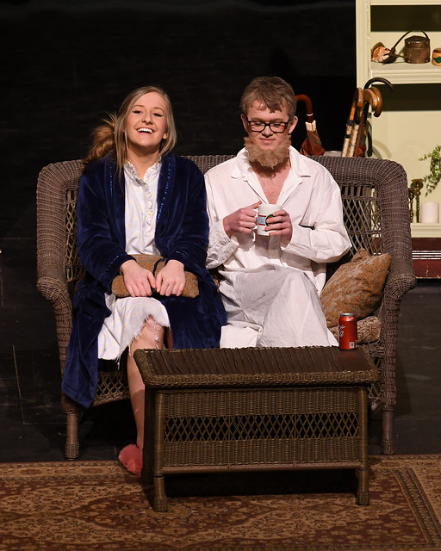
STATE FESTIVAL

Slide 9
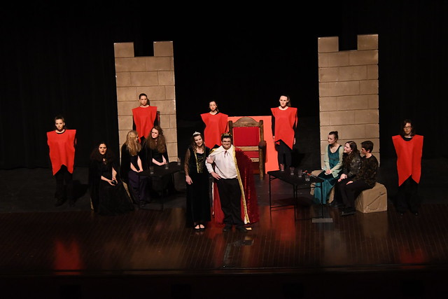
SCHEDULE
Shows run every 45 minutes
Thursday - 9am thru 9:45pm
Friday – 8am thru 9:45pm
Saturday – 8am thru 5pm with awards immediately following final play
Plays alternate between 3 classes (AA, A, B)

Slide 10
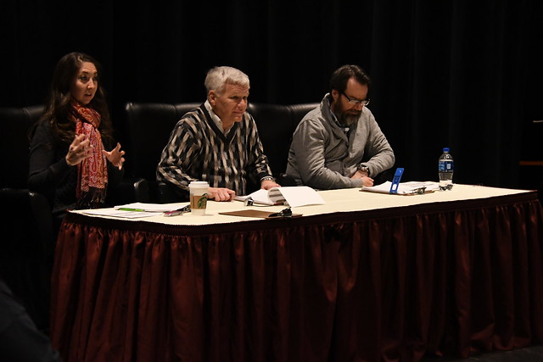
JUDGES
3-Judge Panel is assigned to judge one classification for entire festival.
Must be collegiate level or professional in their field
Digital Ballots
Oral Critiques are given after each performance
Sets and Lighting are NOT factors used in determining rating
Each play is rated as Superior or Not Superior.
2 out of 3 judges rating a Superior = Superior Award

Slide 11
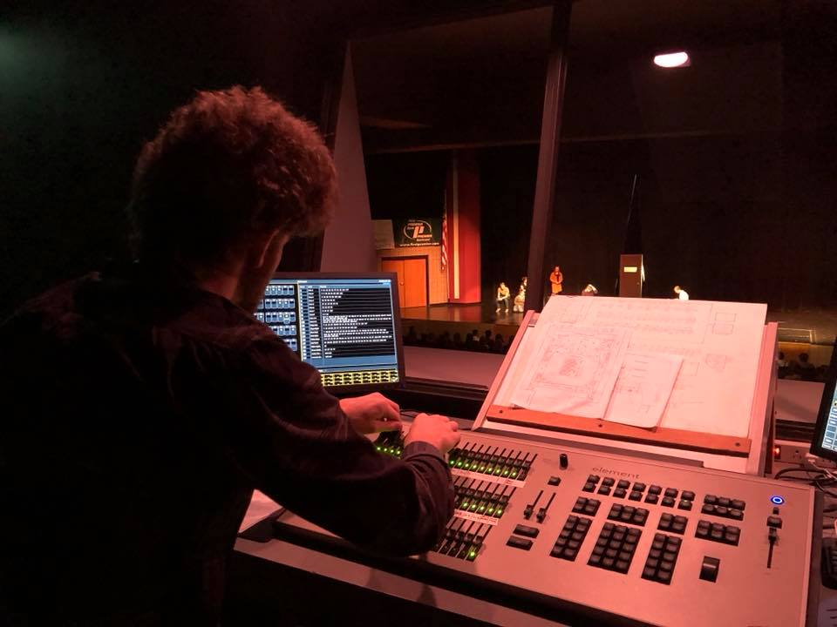
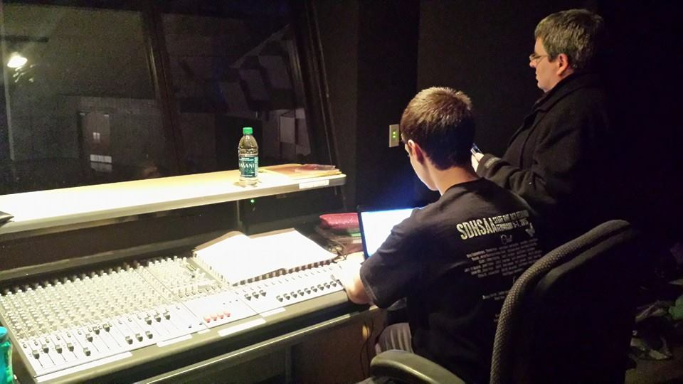
Students run sound and lights for their play.
Site host provides qualified sound and light techs to assist students in need,
as well as stage hands to help with curtains
Schools submit light plots/floor plans to site host prior to the festival
Sound and Lights
YOUR TITLE
Write your description here
Write your description here
Write your description here

Slide 12
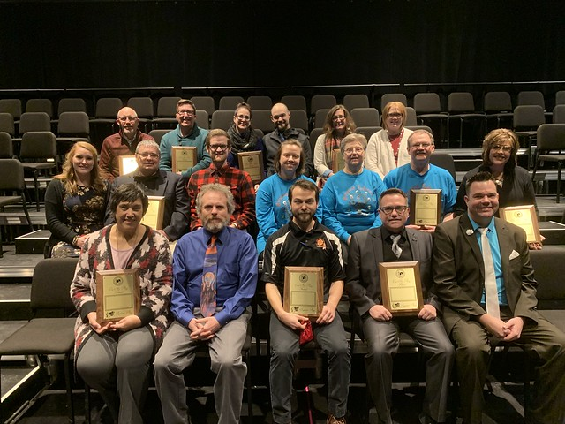
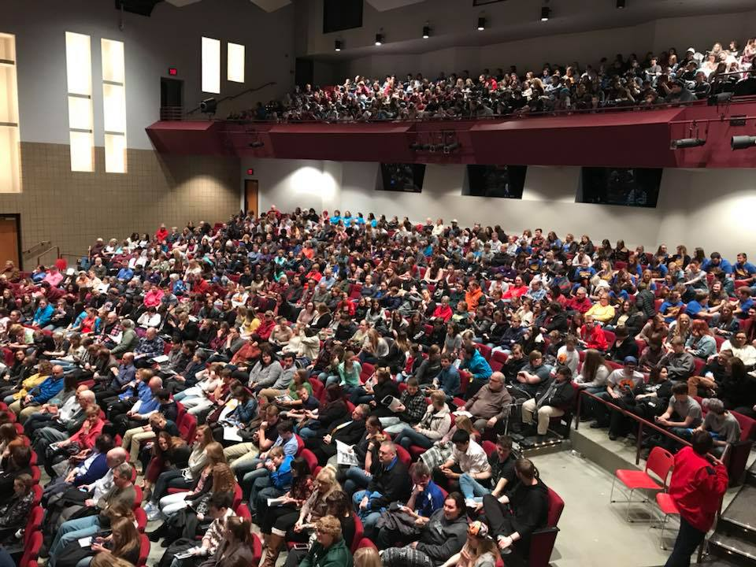
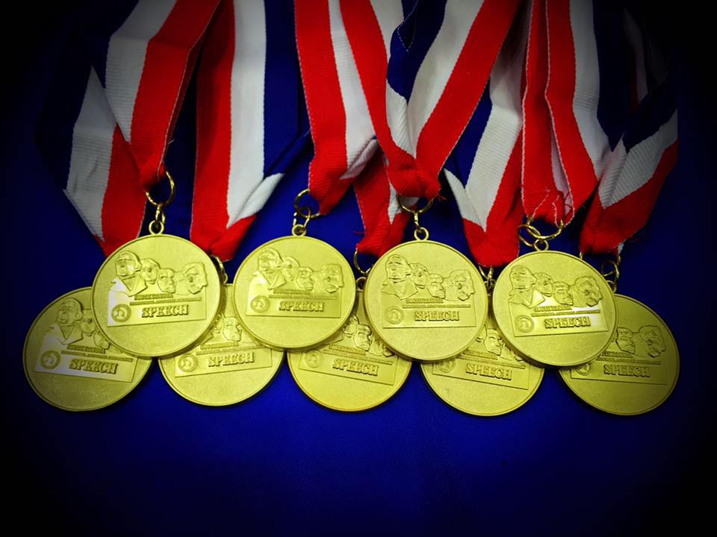
AWARDS

Slide 13
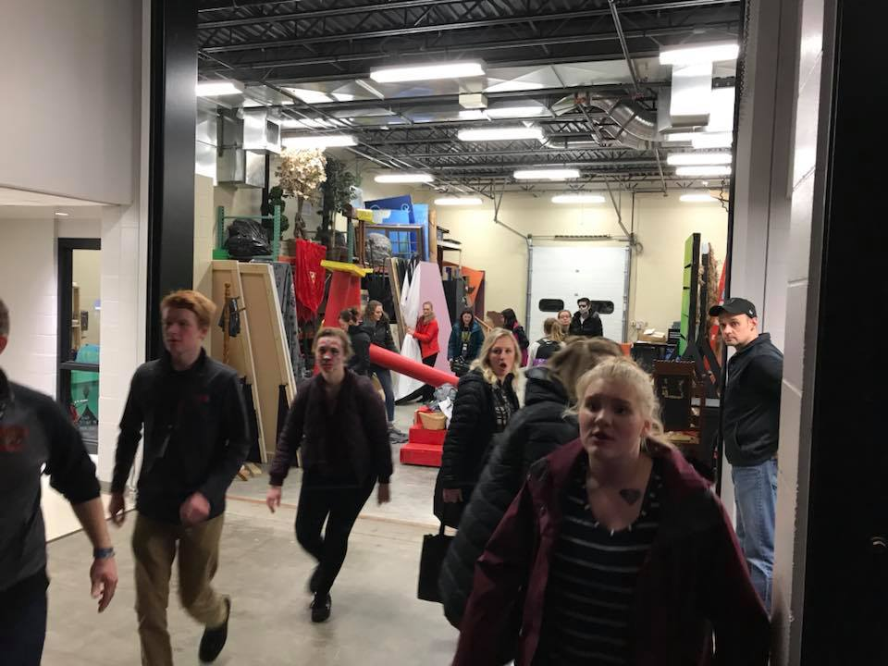
Medals are given to Superior Ensembles, Superior Individual Performers, and Superior Plays
Judges determine ensembles for each play
The SDHSAA provides 20 medals for Superior Play cast members. Schools can purchase more if needed
Superior Plays also receive a plaque
Medals are also given to Superior Award winners in our Theatrical Design Contest

Slide 14
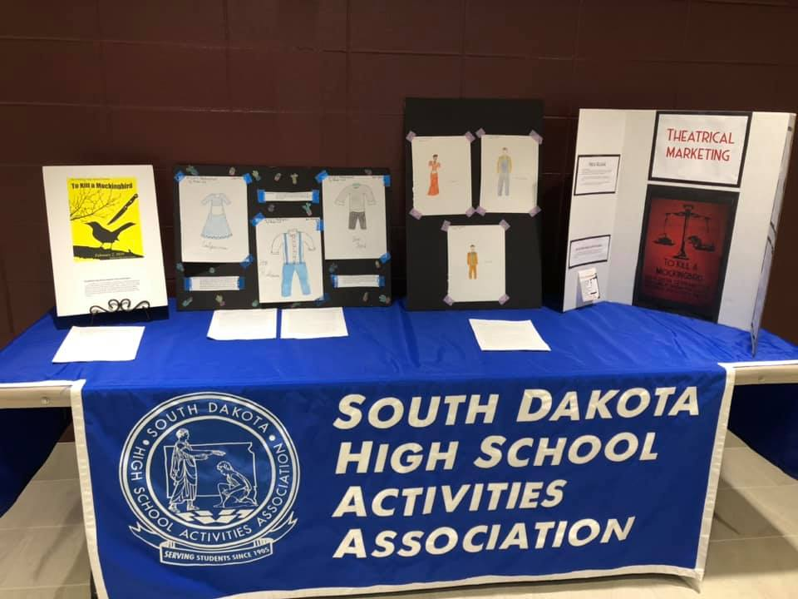
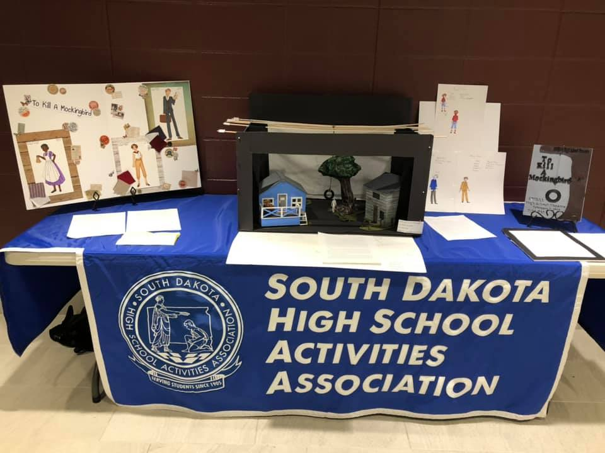
THEATRE DESIGN CONTEST

Slide 15
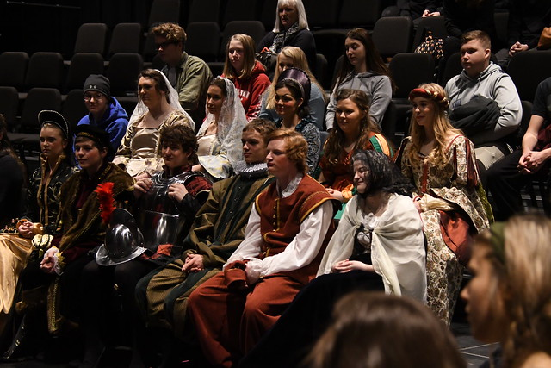
THEATRE DESIGN CONTEST
Set Design – must submit a floor plan, color rendering of the set, and a concept paper
Costume Design – must submit renderings for 3 characters in the play, swatches of costume material(optional), and a concept paper
Theatrical Marketing – must submit a mounted poster design, a press release, and a concept paper
Title of Play to be used in contest is determined by Speech Advisory Committee
Entries are judged on Interpretation, Execution, and Presentation

Slide 16
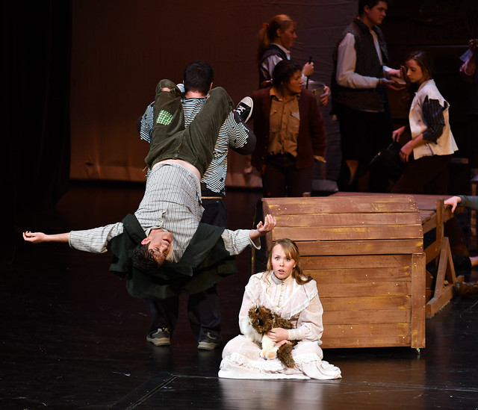
Upcoming Changes
Awards for Tech Crew Members
Rubric for Regional Contests

Slide 17
Questions?

