Slide 1
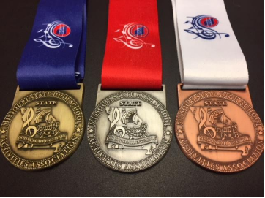
Missouri Music Festival Format
Davine Davis
MSHSAA Assistant Executive Director
September 18, 2019

Slide 2
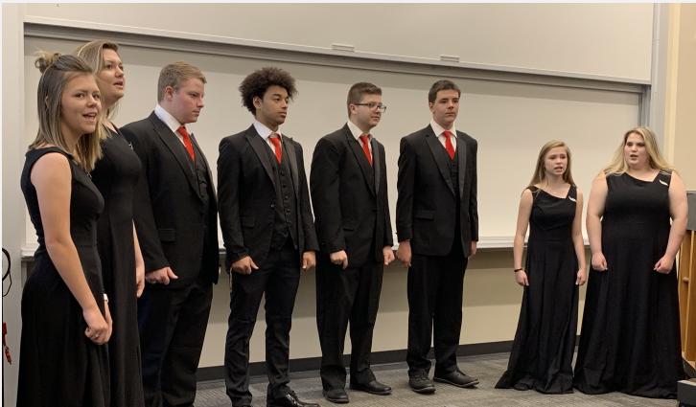
Background
Missouri has a 2 tier system for adjudication for solo/small ensemble festivals.
Solos and small ensembles of 8 or fewer may advance to the state solo/small ensemble festival if awarded an Exemplary rating.
Same process for adjudication was used at state festival prior to spring of 2017.

Slide 3
District Festival Evaluative Performance Standards
Exemplary - A performance that consistently demonstrates true musical expression and few technical errors. The performance is worthy of the distinction of begin recognized as among the very best.
Outstanding – A performance of distinctive quality yet has minor defects in musical expression and fundamental techniques.
Satisfactory – A performance showing accomplishment and marked promise, but lacking consistency of musical expression and fundamental technique.
Developing – A performance indicating room for improvement in consistent musical expression and fundamental technique. Such a performance would include many technical errors, poor musical expression and ineffective use of existing instrumental or choral voicing.
Ineffective – A performance indicating obvious lack of overall preparation.

Slide 4
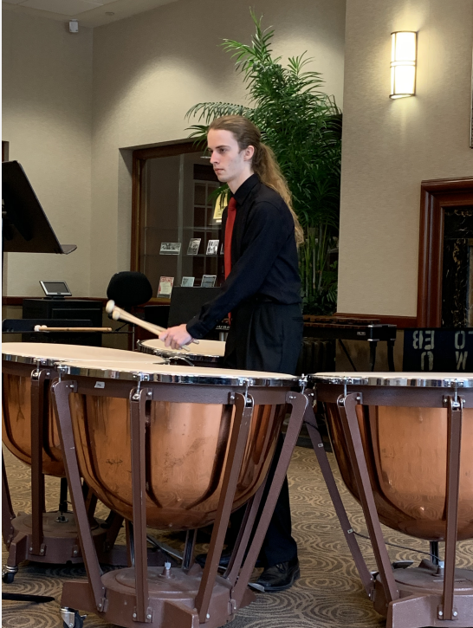
MSHSAA State Solo/Small Ensemble Rating Descriptors
GOLD – This rating is the highest level of musical achievement performance in the MSHSAA sponsored music festivals. This performance is musically artistic and exemplary in all aspects. It is worthy of the distinction of being recognized as among the very best. The performance is “thorough”, nearly flawless, and “always consistent” in maturity of tone, pitch center, technical facility and musical expression. The performer(s) demonstrate the highest level of preparation, poise and confidence. The adjudicator comments are positive and complimentary in all areas of the performance. There may be suggestions for continued growth and improvement.

Slide 5
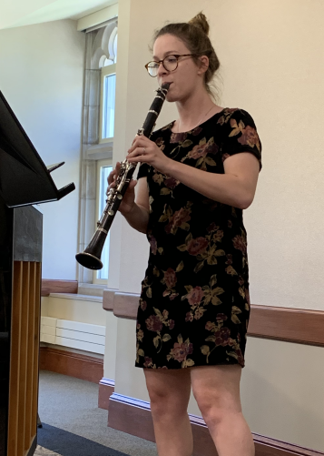
MSHSAA State Solo/Small Ensemble Rating Descriptors
Silver – This rating is a highly commendable level of musical achievement. This performance is artistic and outstanding in many aspects. There are “minor” inconsistencies and the performance is not completely “thorough” and “consistent” in maturity of tone, pitch center, technical facility and musical expression. The performer(s) demonstrate an outstanding level of preparation, poise and confidence. The adjudicator comments are mostly positive and complimentary. There will be suggestions and techniques for continued growth and development regarding the minor inconsistencies in the performance.

Slide 6
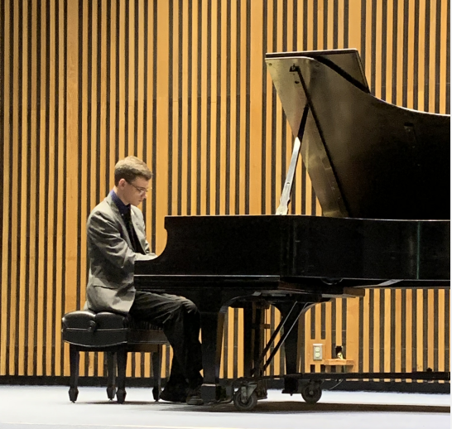
MSHSAA State Solo/Small Ensemble Rating Descriptors
Bronze – This rating is a commendable level of musical achievement. This performance has some musically artistic aspects and show accomplishment and potential but needs more polish and refinement. There are several inconsistencies in maturity of tone, pitch center, technical facility and musical expression. The performer(s) demonstrate an excellent level of preparation, poise and confidence. The adjudicator comments are somewhat positive and complimentary. There will be suggestions for continued growth and development regarding the several inconsistencies in the performance.

Slide 7
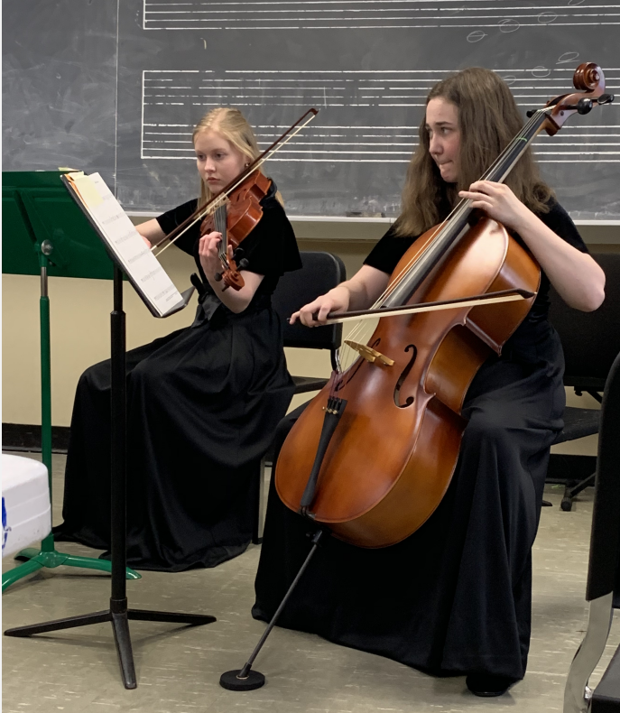
Results Prior to Current System
From 2010 to 2017 the percentage of Exemplary ratings awarded at state ranged from 42% to 50%.
The total number of performances during this time period ranged from 4,424 to 5,155.

Slide 8
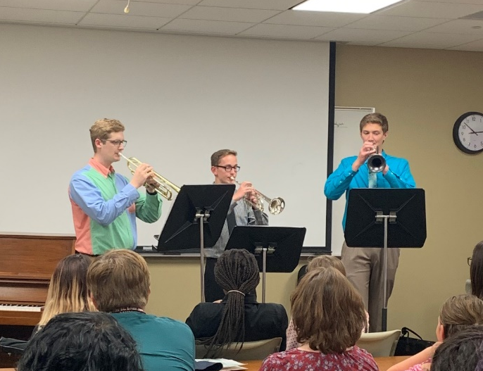
Results Since 2018
4,967 total performances
36% received Gold
49% received Silver
14% received Bronze
1% NS/DQ’s

Slide 9
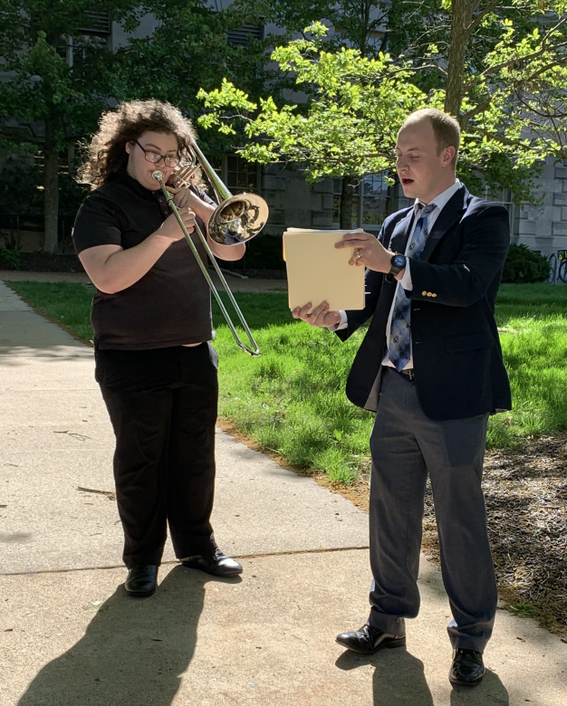
Results Since 2018 cont.
4,745 total performances
36% received Gold
46% received Silver
16% received Bronze
1% NS/DQ’s

Slide 10
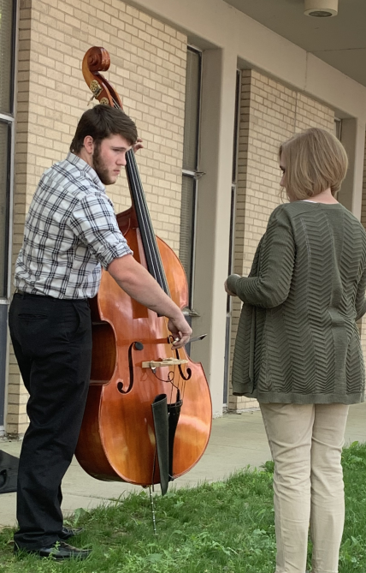
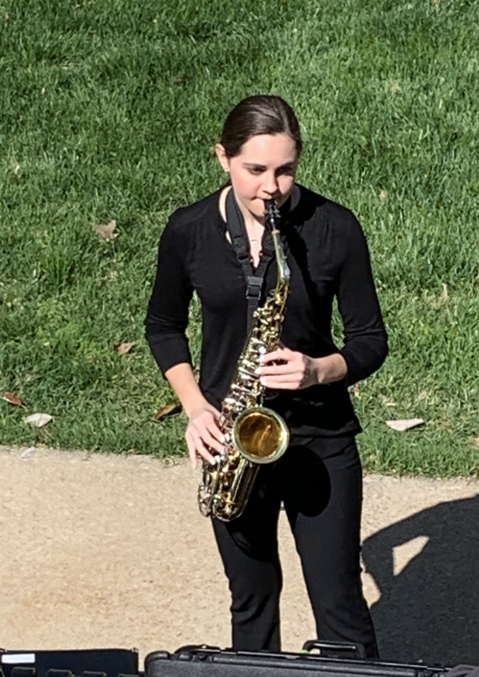
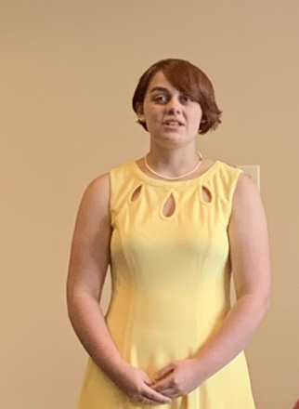
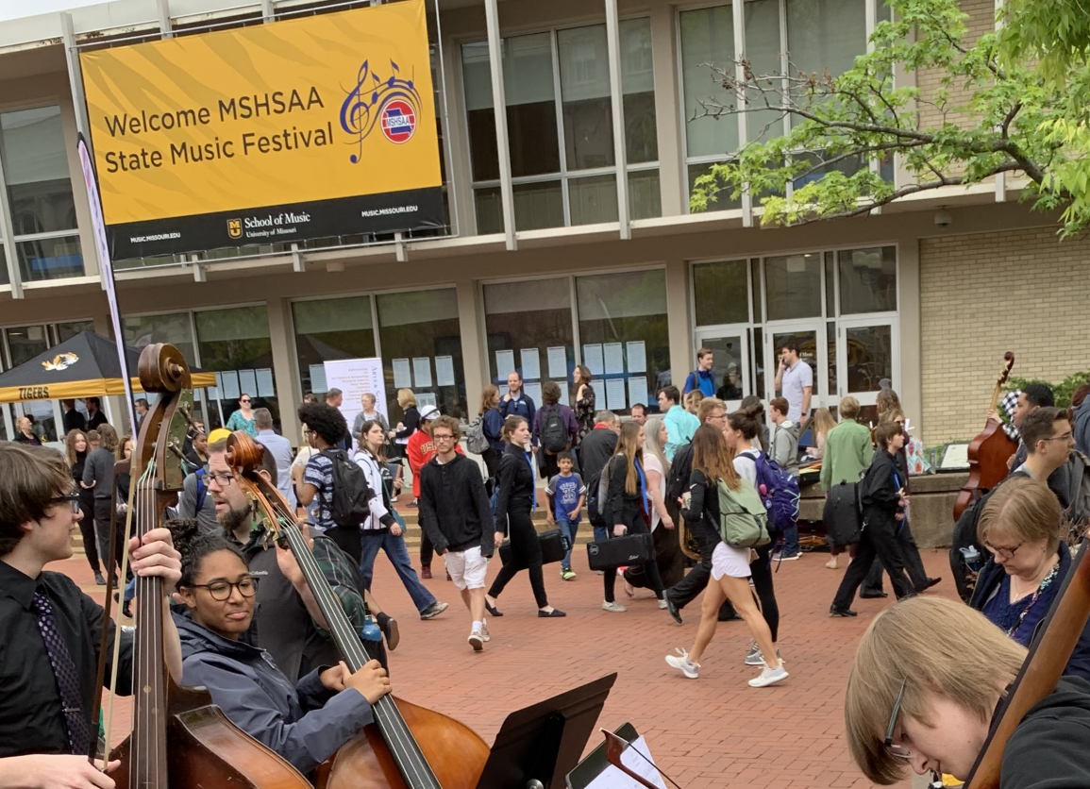
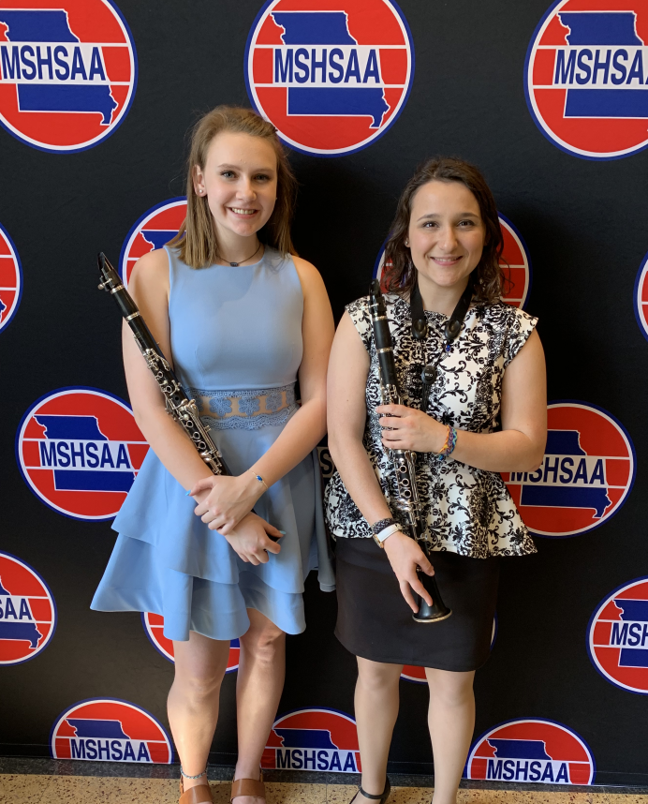
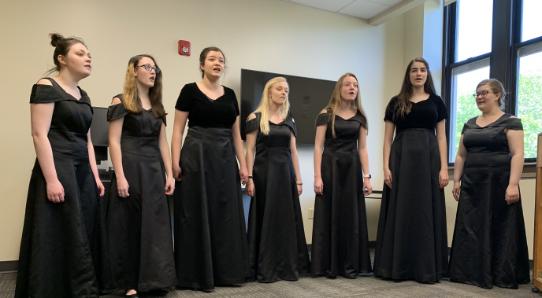
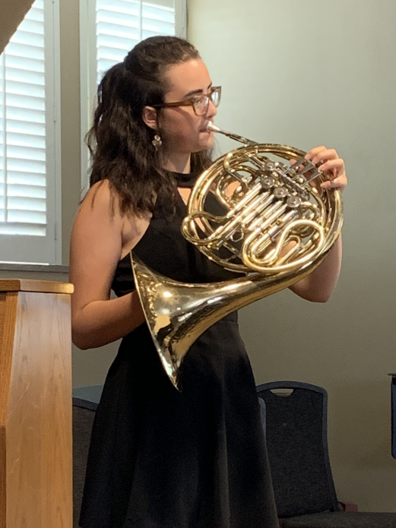
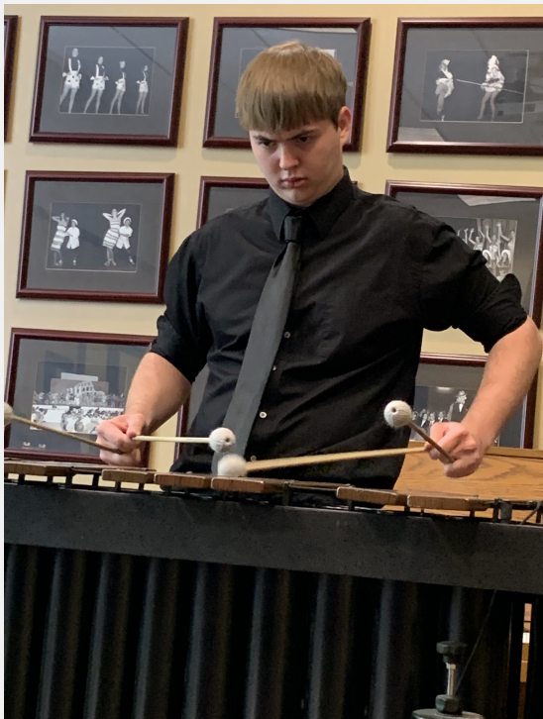
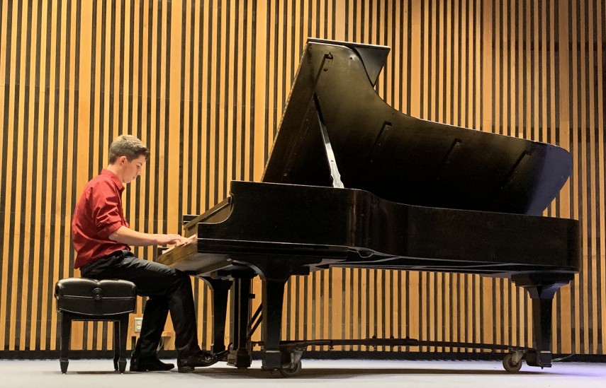
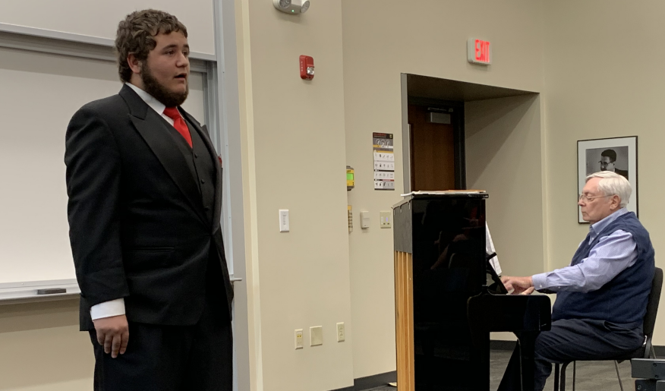
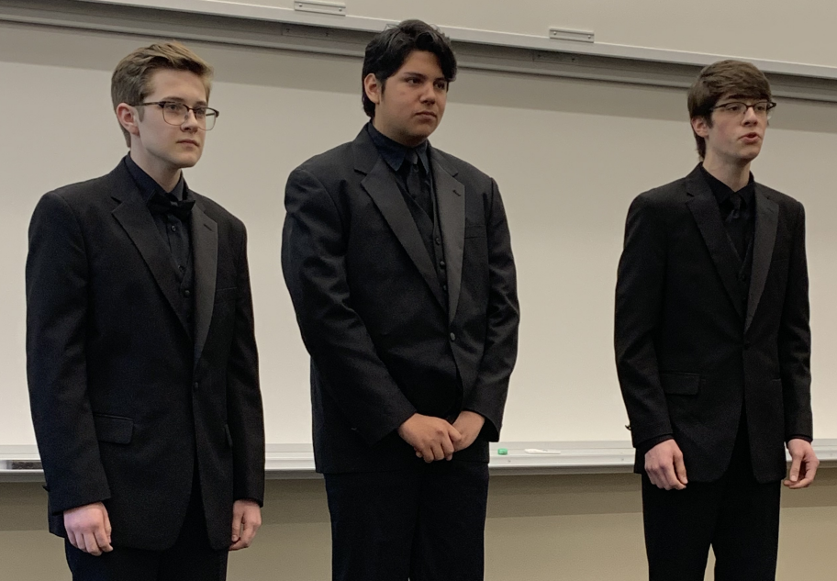
What We Hoped to Accomplish
Establish clearly defined expectations between district and state festivals.
Using terminology that can be easily understood by students, administrators, school board members, parents and community.
Provide quality feedback on performance to further the musical education of our young musicians.

Slide 11
Contact Information
Davine Davis, MSHSAA
1 North Keene St
P.O. Box 1328
Columbia, MO 65201
Phone: 573-875-4880
Email: davine@mshsaa.org

