Slide 1
A Leaders Toolkit for Difficult Conversations-Mike Plunkett-Oklahoma Secondary Schools Activities Association
Ways to speak to people who are upset, or are about to receive bad news!

Slide 2
A Leaders Toolkit for Difficult Conversations-Mike Plunkett-OSSAA
If you are in a position of leadership, at some point you will be faced with the task of delivering bad news, or having to listen to someone who is VERY upset. This is part of the gig, not our favorite part, but it is part of your role. With privilege comes responsibility!

Slide 3
A Leaders Toolkit for Difficult Conversations-Mike Plunkett-OSSAA
Try not to take it personally, it happens to us all.
Remember that “Dogs don’t bark at parked cars”, you in the crosshairs because your doing something!
According to most parents, THEIR KIDS are special (just ask them), remember that when you talk with the parents.

Slide 4
A Leaders Toolkit for Difficult Conversations-Mike Plunkett-OSSAA
Different types of difficult conversations,:
Sounding Board for someone upset!
No longer able to do the job-Can’t judge again
Broken rules-Kids were DQ’ed for a rule infraction
Tabulation errors-Not the fault of the kids

Slide 5
A Leaders Toolkit for Difficult Conversations-Mike Plunkett-OSSAA
List from Barbara Markway, Ph.D., clinical psychologist
Listen, Stay Calm, Don’t Judge, Show Respect
Be careful to say “I Understand”, it usually makes it worse
Avoid smiling-They take it as mocking them
Don’t return Anger with Anger
One response does not fit all situation
When you get through it, debrief. What could have been done if anything, to prevent it?

Slide 6
A Leaders Toolkit for Difficult Conversations-Mike Plunkett-OSSAA
When giving band news(“I can’t use you any longer as a judge”)I believe the best way is to be direct and honest. Present the facts (if you have ratings or numbers to back it up, use them). Rip off the Band-Aid FAST. Get to the bad news quickly, and then work back form it!

Slide 7
A Leaders Toolkit for Difficult Conversations-Mike Plunkett-OSSAA
When rules are broken, be sure and have the rulebook present. Show them the rule, present the facts (show them the stopwatch time, error made etc). This is a little different than a judgement call (In my opinion).

Slide 8
HUG
H-Hear
U-Understand
G-Guide

Slide 9
A Leaders Toolkit for Difficult Conversations-Mike Plunkett-OSSAA
Tabulation errors-Do you have specific rules concerning the reporting of tabulation errors? Is there a timeframe or window that it must be reported? If not, consider having one.
Does it cause the student to be DQ’ed? Dropped in Rank? Eliminated for the year?
Remember that the kids did nothing wrong-Makes it harder.
DCHS-My Experience

Slide 10
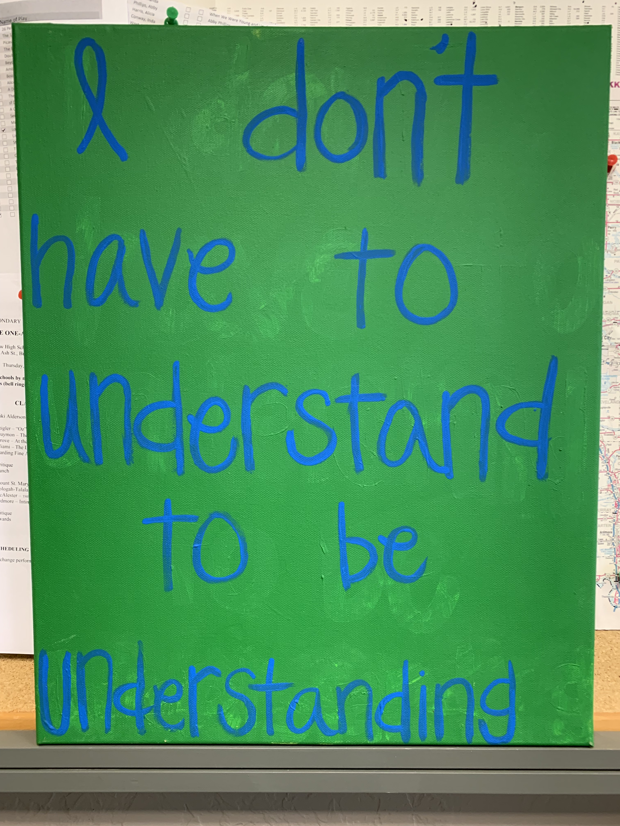

Slide 11

Mike Plunkett OSSAA Fine Arts mplunkett@ossaa.com 405 840-1118

