Slide 1
NFHS Speech/Debate/Theatre & Music Conference
“From the Seats to the Stage”
Lindsey Atkinson, Coordinator of Sports
Sandy Searcy, Director of Sports
National Federation of State High School Associations

Slide 2
Nfhs inclusion staff
Team was created in 2013
NFHS Staff - Bob Gardner, Becky Oakes, Lindsey Atkinson, Sandy Searcy
Inclusion Task Force
Notes:
Team was established in 2013 in response to the Extracurricular Athletics “Dear Colleague” letter (US DOE, Office for Civil Rights). The letter outlined that students with disabilities must be afforded equal opportunities to participate in extracurricular athletics.
NFHS Staff Inclusion Team - Bob Gardner, Becky Oakes, Lindsey Atkinson, Sandy Searcy
NFHS Inclusion Task Force - first met on October 15, 2013
NFHS Staff - Bob Gardner, Jim Tenopir, Becky Oakes
Representatives from state associations- Ron Belinko, Maryland, Marty O’Hern, Missouri
Representative from NIAAA
Representative from NCAA
Mike Furnish, Special Olympics Indiana (Unified)
Bev Vaughn, American Association of Adapted Sports Programs (AAASP) (Adapted)
NCAA Task Force – NFHS included (Becky Oakes)
Mission – to serve as a conduit and repository for best practices associated student participation in athletics and activities.

Slide 3
Agenda Topics
Athletics vs. Performing Arts
What is disability inclusion?
Types of inclusion
Benefits of Inclusion in the Performing Arts
Goals and Objectives
The Game Plan
Resources
Notes:
James asked our team to make a presentation today, to draw some parallels between inclusion in both athletics and the performing arts. We realized that we had committed to a great deal of research with various groups involved with inclusion and athletics, but did not have the same cadre of examples for performing arts inclusion.
Our motto for athletic inclusion has been “Masking the Move from the Sidelines to Game Time”. Our new motto for performing arts inclusion is “From the Seats to the Stage.”
What we found is that currently, there are quite a number of state associations out there that have been providing programming for years, and that the performing arts environment is probably more conducive for inclusion of disabled students than athletics. In other words, you have already been incorporating accommodations for these students, whether it be for one individual or a an entire program or club. We hope that you will be willing to share your experiences today, so that we can begin to build a list of options to be used by state associations.
We chose to organize today’s discussion by the following topics:

Slide 4
Athletics vs. Performing Arts
Similarities
  Education based
  Competition (internal and external)
  Instilling values
  Building character
  Fun
  Differences
  Recruitment is a must
  More opportunities
Notes:
Participation in student activities increases students' standardized test scores, GPAs, graduation rates, college acceptance rates and college success rates. It practically eliminates the likelihood that a student will choose to drop out of high school.
Education based student activities develop core social and emotional skills while reducing high-risk behavioral problems and long term public assistance needs, as well as helps the student learn how to be a part of something bigger than themselves.
In drawing a parallel between athletics and performing arts, the outcomes can be very similar:
Education Based Activities enhance character development, but both athletics and the arts provide opportunity for competitive participation.
Competition - Athletic contests as well as performances do provide entertainment, but can be competitive as well. An athlete is measure his or her performance against a team (external), time or standard, or themselves (internal), but so to can the student who is participating in a choir, band, or speech competition is measuring performance. A theater production provides an opportunity for the performer to improve his or her skills each time the play or musical is conducted.
Values and Building Character- Participation in student activities increases students' standardized test scores, GPAs, graduation rates, college acceptance rates and college success rates. It practically eliminates the likelihood that a student will choose to drop out of high school. Student activities develop core social and emotional skills while reducing high-risk behavioral problems and long term public assistance needs.
Differences
A concept that is consistent over all education activities involving students with special needs – special efforts are required to encourage to participate. A “build it and they will come” perspective does not apply. We need to reach out to those in the student body encourage participation.
Performing arts activities do provide for more opportunities to participate in some cases, as membership on those “teams” so to speak, are not as stringent as membership on varsity athletic teams.

Slide 5
What is Disability Inclusion?
Including students with impairments in everyday activities and encouraging them to have roles similar to their peers who do not have an impairment
Educator’s Role:
  Creating a culture of inclusion
  Providing opportunity
  Encouraging participation
  Addressing policies and practices
Notes:
We are specifically addressing disability inclusion today, but that term refers to inclusion of all areas such as race, gender, sexual orientation as well as disabilities.
Self-Worth – Provide Purpose
This involves more than simply encouraging people; it requires making sure that adequate policies and practices are in effect in a community or organization.
Inclusion should lead to increased participation in socially expected life roles and activities—such as being a student, worker, friend, community member, patient, spouse, partner, or parent.
Socially expected activities may also include engaging in social activities, using public resources such as transportation and libraries, moving about within communities, receiving adequate health care, having relationships, and enjoying other day-to-day activities.
Educator’s Role:
Teens have a strong need for acceptance from peers and adults which many times leads to adults in extracurricular leadership roles to be the first person a student confides in with issues related to their “differentness”.
Section 504 of the Rehabilitation Act of 1973 is a federal law that protects individuals from discrimination based on disability. The nondiscrimination requirements of the law apply to employers and organizations that receive financial assistance from federal departments or agencies. Section 504 forbids organizations and employers from denying individuals with disabilities an equal opportunity to receive program benefits and services. It defines the rights of individuals with disabilities to participate in, and have access to, program benefits and services.²
The Americans with Disabilities Act (ADA) of 1990, as amended, protects the civil rights of people with disabilities, and has helped remove or reduce many barriers for people with disabilities. The legislation required the elimination of discrimination against people with disabilities. The ADA has expanded opportunities for people with disabilities by reducing barriers, changing perceptions, and increasing participation in community life.
ADA guarantees equal opportunity for individuals with disabilities in several areas:
Employment
Public accommodations such as restaurants, hotels, theaters, doctors’ offices, pharmacies, retail stores, museums, libraries, parks, private schools, and day care centers
Transportation
State and local government services
Telecommunications such as telephones, televisions, and computers
Dear Colleague Letter – 2013 Equal opportunity to extracurricular activities
Dear Colleague Letter – 2016 Transgender policies – equal opportunity to participate and accessibility

Slide 6
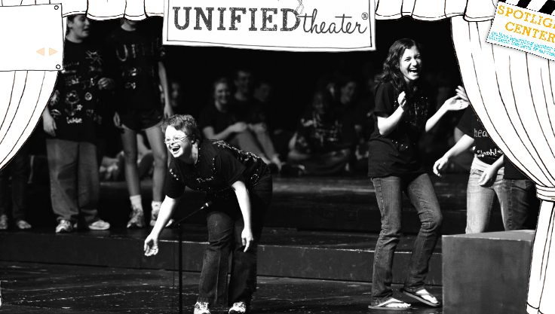
Types of Inclusion
Integration – Inclusion of students with disabilities into existing traditional activities.
Adapted – Addition of a program offering specifically for students with a physical impairment
Unified – Addition of a program offering for students with intellectual impairments partnered with students with no impairment
Notes:
1. Integration of students with disabilities into the existing activities
Participate with and against able-bodied students – may require reasonable accommodation(s)
Participate in traditional activities in separate event/program
2. Adapted program
Addition of activities program offerings specifically for students with disabilities (physical)
3. Unified program
Addition of program offerings for students with intellectual impairments partnered with students with no impairments
Disability in the arts is an aspect within various arts disciplines of inclusive practices involving disability, and manifests itself in the output and mission of some stage and modern dance performing-arts companies, as well as the subject matter of individual works of art, such as the work of specific painters and those who draw.
Disability in the arts is distinguished from disability art in that it refers to art that includes disabled people, whether in themes, performance, or the creation of the artwork, rather than works focusing on disability as the central theme. It^{[specify]} can also refer to work that is made as a political act toward shaping a new community, fostering disability culture:
Disability culture is the difference between being alone, isolated, and individuated with a physical, cognitive, emotional or sensory difference that in our society invites discrimination and reinforces that isolation – the difference between all that and being in community. Naming oneself part of a larger group, a social movement or a subject position in modernity can help to focus energy, and to understand that solidarity can be found – precariously, in improvisation, always on the verge of collapse.

Slide 7
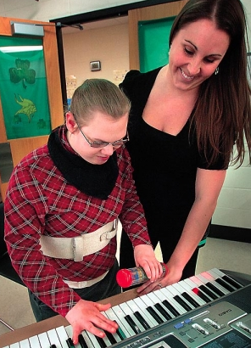
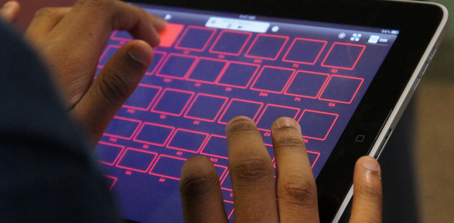
Adaptive Activities
Adaptive activities
  Modifying items, procedures, or systems to enable a person with a disability to use them to the maximum extent possible (reasonable accommodations)
Notes:
2. Reasonable Accommodations
Accommodations are alterations that have been made to items, procedures, or systems that enable a person with a disability to use them to the maximum extent possible. An accommodation can also be a modification to an existing environment or process to increase the participation by an individual with an impairment or activity limitation. Braille, large print, or audio books are examples of accommodations for people who are blind or who have visual limitations otherwise. For people who are deaf or who have difficulty hearing, accommodations may take the form of having an American Sign Language interpreter available during meetings or presentations, or exchanging written messages. Communication accommodations do not have to be elaborated, but they must be able to convey information effectively.

Slide 8
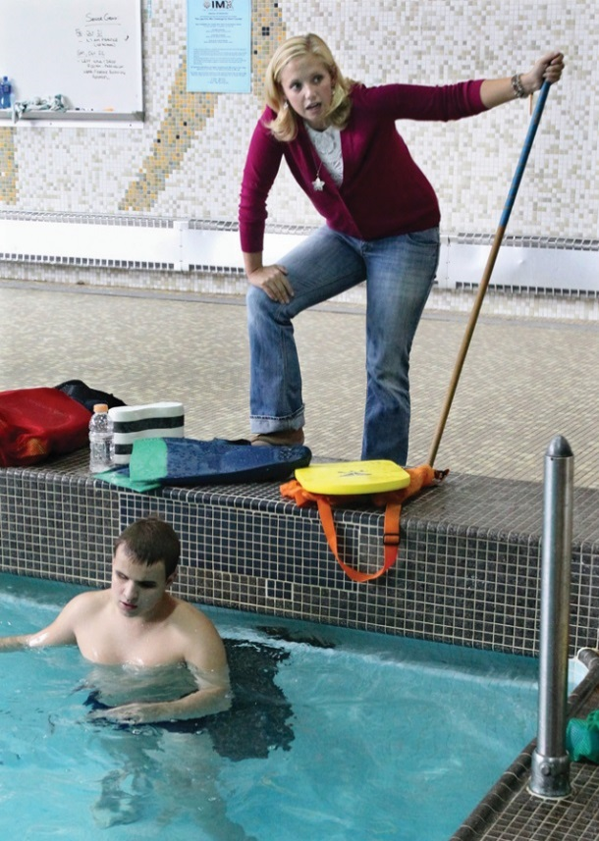
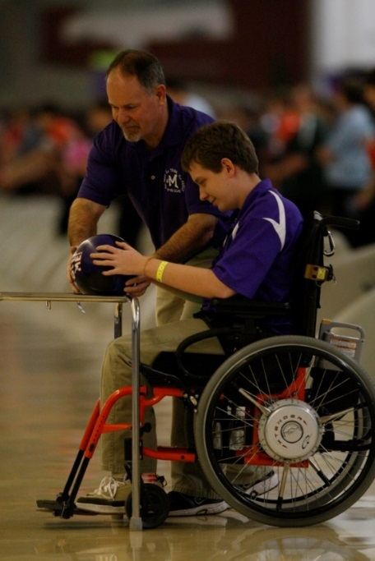
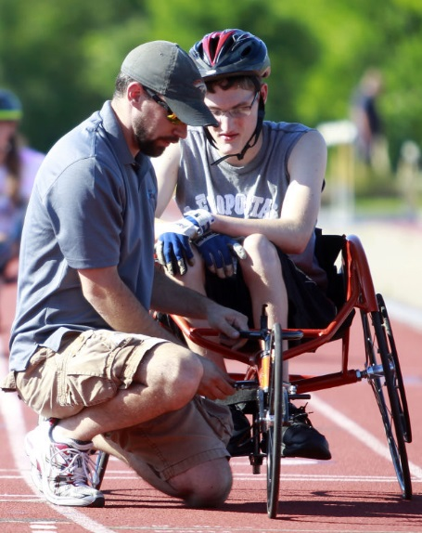
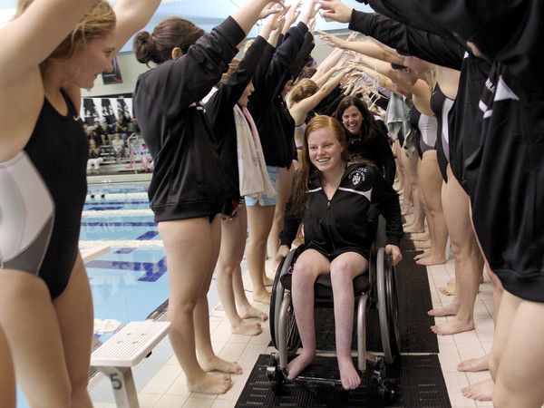
Athletic Accommodations
Accommodations to compete alongside able-bodied students:
  Tapping (swimming)
  Guide runners/dogs
  Light starter
  Different starting position (in the water)
  Clapping (timing jumps)
Impairment events within a meet:
  Wheelchair races
  Seated throwing

Slide 9
Fine Arts Accommodations
Accommodations to participate alongside able-bodied students:
  Facility accessibility
  Hearing impairments
  Visual impairments
  Physical impairments
Notes:
2. Adapted continued
One needs to consider accessibility to the stage as well as to restroom facilities and even hotel accommodations.
Hearing/Speech impaired students who wish to participate:
The speech is provided to the judges ahead of time, so that the speech impairment does not have an impact on scores.
Allow the use of adaptive technology – screen readers (Mikayla Heston, Oregon – Speech and Debate)
Allowing the use of sign language by contestant and/or interpreters
Visually impaired students who wish to participate:
Music/Text can be enlarged so that the student can see the notes
Brail text
Voice commands (Gabe Stanforth, Illinois – Marching Band)
Physical impairments:
Technology apps – iPads and amplifiers (Ethan Och, Minnesota – Band)
It is important note that while accommodations can be made, it is important that they do not affect the integrity of the contest.

Slide 10
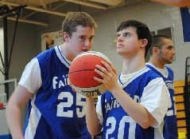
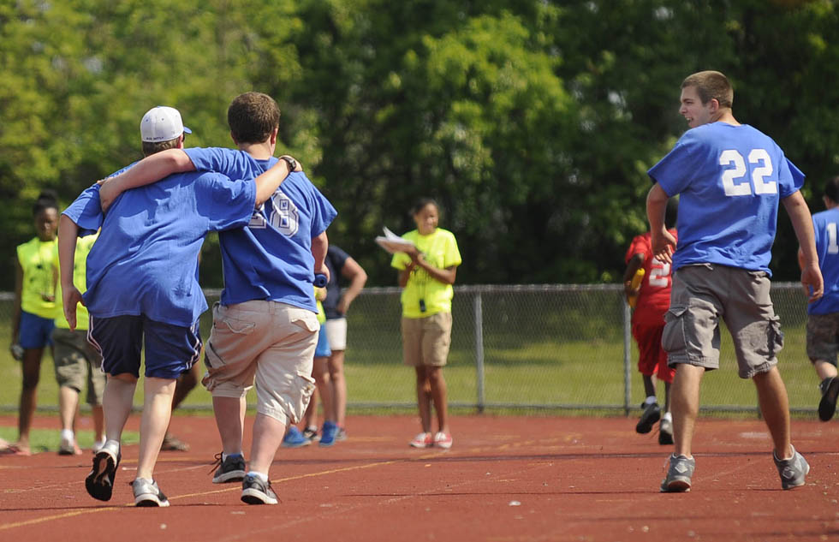
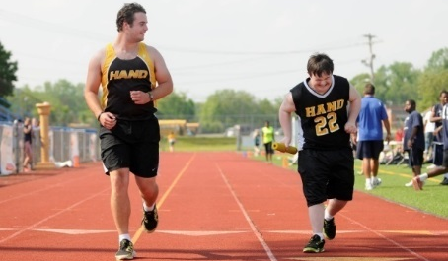
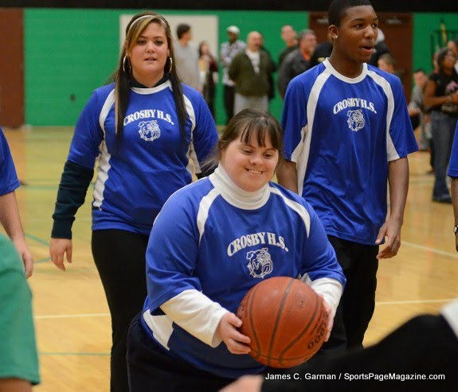
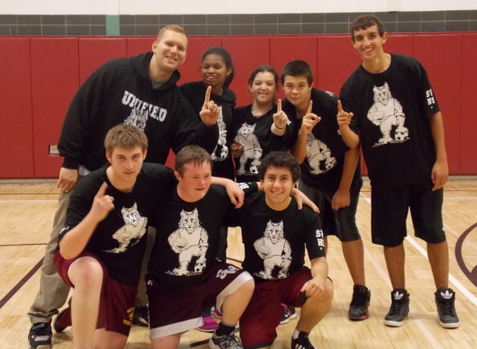
Unified Sports
Unified Sports program
  Addition of sport program offerings for students with intellectual disabilities partnered with students with no disabilities on same team
  Partnership with Special Olympics
Notes:
Unified
Addition of sport program offerings for students with intellectual disabilities partnered with students with no disabilities on same team
Partnership with Special Olympics. Unified athletics have been incorporated into 28 state associations and include sports such as :
Track and Field (most popular) – 12 different sports
Basketball
Soccer
Flag Football
Bowling
Volleyball
Bocce
Cheer
Bass Fishing
Strength Training
Tennis
Swimming
Current NFHS Learn Course – Coaching Unified Sports

Slide 11
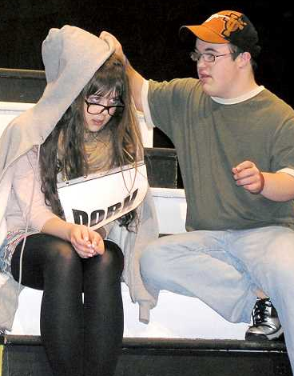
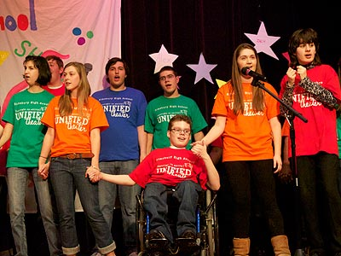
Unified Activities
Unified programs
  Addition of fine arts program offerings for students with intellectual disabilities partnered with students with no disabilities
    Unified Theater
    Roundabout Playback Troupe
    United Sound
    Music for All, Inc.
    https://www.youtube.com/watch?v=u2hW9AFP87k
Notes:
Unified Theater - At Unified Theater, young people with and without disabilities, of all backgrounds, come together as equals to put on a production. The production is entirely organized, written, and directed by the students themselves. In over sixty schools across the country over 6,000 students with and without disabilities have performed to almost 10,000 audience members. The concept is simple: let teens lead, let creativity rule, and put the Spotlight on Ability. It includes students with and without disabilities and is written for students, by students, and out students. I involves approximately 60 schools across the country and close to 6000 students.
Roundabout Playback Troope – local Carmel Parks and Rec improvisational group. Audience members tell a personal story and it is acted out by the troope.
Rehearsals began with the troupe building trust, understanding and positive relationships through creative arts, games and activities.
After the actors started to feel more comfortable, the basics of playback were introduced. A troupe member asks a question such as, “How would you describe your day in one word?” or “What quality makes you a strong community member?” and once the troupe receives a response, one actor steps forward to portray the word with a repetitive movement and sound. Troupe members then add on to each other and create a moving portrait for the teller. Once the portrait is complete, they create other fluids from the responses.
Next in the rehearsal process, the troupe explored “pairs” where two opposite feelings are explored. If an audience member says his day was hectic and fun, then the troupe can show the audience both feelings through pairs. One actor shows one feeling while the other portrays the opposite feeling.
Once pairs were perfected, the troupe rehearsed full stories, where an audience member tells a story and the troupe of actors performs, or plays back, the story on the spot. It could be a dream, a memory, a short narrative or even “something you want to occur.” The troupe uses musical instruments, colorful scarfs, dancing and role-play to show the story to the teller. The troupe was supported by a music therapist, so music was a large component through the rehearsal process. Each week, one of the members would bring a piece of music for everyone to learn. During rehearsals, the troupe performed its opening musical number, “Everything Is Awesome,” and choreography was incorporated to show originality.
The Performance
A broad theme that allowed audience members to generate the topics they wanted to explore during the performance. Yadon explained the diversity among audience members: “There are some audience members who enjoy being part of the experience but never share, and this is still very helpful because they serve as a support system for the tellers.” Some performances can be very joyful and happy when audiences are exploring friendships and community strengths, while other groups may explore personal losses, tragedies and world disasters. The variety of topics means it is imperative that the person directing the troupe has a background in playback. Yadon’s drama therapy background has been especially beneficial because she can support audiences in safely exploring topics and leave them feeling empowered.
It is beautiful to watch the understanding and empathy as the audience experiences individuals with disabilities exploring these complex topics. Yadon reflected on one of her favorite moments from the first performance: “We asked the audience to shout out a word that described a strength, and one woman said ‘compassion.’ One of the actors went center stage, and he put his hands over his heart and made a beeping sound. You could hear the auditorium filling with sounds from the audience, and it brought tears to my eyes. He showed a complex emotion with one movement and sound that we all understood. It was breathtaking.”
United Sound – Carmel High School Club (local pilot program) – Elisabeth Ohly Davis
“About Us” tab and drop down to “Who We Are.” The video next to Julie Duty’s bio is a great introduction.
“About Us” in the “What People Say” drop down there is a great video in the middle where several teachers share their experiences. The parent video on the left is also good, if you have time. The student video on the right is short and fun!
Next, the “What to Expect” section is very informative. All the drop-downs shown in order are a great way to show the audience how easy it is to get involved.
*Finally, on the “Watch” tab, the video in the middle, third one down, has a teacher talking about his experiences and what to expect.
Music For All - Music for All is one of the largest and most influential national music education organizations in support of active music making. Music for All is unique in that it combines programming at a national level with arts education advocacy. Bands of America (BOA) and Orchestra America are programs of Music for All, first founded in 1975, with a heritage in providing spectacular educational experiences and performance events for instrumental music programs and students.
Current NFHS Learn Courses: Intro to Interscholastic Music, Intro to Music Adjudication; why not a course involving unified activities in the arts?

Slide 12
The student Experience
“I believe it's good character and integrity, and that's what Unified Theater teaches us. Along with working close together and embracing all our individuality, we learn how to be inclusive and good citizens, which makes us pull off these shirts so well.” – Sara
"I have learned that we are all just people wanting to belong and be appreciated." -Maddie C.
"Coming to United Sound could completely change the direction of a bad day for me. I think that is powerful." -Abby W.

Slide 13
The Parent Experience
"United Sound has provided a new and powerful way for our daughter to communicate and given her more confidence when she does." -Bill and Sam Love
"My daughters are learning to teach! They are learning about life, compassion, and how to be a neighbor and friend. I am grateful for the involvement that my girls have had. It has made a huge impact!" -Carl Bloomfield
https://www.youtube.com/watch?v=GwBUSrcy4P8

Slide 14
The Educator Experience
“United Sound is the opportunity for these kids to be high school students. It’s the opportunity for them to belong and really reach a potential that no one even thought of as an option before.” -Mike Hall, Band Director, Tempe High School
"Your program and these students have enriched our lives so much, and I think we've enriched theirs too. What an incredible thing this is!" -Soo Han, Orchestra Director, Carmel High School
https://www.youtube.com/watch?v=G7OmjXCYdz8

Slide 15
Why inclusion in Performing arts?
Benefits:
  Encourages physical activity and interaction with peers
  Can improve both gross and fine motor skills
  Improves communication skills
  Increases self-esteem
  Builds character
    Empathy
    Understanding
    Teamwork
    Compassion
    Integrity
    Leadership
https://www.youtube.com/watch?v=CenfB8m1hiA

Slide 16
Goals and Objectives
Making the Move from the Seats to the Stage
The Game Plan
Repeat
We must
provide
Re-inspire
Results
Action
Motivation
For students with disabilities
Inspiration
Notes:
The Task Force has developed a “Game Plan” to change our culture so our students with disabilities not only have opportunities for participation but also have the attitude of “I should participate”.
Simply stated, “Making the Move from the Seats to the Stage” is the desired cultural change.
So our cycle to start this change is one step at a time and repeat with strong conviction each time we take a step for students.

Slide 17
The Game Plan
Breaking Down Barriers
  Attitudinal Barrier - Focus on what a person can do rather than what he/she can’t do
    Action Plan – Develop in your school
      Look for ways to include rather than exclude
      Look for the yes vs. the easy no
      Create an inclusive environment
      Make all feel welcome
  Physical Barrier - Physical obstructions to participation should be eliminated
    Action Plan – Minimize barriers in your school
      Universal design of facilities
      Have your students spend a day identifying where there may be barriers and how to become more accessible
      Creative solutions to expand diverse opportunities to participate
      Make all feel welcome
Notes:
Our Game Plan includes breaking down barriers both attitudinal and physical as we reach out for greater inclusion of all students.
In our states and our schools we must develop and implement our action plans to begin the removal of these barriers.

Slide 18
The Game Plan
Building Opportunities & Future Programs for students with disabilities
Action Plan
  Develop strategies to foster a school culture of “I can and I will”
  Engage the students
  Explain the opportunities
  Show a clear pathway of success
  Participation
  Part of the school program and community
  Engage other partners in your community
  Fun
  Gaining knowledge of the sport/activity
  Further opportunities
Notes:
Changing the culture to have our students with a disability move from the sidelines and into the game will include our having a better understanding of the characteristics that the young person may display.
We must find ways to engage the young people and their parents to be motivated to participate.
It is important that we are learning and understanding what hurdles exist for a young person with a disability as we develop our action plan to motivate participation.
The “build it and they will come” may not be as applicable due to the hurdles which must be met just to participate.
This is the importance of changing the culture as a whole and not just from one direction.

Slide 19
NFHS - Heart of the Arts Award
Molly Parker, 2015 Section 1 Recipient
  Deaf at the age of 2 ½
  Cast member of two musical dramas and three plays
  Member of Art Club
  Camper at Camp Mark 7 Deaf Film Camp
    Produced several short films
    Collaborated with campers to create music video set to Pharrell William’s song “Happy”
"Happy" Music Video

Slide 20
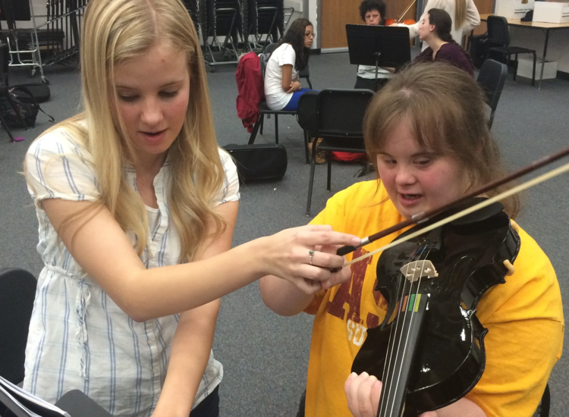
NFHS Inclusion
Education-based high school programs enrich each student’s educational experience. Participation helps prepare our students for their next level of life.
Inclusion
“Making the Move from the Seats to the Stage”
NFHS Inclusion Team:
Bob Gardner, Lindsey Atkinson, Becky Oakes, Sandy Searcy

Slide 21
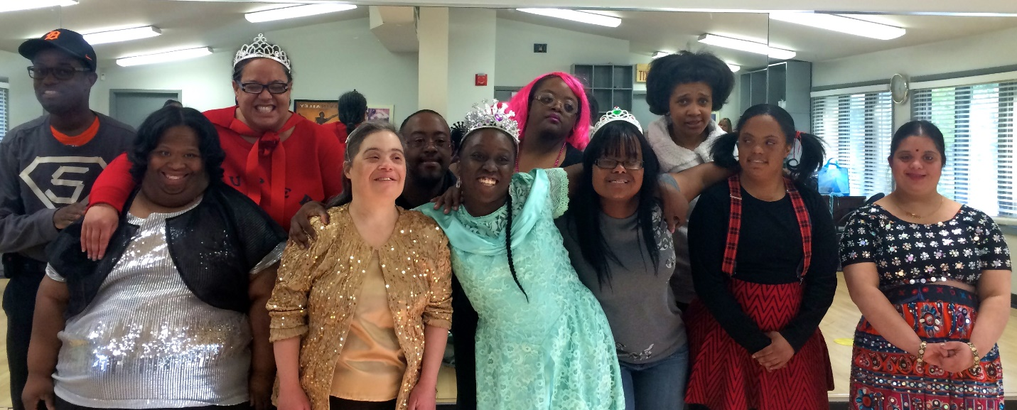
Audience participation
What types or provisions and accommodations has your state association provided for performing arts?
"It's a room full of happiness, love, and acceptance that is simply contagious."
http://www.4thwallkids.com/

Slide 22
Inclusion Staff
Contact Information
  NFHS Office – 317-972-6900
  Lindsey Atkinson (latkinson@nfhs.org)
  Becky Oakes (boakes@nfhs.org)
  Sandy Searcy (ssearcy@nfhs.org)

Slide 23
References
Unified Theater: http://unifiedtheater.org/
United Sound: http://www.unitedsound.org/
Music For All: https://www.musicforall.org/who-we-are/who-we-are
Roundabout Playback Group: https://www.youtube.com/watch?v=u2hW9AFP87k

