Slide 1

Online Training for Speech Officials
Blending Online Courses with In-Person Workshops
Adam Jacobi, WHSFA – adam@whsfa.org

Slide 2

Background
Early 1990s, “adjudicators”
4-hour workshop, $35
Videos
50-question, rules test
3-year certification

Slide 3
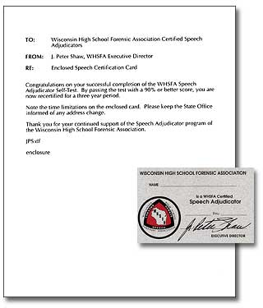
Assessing Process
Renewals upon $5 & Test (80%)
Complaints re: adjudicators increasing
Trainers: inconsistent approaches

Slide 4
Improving Process
Idea: Require “refresher” workshop for renewal
Problem: Records inconsistent (longevity)
New Idea: Online; always require

Slide 5
New Protocol
Initial Certification: 2-hour online course + 2.5-hour in-person workshop
Renewal Certification: 30-minute online course + ~15-minute assessment of video

Slide 6
Development Tools
Select eLearning platform (Moodle)
Create presentation lessons (PowerPoint)
Record video tutorials (ScreenFlow for Mac) Involve board members for voiceovers
Video streaming service (Vimeo)
Certificate plugin for Moodle

Slide 7
Online Course View
Main Course Page

Slide 8
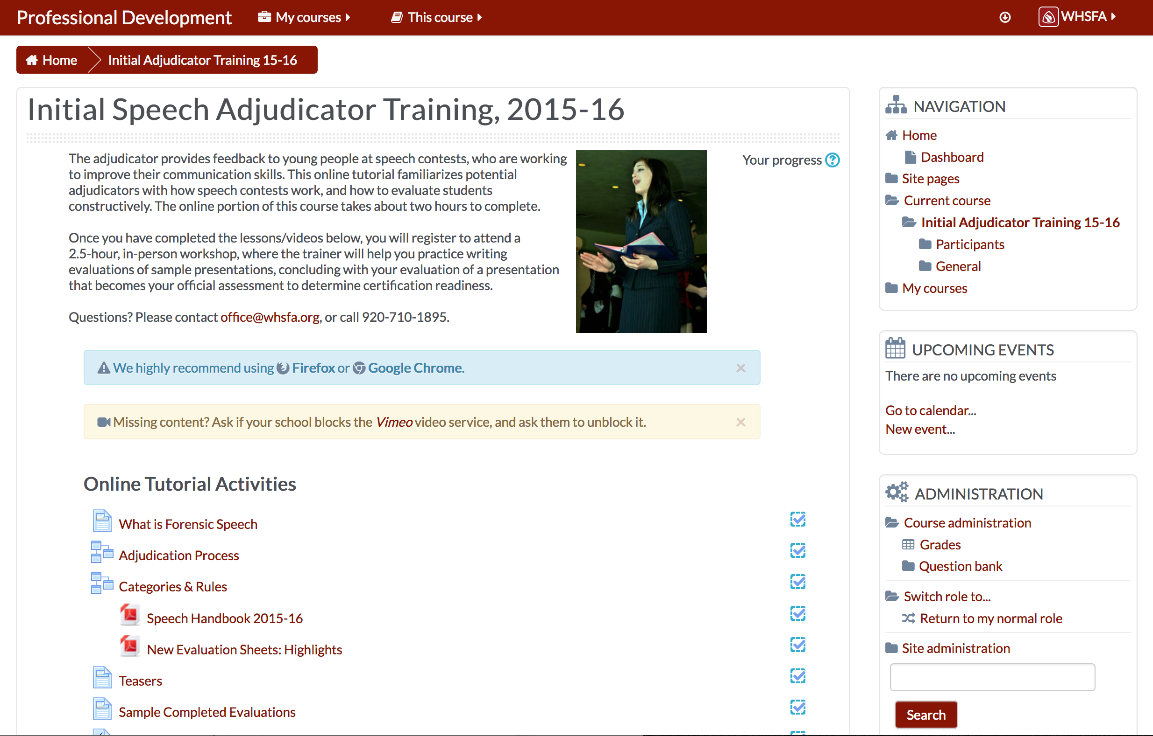

Slide 9
Individual Lesson
Video Feature

Slide 10
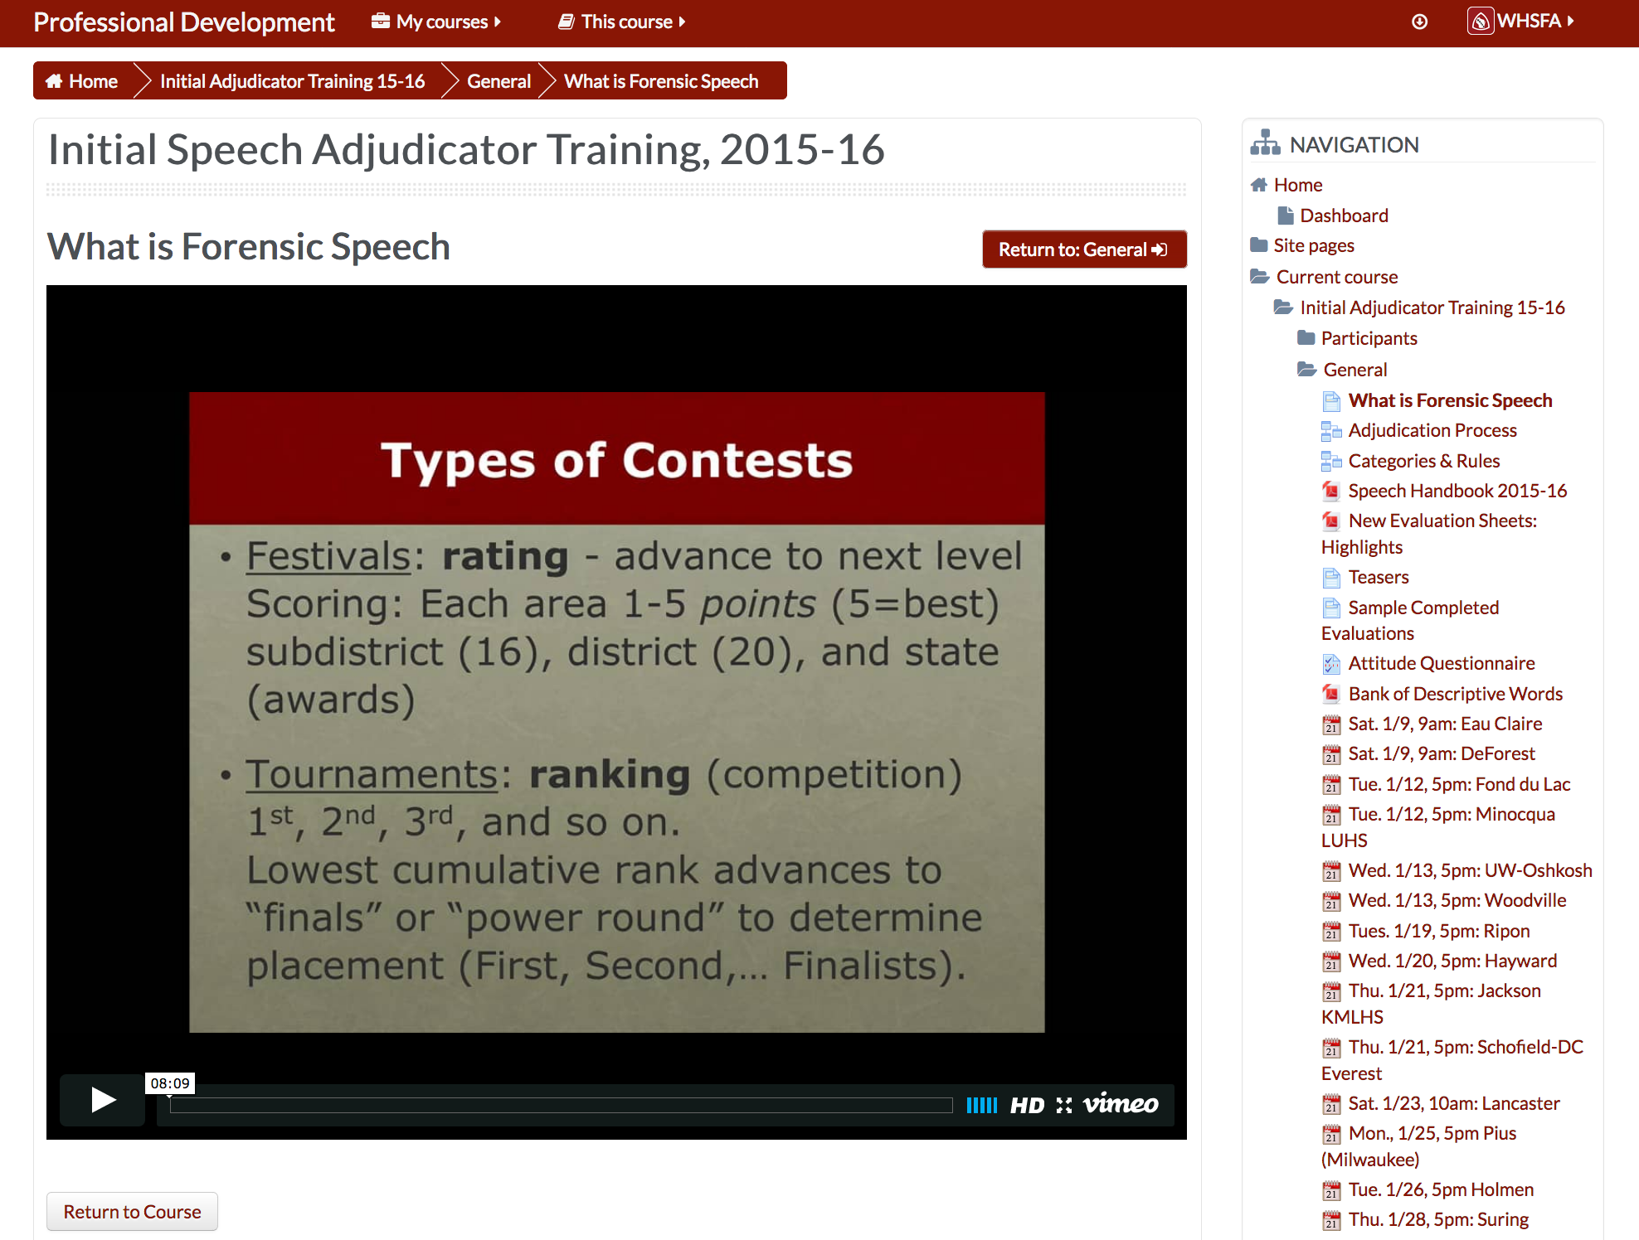

Slide 11
Lesson Questions
Embedded Between Videos to Check Understanding

Slide 12
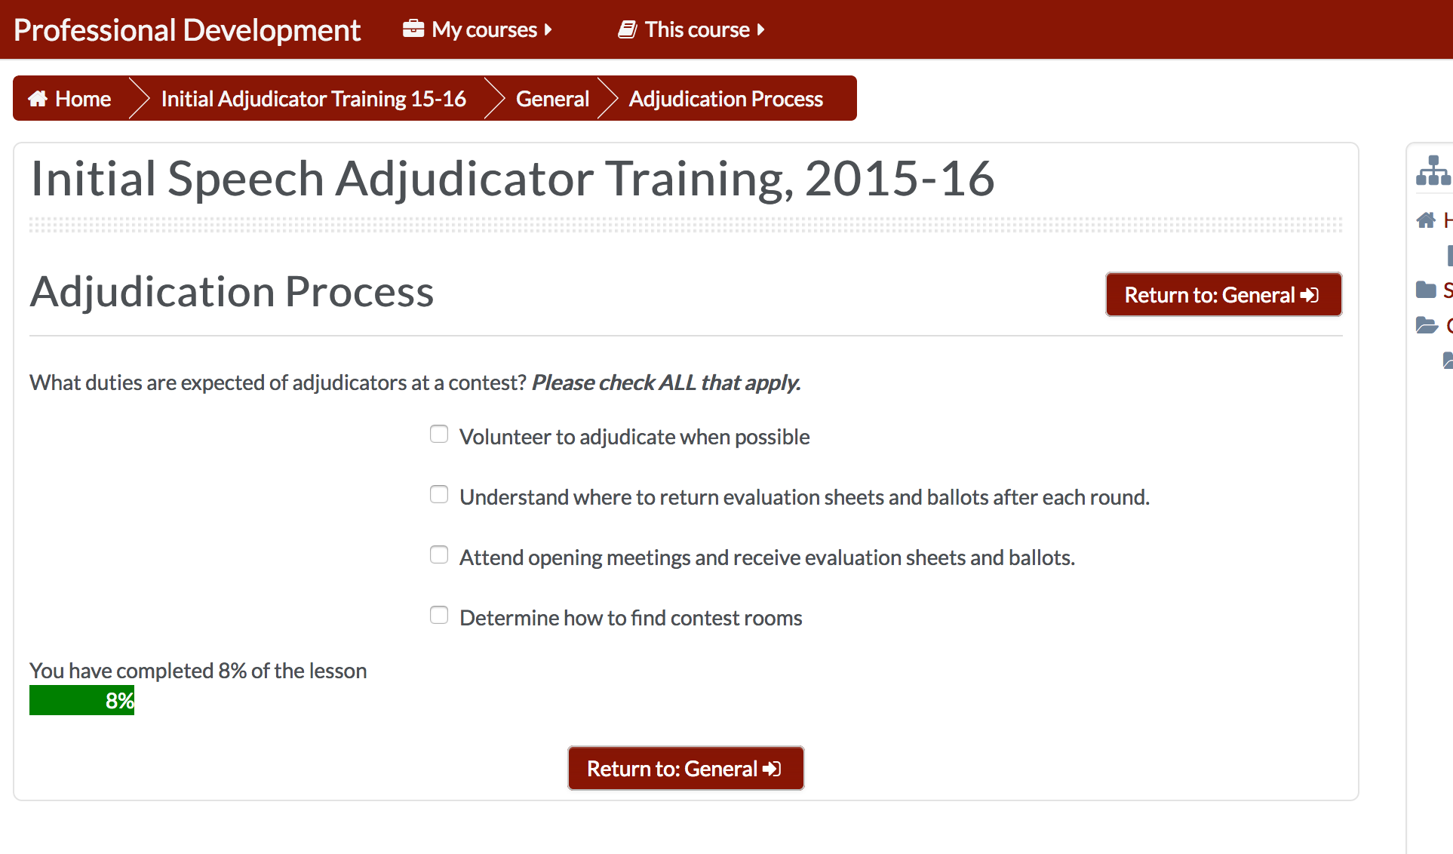

Slide 13
Course View
Scrolled-down view

Slide 14
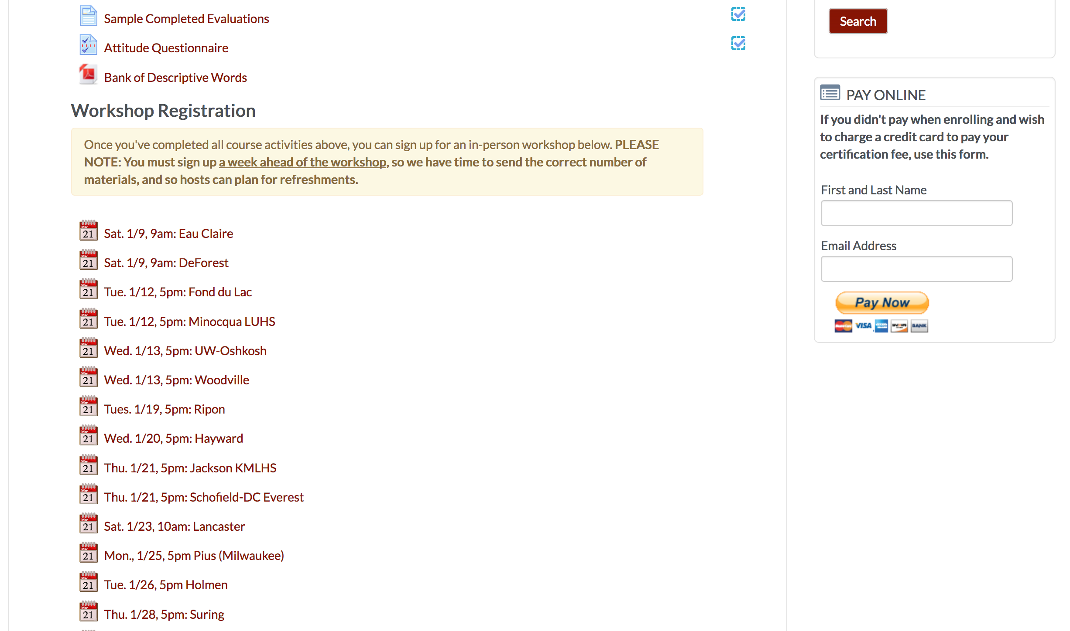

Slide 15
Interactive Activities
True/False “Quiz” to Activate Thinking

Slide 16
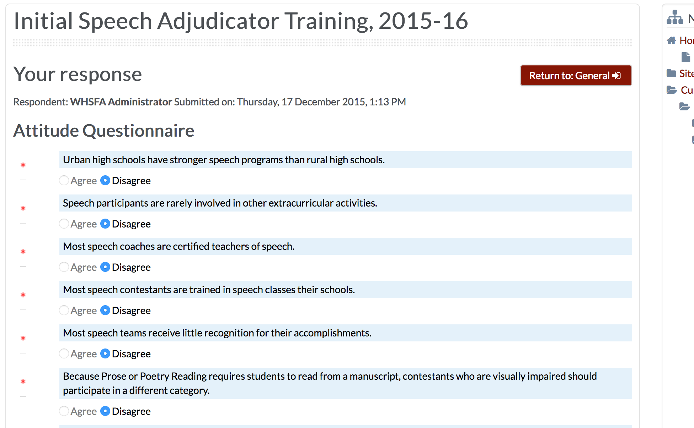

Slide 17
Register for In-Person Workshop
Select from list of dates/locations

Slide 18
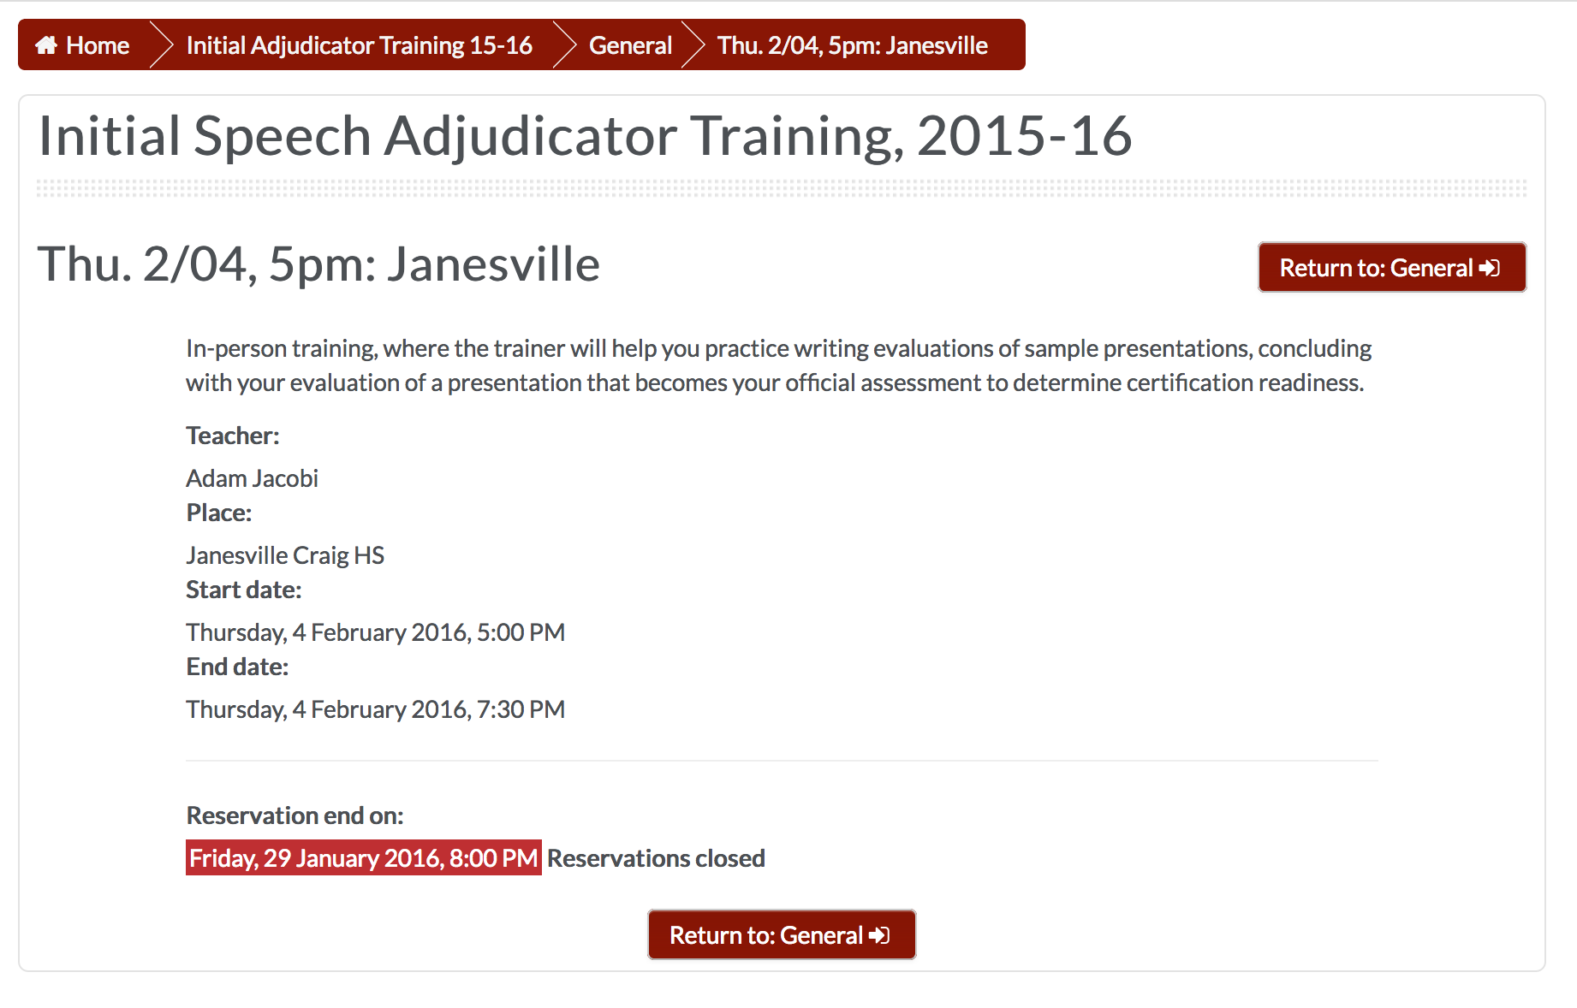

Slide 19
Course View
End of page

Slide 20
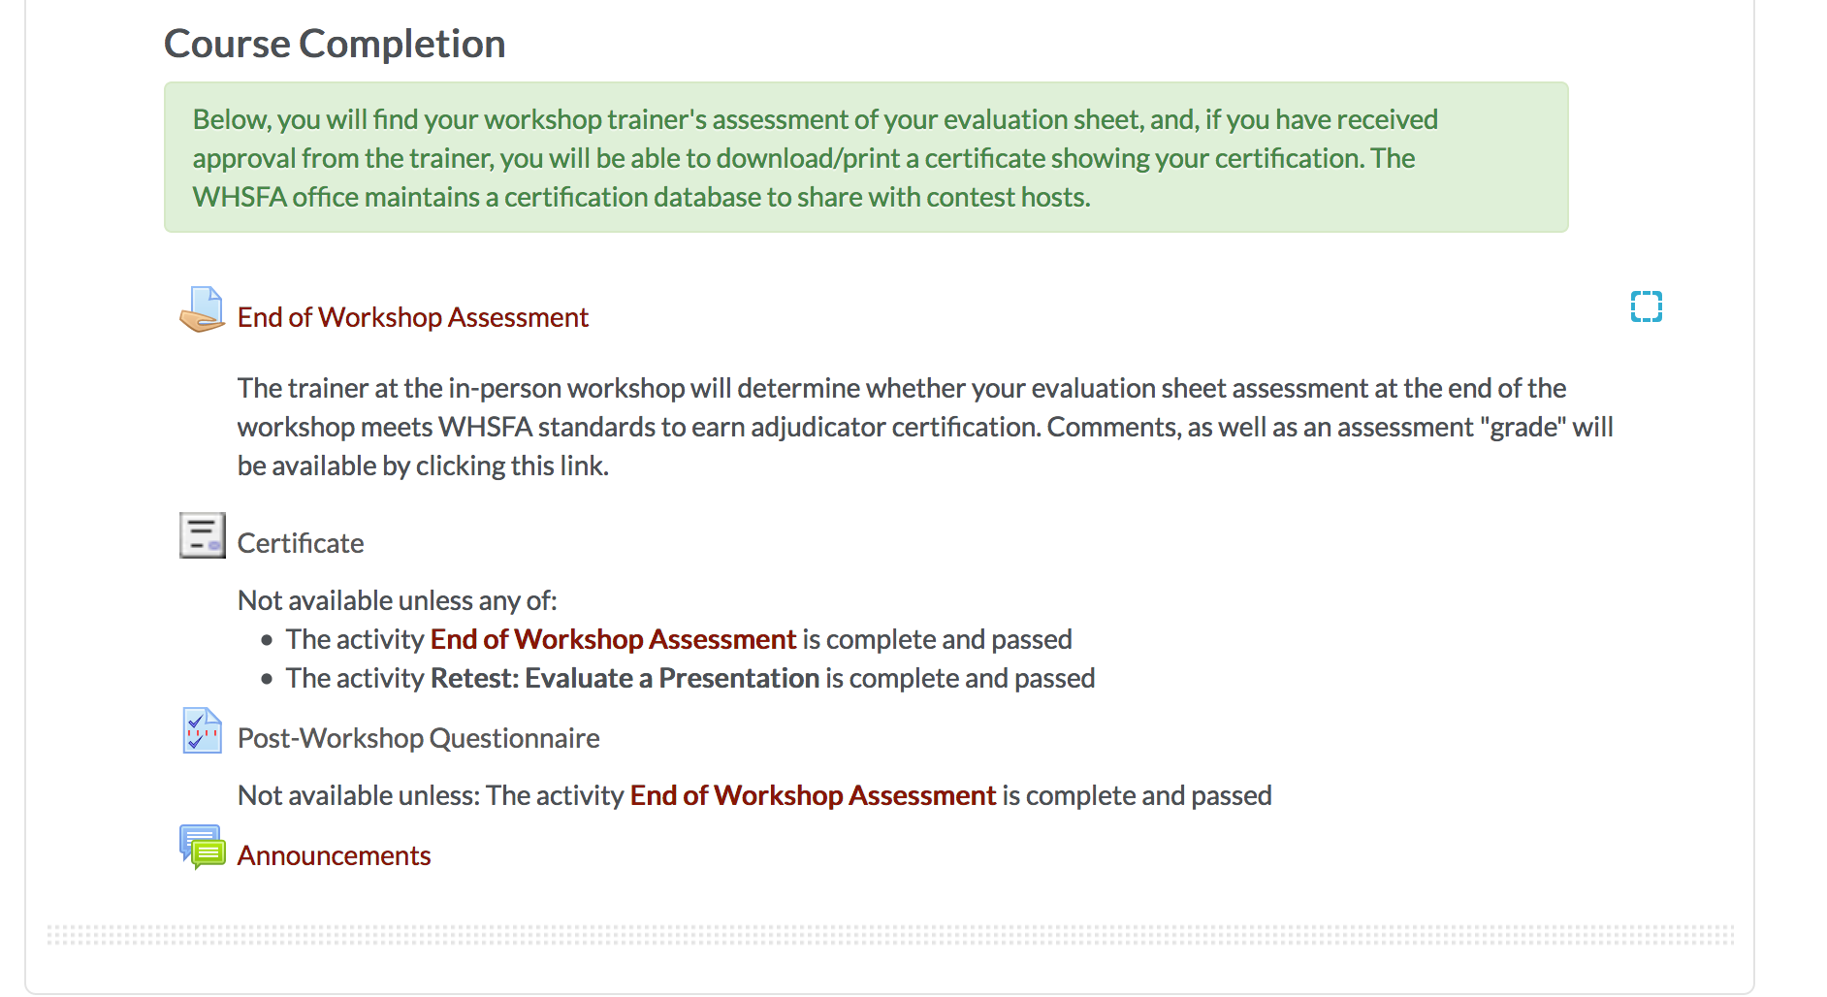

Slide 21
In-Person Workshop

Slide 22
Workshop Outline
Trainer answers lingering questions
Review a few hypothetical situations with rules
Show video, complete evaluation as a group
Show video, evaluate independently and share
Repeat

Slide 23
Workshop Outline
Show video, evaluate independently, turn in
Repeat

Slide 24
Assessment Feedback
Participants can view comments and score

Slide 25
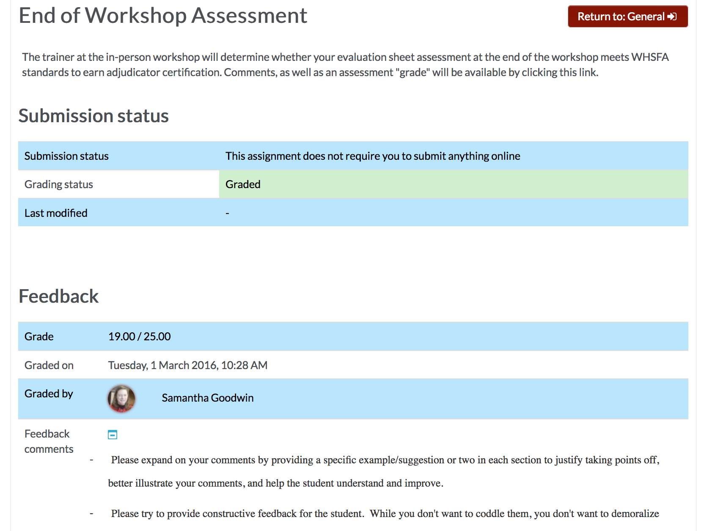

Slide 26
Online Assessment/Retest
Can see assessor comments regarding commentary

Slide 27
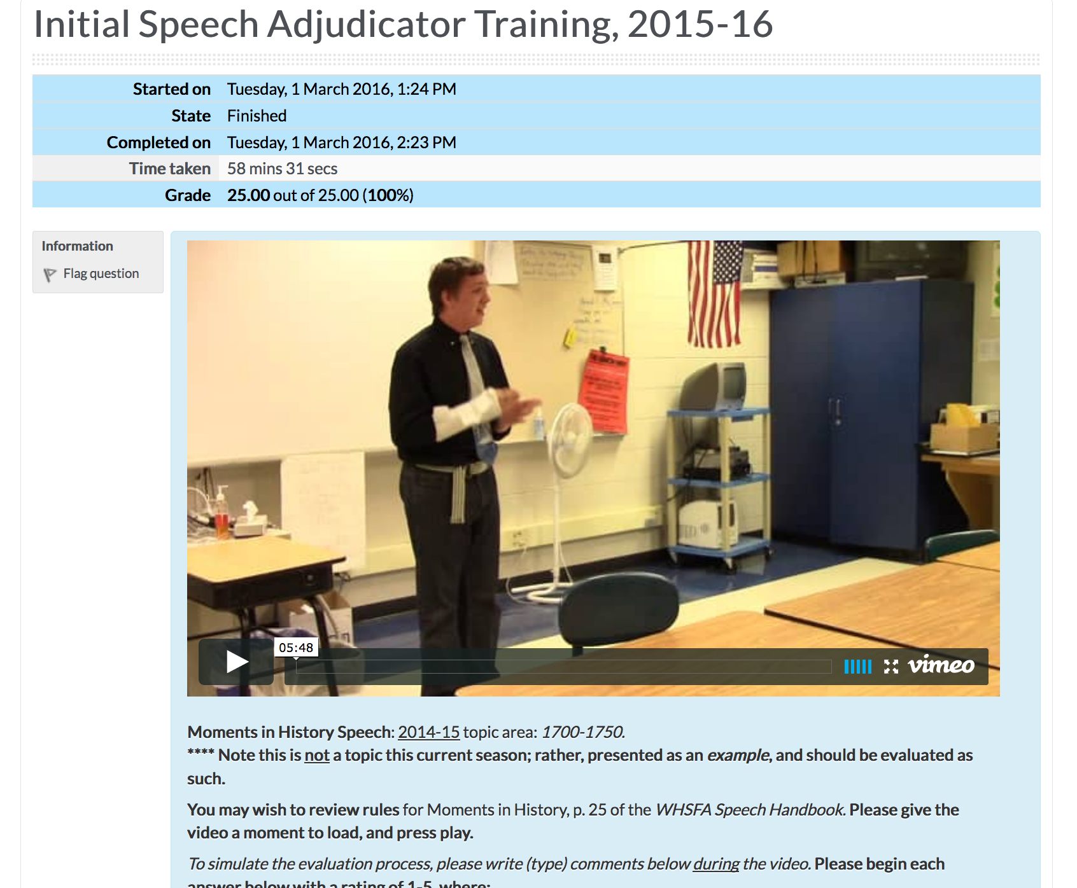

Slide 28
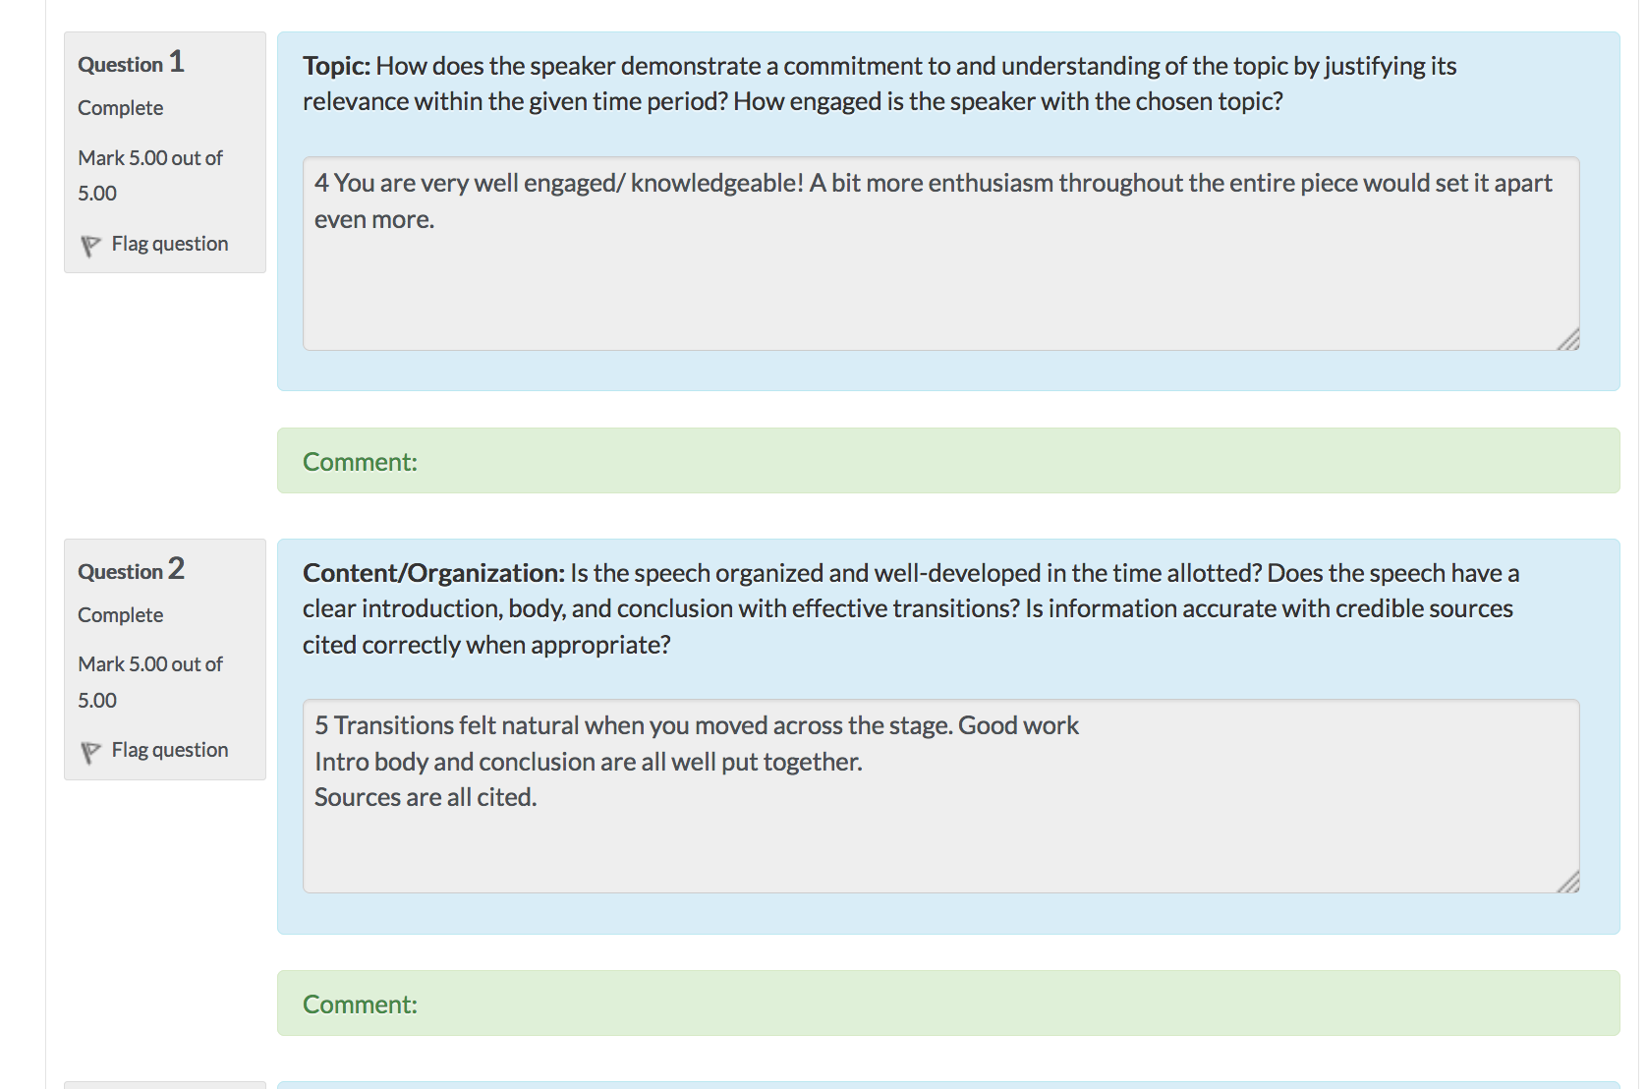

Slide 29
Downloadable Certificate
Concurrent with online roster update

Slide 30
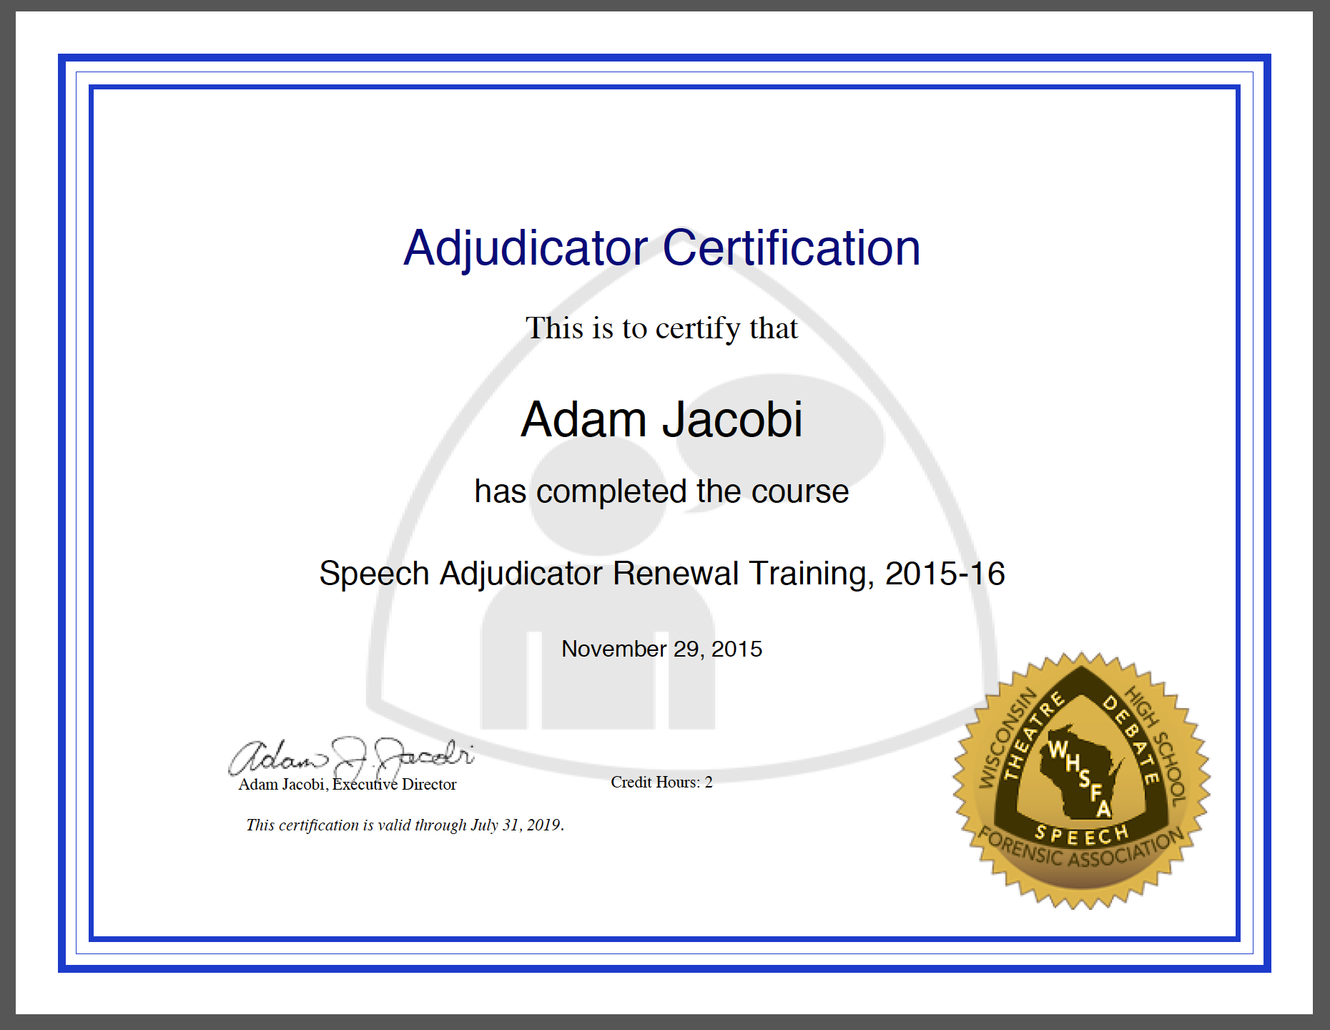

Slide 31
Renewal Course View

Slide 32
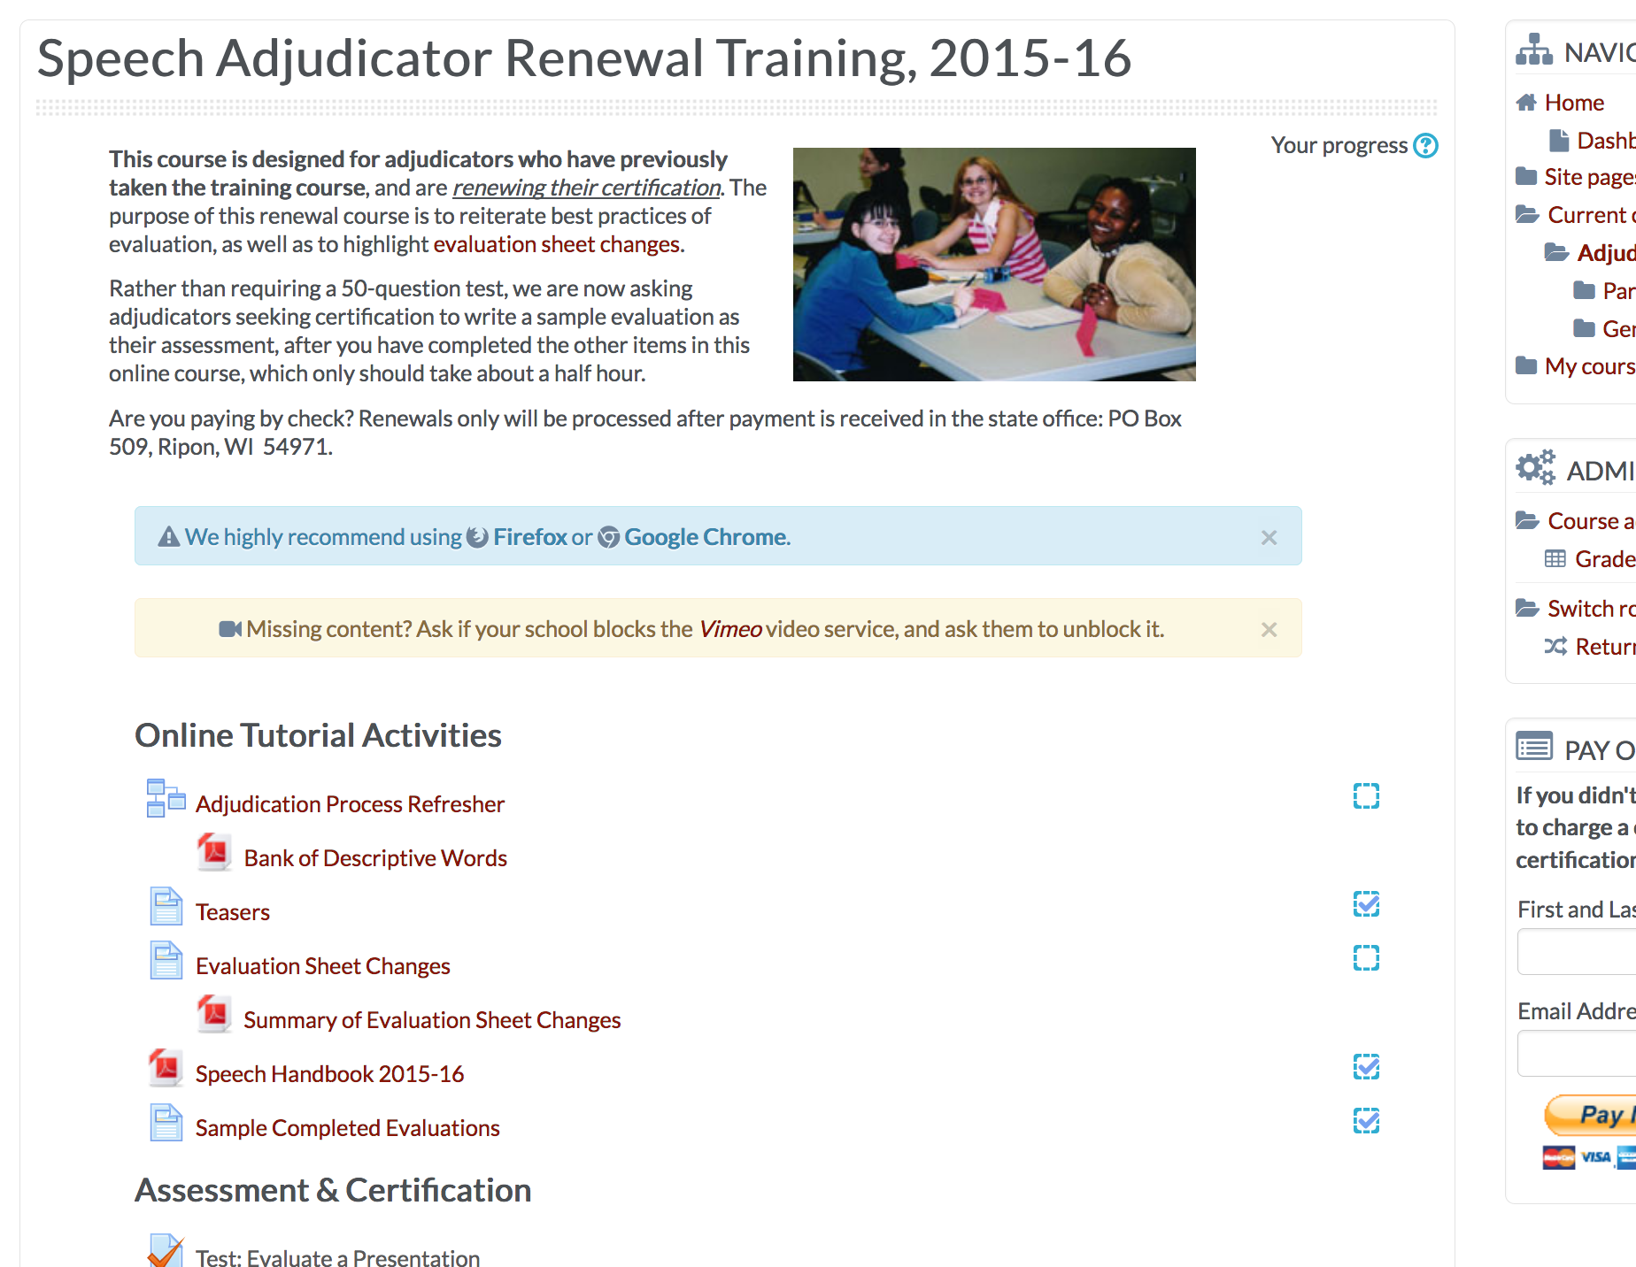

Slide 33
Office Workflow

Slide 34
Certification Status
Payment tracking
Renewal assessment completion
In-person workshop assessments

