Slide 1
The Nfhs learning center
Dan Schuster, CMAA, CIC
Director of Educational Services
dschuster@nfhs.org
317-822-5714

Slide 2


Slide 3
The nfhs learning center
Not just a “coaches” site
“NFHSLearn for All”
Changing the culture of professional development for the interscholastic community
22 Free Online Courses
Completion Certificates

Slide 4


Slide 5
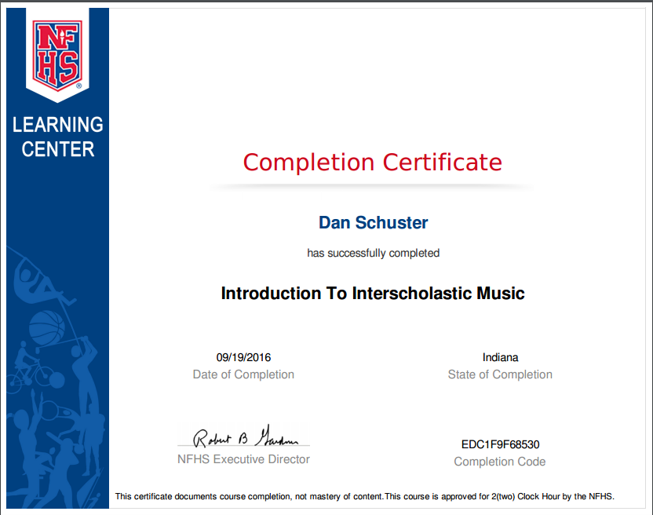

Slide 6
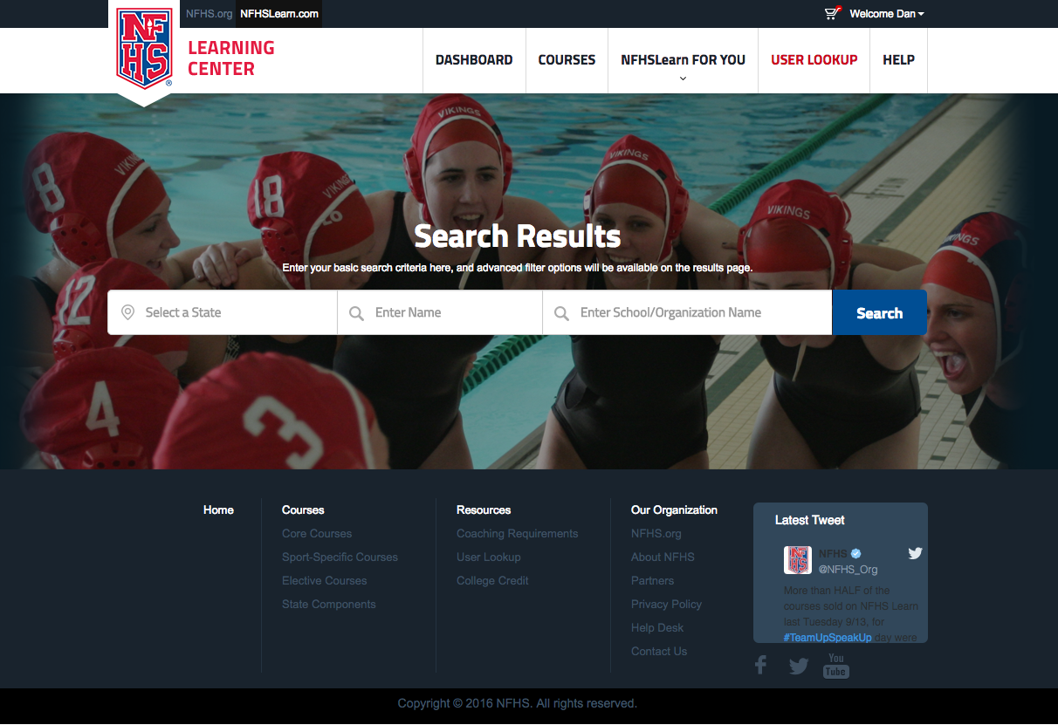

Slide 7
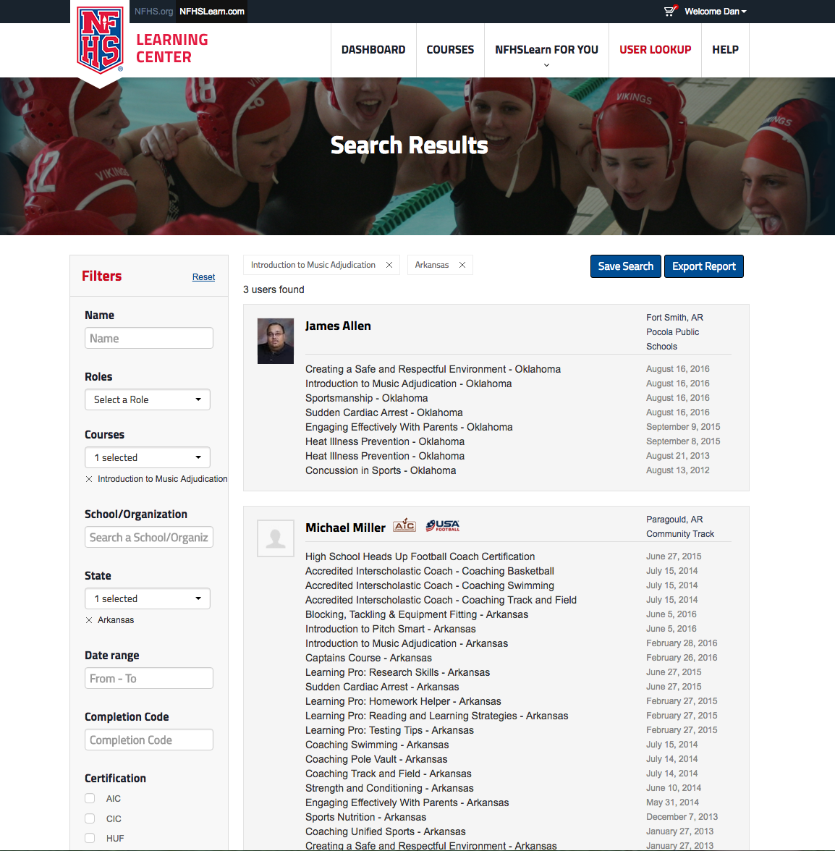

Slide 8
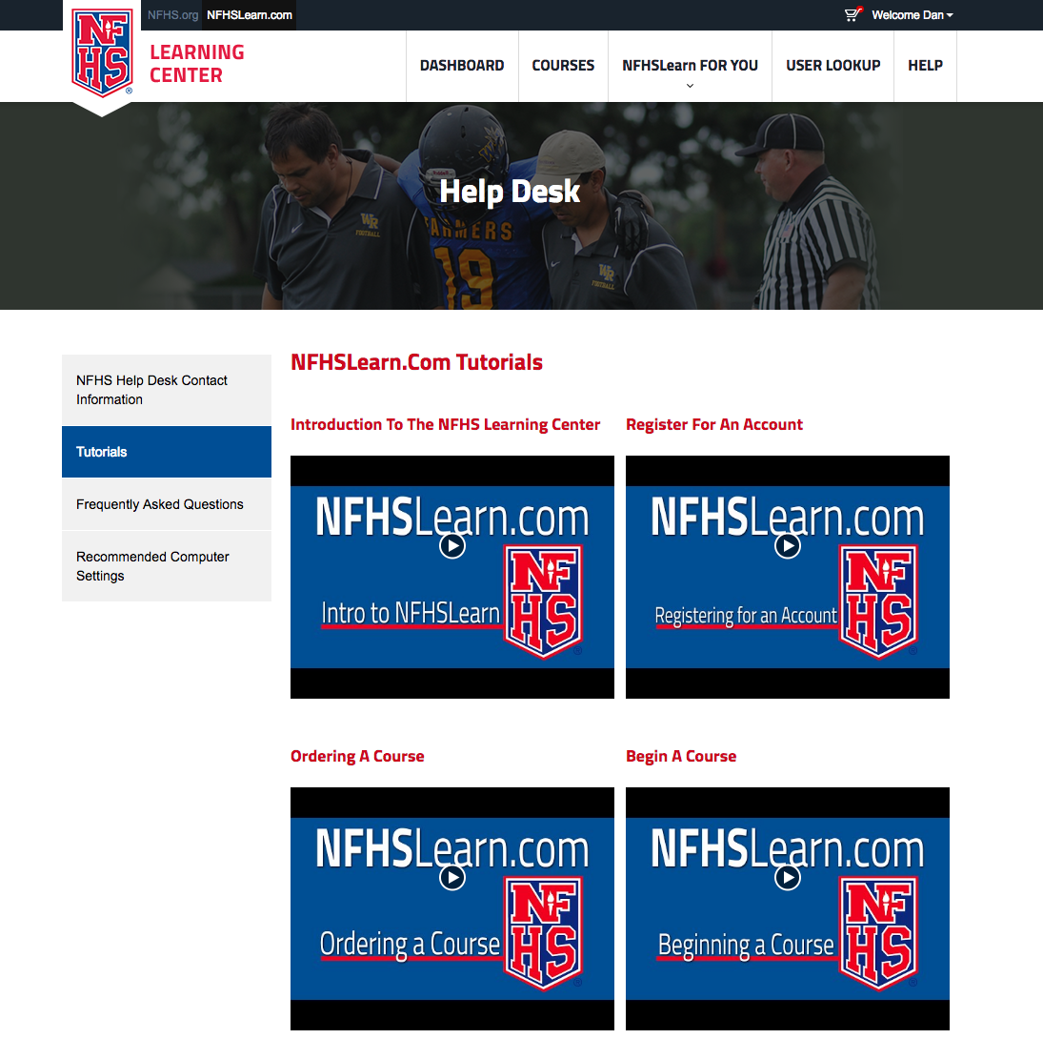

Slide 9

Sneak peek

Slide 10
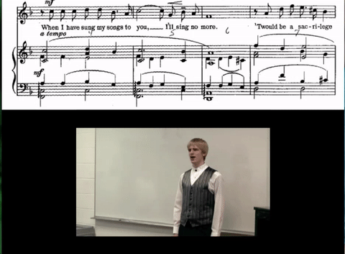
performances

Slide 11

quotes

Slide 12
Sneak peek

Slide 13
Congratulations!

Slide 14
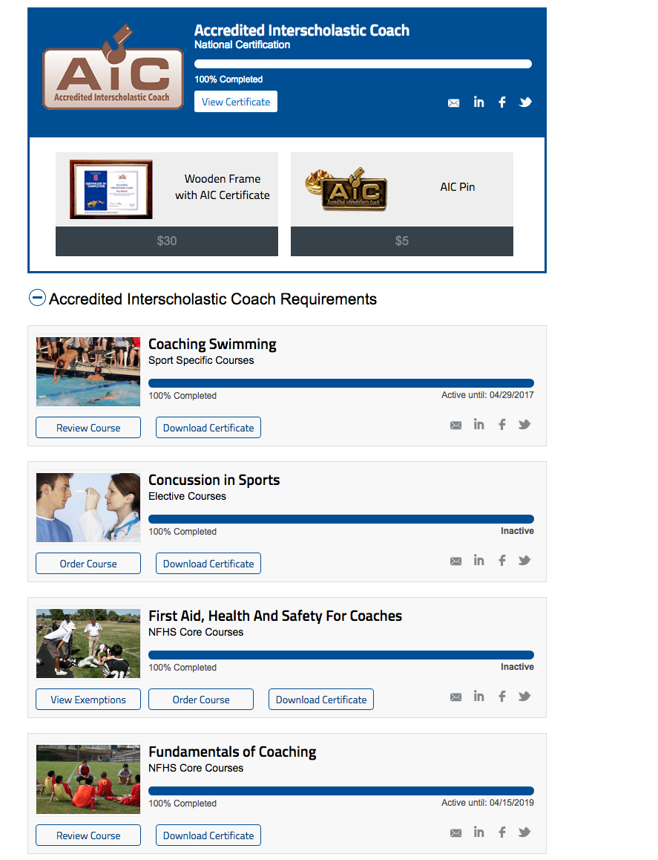

Slide 15
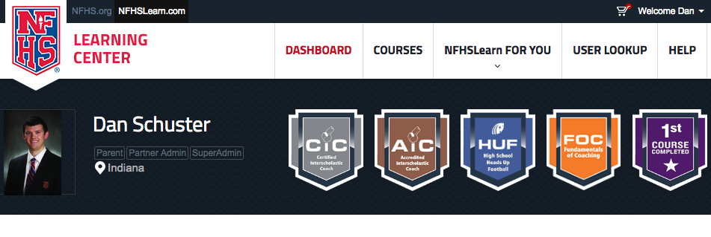
badges/certifications

