Slide 1
The Nfhs learning center
Dan Schuster, CMAA, CIC
Director of Educational Services
dschuster@nfhs.org
317-822-5714

Slide 2


Slide 3


Slide 4
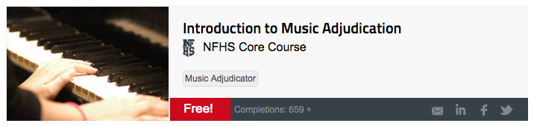
Introduction to music adjudication
Role and Responsibilities of Adjudicators
Adjudicating Guidelines and Standards
Putting It All Together

Slide 5

Sneak peek

Slide 6
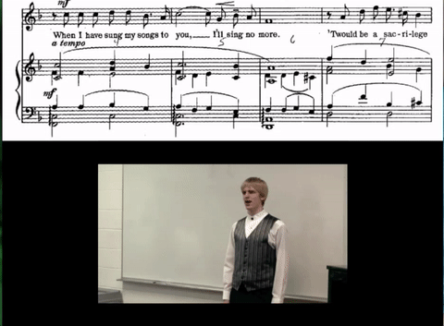
performances

Slide 7
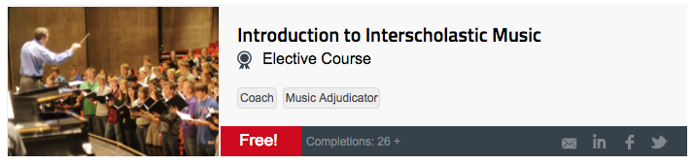
Introduction to interscholastic music
Roles and Responsibilities of the New Music Teacher
Identifying Proficiency and Promoting Growth Within Your Program’s Ensembles
Enhance the Music Classroom Using Goals

Slide 8

quotes

Slide 9
Sneak peek

Slide 10
Congratulations!

Slide 11
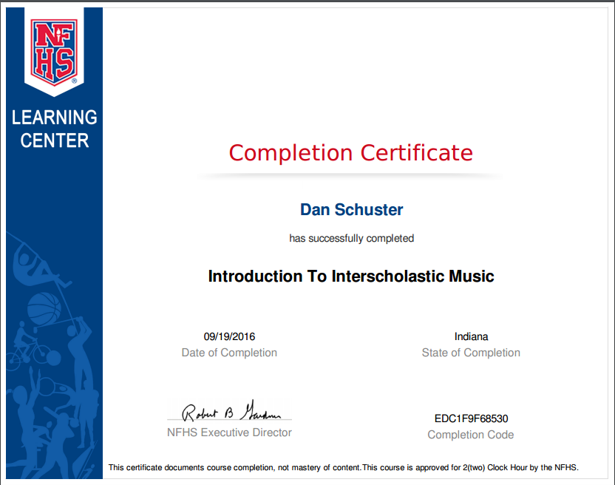
Completion certificate

Slide 12
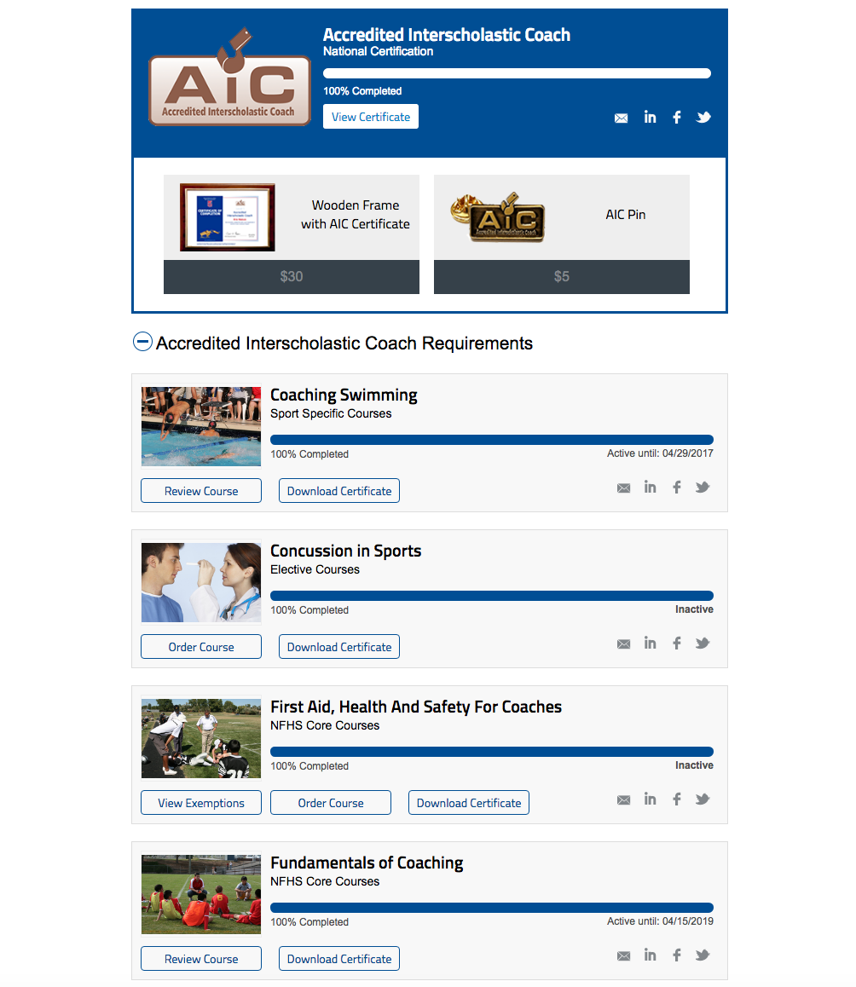

Slide 13
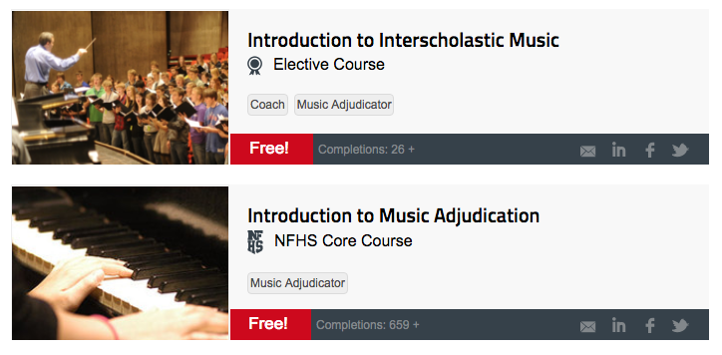

Music certification

Slide 14
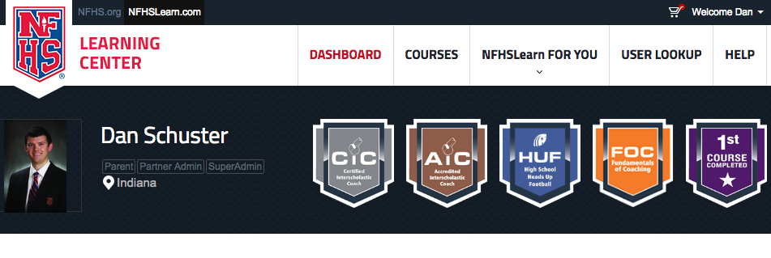
Music badges/certifications

