Slide 1


Slide 2

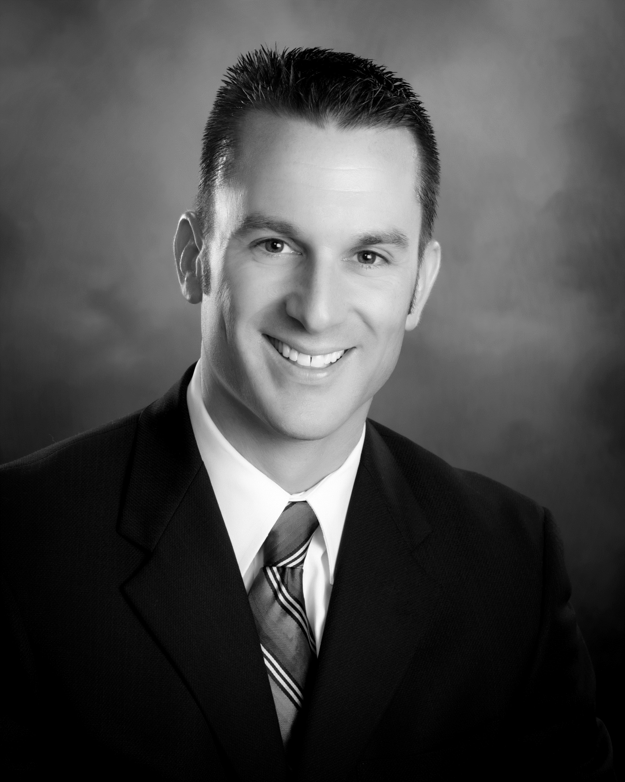
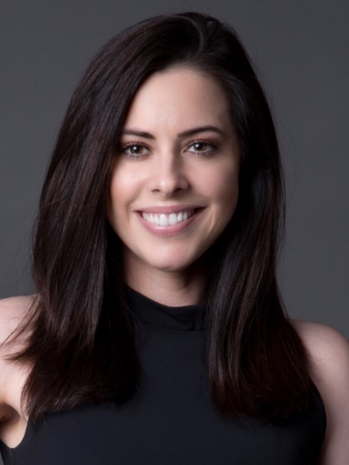
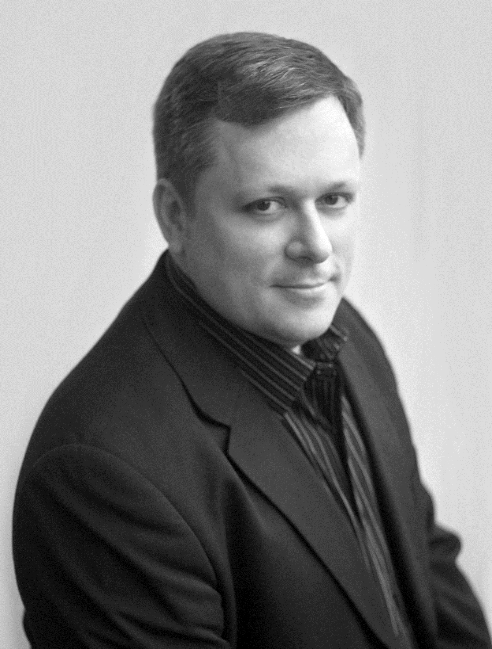
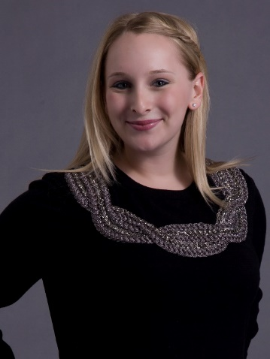
Mark Koski
Director of Sports, Events & Development
NFHS
Melinda Schnell
Account Lead
Vice President
Edelman
JT Anderson
Creative Lead
Senior Vice President
Edelman
Emily Marks
Execution Lead
Senior Account Supervisor
Edelman
Your Team
Notes:
KEY CAMPAIGN CONTACTS.

Slide 3
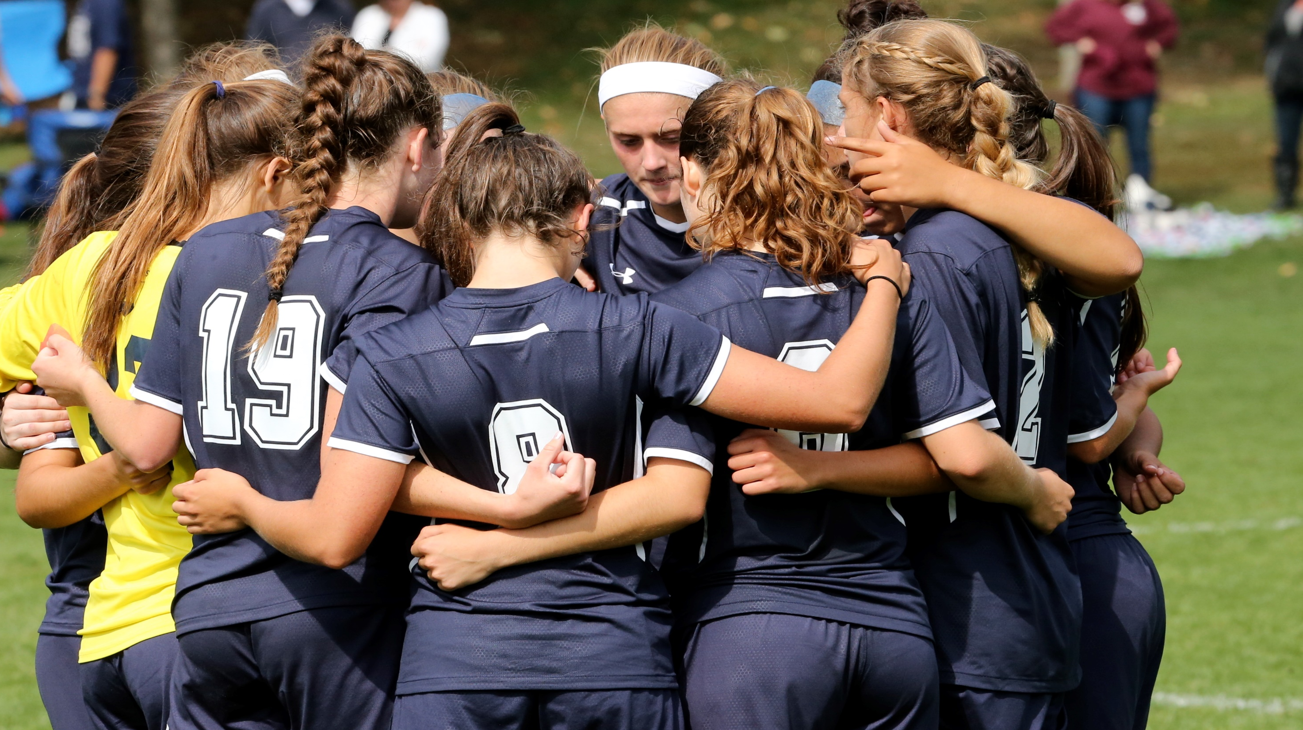

Key Messaging

Slide 4
#MyReasonWhy will highlight the value and benefits of participating in high school sports and activities
Will do so through real and engaging stories from students, parents, coaches and the community at-large
Engage our target audience via a multi-channeled, multi-year communications campaign
NFHS looks to strengthen support for high school athletics and activities while also showcasing the outstanding work of our 51 state associations
The NFHS aims to drive participation

Slide 5
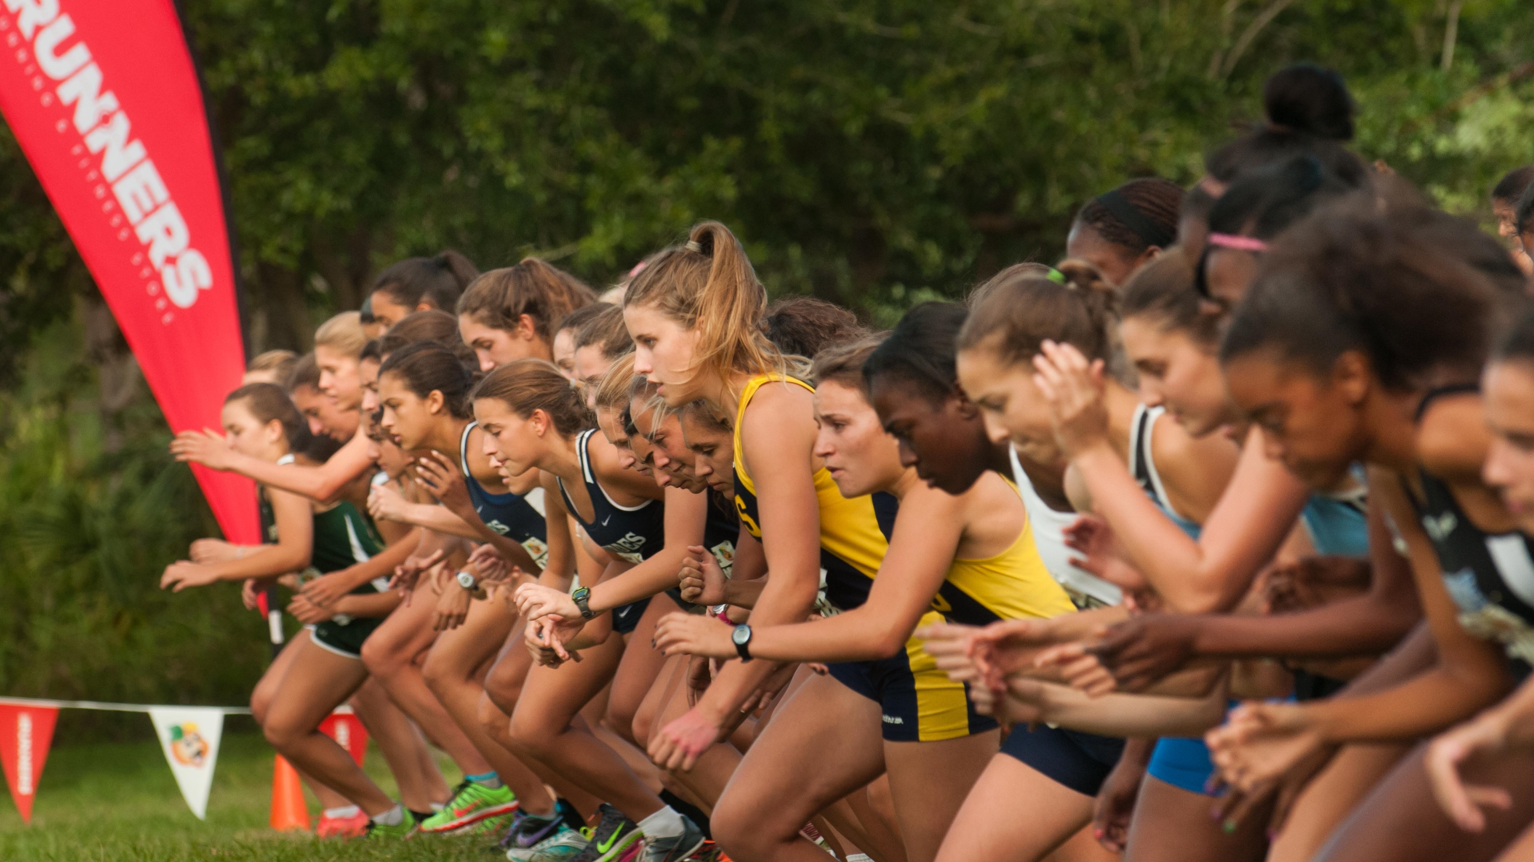
Rollout + Milestones

Slide 6
September 16th, 2016
State Associations Toolkit Delivery
October 3rd, 2016
Nationwide Coordinated #MyReasonWhy Campaign Launch
October thru November 2016
Bi-Weekly email reminders from NFHS on content sharing and progress
January 12th, 2017
2nd State Association Webinar, gearing up for Spring sports and activities

Slide 7


Slide 8




