Slide 1
Three elements of forensic competition: coach, content, and students
J. Scott Baker,
University of Wisconsin-La Crosse

Slide 2
Research Rationale
Limited prior PURE research:
Difficult to explain what we do
Difficult to categorize what we do
Difficult to speak/write across multi-state organizations

Slide 3
3 Article Format Justification
In any educational experience, 3 key factors play into success: student, curriculum, and teacher (in the case of forensics, a coach).
All 3 elements are vital to prepare a student for his/her/their future.
Experience
Teacher/Coach
Student
Curriculum

Slide 4

Article 1: Curriculum and Forensics
Article 1 discusses how forensics plays into a high-stakes testing educational setting. By analyzing current issues around mandated testing, what role does forensics have in the curriculum?
The article uses The Wizard of Oz as an analogy to what is happening
in schools today…

Slide 5

Technicolor Solutions
Article 1 describes how forensic participation keeps students involved in school. Forensic participation provides:
Dialogue
Diversity of Literature
Original Thought

Slide 6
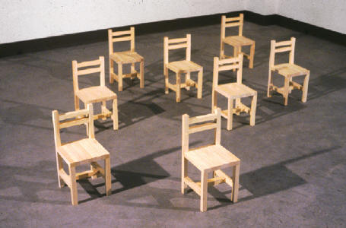
Article #2: Lives of Forensic Coaches
Reponses from 434 participant speech & debate coaches are used to create a performance ethnography. The scene takes place as if respondents are auditioning for a role. The director brings them on stage to ask questions regarding their lived experiences.

Slide 7
Coach Response Themes
Skill sets for students in multiple arenas.
Higher level thinking than in other, standardized classrooms.
Passion and love for the activity.
Social Justice.
College Preparedness.
Inequality in funding and recognition.

Slide 8

Article 3: Survey of Former Competitors
Article 3 attempts to determine individual student benefits for participation in forensics. Using a survey to question participants, the research identifies perceived benefits former competitors feel participation afforded them.
1,050 Responses from 43 states

Slide 9

Diversity
The survey focused on diverse alumni populations, since debate is often seen as a White male dominated activity. The survey results are analyzed overall as well as broken down into populations underrepresented in extracurricular activities: Black, Hispanic, LGBTIQ, persons with a disability, and FIT (female, intersex and transgender).

Slide 10
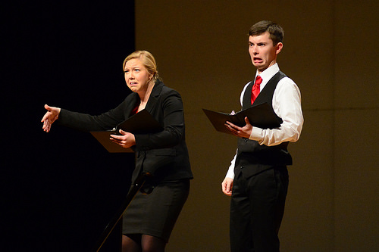
Event Specializations
Responses are categorized by debate, public speaking, and oral interpretation event specializations. Since students in these three foci differ in their experiences, are there are any correlations with the different types of specialization in post-secondary benefits for students?

Slide 11
Results for Diverse Populations
All diverse classifications: Black, Hispanic, LGBTIQ, persons with a disability, and FIT presented a strong positive attitude regarding experiences.
All diverse classifications, except FIT presented a strong positive perceived influence on life post-secondary education.
FIT population was significantly different, yet showed a positive perceived influence.

Slide 12
Themes from Diverse Populations
Voice: “It not only gave me a voice, it taught me how to amplify it in order to speak my respective truths.”
Family: “It helped me find my footing, my family. I made friends and found a home on the speech team.”
Skills: “I learned research and critical thinking skills.”
Home: “being a member of the team made me feel like I had a home within school, a family of peers who were like-minded.”
Confidence: “I have my experiences in high school forensics to thank for the poise and confidence I’m consistently able to project.”
Friendship: “I am now 67 years old and several of my closest friends are people I first met in HS forensics.”

Slide 13
Results for Event Preferences
All classifications of event preferences: debate, public speaking, and oral interpretation showed a strong positive attitude regarding experience.
All classifications of event preferences: debate, public speaking, and oral interpretation showed a strong positive perceived influence on life post-secondary education.
Themes were not evaluated by event preference.

Slide 14
Coach Participants
434 Total Coach Participants:
(1) Texas: 64 (5) California: 17
(2) Kansas: 57 (6) Colorado: 16
(3) Nebraska: 47 (7) North Dakota: 15
(4) Illinois: 28 (7) Wisconsin: 15

Slide 15
Alumni Participants
1,050 Total Alumni Participants:
(1) Texas: 229 (6) Wisconsin: 45
(2) Kansas: 142 (7) Nebraska: 36
(3) Oklahoma: 58 (8) Minnesota: 35
(4) California: 47 (9) Indiana: 33
(4) Missouri: 47 (10) CO/FL: 29

Slide 16
Data Distribution #1
“If You Don't Believe the Teachers, Ask Students about Benefits of Speech & Debate”
Texas Speech Communication Journal, focuses on responses of Texas alumni.
“Are our best advocates not fully advocating for us?”
Rostrum, focuses on alumni influence S&D has on students WHILE in High School.

Slide 17
Data Distribution # 2
“Interpreting Poetic Inquiry: Authenticity realized from alumni performers' narratives”
Journal of Curriculum & Pedagogy, focuses on OI preferred alumni.
“Title I Alumni: Perceived Influence of Speech & Debate programs while in High School”
AERA conference (Spring 2017), focuses on alumni from Title I schools.

Slide 18
Data Distribution # 3
“A Candid Conversation about Speech & Debate Coaches”
High School Today, rejected for length and point of view, submitting to Principal Leadership Oct 2016, focuses on Texas alumni
“Confidently Speaking about Experiences”
UIL Leaguer, focuses on confidence in Texas alumni.

Slide 19
Data Distribution # 4
“An Educational Play: The Lives of Speech & Debate Coaches”
Reader’s Theater workshop at Texas Speech Communication Association in Oct 2016, presentation of Article 2 play on coach experiences.
To Be Named: “Event Preferences”
Rostrum, submit Oct 2016, focuses on event preferences of alumni.

Slide 20
Where Do We Go From Here?
Ideas, places you want to see data distributed for your state, etc.
Email: jscottbaker01@gmail.com

